Slide 1
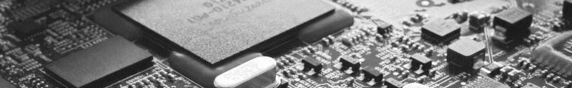
Embedded System C Programming
Hyundai Intensive Software Programming Course
AI-Embedded S²oftware-on-Chip (AI-SoC) Lab

