Slide 1
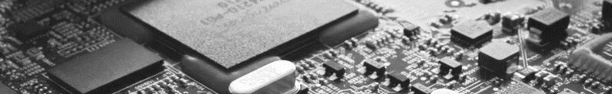
2026 18th Symposium on AI-Embedded System-on-Chip
Kyungpook National University, Daehak-ro 80, No. 724, Daegu, Korea, May 28, 2026
AI-Embedded S²oftware-on-Chip (AI-SoC) Lab

