Slide 1
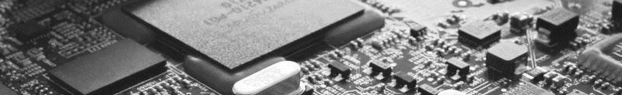
2023 7th Symposium on AI-Embedded System-on-Chip
Kyungpook National University, Daehak-ro 80, No. 724, Daegu, Korea, Sept. 25, 2023
AI-Embedded S²oftware-on-Chip (AI-SoC) Lab

