Slide 1
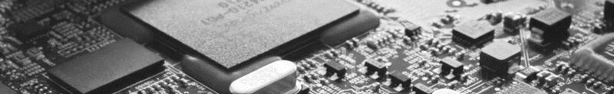
2024 13th Symposium on AI-Embedded System-on-Chip
Kyungpook National University, Daehak-ro 80, No. 724, Daegu, Korea, Nov. 29, 2024
AI-Embedded S²oftware-on-Chip (AI-SoC) Lab

