Slide 1
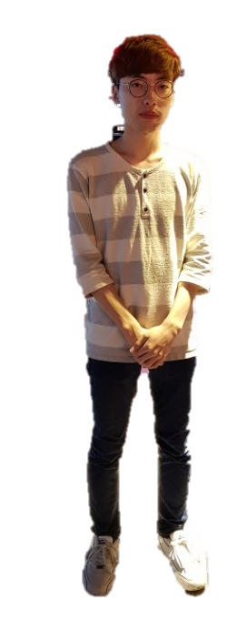
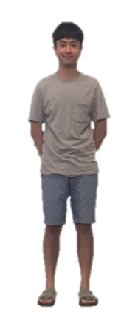
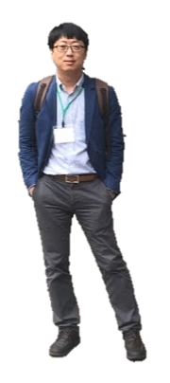
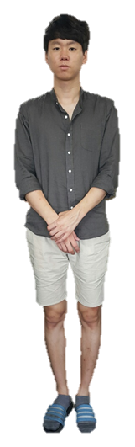
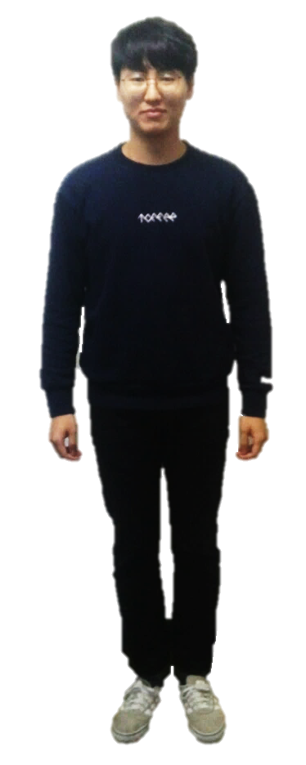
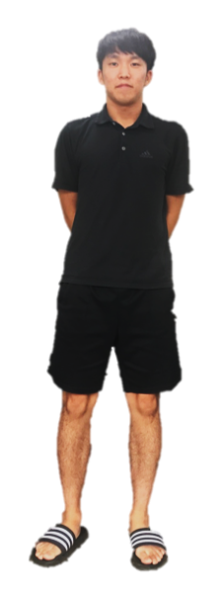
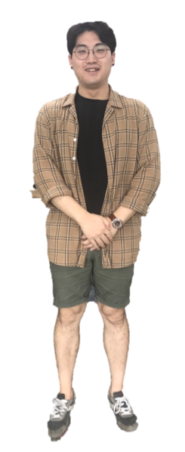

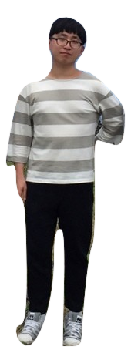
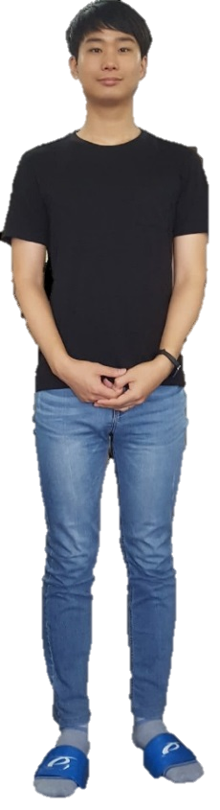
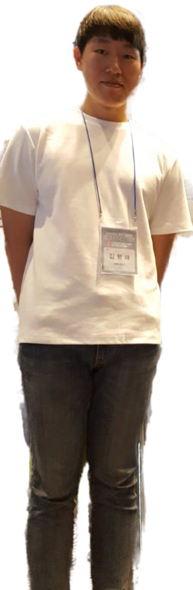
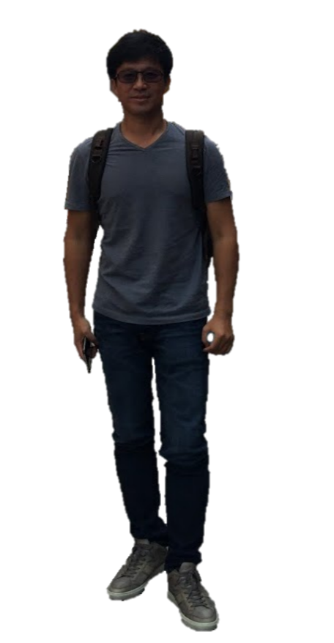
H. G Moon (M.S.C)
D. K. Lee (I.Ph.D.C.)
H. R. Kim (I.Ph.D.C.)
J. S. Kwon (B.S.C.)
J. Y. Jeong (B.S.C.)
J. H. Kim (B.S.C)
J. H. Kwak (B.S.C.)
Y. S. Noh (B.S.C.)
D. J. Park (Prof.)
S. S. Kim (M.S.C.)
K. H. Choi (M.S.C.)
J. H. Cho (Prof.)
ACES Lab.
APPLICATION-AWARE COMPUTING FOR EMBEDDED SYSTEMS (ACES) LAB.
SCHOOL OF ELECTRONICS ENGINEERING, KYUNGPOOK NATIONAL UNIVERSITY

