Slide 1
SENTIMENT ANALYSIS
AN ARTIFICIAL INTELLIGENCE PROJECT – PHASE 5

Slide 2
THE PROJECT OVERVIEW >>
PROJECT TITLE : Innovative sentiment analysis using Artificial Intelligence
OVERVIEW : Sentiment analysis is a valuable application of artificial intelligence (AI) that involves the classification of text data into positive, negative, or neutral sentiments. While sentiment analysis is widely used in areas like social media monitoring and customer feedback analysis, an innovative approach can make it stand out and provide unique value.
PROJECT GOALS :
Develop an AI-powered sentiment analysis system that goes beyond traditional sentiment polarity classification and provides deeper insights into emotions and intentions.
Create a user-friendly interface or application that allows users to interact with the sentiment analysis tool and gain valuable insights from text data.
Integrate advanced natural language processing (NLP) techniques, machine learning models, and data visualization methods to enhance the accuracy and interpretability of sentiment analysis results.
IDEA : Implement Emotion Contextualization Rather than just classifying sentiments as positive, negative, or neutral, the innovative aspect of this project involves contextualizing emotions. Emotion contextualization aims to understand not only what emotion is expressed but also why and how it is expressed. This can provide a deeper understanding of user sentiments and intentions.

Slide 3
KEY FEATURES IN THIS PROJECTS >>
Emotion Detection: Implement advanced NLP techniques to detect a wider range of emotions, such as joy, anger, sadness, fear, surprise, and more, within the text data.
Emotion Attribution: Identify the specific elements in the text that contribute to the expressed emotion, such as keywords, phrases, or linguistic patterns.
Emotion Trends: Analyze trends and patterns in emotion expression over time, helping users identify shifts in sentiment or emerging themes.
Sentiment Intensity: Quantify the intensity of each emotion expressed, allowing users to gauge the strength of sentiment.
Sentiment Visualization: Create interactive visualizations that represent emotion and sentiment trends, making it easy for users to explore and understand the data.
Real-time Analysis: If applicable, develop a real-time sentiment analysis module that can process and display sentiment changes as new data is inputted.

Slide 4
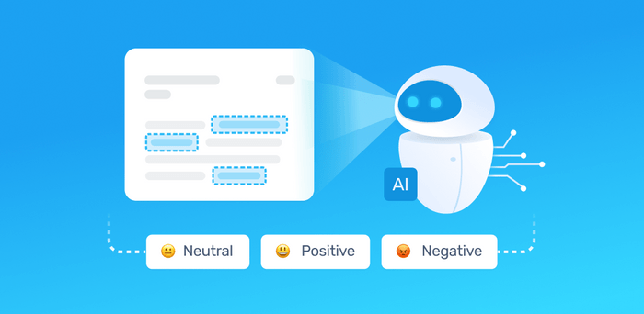
Steps and processes involved in sentiment analysis >>
Defining project goals
Data Collections
Data Preprocessing
Feature Engineering
Model Training
Model Evaluation
Deployment

Slide 5
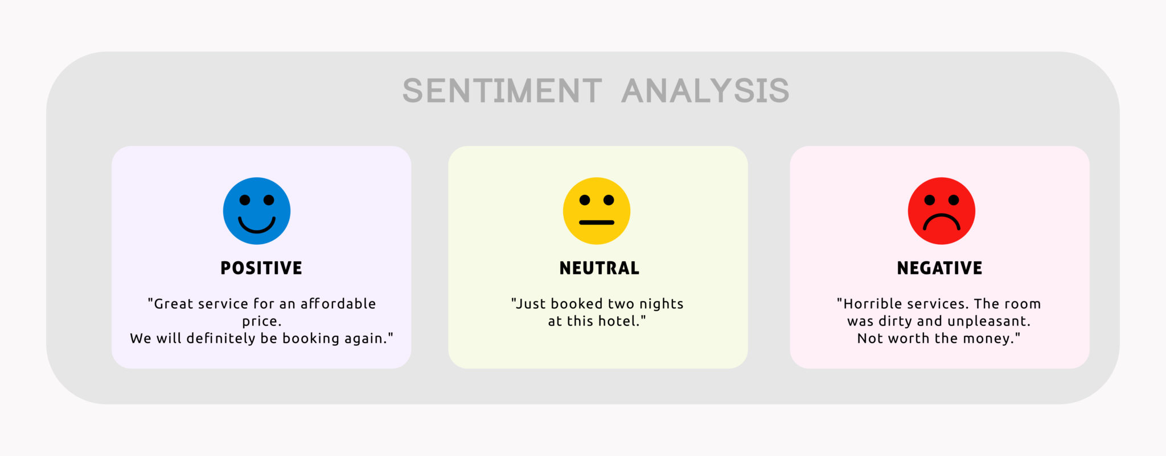
IMPLEMENTATION, OUTCOMES & benefits >>
Utilize state-of-the-art NLP libraries and frameworks like spaCy, NLTK, or Transformers (e.g., BERT, GPT-3) for language processing and emotion detection.
Train and fine-tune machine learning models on large and diverse datasets to improve emotion detection accuracy.
Implement a user-friendly web or mobile application using technologies like Flask, Django, React, or Flutter for seamless interaction with the sentiment analysis tool.
The innovative sentiment analysis system with emotion contextualization will offer users a more comprehensive understanding of text data, enabling them to make informed decisions in various domains, such as marketing, customer service, social media management, and more. It can help organizations better understand customer feedback, identify emerging trends, and respond to user sentiments effectively.
By focusing on emotion contextualization, this project can provide a unique and valuable perspective on sentiment analysis, setting it apart from traditional sentiment analysis tools.

Slide 6
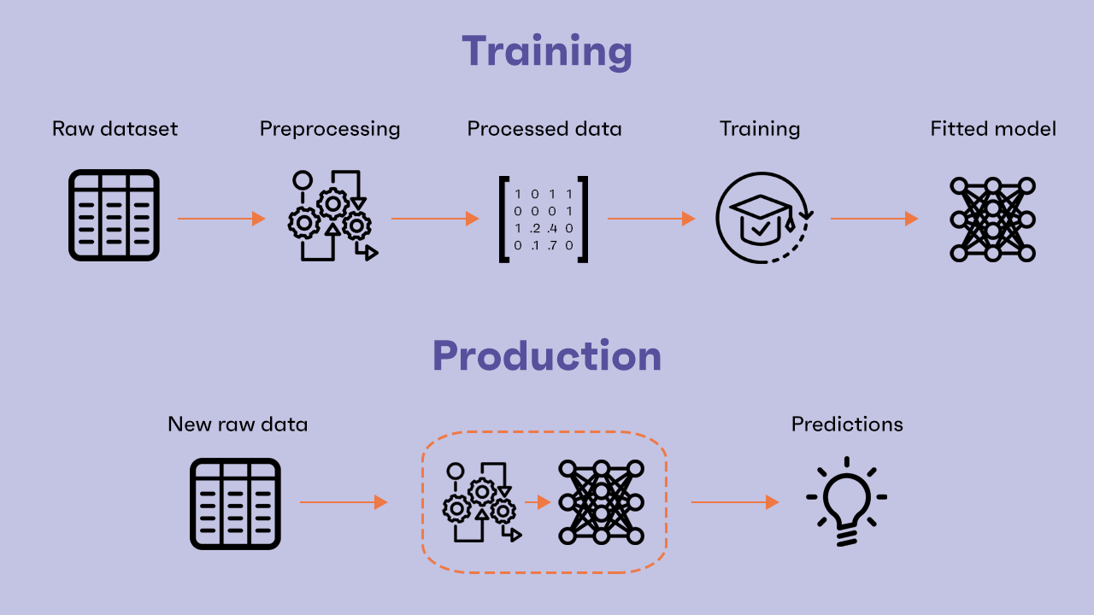
DATA PREPROCESSING >>
Building a sentiment analysis project with emotion contextualization, as described in the previous response, involves several steps, including dataset preprocessing. Here's a step-by-step guide on how to get started with the project and preprocess the datasets:
Data Collection
Data preprocessing
Data Cleaning
Exploratory Data Analysis (EDA):

Slide 7
Data collection and preprocessing >>
Collecting Twitter data, especially historical tweets, can be a complex process, and it's important to adhere to Twitter's policies and terms of service. However, I can provide you with an outline of the steps you can follow to collect Twitter airline-related data using the Twitter API and perform basic data preprocessing. Note that you will need to set up a Twitter Developer account, create a Twitter App, and obtain API keys to access Twitter data.
Data Collection using Tweepy (Python Library):
1.Install Tweepy: Install the Tweepy library, which allows you to interact with the Twitter API in Python.
code → pip install tweepy
2. Access Twitter API: Use your Twitter Developer account to create an App and obtain the API keys (API Key, API Secret Key, Access Token, Access Token Secret).
3. Python Script to Collect Tweets: Create a Python script to collect tweets based on a specific query or keyword

Slide 8
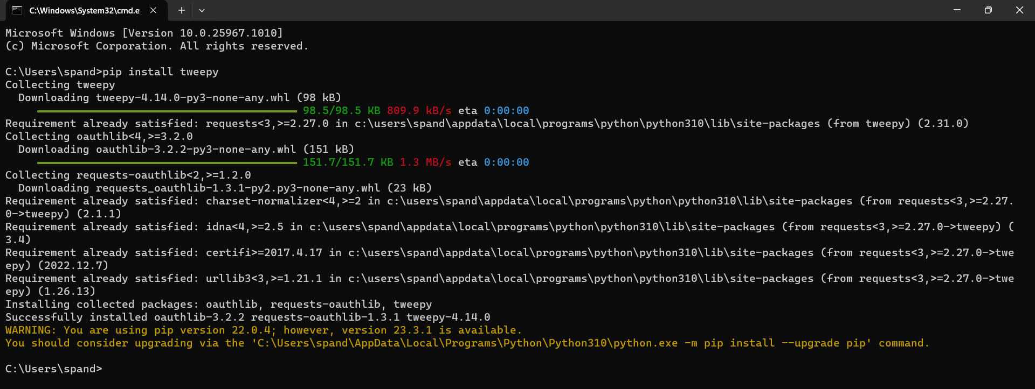

Step 1 – command for data collection >>
Step 2 – access twitter api
Use your Twitter Developer account to create an App and obtain the API keys (API Key, API Secret Key, Access Token, Access Token Secret).

Slide 9
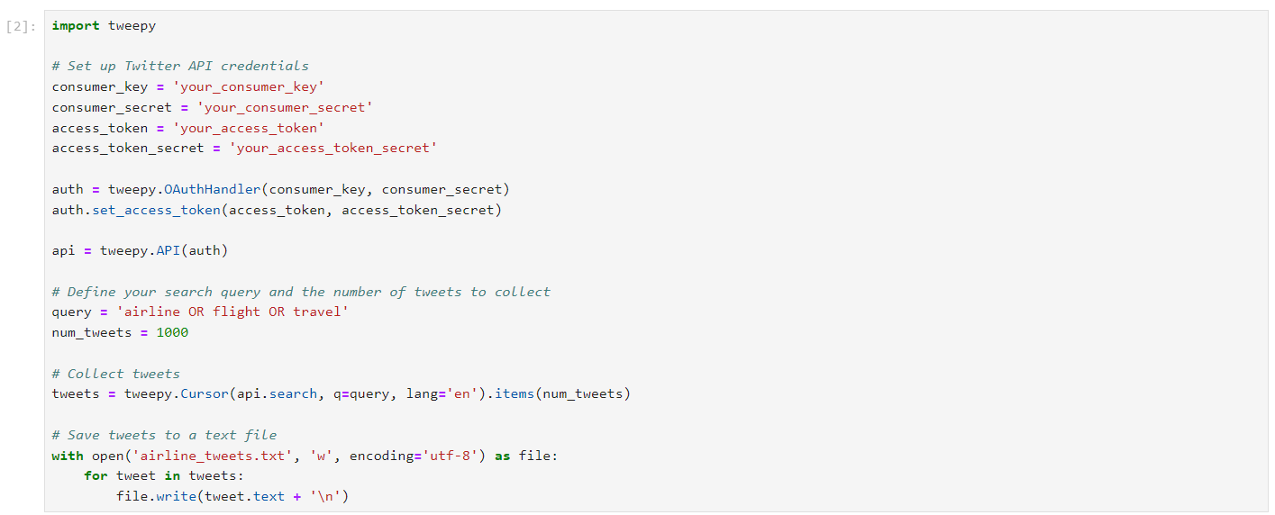
Step- 3: Python script for data collection >>
Create a Python script to collect tweets based on a specific query or keyword. Here is the python code for the data collection from the tweepy library

Slide 10
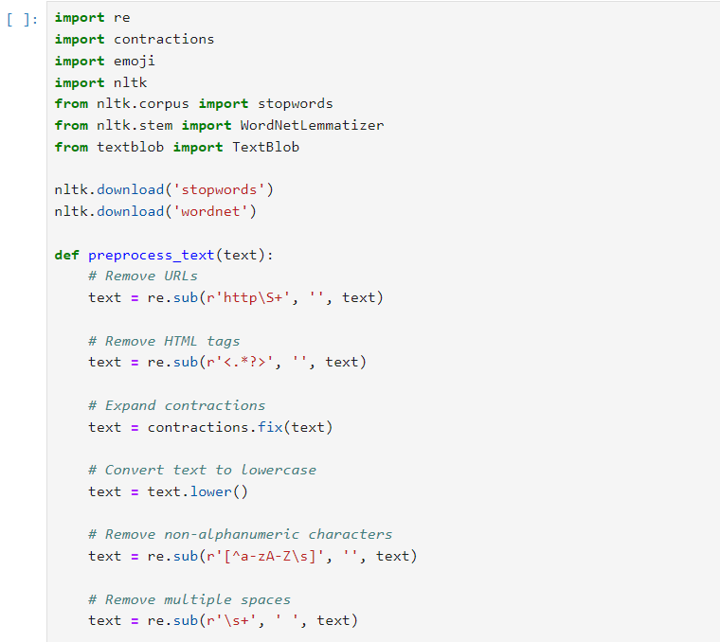
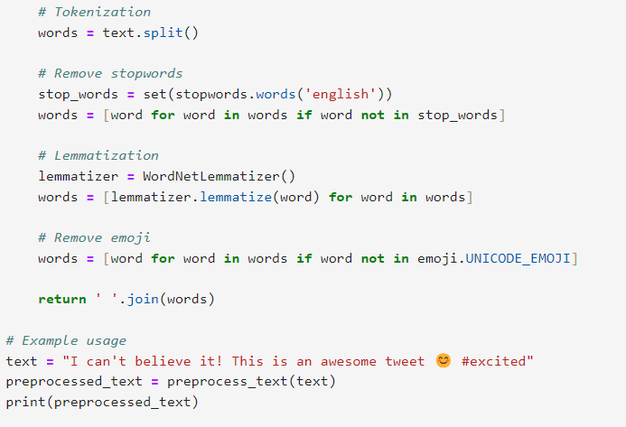
Step- 4: PYTHON SCRIPT FOR DATA PREPROCESSING >>

Slide 11
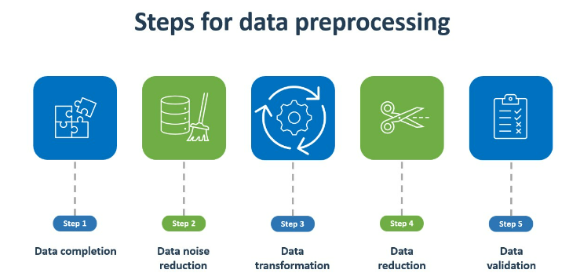
Processes involved in data preprocessing >>
Emoji Removal: It removes emojis from the text using the “emoji.UNICODE_EMOJI” list
HTML Tag Removal: It removes HTML tags.
Non-Alphanumeric Character Removal: It eliminates non-alphanumeric characters except spaces.
Space Reduction: It replaces multiple consecutive spaces with a single space.
Lemmatization: It uses the WordNet lemmatizer to reduce words to their base forms.

Slide 12
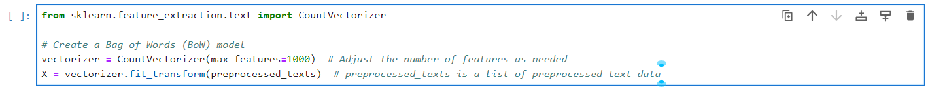
Feature engineering >>
Certainly, let's continue building the sentiment analysis project by covering key activities such as feature engineering, model training, and evaluation. we'll focus on using a popular machine learning model for sentiment analysis.
Feature engineering is the process of selecting or creating relevant features that can improve the performance of your sentiment analysis model. For this example, we'll use a simple bag-of-words (BoW) model as our feature representation.
Feature engineering uses the bag-og-words model to perform the improvising of the performance in the sentiment analysis.
The python script for feature engineering →

Slide 13
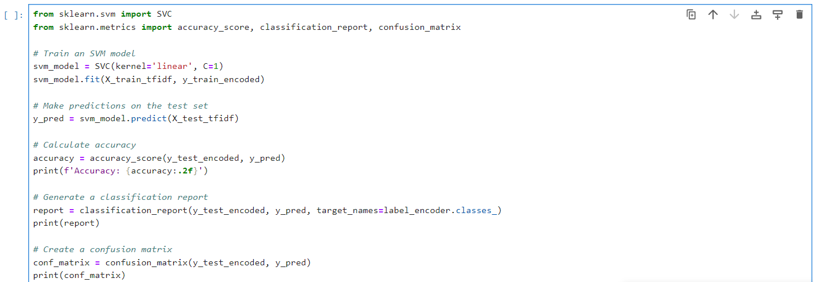
Model training >>
In this step, you'll train a machine learning model to predict sentiment labels based on the features you've engineered.
Now, let's train a Support Vector Machine (SVM) classifier on the preprocessed data:

Slide 14
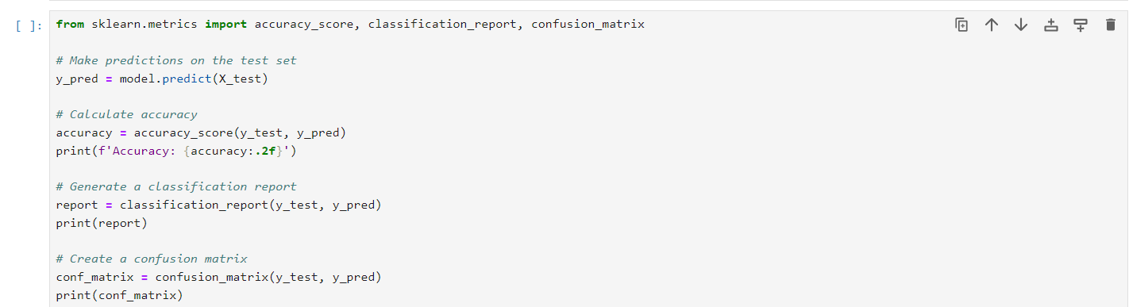
Model evaluation >>
Model evaluation is a critical step in assessing the performance of your sentiment analysis model. It helps you determine how well your model is performing in terms of making predictions and understanding its strengths and weaknesses. Here's an elaboration on common metrics and techniques for evaluating sentiment analysis models:
Evaluating the model's performance is crucial. Common evaluation metrics for sentiment analysis include accuracy, precision, recall, F1-score, and confusion matrix.

Slide 15
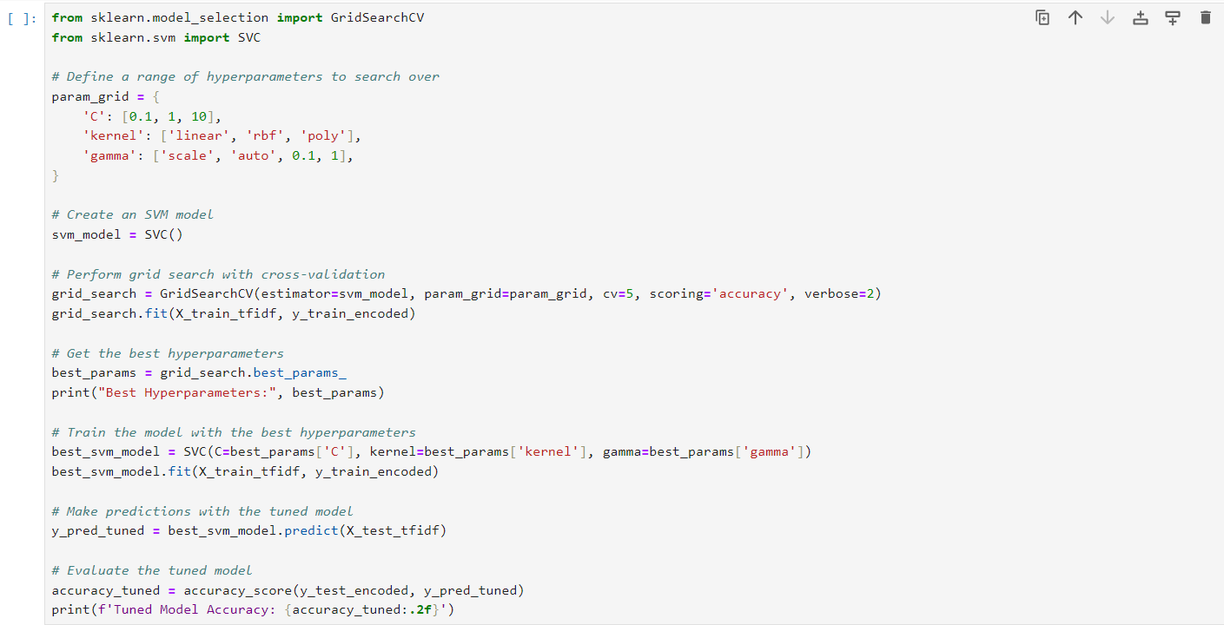
Hyperparameter tuning >>
Hyperparameter tuning is a crucial step in optimizing the performance of machine learning models, including the Support Vector Machine (SVM) model we've been using for sentiment analysis. In this section, we'll elaborate on the code for hyperparameter tuning, focusing on the grid search technique.

Slide 16
Processes involved hyperparameter tuning >>
We define a ‘param_grid’ dictionary that specifies the hyperparameters to be tuned. In this example, we're tuning the ‘c’ parameter (regularization strength),’kernal’ and ‘gamma’.
We create an SVM model using ‘svc’.
We use ‘gridsearchCV’ o perform the grid search. This function takes the model, the parameter grid, cross-validation settings he scoring metric and “verbres =2” to display progress.
The best hyperparameters are obtained using ‘grid_search.best_param
We then train a new SVM model with the best hyperparameters.
The tuned model is used to make predictions on the test set, and accuracy is calculated to evaluate its performance.

Slide 17
Deployment >>
Once your model is trained and performing well, you can deploy it as part of your sentiment analysis tool or application. For real-time analysis, consider building a web-based interface that takes user input and uses your model to provide sentiment analysis results.
The deployment process for a sentiment analysis model involves making your model accessible to users or integrating it into an application or system. Here's an elaboration on the steps involved in deploying a sentiment analysis model:
Model Serialization
API Development
Model Hosting
Security
Model Updates
User Documentation
Testing and Quality Assurance
Deployment and Monitoring

Slide 18
Thanking you

