Slide 1
HX83192 FW EMS & ESD pattern
2021/07/15
Stella Huang

Slide 2
ESD, EMS tuning -- Pattern – Sensed_block
Parameter_table: 0x8091
TX
FAE可定義:
Function EN ESD_DETECTION 須為0x01
Size | Name | Address
2-byte | Max_sensed_block | Rfeh_9C (low) Rfeh_9D (high)
RX
當Max_sensed_block為0時，此功能關閉
Condition | Description
1 | 當Sensed block 數目超過Max_sensed_block時，成立
當Condition 1 成立時，做鬼點保護 (Level 1)

Slide 3
ESD, EMS tuning -- Pattern – Data process
Parameter_table: 0x8091
Max Diff 的column位置
FAE可定義:
Function EN ESD_DETECTION 須為0x01
Size | Name | Address
2-byte | column_mean_thx | Rfeh_9E (low) Rfeh_9F (high)
1-byte | column_block_thx | Rfeh_A0
RX
當column_mean_thx為0時，此功能關閉
Condition | Description
1 | 當黃色區域的平均值超過column_mean_thx時，成立
2 | 紀錄在黃色區域，delta 值超過column_mean_thx的個數， 當此個數超過column_block_thx個時，成立
當Condition 1 和 2 同時成立時，做鬼點保護 (Level 1)

Slide 4
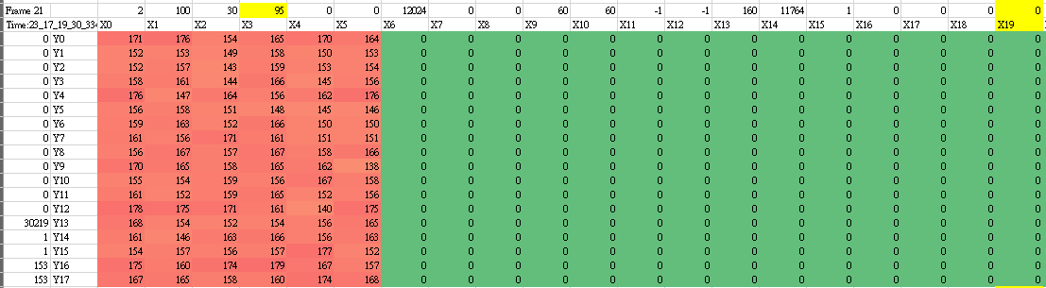
EMS Example -- TEMCELL 15kV 0623 Log
> 160 (Signal thx) sensed block num: 95 (less than a mux) → Enter Palm
Max Delta is 179 on (X3, Y16)
The mean on X3 is about 161
Add ESD pattern:
On the max delta column, when it satisfies both (a) and (b), enter ghost point protection
Column mean > 150
#(delta > 150) > 3*RX/4

Slide 5
ESD, EMS tuning -- Pattern – Max Delta
Parameter_table: 0x8092
Max Delta 的大小
FAE可定義:
Function EN ESD_DETECTION 須為0x01
Size | Name | Address
2-byte | esd_max_delta | Rfeh_A1 (low) Rfeh_A2 (high)
RX
當esd_max_delta為0時，此功能關閉
Condition | Description
1 | 當max delta超過esd_max_delta時，成立
當Condition 1 成立時，做鬼點保護 (Level 1)

Slide 6
ESD, EMS tuning -- Pattern – One block debounce
Parameter_table: 0x8096
FAE可定義:
Function EN ESD_DETECTION 須為0x01
Size | Name | Address
1-byte | esd_debounce_block | Rfeh_AB
1-byte | one_block_wet_th | Rfeh_16B
RX
當esd_debounce_block為0時，此功能關閉
Condition | Description
1 | 當該點的sensed block只有1個時，weight 會看Rfeh_16B * Rfeh_0F

Slide 7
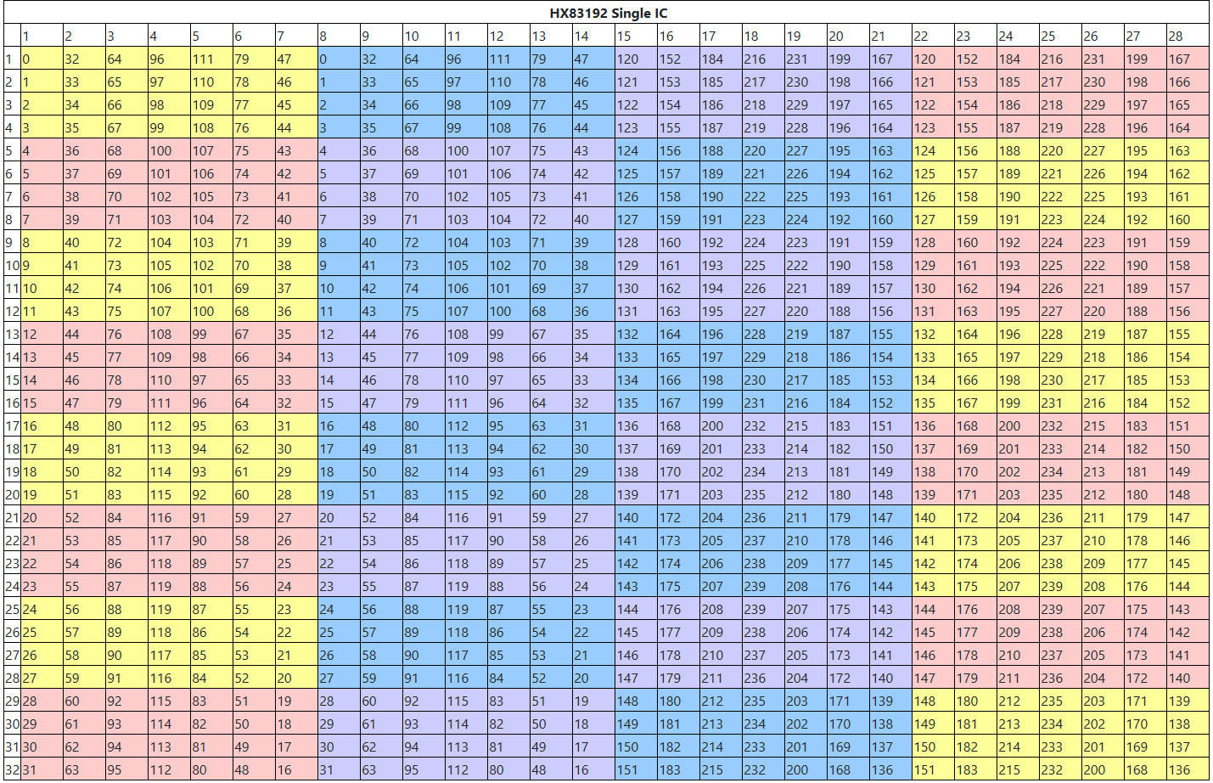
ESD, EMS tuning -- Pattern – Horizontal Mapping
Parameter_table: 0x8096
FAE可定義:
Function EN ESD_DETECTION 須為0x01
Size | Name | Address
1-byte | esd_hor_a_mux_col_block_count | Rfeh_A5
2-byte | esd_hor_a_mux_col_block_thx | Rfeh_A3 (low) Rfeh_A4 (high)
當esd_hor_a_mux_col_block_count 為0時，此功能關閉
Condition | Description
1 | 某一mux的column值超過esd_hor_a_block_thx時，count++，當count大於esd_hor_a_mux_block_count時，成立
當Condition 1 成立時，做鬼點保護 (Level 1)

Slide 8

Drive for better vision

