Slide 1
HX83192
Self Diagnosis
2021/07

Slide 2
Outline
Self test two modes compare
Self test – normal mode
  Listen mode
  Short diagram
  Open diagram
  Detect short and open at the same time
  Self test sensing timing
  Partition detection
  Parameter
  Output value
  Unable to detect short NG case
  Detect Open NG Case
Self test – inspect mode
  System diagram
  Command description
  Result data format
  Parameter

Slide 3
Self Test Two Modes Compare
About self test of TP sensor, we provide two modes for using.
 | Normal Mode | Inspect Mode
Test Item | Short Open | Short Open Noise
Accuracy | Rough | Fine
Execute | Run test flow at background. | Test flow is same as MPAP flow.
Can user touch panel? | Yes | No
Cost time | Short | Long
Output | Status Register(DD REG E5h) FAIL_DET (or TP_GPIO) | Event Stack TXIS

Slide 4
Self Test – Normal Mode

Slide 5
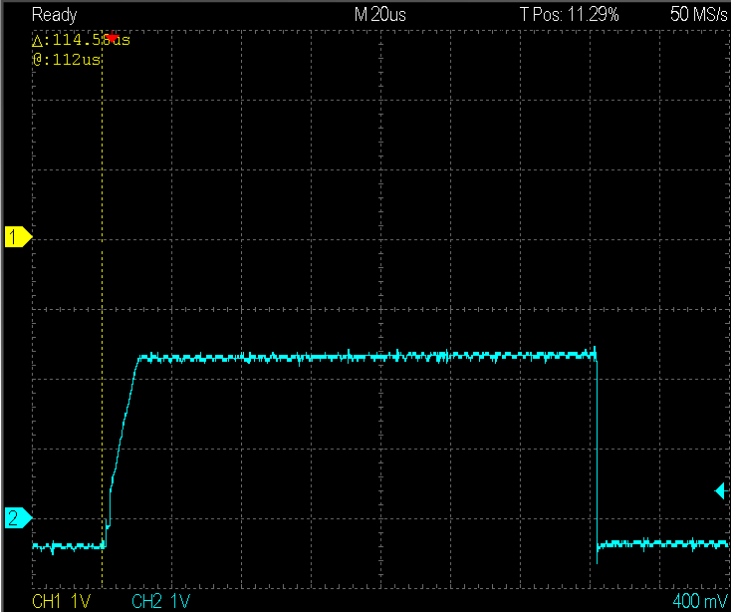
Listen Mode
Sensing is a DC voltage in listen mode, different from normal mode is a trapezoidal wave or sine wave.

Slide 6
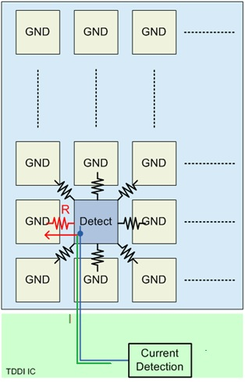

Short Diagram
If there is a leakage current that requires the need to input more charge, and will count this charge in short mode.
Input current
VR
GND
Leakage current
Voltage
Normal
Extra charge
Short
Charge time
Detect time

Slide 7
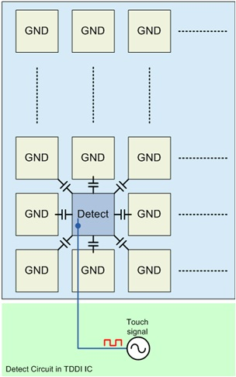
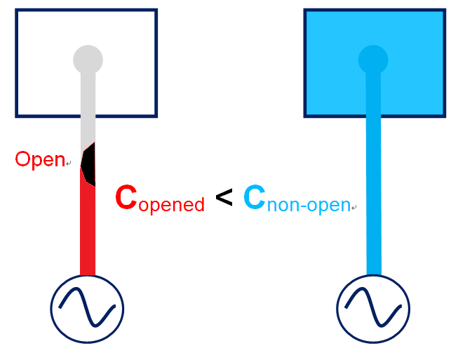
Open Diagram
The C of non-open condition is greater than opened since the opened pad only remain the line and there is no way to charge the pad.
Totally Open
Voltage
Non-open
(Normal)
0
Detect time

Slide 8
Detect Short and Open at The Same Time
We use one setting to detect open & short.
Expected result
  Normal: Median value
  Open: Smaller value
  Short: Larger value
Open
Normal
Voltage
Short
0
Detect time

Slide 9
Self Test Sensing Timing
We use the last TPEN to detect open/short.
This way doesn’t affect the reporting point function.
VSYNC
Touch normal sensing
Listen sensing

Slide 10
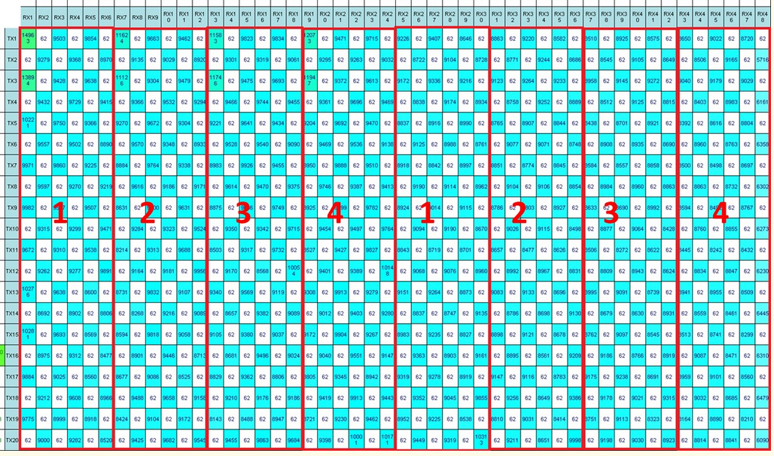
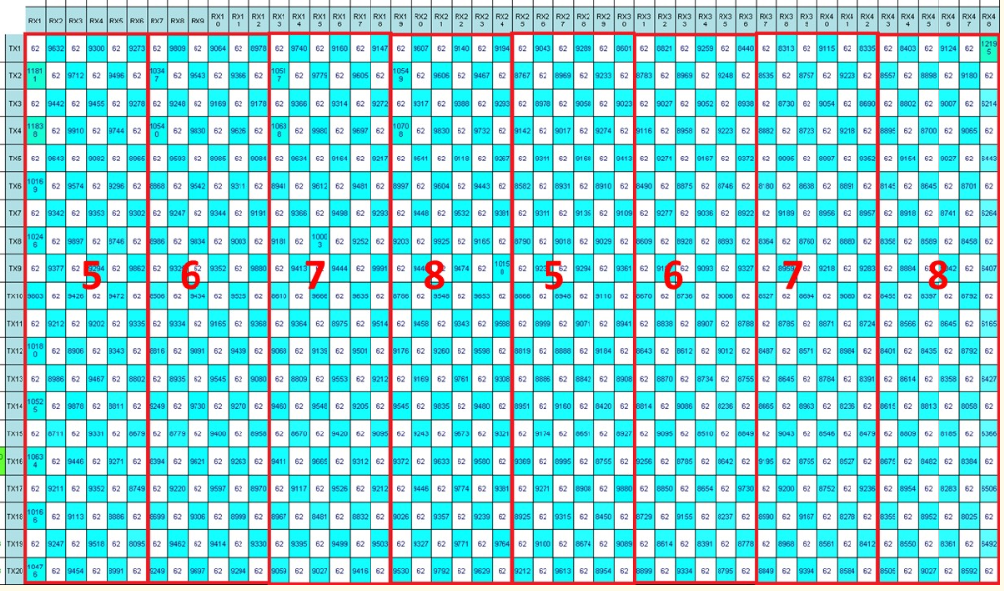
Partition Detection
GND
HX83192-A's AFE architecture is mux-4. Sensing 4 times will make a TP raw data.
Currently, there are 10 TPENs on each display frame, we use one TPEN for sensor Open/Short diagnosis.
Due to sensing behavior, totally it should take 8 display frames for a whole open/short diagnosis data.
  Ex: Display 60Hz: should take 133.33ms
Sensing
s
G
s
G
s
G
1
2
3
4
1
2
3
4
s
G
s
Method1
G
s
G
s
G
s
5
6
7
8
5
6
7
8
G
s
G
Method2
Time
VSYNC
~60Hz
TP Frame
Data Process
f(n)
f(n+1)
f(n+2)
f(n+3)
f(n)
f(n+1)
f(n+2)
f(n+3)
Sensor
Open/Short
Diagnosis.
1/8 frame
1/8 frame
1/8 frame
1/8 frame
1/8 frame
1/8 frame
1/8 frame
1/8 frame
1
2
3
4
5
6
7
8
Method1
Method2

Slide 11
Parameter
Only fail threshold can be adjusted
Self test raw data in normal mode: percentage of maximum value
  High boundary: open NG threshold. Ex. [31:16] = 0x5A , Max. = 118 → High boundary = 118 * 90% = 106
  Low boundary: short NG threshold . Ex. [15:0] = 0x0A , Max. = 118 → High boundary = 118 * 10% = 11
Fail point boundary: The amount of NG blocks must exceed this value, FW will raise the fail bit.
  If this parameter is set to 0x05, open NG blocks must exceed 5 blocks.
Frame base: The self test frames must exceed this value, FW will raise the fail bit.
  If this parameter is set to 0x05, FW requires 5 consecutive fail frames to raise the fail bit.
Address | Threshold Item | [31:16] | [15:0]
0x100074B0 | Self test raw data in normal mode | High Boundary | Low Boundary
0x100074B4 | Fail point boundary | -
0x100074B8 | Frame base | -

Slide 12
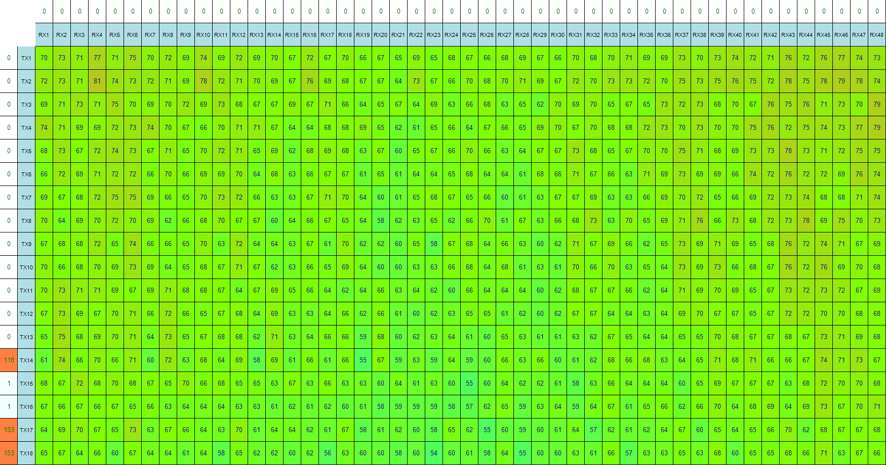
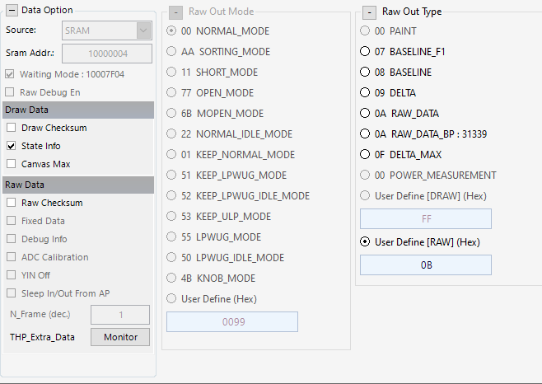
Output Value
Self test value
  Raw out type 0x0B in normal mode: output value is about half of the maximum
Maximum
value

Slide 13
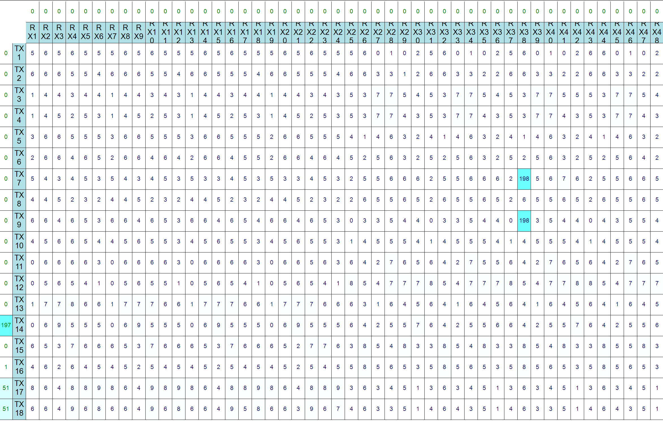
Unable to Detect Short NG Case(1/2)
Short NG block can be detected in short mode(MPAP).

Slide 14
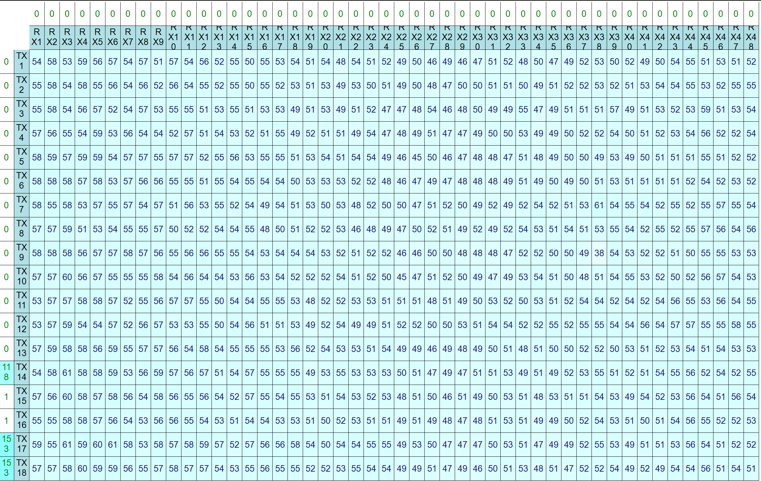
Unable to Detect Short NG Case(2/2)
Short NG block may not be detectable in self test – normal mode.
  Because the sensing blocks are shorted together. Ex. ADC drive : C = 1 : 1 = 2 : 2

Slide 15
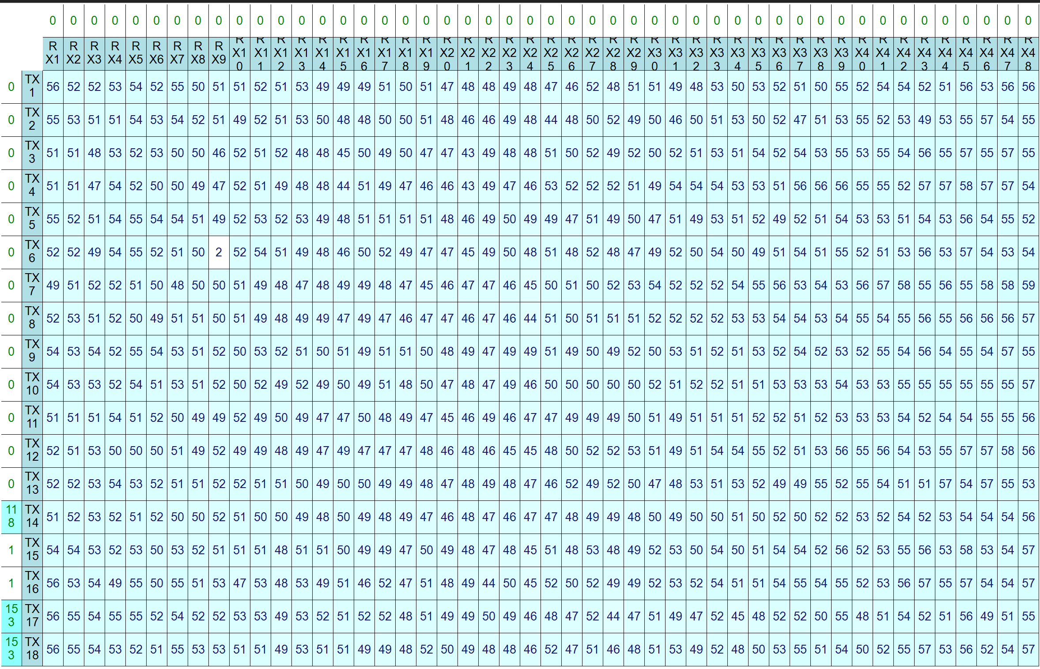
Detect Open NG Case
Open NG must be detected in self test – normal mode.

Slide 16
Self Test – Inspect Mode

Slide 17
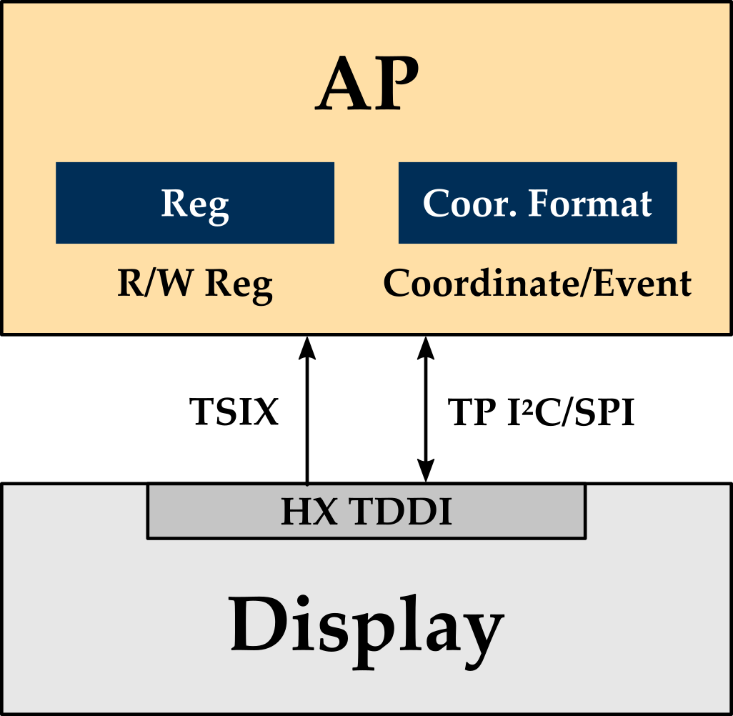
System Diagram
Through R/W Reg node of AP to access Himax TDDI.
Following Himax design command and flow to do TP sensor function check.
  Test Item: Open, Short, Noise
Check results after inspect mode done.

Slide 18
Command Description
Command address: 0x10007454
32 bits definition of register
32 bits
Command
Reserved
Test Item
Checksum
8 bits
8 bits
8 bits
8 bits
0x00: Initial Value
0x5A: Trigger Self-Test (Update by Indigo3)
0xA5: Start Self-Test (Update by Hx TDDI)
0xFF: Self-Test is done. (Update by Hx TDDI)
Bit | Description
[0] | Do Short Test
[1] | Do Open Test
[2] | Reserved
[3] | Do Noise Test
[4~7] | Reserved
Example:
1. Do 3 test: W 0x5A00_0B9B
2. Only do open test: W 0x5A00_02A4

Slide 19
Result Data Format
Definition of Result Data Format -1
Data format
Data 1
Data 2
Data 3
Data 9
Checksum
32bit
32bit
32bit
32bit
8bit
Command
Test
Result
Result
Information
Reserved
Checksum
Content
Data | Description
0x2019 0001 | Self Test is done.
0x2019 0010 | Self Test command error
0x2019 0020 | Self Test command CRC error

Slide 20
Result Data Format
Definition of Result Data Format -2
Data format
Data 1
Data 2
Data 3
Data 9
Checksum
32bit
32bit
32bit
32bit
8bit
Command
Test
Result
Result
Information
Reserved
Checksum
Content
Bit | Description | Result Information
[0] | Short Test | 0: lower than low boundary 1: higher than high boundary
[1] | Open Test | 0: lower than low boundary 1: higher than high boundary
[2] | Reserved | 0
[3] | Noise Test | 0: lower than low boundary 1: higher than high boundary
[4~31] | Reserved | 0
Bit | Description | Test Result
[0] | Short Test | 0: Pass 1:Fail
[1] | Open Test | 0: Pass 1:Fail
[2] | Reserved | 0
[3] | Noise Test | 0: Pass 1:Fail
[4~31] | Reserved | 0

Slide 21
Result Data Format
Definition of Result Data Format -3
Data format
Data 1
Data 2
Data 3
Data 9
Checksum
32bit
32bit
32bit
32bit
8bit
Command
Test
Result
Result
Information
Reserved
Checksum
Content
● Calculate the min and max value from each sensor of the TP chs (MxN).
Data x | Description | [31:16] | [15:0]
Data 4 | Short Test | Max value | Min value
Data 5 | Open Test | Max value | Min value
Data 6 | Reserved
Data 7 | Noise Test | Max value | Min value
Data ... | Reserved

Slide 22


Inspect Mode - Example
Command Trigger Self-Test
Do short & open & noise test
Ex1: Normal case
  Step1: Addr. 0x10007454 Write 0x5A00_0B9B
  Step2: Read data from event_stack
Ex2: Noise happened case
  Step1: Addr. 0x10007454 Write 0x5A00_0B9B
  Step2: Read data from event_stack
Checksum
Self Test is done.
Test Result
Result Information
Short Max. & Min.
Open Max. & Min.
Checksum
Noise Max. & Min.
Noise test fail
Noise higher than high boundary
Noise Max. Value

Slide 23
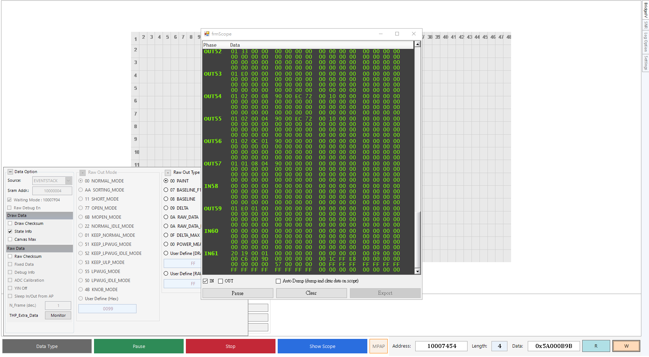
Inspect Mode - Example
Use Show Scope
Start
Set 0x10007454 = 0x5A000B9B
Wait Event Stack
(About 10 seconds)
4
2
1
3

Slide 24
Parameter
Short & Open test: use short & open test mode to detect(= MPAP)
  High boundary: equivalent to MPAP Upper
  Low boundary: equivalent to MPAP Lower
Noise test: use noise test mode to detect(= MPAP)
  High boundary: percentage of signal threshold. (Positive value)
  Low boundary: percentage of recalibration threshold. (Negative value)
Fail point boundary: The amount of NG blocks must exceed this value, FW will raise the fail bit.
  If this parameter is set to 0x05, open NG blocks must exceed 5 blocks.
Address | Threshold Item | [31:16] | [15:0]
0x100074A0 | Short test | High Boundary | Low Boundary
0x100074A4 | Open test | High Boundary | Low Boundary
0x100074AC | Noise test | High Boundary | Low Boundary
0x100074B0 | Fail point boundary | -

Slide 25

Drive for better vision

