Slide 1
AI TraceFinder
Forensic Scanner Identification
Infosys Springboard Internship Project
-Submitted by: Nageswari Mettukuru
Notes:
Greet the panel. Introduce the project: identify scanner source from scanned images using PRNU/noise fingerprints.

Slide 2
Executive Summary
What this project delivers
96.97%
Best Accuracy (PRNU Correlation)
Detect the scanner brand/model from any scanned image
Uses scanner-specific noise fingerprints (PRNU) for identification
Supports document authenticity checks in forensic workflows
Provides a deployable Streamlit application with audit logs
96.40%
CNN Val Accuracy
Infosys Springboard Internship Project
AI TraceFinder
Notes:
Give a quick overview: what it is, how it works, and best results. Mention PRNU correlation is best performer.

Slide 3
Motivation & Problem Statement
Motivation
Problem statement
Scanned documents are used in banking, education, legal, and government work
Forgery and tampering are increasing with digital editing tools
Scanner devices leave unique noise patterns that act as fingerprints
Input: scanned image
Output: predicted scanner model/brand
Approach: detect PRNU/noise patterns (content-independent)
Goal: forensic-ready accuracy and explainability
Infosys Springboard Internship Project
AI TraceFinder
Notes:
Explain why scanner source identification matters and define the problem clearly.

Slide 4
Objectives & Use Cases
Objectives
Use cases
Prepare labeled multi-scanner dataset
Build preprocessing pipeline (resize, grayscale, normalize)
Compare baseline ML vs PRNU correlation vs CNN
Add explainability with Grad-CAM
Deploy as a simple web app with logging
Digital forensics investigations
Document authentication / auditing
Legal evidence verification
Compliance checks for approved scanning devices
Infosys Springboard Internship Project
AI TraceFinder
Notes:
Present project goals and real-world scenarios where this solution adds value.

Slide 5
Dataset Overview
Data sources
Labeling strategy
Flatfield scans: blank pages to capture scanner noise strongly
Official documents: realistic forensic documents
Wikipedia content: diverse layouts for robustness
Folder name = scanner class label
Generated labels.csv for supervised training
Maintained consistent dataset structure
Key preprocessing rules
Resize to 512×512 and convert to grayscale
Normalize values for consistent model input
Avoid aggressive augmentation to preserve PRNU signal
Infosys Springboard Internship Project
AI TraceFinder
Notes:
Explain dataset types and the key rule: preserve PRNU during preprocessing.

Slide 6
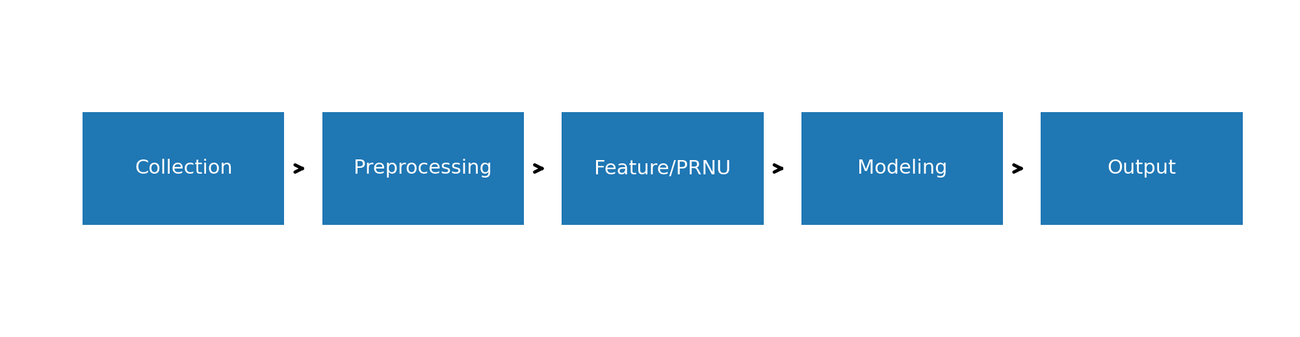
System Architecture
Pipeline modules
Collection → Preprocessing → PRNU/Features → Modeling (ML/CNN) → Prediction + Logs
Infosys Springboard Internship Project
AI TraceFinder
Notes:
Walk through the architecture diagram: each block and how output is generated.

Slide 7
Milestone-1: Data Collection & Preprocessing
Work completed
Outcome
Collected multi-source data for multiple scanners
Removed unwanted metadata/junk files
Standardized images (512×512, grayscale, normalized)
Generated labels.csv and consistent folder structure
Saved clean dataset in Processed/ directory
Stable and reproducible dataset
Ready for feature extraction and model training
Reduced noise inconsistency across files
Infosys Springboard Internship Project
AI TraceFinder
Notes:
Emphasize milestone 1 is the foundation: clean data + labels + consistent preprocessing.

Slide 8
Milestone-2: Feature Engineering & Baselines
Handcrafted features
Baseline models
Intensity stats: mean, standard deviation
FFT: frequency-domain magnitude properties
LBP: texture descriptors
Noise variance: residual noise estimate
PRNU stats: energy and variance
Logistic Regression (~74%)
SVM (~76%)
Random Forest (~75%)
Limitation: weak capture of spatial PRNU signature
Infosys Springboard Internship Project
AI TraceFinder
Notes:
Explain why baselines are useful and why we moved to PRNU correlation and CNN.

Slide 9
Proposed Method: PRNU Correlation (Best Result)
How PRNU correlation works
Extract noise residual: image − Gaussian blurred image
Crop central region to reduce boundary artifacts
Create fingerprint by averaging residuals per scanner
Predict scanner using normalized cross-correlation score
Accurate because PRNU is device-specific and stable
96.97%
Best Accuracy
Forensic-ready
Key Benefit
Infosys Springboard Internship Project
AI TraceFinder
Notes:
Clearly explain PRNU fingerprinting and why it improves accuracy. Highlight 96.97% result.

Slide 10
Milestone-3: CNN Model + Explainability
CNN approach
Performance + Grad-CAM
Input: PRNU/noise-focused images
Architecture: Conv + BatchNorm + MaxPool + Dense + Softmax
Hyperparameters tuned for best validation performance
Used minimal augmentation to protect PRNU signature
Train: 97.28%
Validation: 96.34%
Test: 93.08%
Grad-CAM confirms model uses noise regions (not text)
Infosys Springboard Internship Project
AI TraceFinder
Notes:
Present CNN results and explain how Grad-CAM improves trust and interpretability.

Slide 11
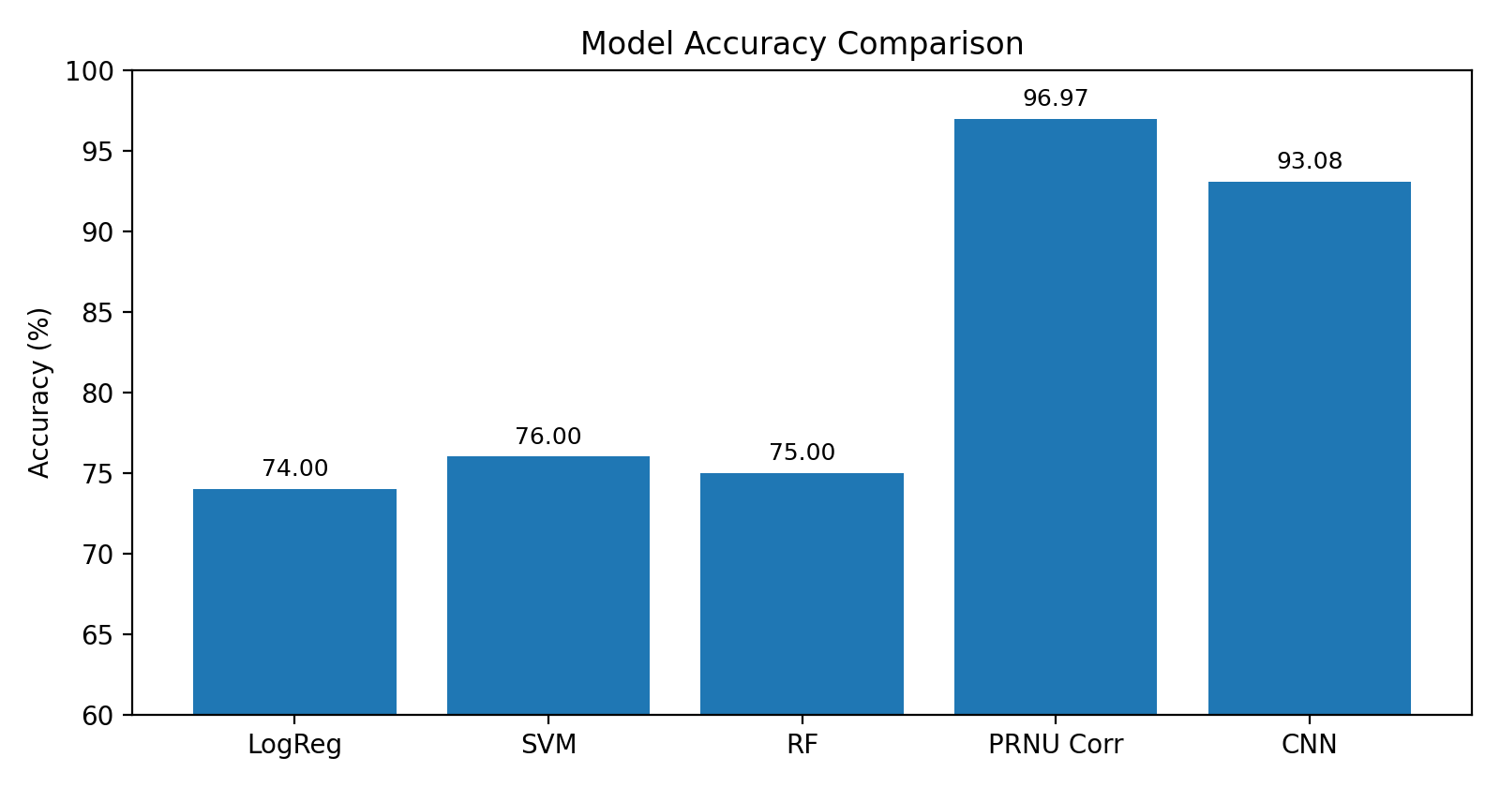
Results Comparison
Key takeaway
PRNU Correlation achieved the highest accuracy, followed by CNN with explainability support.
Infosys Springboard Internship Project
AI TraceFinder
Notes:
Use the bar chart to explain improvement from baselines to PRNU correlation and CNN.

Slide 12
Deployment: Streamlit Application
Features
Deliverables
Upload scanned image (PNG/JPG/JPEG)
Predict scanner model/brand with confidence score
Store each prediction into predictions.csv (audit log)
Download logs for documentation and reporting
Simple UI for quick forensic verification
Trained model
Inference pipeline
Streamlit UI
Prediction logs
Infosys Springboard Internship Project
AI TraceFinder
Notes:
Explain app workflow: upload → predict → log → download. Mention usability for forensic teams.

Slide 13
Challenges & Solutions
Challenges faced
Solutions applied
Noise patterns are very subtle and easy to destroy
Different documents add content variation
Baseline ML models underperform on spatial fingerprints
Need interpretability for forensic confidence
PRNU-safe preprocessing (minimal distortions)
Central cropping to reduce boundary artifacts
PRNU correlation fingerprint matching
CNN + Grad-CAM for accuracy + transparency
Infosys Springboard Internship Project
AI TraceFinder
Notes:
Show that you handled real research challenges and implemented solid solutions.

Slide 14
Conclusion & Future Scope
Conclusion
Future scope
Successfully identified scanner source using PRNU/noise fingerprints
PRNU correlation achieved best accuracy: 96.97%
CNN achieved strong performance with explainability support
Deployed a working Streamlit prototype with audit logging
Expand dataset with more scanner models and real documents
Improve robustness against compression/blur
Optimize inference speed for real-time bulk verification
Build a complete fingerprint library for large-scale matching
Infosys Springboard Internship Project
AI TraceFinder
Notes:
Close with impact, best results, and realistic improvements you would implement next.

