Slide 1

Scanner Identification System using Machine Learning and Deep Learning

Slide 2



Abstract: Unveiling the Source
Overview
Methodology
Deployment
This project details a robust system for identifying the source scanner of digital documents using advanced Machine Learning (ML) and Deep Learning (DL) techniques.
Leveraging image processing and classification algorithms, the system accurately distinguishes between different scanner models based on subtle forensic artifacts.
The developed solution is deployed as an intuitive web application using Streamlit, facilitating real-time analysis and user interaction.

Slide 3

Introduction: The Crucial Role of Scanner Identification
In an era of increasing digital document forgery and manipulation, identifying the originating source of scanned documents is paramount. This project addresses the growing need for reliable forensic tools.
Our system acts as a crucial aid in digital forensics, combating fraud, and enhancing document security by pinpointing the specific brand and model of the scanner used to create a digital image.

Slide 4

Problem Statement: The Challenge of Digital Fingerprints
Identifying scanner brands from scanned images presents significant challenges due to:
Subtle, often imperceptible, microscopic patterns introduced by each scanner.
Variations in scanning resolutions, lighting, and document types.
The need for high accuracy and robustness against image manipulation.

Slide 5
Project Objectives: Precision and Transparency
1
2
Scanner Classification
System Deployment
Develop and evaluate ML/DL models for accurate scanner brand and model classification.
Implement a user-friendly Streamlit application for practical, real-world usage.
3
4
Explainability
Logging & Reporting
Incorporate techniques like Grad-CAM/SHAP to understand model decisions, enhancing trust and auditability.
Establish comprehensive logging and reporting mechanisms for system performance and usage.

Slide 6
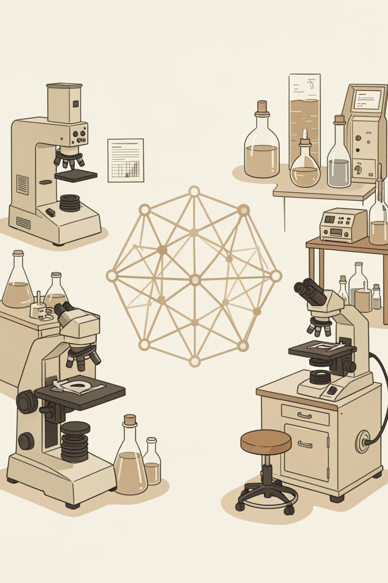
Literature Review: Foundations in Forensics and AI
1
Traditional Document Forensics
Review of classic methods including ink analysis, paper fiber examination, and watermark detection, providing a historical context.
2
Machine Learning in Image Classification
Exploration of foundational ML algorithms (SVM, Logistic Regression) and their application in image feature recognition.
3
Deep Learning Advancements
Focus on Convolutional Neural Networks (CNNs) and their superior performance in complex image pattern learning and classification tasks.

Slide 7
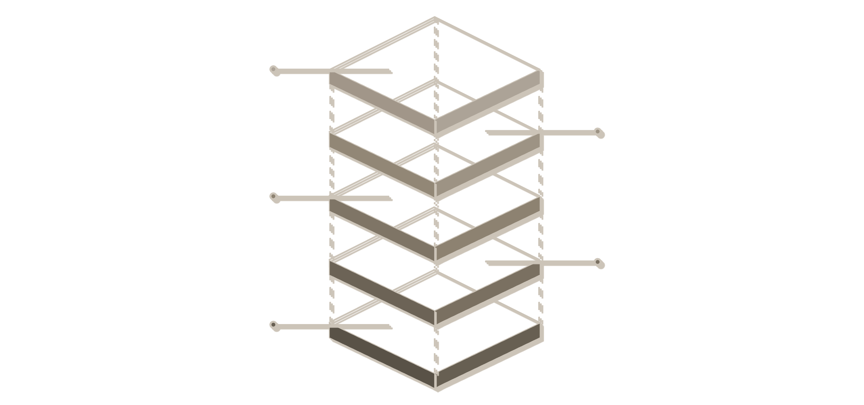
System Architecture: A Multi-Layered Approach
Deployment
Serve via Streamlit app
Explainability
Interpret model predictions
Modeling
SVM, Logistic Regression, CNN
Preprocessing
Clean and engineer features
Data Ingestion
Collect raw data from sources
The system architecture integrates data acquisition, feature engineering, model training, explainability modules, and a user-facing deployment, ensuring a robust and comprehensive solution.
Data flows from raw scanned images through preprocessing, then into the ML/DL pipeline for classification, with results presented via the Streamlit interface.

Slide 8
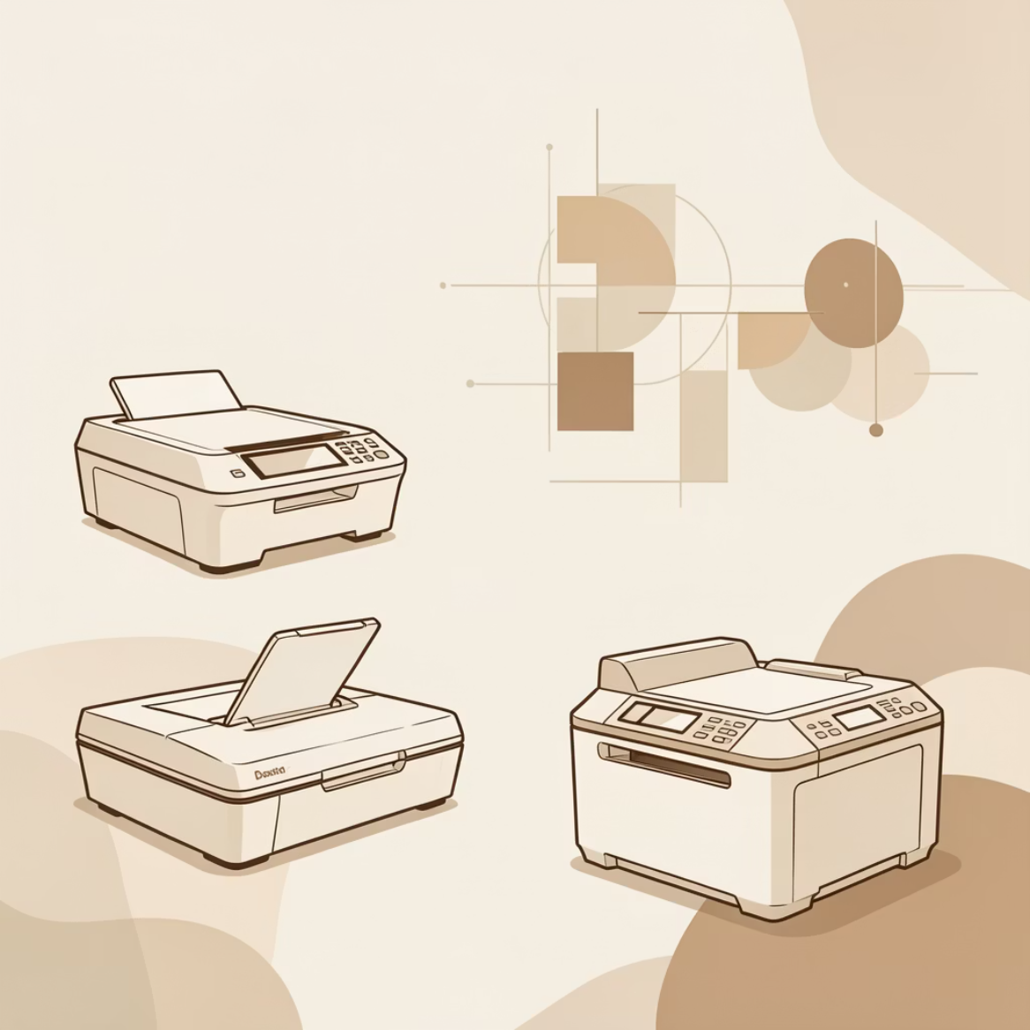
Dataset & Methodology: Training for Precision
Dataset Description
Methodology
Scanner Types: Comprehensive collection from Scanner A, B, C, and D.
Feature Extraction
Image Preprocessing: Noise reduction, normalization, and cropping to isolate relevant features.
1
Statistical and textural feature extraction from image patches.
Augmentation: Rotations, flips, and intensity changes to enhance model generalization and robustness.
Traditional ML
2
Implementation of Support Vector Machines (SVM) and Logistic Regression for baseline classification.
Deep Learning (CNN)
3
Development and training of Convolutional Neural Networks using TensorFlow for advanced pattern recognition.

Slide 9

Deployment & Conclusion: Real-World Impact
Interactive Deployment with Streamlit
Conclusion & Future Enhancements
The project successfully developed a reliable scanner identification system, demonstrating high accuracy and interpretability.
Intuitive UI for image upload and analysis.
Real-time prediction with confidence scores.
Automated logging of predictions for auditing and system improvement.
Cloud hosting for scalability.
Integration with real-time scanning pipelines.
Expansion to include a wider array of scanner models.

