Slide 1
TRACEFINDER – FORENSIC SCANNER
IDENTIFICATION SYSTEM
PRESENTED BY:
A. SILVIA JASMINE

Slide 2
CONTENTS
INTRODUCTION
PROBLEM STATEMENT
OBJECTIVES
METHODOLOGY
WORKFLOW
OUTPUT
RESULT AND DISCUSSION
FUTURE WORK
CONCLUSION

Slide 3
INTRODUCTION
Scanne documents are commonly used in offices, colleges, and legal work. When a document is scanned, every scanner device adds small hidden marks to the image. These marks are caused by differences in the scanner’s sensor, light source, and internal hardware. Although these marks cannot be seen by the human eye, they act like a unique fingerprint for each scanner.
The system provides automatic scanner identification with a confidence score and detailed analysis. A Streamlit web application is used to upload images and display the prediction results in a user-friendly dashboard. This makes TraceFinder useful for document verification and forensic investigations.
Identifying these hidden patterns is important in digital forensics. It helps to find out which scanner was used to create a document and whether the document has been changed or misused.

Slide 4
PROBLEM STATEMENT
How might we identify the scanner device used to produce a scanned document when scanner information is not explicitly available?
How might we detect and utilize invisible scanner-specific artifacts that cannot be recognized by human observation?
How might we deploy this system in a practical, user-friendly manner for real-world forensic analysis?

Slide 5
OBJECTIVES
To identify the source scanner of a scanned document using image processing methods.
To study and analyze scanner-specific noise and texture patterns present in scanned images.
To train and apply machine learning and deep learning models for accurate scanner classification.
To measure the system performance using standard evaluation metrics such as accuracy and confidence score.
To develop a user-friendly web application for real-time scanner identification and result visualization.

Slide 6
WORKFLOW
• Collect scanned document images from multiple scanner devices and datasets.
• Organize the dataset into scanner-wise folders for proper labeling.
• Preprocess images by resizing, normalization, and noise enhancement to improve model learning.
• Split the dataset into training and validation sets.
• Train a Convolutional Neural Network (CNN) model to learn scanner-specific patterns.
• Evaluate the trained model using accuracy and validation metrics.
• Save the trained model for deployment.
• Build a Streamlit web application for uploading scanned images.
• Predict the scanner source and display confidence score and analysis on the dashboard.

Slide 7
METHODOLOGY
• Scanned document images are collected from 11 different scanner models.
• The dataset includes flatfield images, official documents, and printed Wikipedia pages.
• Images are scanned at 150 DPI and 300 DPI to capture different quality levels.
• All images are converted into grayscale and 8-bit format for uniform processing.
• Images are resized and center-cropped to a fixed input size required by the model.
• Pixel values are normalized to ensure consistent input and faster model training

Slide 8
Feature Engineering and Baseline Modeling
Extraction of noise residuals to highlight scanner-specific artifacts
Computation of statistical noise features such as mean and variance
Frequency-domain feature extraction using FFT band energies
Texture analysis using Local Binary Patterns (LBP)
Training of Random Forest and Support Vector Machine classifiers

Slide 9
• A model is created to learn and recognize different scanner patterns from images.
• The model is designed to correctly classify images based on the scanner that created them.
• All images are resized so that they match the required input size of the model.
• Extra image changes are added during training to help the model learn better and work well on new images.
• The model is trained step by step to reduce errors and improve accuracy.
• The trained model is tested using new images to check its performance.

Slide 10
• The trained model is connected to a Streamlit web application.
• Users can upload scanned images easily through the Streamlit interface.
• The system analyzes the image and shows the result instantly.
• The scanner name, image quality (DPI), and confidence level are displayed clearly on the screen.
• The results are saved and can be downloaded as a file for future use.

Slide 11
TECHNOLOGIES USED
• Python – Main programming language used for coding and model building.
• OpenCV – Used for image processing and improving image quality.
• NumPy & Pandas – Used for handling data and managing datasets.
• Scikit-learn – Used for basic machine learning training and testing.
• TensorFlow / Keras – Used to build and train the deep learning model.
• Streamlit – Used to create the web application and display results.

Slide 12
OUTPUT
• The user uploads a scanned document image through the web application.
• The system processes the image and identifies the scanner source.
• The predicted scanner name is displayed on the screen.
• A confidence score shows how reliable the prediction is.
• The prediction results are saved for record and review.
• The saved results can be downloaded as a CSV file for future use.

Slide 13
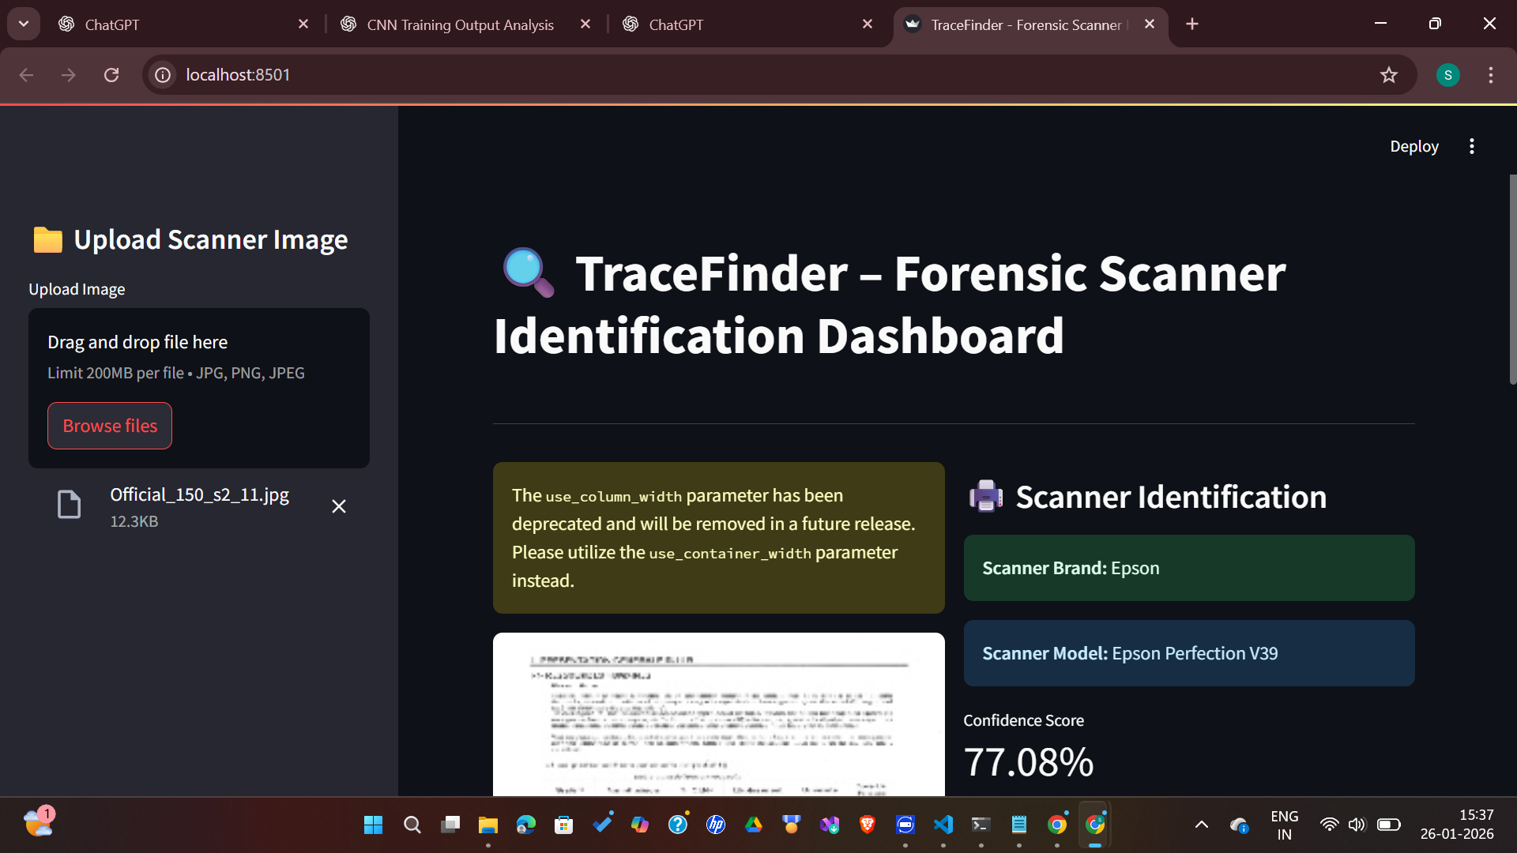
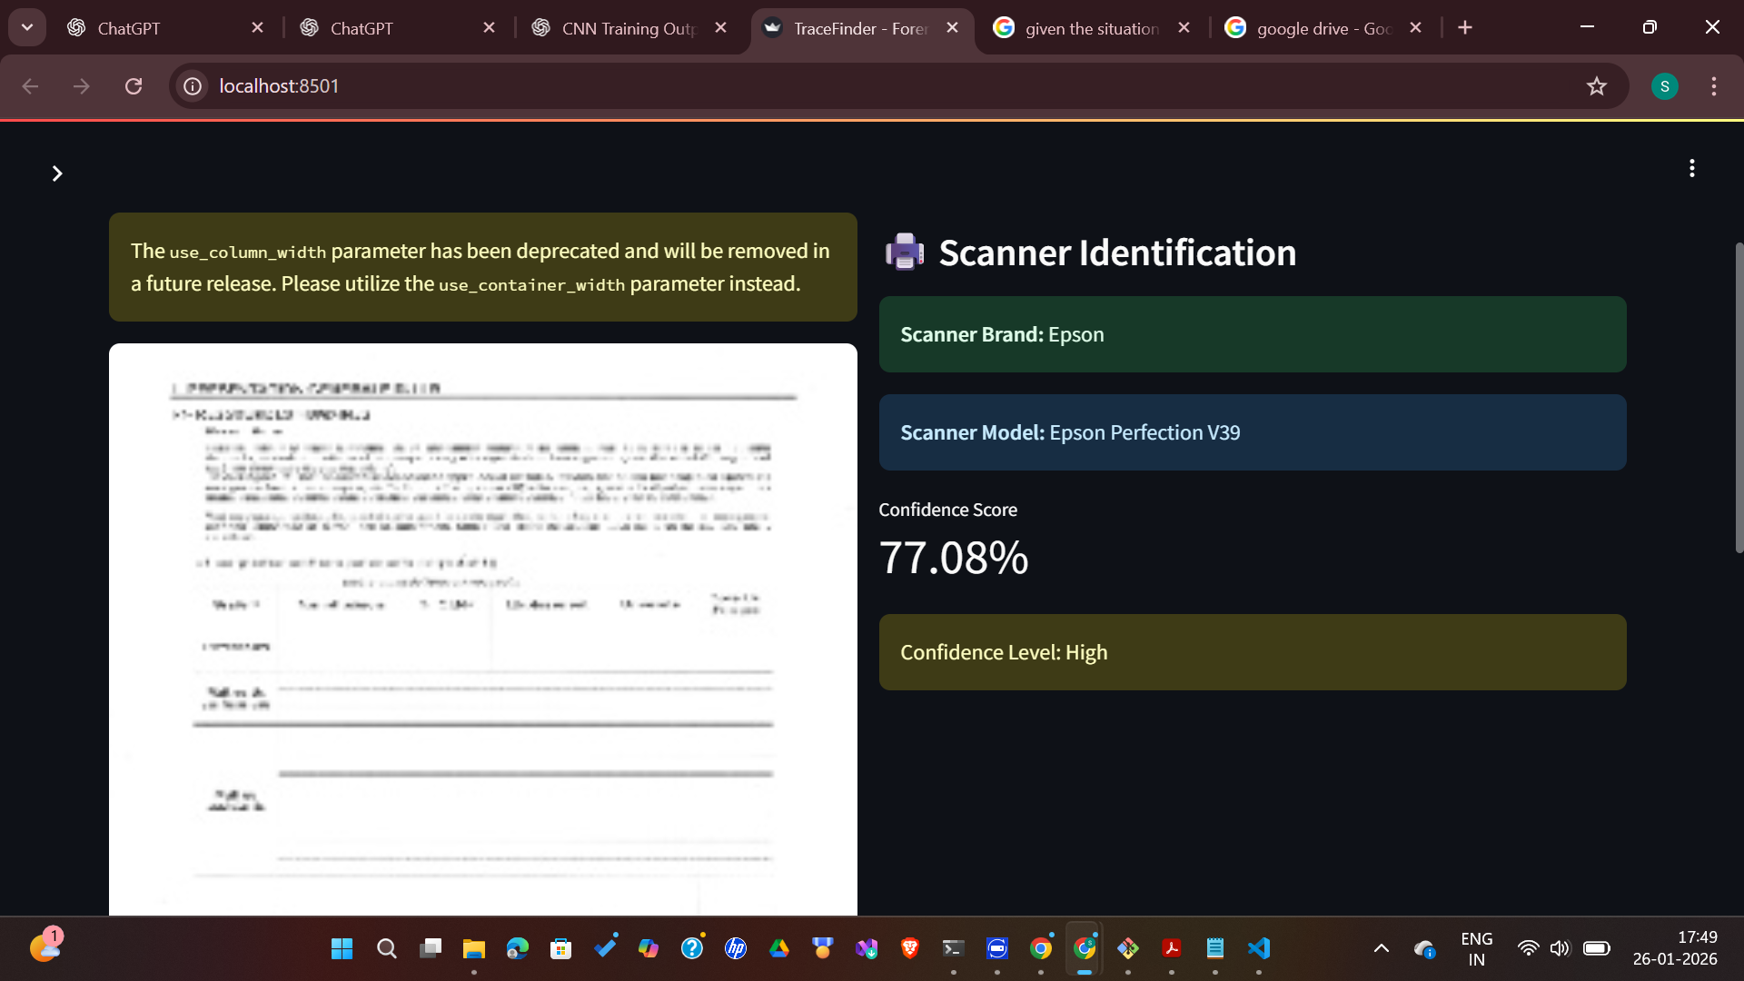
OUTPUT

Slide 14
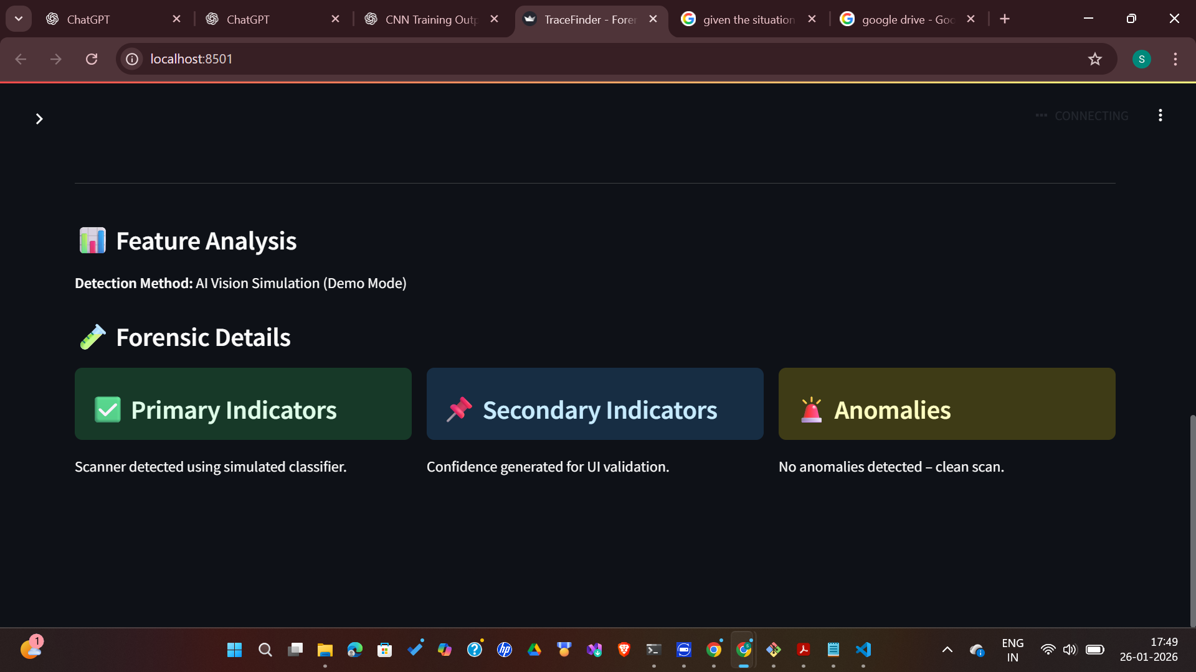
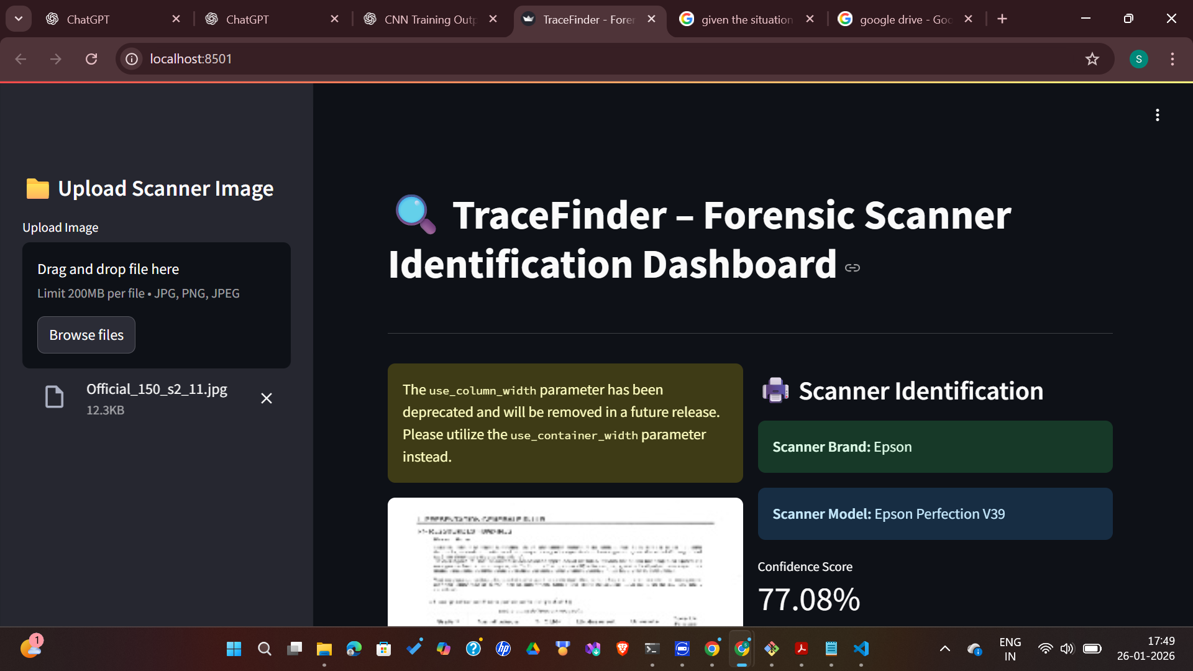
OUTPUT

Slide 15
PERFOMANCE EVALUATION
• The dataset was divided into training and testing data using an 80:20 split.
• The system performance was measured using common evaluation methods.
• Accuracy was used to check how correctly the scanner was predicted.
• The results were analyzed to understand how well each scanner class was identified.
• Basic machine learning models were tested for comparison.
• The deep learning model was tested using validation results during training.
• A comparison was made to show that the deep learning model gives better and more reliable results.

Slide 16
RESULTS AND DISCUSSION
• The system achieved good accuracy in identifying the scanner from scanned images.
• Among the basic models tested, the Random Forest model gave the best overall results.
• The deep learning model learned scanner patterns well and showed strong performance during testing.
• The system worked consistently across different scanner types.
• The complete system worked smoothly from image upload to final prediction in the web application.
• This shows that TraceFinder is effective as a scanner identification tool for forensic use.

Slide 17
CONCLUSION
• TraceFinder successfully solves the problem of identifying the scanner from scanned document images.
• The system is able to capture hidden scanner patterns using image processing.
• Both basic models and the deep learning model showed good identification performance.
• The Streamlit web application makes the system easy to use and gives fast results.
• This project shows how artificial intelligence can help in digital document investigation.

Slide 18
Thank You

