Slide 1


AITracker
Project Presentation
Yatendra Pachori
yatendra054

Slide 2
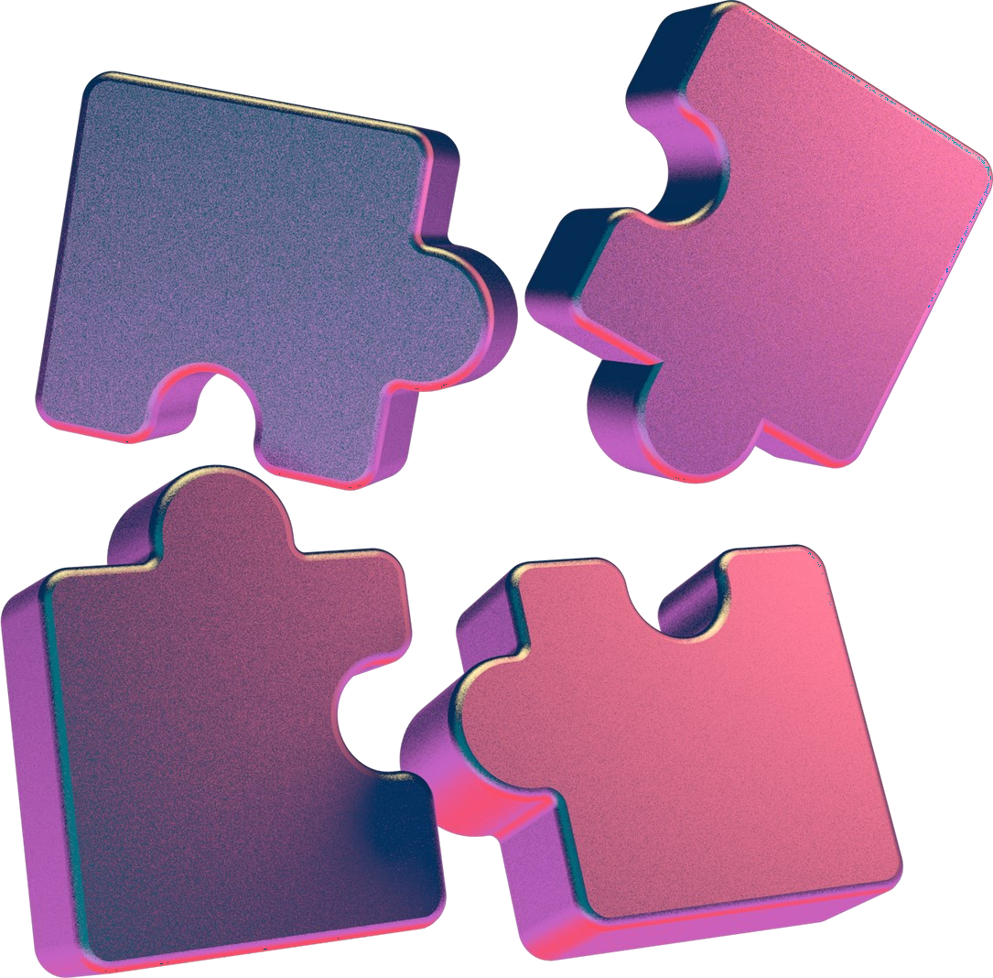
Scanner Device Identification from Scanned Documents
Scanned documents contain hidden device-specific patterns invisible to the human eye—subtle artifacts and noise signatures unique to each scanner model.
Our Objective: Build an intelligent system that can accurately predict the scanner brand from scanned images using machine learning and deep learning techniques.

Slide 3
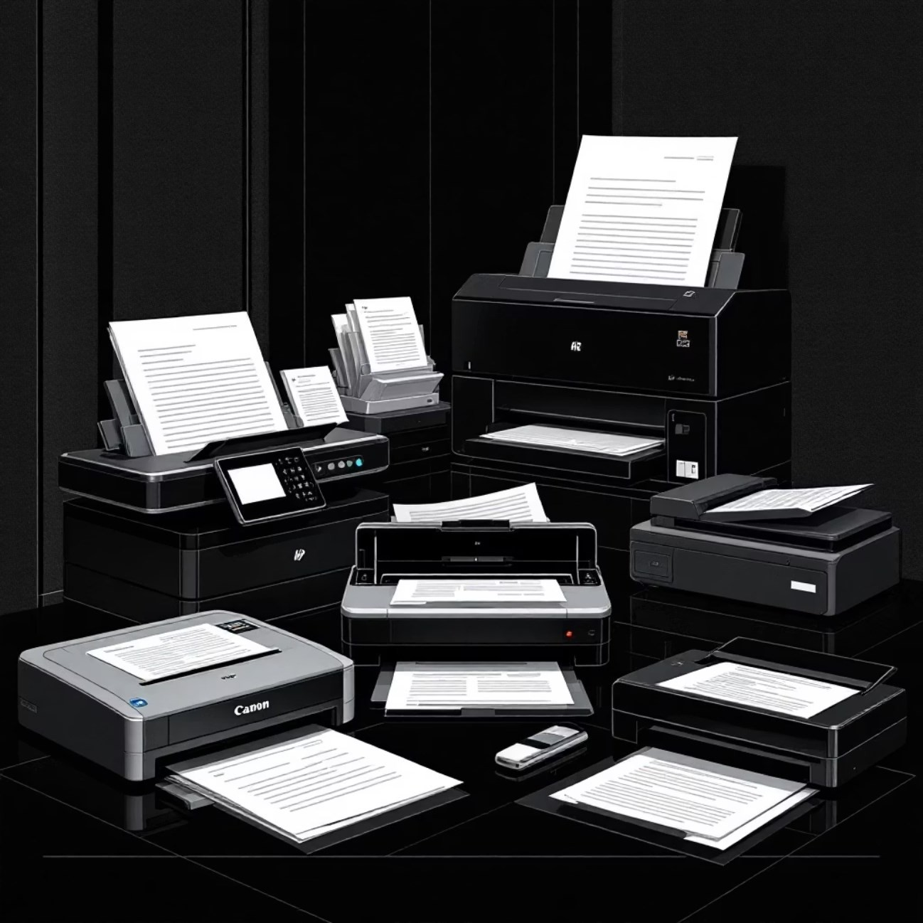
Dataset Collection & Understanding
Dataset Composition
We assembled a comprehensive collection of scanned document images from three major scanner manufacturers: Canon, HP, and Epson. Each brand exhibits distinctive scanning characteristics that serve as forensic fingerprints.
1000+ scanned document images
Multiple resolutions: 150 DPI and 300 DPI
High-quality TIFF format for maximum detail
Carefully labeled dataset with brand annotations

Slide 4
Image Preprocessing Pipeline
01 02 03
Grayscale Conversion Image Resizing Pixel Normalization
Converted color images to grayscale to Standardized all images to a fixed Scaled pixel values to a standard range, focus on texture and noise patterns rather dimension to ensure consistent input for improving model convergence and training than color variations model training stability
04
TIFF Handling
Implemented specialized processing for high-resolution TIFF files to preserve forensic details
05
Quality Assurance
Validated preprocessing consistency across entire dataset to eliminate pipeline variability

Slide 5


Feature Extraction & Classical Machine Learning
Local Binary Pattern Features
We extracted Local Binary Pattern (LBP) features—a powerful texture descriptor that captures the micro-patterns and noise characteristics unique to each scanner. LBP excels at detecting subtle variations in pixel neighborhoods that distinguish scanner signatures.
92%
SVM Accuracy
Best performance on 300 DPI dataset
Classical ML Models Tested
Support Vector Machine (SVM)
Random Forest Classifier
K-Nearest Neighbors (KNN)
Logistic Regression
Key Finding: Performance degraded when mixing 150 and 300 DPI images, revealing that classical ML models are highly sensitive to resolution changes. This limitation motivated our exploration of deep learning approaches.

Slide 6




Deep Learning Approach: From Scratch to Transfer Learning
CNN from Scratch
Initial attempt with custom convolutional neural network revealed severe underfitting due to
limited dataset size. Accuracy plateaued at only 40-55%, indicating insufficient training data.
Transfer Learning
Leveraged pre-trained MobileNetV2 and EfficientNet architectures, fine-tuning them on our
scanner dataset. Applied extensive data augmentation to artificially expand training samples.
Performance Breakthrough
Achieved dramatic improvement with 82% training accuracy and 84%+ validation/testing
accuracy. Transfer learning effectively addressed the small dataset challenge.

Slide 7
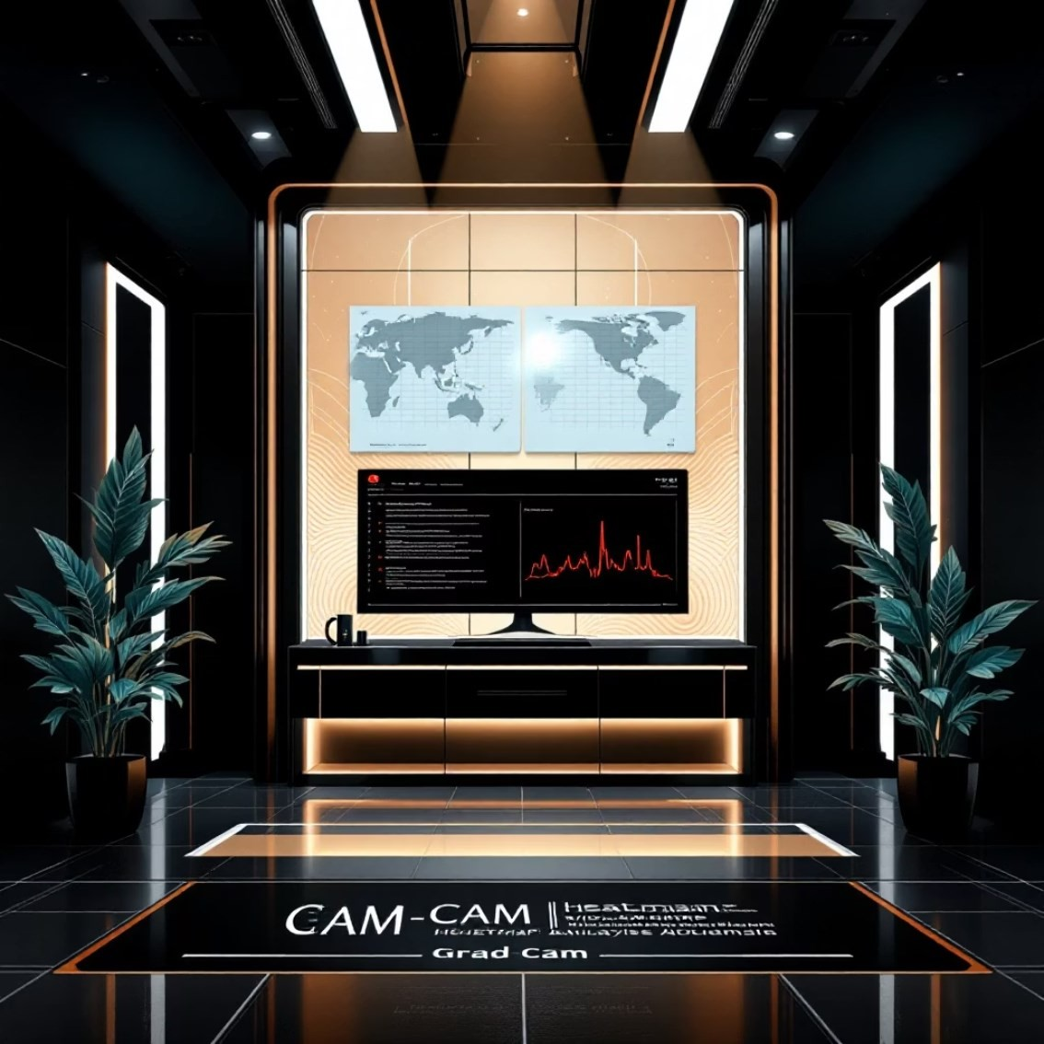
Model Explainability: Understanding CNN Decisions
Grad-CAM Visualization
To understand what our CNN models actually learned, we employed Gradient-weighted Class Activation Mapping (Grad- CAM), a powerful technique that highlights which image regions most influence predictions.
Critical Observations
Model attention concentrated on background areas and noise patterns
Minimal focus on text content itself
Strong activation in margin regions and uniform backgrounds
These visualizations confirm our hypothesis: the model successfully learns scanner-specific artifacts—the subtle noise signatures and textural patterns each device imprints—rather than document content. This validates the forensic soundness of our approach.

Slide 8

Deployment & Key Takeaways
Streamlit Web Interface
Deployed an intuitive web application where users can upload scanned documents and receive instant scanner brand predictions. The interface maintains the exact preprocessing pipeline used during training, ensuring prediction consistency.
Project Conclusions
SVM + LBP: Optimal for single-DPI scenarios
with 92% accuracy
CNN Models: Superior generalization across different DPI settings
Transfer Learning: Essential for small forensic datasets
Complete ML Pipeline
Demonstrated end-to-end forensic machine learning: from data collection through model explainability to production deployment
Forensic Applications
Practical tool for document authentication, fraud detection, and legal investigations requiring scanner source attribution
Future Directions
Expand to more scanner brands, explore printer identification, and integrate with document verification systems

