Slide 1
Semantics in the Semantic Web– the implicit, the formal and the powerful
(with a few examples from Glycomics)
Amit Sheth
Large Scale Distributed Information Systems (LSDIS) lab, Univ. of Georgia
October 26, 2004, 1:30pm to 2:30pm
Berkeley Initiative in Soft Computing (BISC) Seminar
Special thanks to Christopher Thomas & Satya Sanket Sahoo

Slide 2

NIH Integrated Technology Resource
for Biomedical Glycomics
Complex Carbohydrate Research Center
The University of Georgia
Biology and Chemistry
Michael Pierce – CCRC (PI)
Al Merrill - Georgia Tech
Kelley Moremen - CCRC
Ron Orlando - CCRC
Parastoo Azadi – CCRC
Stephen Dalton – UGA Animal Science
Bioinformatics and Computing
Will York - CCRC
Amit Sheth, Krys Kochut, John Miller; UGA Large Scale Distributed Information Systems Laboratory

Slide 3
Central thesis
Machines do well with “formal semantics”; but current mainstream approach for “formal semantics” based on DLs and FOL is not sufficient
Incorporate ways to deal with raw data and unorganized information, real world phenomena, and complex knowledge humans have, and the way machines deal with (reason with) knowledge
need to support “implicit semantics” and “powerful semantic” which go beyond prevalent “formal semantics” based Semantic Web

Slide 4
Towards the semantic web
One goal of the semantic web is to facilitate the communication between machines
Based on this, another goal is to make the web more useful for humans

Slide 5
The Semantic Web
capturing “real world semantics” is a major step towards making the vision come true.
These semantics are captured in ontologies
Ontologies are meant to express or capture
  Agreement
  Knowledge
Current choice for ontology representation is primarily Description Logics

Slide 6
What are formal semantics?
Informally, in formal semantics the meaning of a statement is unambiguously burned into its syntax
For machines, syntax is everything.
A statement has an effect, only if it triggers a certain process.

Slide 7
Description Logics
The current paradigm for formalizing ontologies is in form of bivalent description logics (DLs).
A subset of First Order Logics (FOL)

Slide 8
Semantics, intelligent systems
… and what that means …and entails
Can we talk about real-world and real-world semantics?
How do we make a computer understand (a “relevant” part of) the world?
  A necessary condition for “agents” to automate what humans do … the vision of the Semantic Web
Can we put them in a machine?
  Where do we get it from?
  From existing content (documents and repositories)
  By “knowledge engineering” human expertise
Notes:
Is there a meaning to the things in the world or IS it only? Do we assign the meaning to it according to our perception of the world?
And if there is a)some meaning in the world as such or b)in our perception/interpretation of it, can we make a computer understand this meaning?

Slide 9
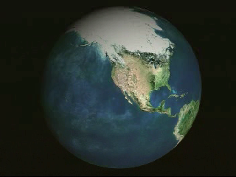
Real World?

Slide 10
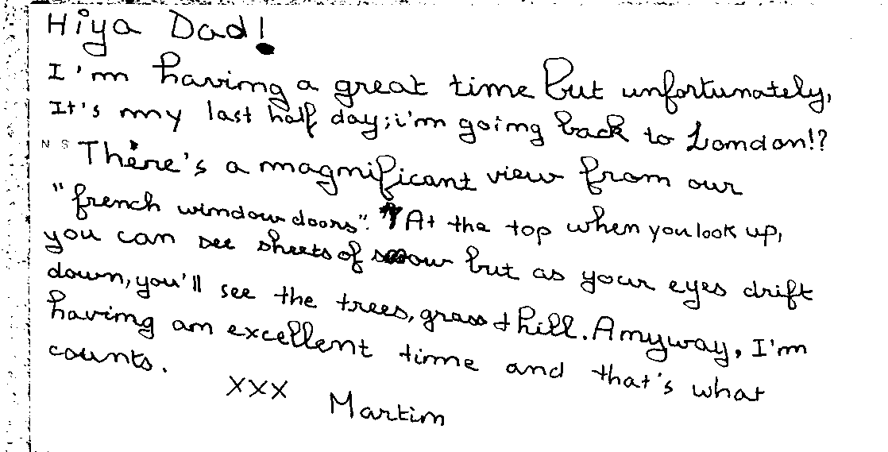
The world is informal
Even more than humans,
Machines have a hard time
The solution:
understanding the “real world"
<joint meaning>
<meaning of>Formal</meaning of>
<meaning of>Semantics</meaning of>
</joint meaning>

Slide 11

The world can be incomprehensible
Sometimes we only see a small part of the picture
We need to be able to see the big picture

Slide 12
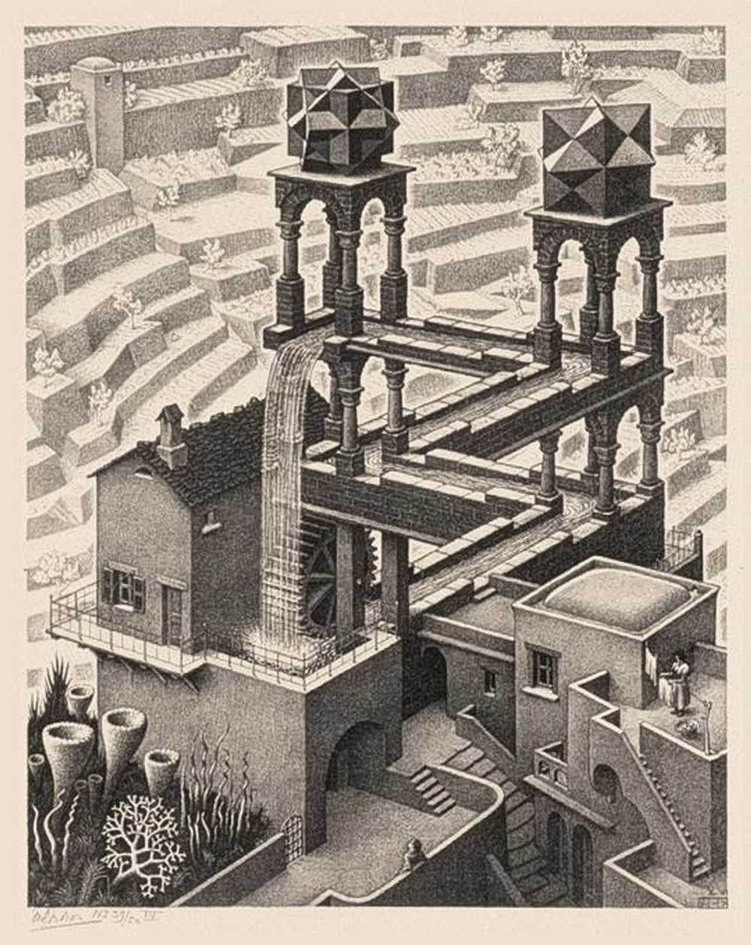
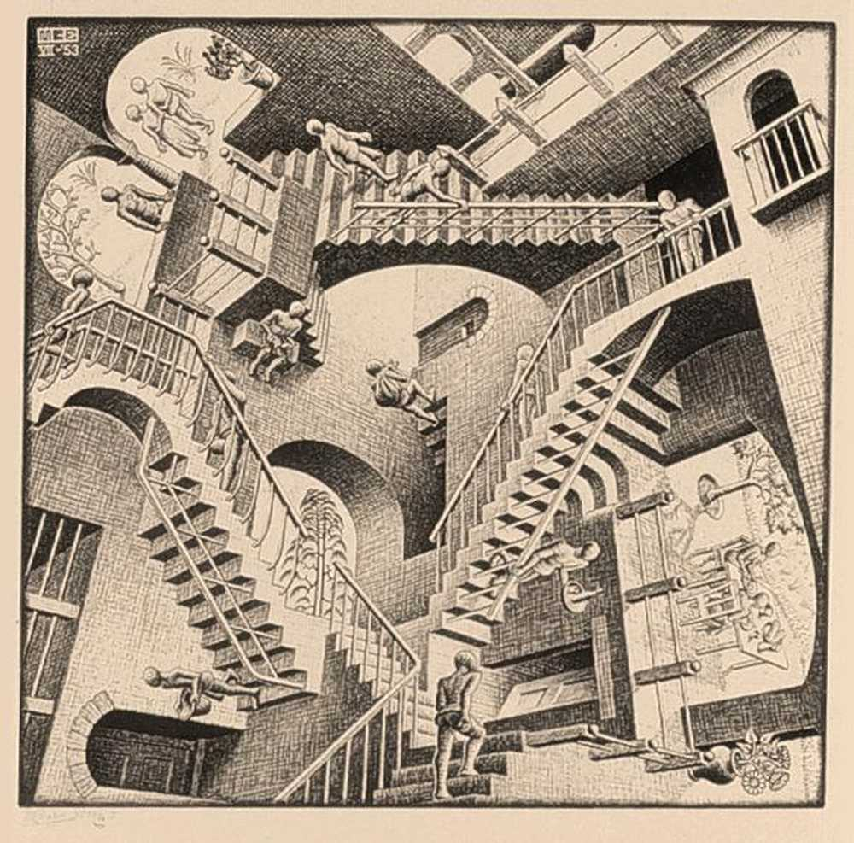
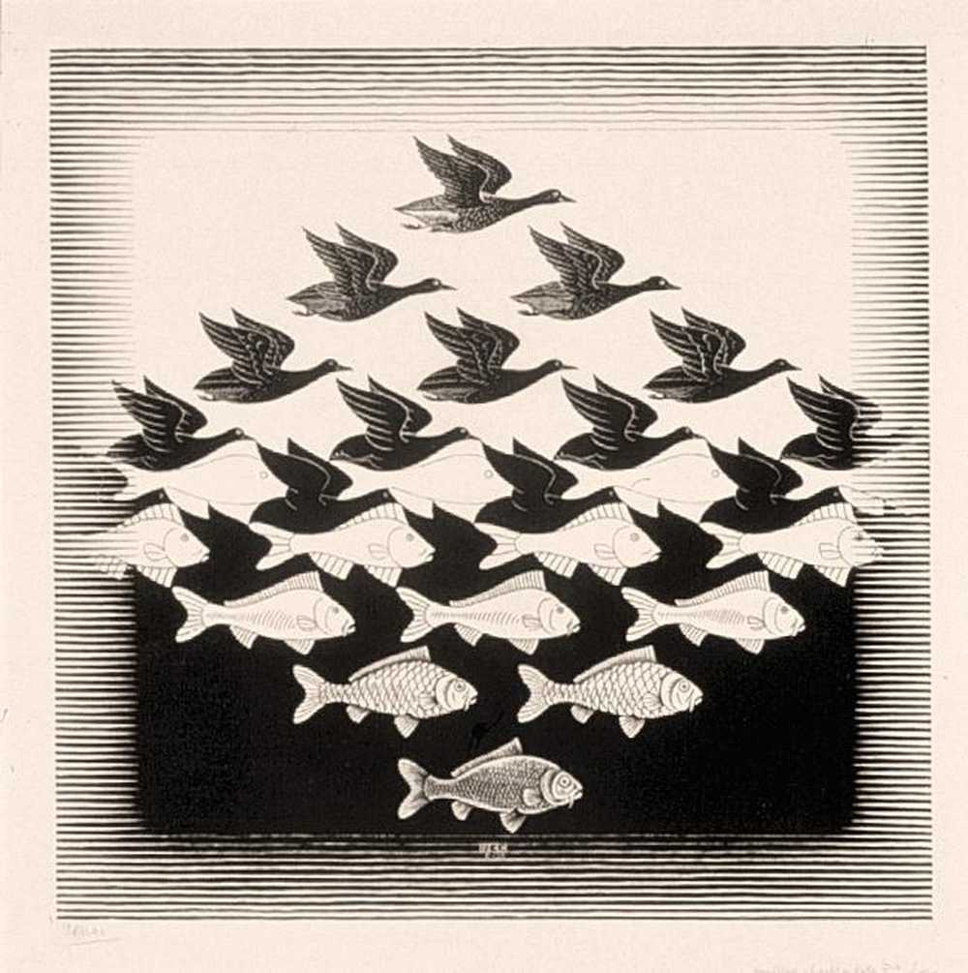
The world is complex
Sometimes our perception plays tricks on us
Sometimes our beliefs are inconsistent
Sometimes we can not draw clear boundaries
→ we need more Powerful Semantics

Slide 13
William Woods
  “Over time, many people have responded to the need for increased rigor in knowledge representation by turning to first-order logic as a semantic criterion. This is distressing, since it is already clear that first-order logic is insufficient to deal with many semantic problems inherent in understanding natural language as well as the semantic requirements of a reasoning system for an intelligent agent using knowledge to interact with the world.” [KR2004 keynote]

Slide 14
Lotfi Zadeh
Lotfi Zadeh identifies a lexicon of World Knowledge and a sophisticated deduction system as the core of a question answering system
World Knowledge cannot be adequately expressed in current bivalent logic formalisms
Much of Human knowledge is perception based
“Perceptions are intrinsically imprecise”*
*Lotfi A. Zadeh, “From Search Engines to Question-Answering Systems. The Need For New Tools”
Notes:
Cite paper “From search engines to QA systems

Slide 15
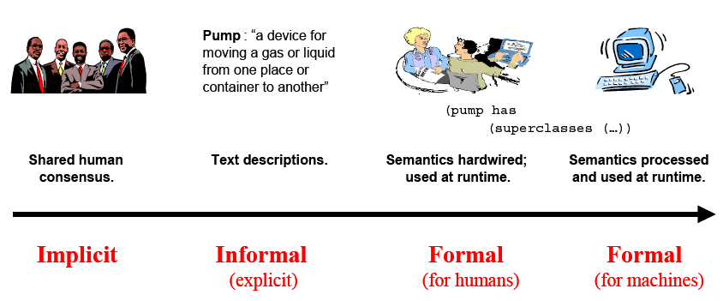
Michael Uschold’s semantic categories

Slide 16
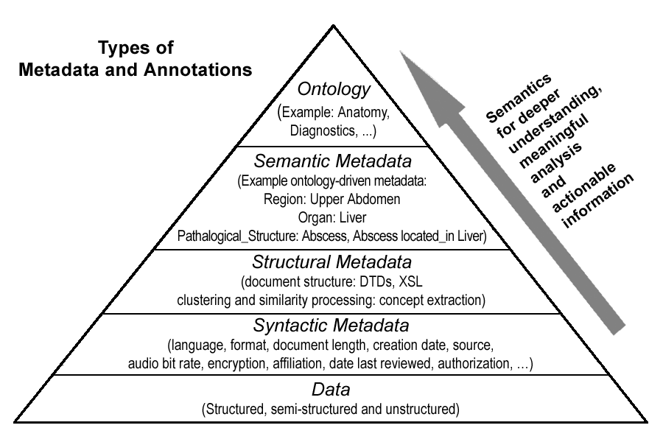

Metadata and Ontology: Primary Semantic Web enablers
Deep semantics
Expressiveness,
Reasoning
Shallow semantics

Slide 17
Central Role of Ontology
Ontology represents agreement, represents common terminology/nomenclature
Ontology is populated with extensive domain knowledge
or known facts/assertions
Key enabler of semantic metadata extraction from all forms of content:
  unstructured text (and 150 file formats)
  semi-structured (HTML, XML) and
  structured data
Ontology is in turn the center price that enables
  resolution of semantic heterogeneity
  semantic integration
  semantically correlating/associating objects and documents

Slide 18
Types of Ontologies (or things close to ontology)
Upper ontologies: modeling of time, space, process, etc
Broad-based or general purpose ontology/nomenclatures: Cyc, CIRCA ontology (Applied Semantics), SWETO, WordNet ;
Domain-specific or Industry specific ontologies
  News: politics, sports, business, entertainment
  Financial Market
  Terrorism
  Pharma
  GlycO
  (GO (a nomenclature), UMLS inspired ontology, …)
Application Specific and Task specific ontologies
  Anti-money laundering
  Equity Research
  Repertoire Management

Slide 19
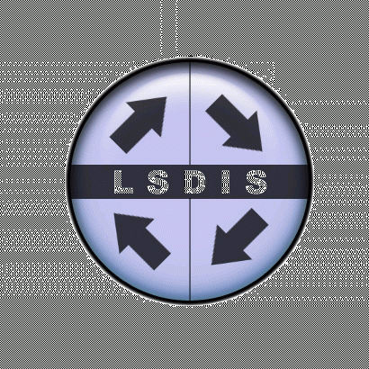
Expressiveness Range:
Knowledge Representation and Ontologies
KEGG
TAMBIS
Thesauri
“narrower
term”
relation
BioPAX
Disjointness, Inverse,
part of…
Formal
is-a
Frames
(properties)
Catalog/ID
DB Schema
UMLS
RDF
RDFS
DAML
CYC
Wordnet
OO
OWL
IEEE SUO
Terms/
glossary
Informal
is-a
Formal
instance
Value Restriction
General
Logical
constraints
GO
SWETO
GlycO
EcoCyc
Simple
Taxonomies
Pharma
Expressive
Ontologies
Ontology Dimensions After McGuinness and Finin
Notes:
GO (Gene ontology). KEGG (Kyoto Encyclopedia of Genes and Genomes) is a bioinformatics resource for understanding higher order functional meanings and utilities of the cell or the organism from its genome information. TAMBIS (Transparent Access to Multiple Bioinformatics Information Source). TAMBIS aims to aid researchers in biological science by providing a single access point for biological information sources round the world. EcoCyc, a part of the BioCyc library, is a scientific database for the bacterium Escherichia coli. The EcoCyc project performs literature-based curation of the entire E. coli genome, and of E. coli transcriptional regulation, transporters, and metabolic pathways. BioPAX (Biological Pathways Exchange).

Slide 20
Building ontology
Three broad approaches:
  social process/manual: many years, committees
    Can be based on metadata standard
  automatic taxonomy generation (statistical clustering/NLP): limitation/problems on quality, dependence on corpus, naming
  Descriptional component (schema) designed by domain experts; Description base (assertional component, extension) by automated processes
Option 2 is being investigated in several research projects;
Option 3 is currently supported by Semagix Freedom

Slide 21
What are implicit semantics?
Every collection of data or repositories contains hidden information
We need to look at the data from the right angle
We need to ask the right questions
We need the tools that can ask these questions and extract the information we need
Notes:
- Co-occurrence of documents or terms in the same cluster after a clustering process based on some similarity measure is completed.
- A document linked to another document via a hyperlink, potentially associating semantic metadata describing the concepts that relate the two documents.
- Automatic classification of a document to broadly indicate what a document is about with respect to a chosen taxonomy. Further use the implied semantics to disambiguate (does the word “palm” in a document refer to a palm tree, the palm of your hand or a palm top computer?)
- Bioinformatics applications that exploit patterns like sequence alignment, secondary and tertiary protein structure analysis, etc.
More detail
There is a lot of data out there (see old berkeley talk and glycomics data and medline, etc)

Slide 22
How can we get to implicit semantics?
Co-occurrence of documents or terms in the same cluster
A document linked to another document via a hyperlink
Automatic classification of a document to broadly indicate what a document is about with respect to a chosen taxonomy.
Use the implied semantics of a cluster to disambiguate (does the word “palm” in a document refer to a palm tree, the palm of your hand or a palm top computer?)
Bioinformatics applications that exploit patterns like sequence alignment, secondary and tertiary protein structure analysis, etc.
Techniques and Technologies: Text Classification/categorization, Clustering, NLP, Pattern recognition, …
Notes:
More detail
There is a lot of data out there (see old berkeley talk and glycomics data and medline, etc)

Slide 23
Implicit semantics
Most knowledge is available in the form of
  Natural language → NLP
  Unstructured text → statistical
Needs to be extracted as machine processable semantics/ (formal) representation

Slide 24
Taxaminer
Since ontology creation is an expensive and time-consuming task, the Taxaminer project at the LSDIS lab aims at semi-automatically creating a Labeled hierarchical topic structure as a basis for automatic classification and semi-automated ontology creation
  Knowledge about a domain can be found in documents about the domain.
  How can a machine identify sub-topics and give them an adequate label?

Slide 25
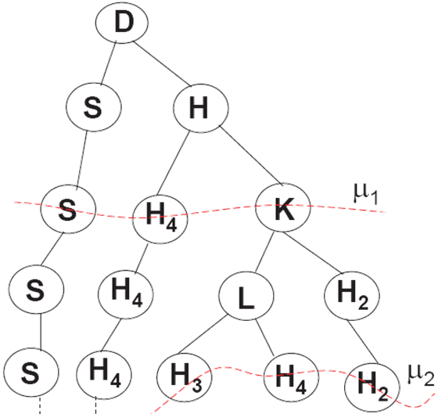
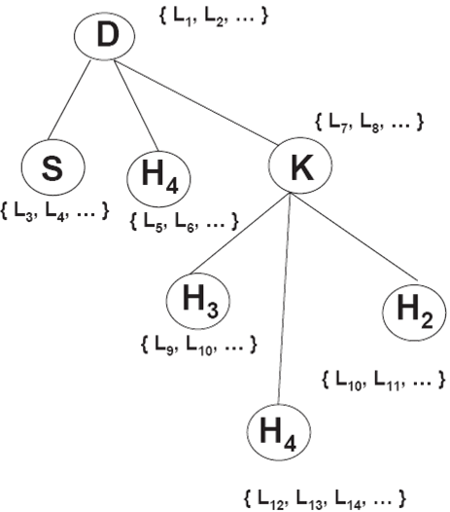
Taxaminer
Build
vector space
model
Build hierarchical cluster
Document collection
Select the “best” clusters and assign the most pertaining words as labels of the nodes in the resulting hierarchy

Slide 26
Taxaminer
Build
vector space
model
Build
vector space
model
Build hierarchical cluster
Build hierarchical cluster
Document collection
Document collection
A document collection is “flat”.
The topic hierarchy is implicit.
Select the “best” clusters and assign the most pertaining words as labels of the nodes in the resulting hierarchy
Select the “best” clusters and assign the most pertaining words as labels of the nodes in the resulting hierarchy

Slide 27
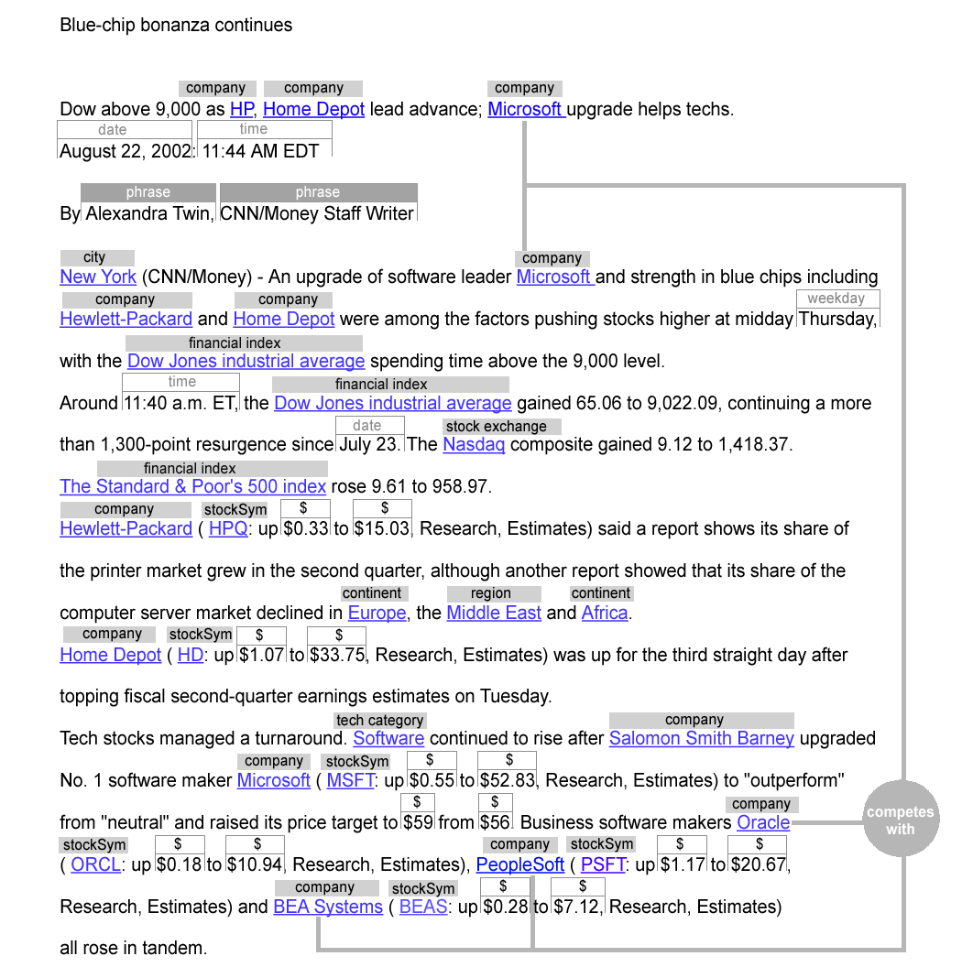
Automatic Semantic Annotation of Text:
Entity and Relationship Extraction
KB, statistical
and linguistic
techniques

Slide 28
Ontology can be very large
Semantic Web Ontology Evaluation Testbed – SWETO v1.4 is
Populated with over 800,000 entities and over 1,500,000 explicit relationships among them
Continue to populate the ontology with diverse sources thereby extending it in multiple domains, new larger release due soon
Two other ontologies of Semagix customers have over 10 million instances, and requests for even larger ontologies exist

Slide 29
GlycO
is a focused ontology for the description of glycomics
models the biosynthesis, metabolism, and biological relevance of complex glycans
models complex carbohydrates as sets of simpler structures that are connected with rich relationships

Slide 30
GlycO statistics: Ontology schema can be large and complex
767 classes
142 slots
Instances Extracted with Semagix Freedom:
  69,516 genes (From PharmGKB and KEGG)
  92,800 proteins (from SwissProt)
  18,343 publications (from CarbBank and MedLine)
  12,308 chemical compounds (from KEGG)
  3,193 enzymes (from KEGG)
  5,872 chemical reactions (from KEGG)
  2210 N-glycans (from KEGG)

Slide 31
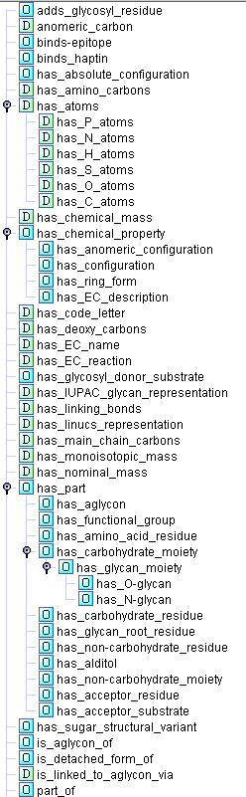
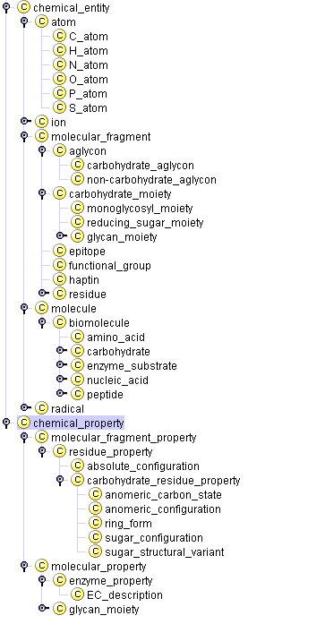
GlycO taxonomy
The first levels of the GlycO taxonomy
Most relationships and attributes in GlycO
GlycO exploits the expressiveness of OWL-DL.
Cardinality constraints, value constraints, Existential and Universal restrictions on Range and Domain of properties allow the classification of unknown entities as well as the deduction of implicit relationships.
Notes:
The left side shows the first levels of the GlycO taxonomy. It has >700 classes, so it cannot be shown in total. The animation slide shows some of the classes and constraints “in action”
The right side shows most of the Object- and Datatype properties in GlycO.

Slide 32
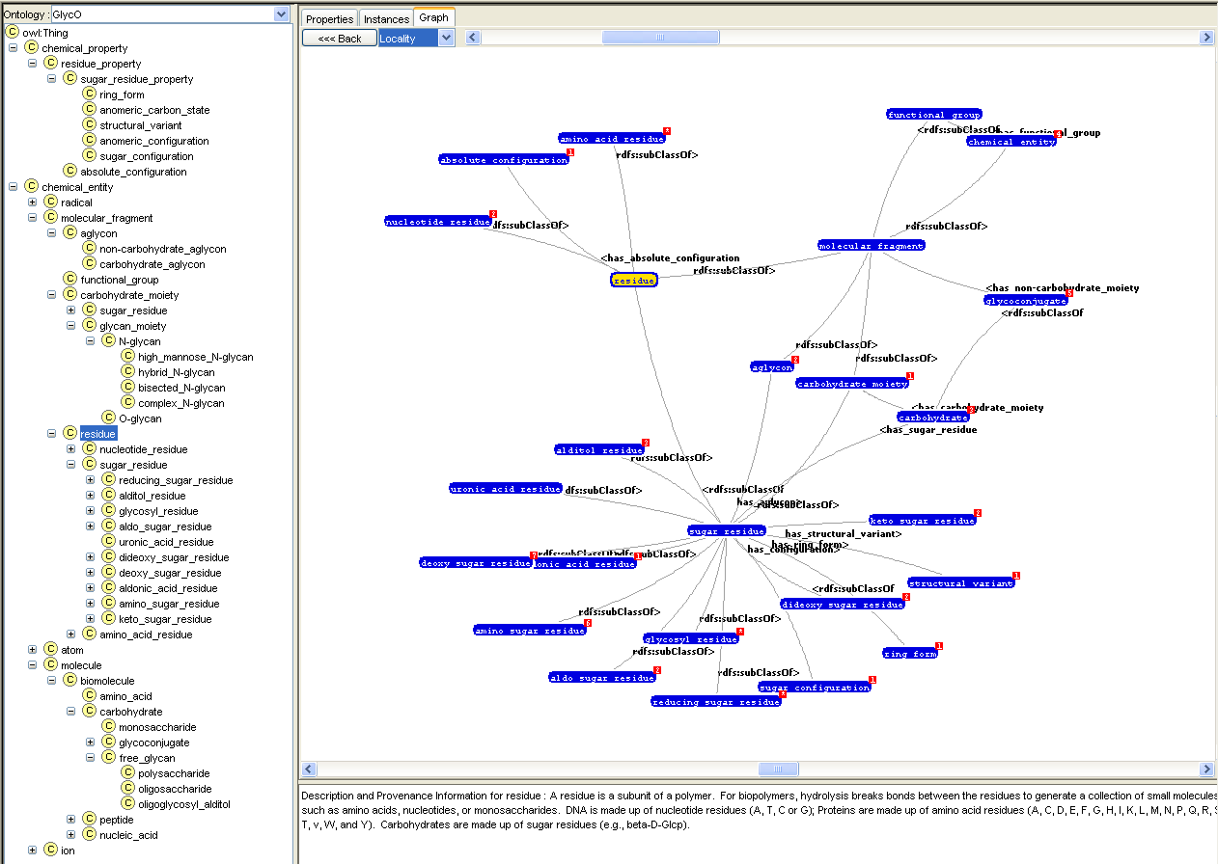
Query and visualization

Slide 33
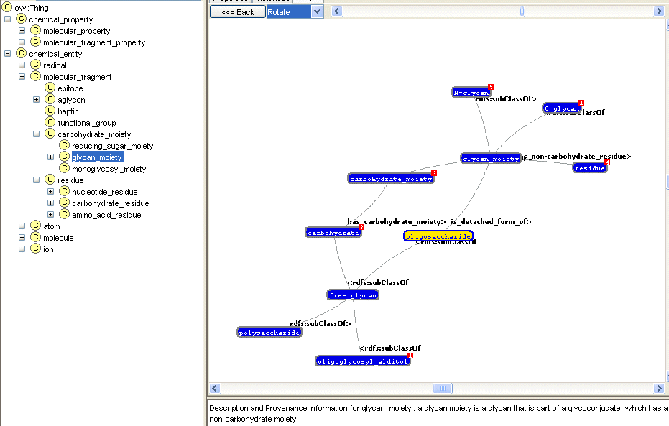
Query and visualization

Slide 34
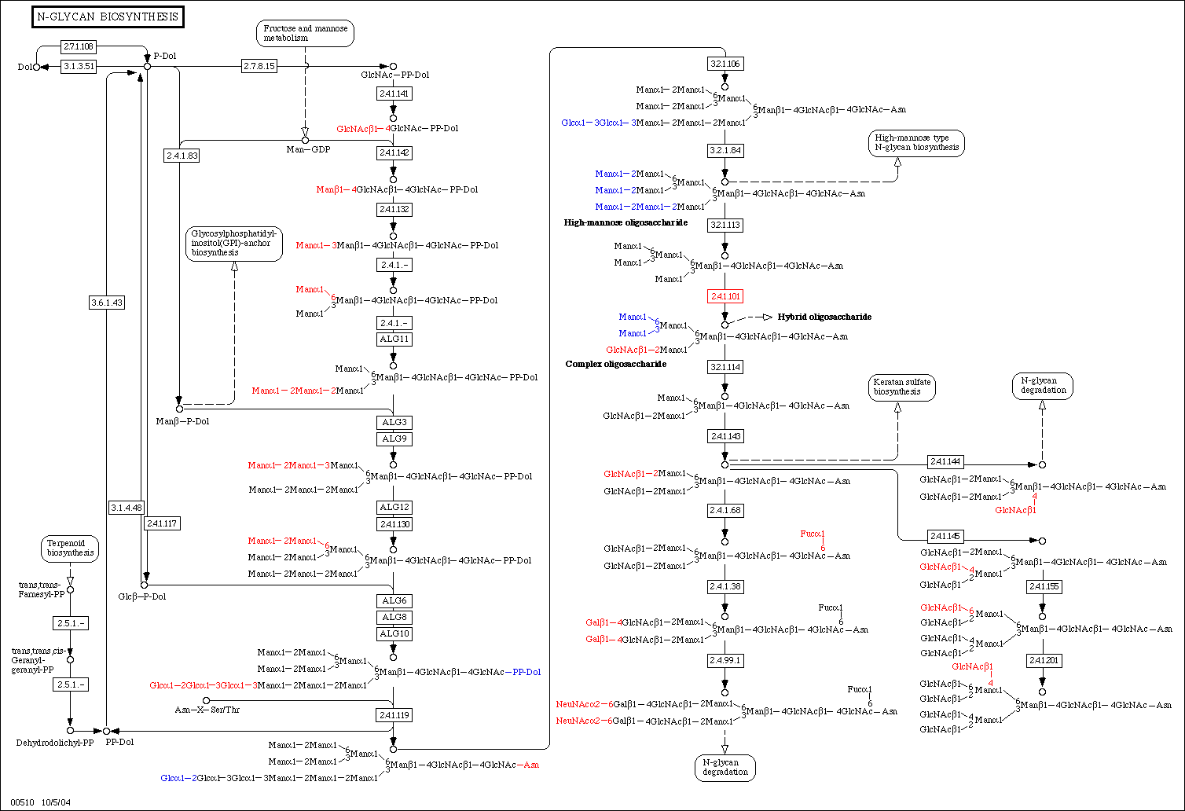
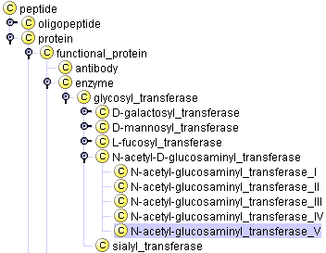
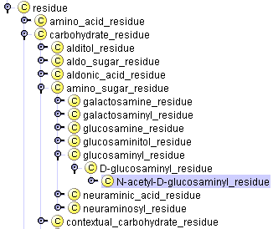
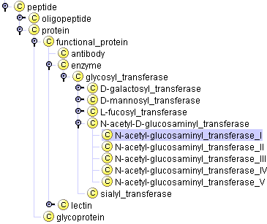
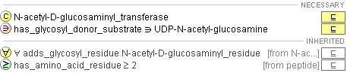
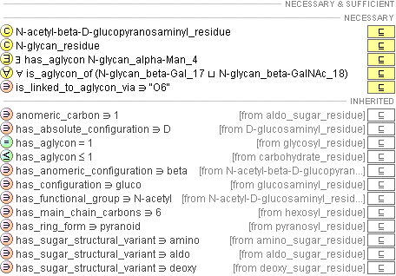
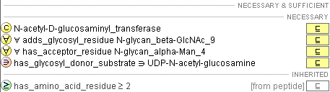
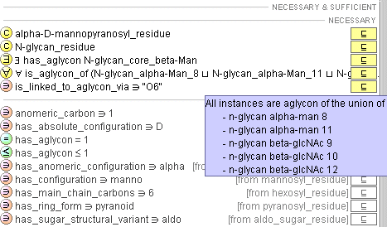
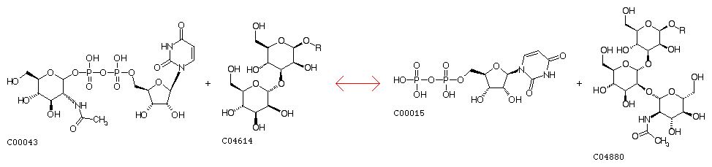
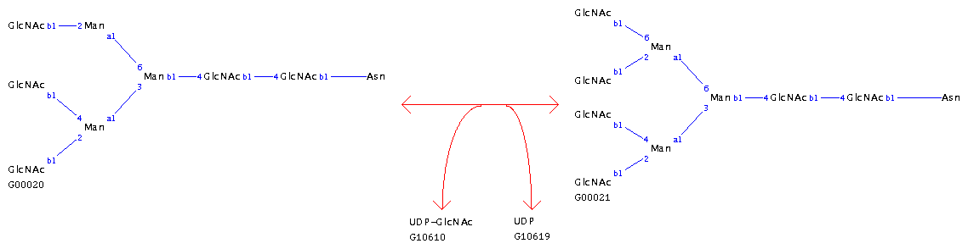
A biosynthetic pathway
GNT-I
attaches GlcNAc at position 2
N-glycan_beta_GlcNAc_9
N-acetyl-glucosaminyl_transferase_V
N-glycan_alpha_man_4
GNT-V
attaches GlcNAc at position 6
UDP-N-acetyl-D-glucosamine + alpha-D-Mannosyl-1,3-(R1)-beta-D-mannosyl-R2
<=>
UDP + N-Acetyl-$beta-D-glucosaminyl-1,2-alpha-D-mannosyl-1,3-(R1)-beta-D-mannosyl-$R2
UDP-N-acetyl-D-glucosamine + G00020 <=> UDP + G00021
Notes:
1: the whole pathway is shown from the Dolichol compund over the first sugar: N-Acetyl-D-glucosaminyldiphosphodolichol (or GlcNAc-PP-dol) to the N-Glycan G00022 (KEGG accession No) or (GlcNAc)7 (Man)3 (Asn)1 (just numbers of residues, the glycan doesn’t have a common name, but belongs to a class of “Pentaantennary complex-type sugar chains”).
2. GNT-I (UDP-N-acetyl-D-glucosamine:3-(alpha-D-mannosyl)-beta-D-mannosyl-$glycoprotein 2-beta-N-acetyl-D-glucosaminyltransferase)
catalyzes the reaction from 3-(alpha-D-mannosyl)-beta-D-mannosyl-R to 3-(2-[N-acetyl-beta-$D-glucosaminyl]-alpha-D-mannosyl)-beta-D-mannosyl-R
3. GNT-V (UDP-N-acetyl-D-glucosamine:6-[2-(N-acetyl-beta-D-glucosaminyl)-$alpha-D-mannosyl]-glycoprotein $6-beta-N-acetyl-D-glucosaminyltransferase)
catalyzes the reaction from 6-(2-[N-acetyl-beta-D-glucosaminyl]-$alpha-D-mannosyl)-beta-D-mannosyl-R to
6-(2,6-bis[N-acetyl-$beta-D-glucosaminyl]-alpha-D-mannosyl)-beta-D-mannosyl-R, which is part of the Glycan G00021
4. The part of the ontology tree just shows where GNT-V is.
5. The GNT-V entry in the ontology shows that N-Glycan_beta_GlcNAc_9 is added with the help of Enzyme GNT-V to a sugar containing the residue
N-glycan_alpha_man_4.
Why this is important for GLycomics:
G00021 is a so-called tetraantennary complex N-Glycan. When the red BlcNAc beta 1-6 is present due to GNT-V, this chain can be extended with polylactosamine. Polylactosamine is found in some metastatic cells.
A challenge now is to find out whether this Glycan structure is always made by GNT-V. Then we might be able to tell something about GNT-V and cancer
That is where probabilistic reasoning comes into play.
Mention that man_4 and glcnac_9 are Contextual residues. Mention GlycoTree

Slide 35
The impact of GlycO
GlycO models classes of glycans with unprecedented accuracy.
Implicit knowledge about glycans can be deductively derived
Experimental results can be validated according to the model

Slide 36




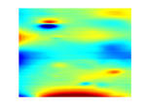

Identification and Quantification of N-glycosylation
Cell Culture
extract
Glycoprotein Fraction
proteolysis
Glycopeptides Fraction
1
Separation technique I
n
Glycopeptides Fraction
n
PNGase
Peptide Fraction
Separation technique II
n*m
Peptide Fraction
Mass spectrometry
ms data
ms/ms data
Data reduction
Data reduction
ms peaklist
ms/ms peaklist
binning
Peptide identification
Peptide identification
and quantification
N-dimensional array
Peptide list
Data correlation
Signal integration
Notes:
Proteolysis: treat with trypsin
Separation technique I: chromatography like lectin affinity chromatography
From PNGase F: we get fractions that contain peptides and glycans – we focus only on peptides.
Separation technique II: chromatography like reverse phase chromatography

Slide 37
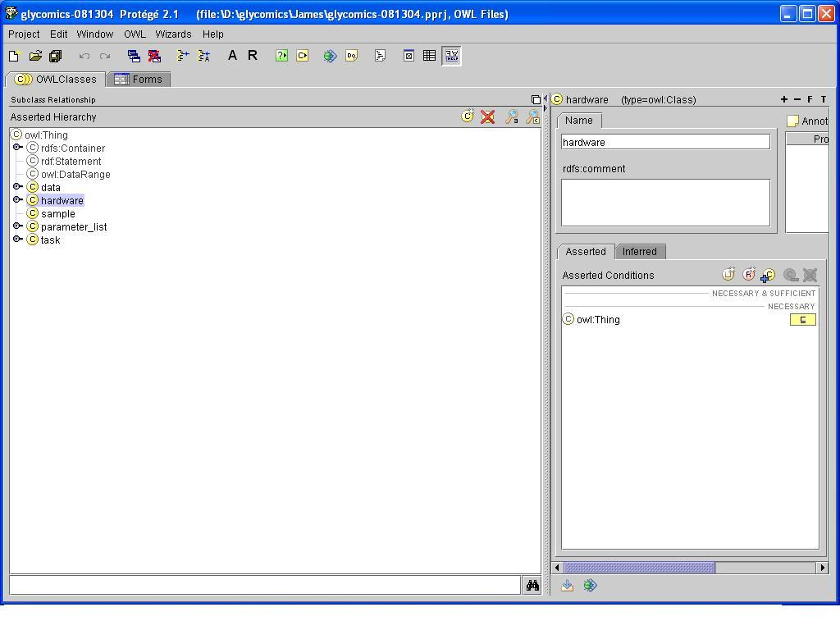
ProglycO – Structure of the Process Ontology
Four structural components†:
Sample Creation
Separation (includes chromatography)
Mass spectrometry
Data analysis
†: pedrodownload.man.ac.uk/Domains.shtml

Slide 38
Semantic Annotation of Scientific Data
<ms/ms_peak_list>
<parameter instrument=micromass_QTOF_2_quadropole_time_of_flight_mass_spectrometer
mode = “ms/ms”/>
<parent_ion_mass>830.9570</parent_ion_mass>
<total_abundance>194.9604</total_abundance>
<z>2</z>
<mass_spec_peak m/z = 580.2985 abundance = 0.3592/>
<mass_spec_peak m/z = 688.3214 abundance = 0.2526/>
<mass_spec_peak m/z = 779.4759 abundance = 38.4939/>
<mass_spec_peak m/z = 784.3607 abundance = 21.7736/>
<mass_spec_peak m/z = 1543.7476 abundance = 1.3822/>
<mass_spec_peak m/z = 1544.7595 abundance = 2.9977/>
<mass_spec_peak m/z = 1562.8113 abundance = 37.4790/>
<mass_spec_peak m/z = 1660.7776 abundance = 476.5043/>
<ms/ms_peak_list>
830.9570 194.9604 2
580.2985 0.3592
688.3214 0.2526
779.4759 38.4939
784.3607 21.7736
1543.7476 1.3822
1544.7595 2.9977
1562.8113 37.4790
1660.7776 476.5043
ms/ms peaklist data
Annotated ms/ms peaklist data
Notes:
The semantic annotation uses concepts defined in the ProglycO ontology. The data element not only has provenance information (tracing its ancestry) but also is mapped to concepts that help formalize its own meaning. This enables interpretation and inference with that data element like a mass_spec_peak is a digested piece of data. It is like a sampling of data generated from the mass spectrometry of a given separated peptide fraction. This is not possible with just data provenance associated with a scientific data element.

Slide 39
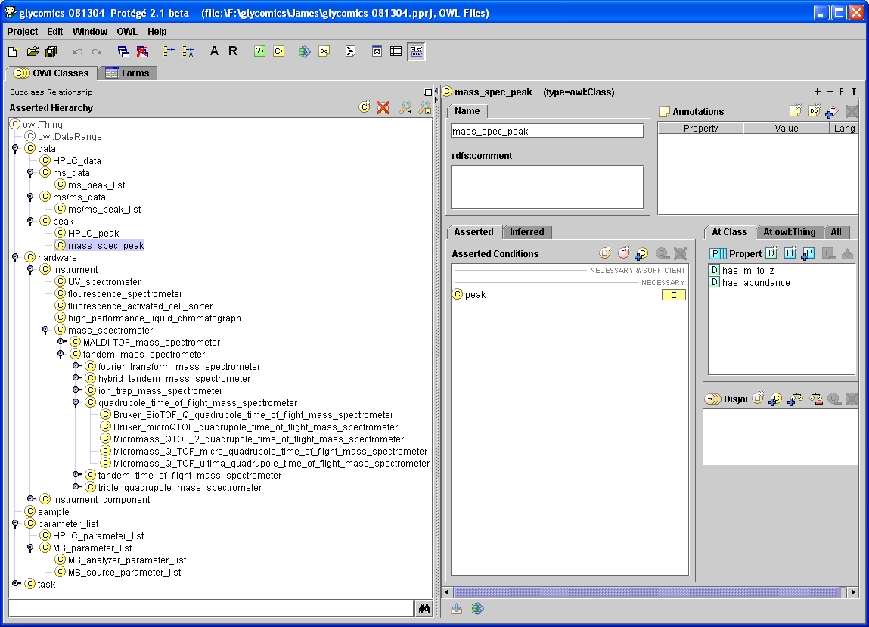
Semantic annotation of Scientific Data
<ms/ms_peak_list>
<parameter
instrument=“micromass_QTOF_2_quadropole_time_of_flight_mass_spectrometer”
mode = “ms/ms”/>
<parent_ion_mass>830.9570</parent_ion_mass>
<total_abundance>194.9604</total_abundance>
<z>2</z>
<mass_spec_peak m/z = 580.2985 abundance = 0.3592/>
<mass_spec_peak m/z = 688.3214 abundance = 0.2526/>
<mass_spec_peak m/z = 779.4759 abundance = 38.4939/>
<mass_spec_peak m/z = 784.3607 abundance = 21.7736/>
<mass_spec_peak m/z = 1543.7476 abundance = 1.3822/>
<mass_spec_peak m/z = 1544.7595 abundance = 2.9977/>
<mass_spec_peak m/z = 1562.8113 abundance = 37.4790/>
<mass_spec_peak m/z = 1660.7776 abundance = 476.5043/>
<ms/ms_peak_list>
Annotated ms/ms peaklist data
Notes:
Salient point: one ms/ms data element is annotated (mapped to) with multiple concepts in the ontology. Using ontological concepts enables the following:
Comparison of data generated from heterogeneous sources.
Interoperability of heterogeneously generated data
Discovery of a relationship through a chain of mappings/connections.
Hypothesis formulation.

Slide 40
Beyond Provenance…. Semantic Annotations
Data provenance: information regarding the ‘place of origin’ of a data element
Mapping a data element to concepts that collaboratively define it and enable its interpretation – Semantic Annotation
Data provenance paves the path to repeatability of data generation, but it does not enable:
  Its interpretability
  Its computability
  Semantic Annotations make these possible.
Notes:
Example: Using data provenance, we can repeatedly generate ms/ms data for a given cell culture. But, if it is not semantically annotated, it cannot be automatically interpreted as ms/ms data or ms data (data provenance will only state that it was generated after a certain number of steps using a mass spectrometer. But, both ms-data and ms/ms data are generated by a mass spectrometer. How does an automated application differentiate? Only through semantic annotation!

Slide 41
Discovery of relationship between biological entities
ProglycO
p
r
o
c
e
s
s
GlycO
Lectin
Collection of
N-glycan ligands
Identified
and quantified
peptides
Gene Ontology (GO)
Fragment of
Specific protein
Genomic database (Mascot/Sequest)
The inference: instances of the class collection of Biosynthetic enzymes (GNT-V) are involved in the specific cellular process (metastasis).
Specific cellular
process
Collection of
Biosynthetic enzymes
Notes:
This example shows discovery of a possible relationship between two biological concepts/entities which would not have been possible for a human to discover by traversing the multiple and complex series of relationships and mappings. This method is also akin to hypothesis formulation.
Example of collection of biosynthetic enzymes are: glycosyl Transferases (10 members of this class)
Specific cellular process: cell division or metastasis
Collection of Biosynthetic enzymes: GNT-V which has a role in metastasis. There are 10 members of this class.

Slide 42
Ontologies – many questions remain
How do we design ontologies with the constituent concepts/classes and relationships?
How do we capture knowledge to populate ontologies
Certain knowledge at time t is captured; but real world changes
imprecision, uncertainties and inconsistencies
  what about things of which we know that we don’t know?
  What about things that are “in the eye of the beholder”?
Need more powerful semantics
Notes:
“All we know” means “all we think we know for sure”. Certain knowledge.

Slide 43
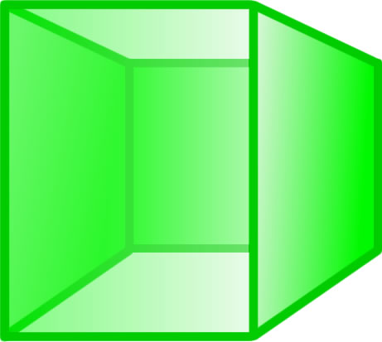
Dimensions of expressiveness
Current Semantic
Web Focus
Formal
Future
research
Semi-Formal
Degree of Agreement
Expressiveness
FOL with
functions
Informal
FOL w/o
functions
complexity
RDFS/OWL
bivalent
Multivalued
discrete
continuous
XML
RDF
Cf: Guarino, Gruber
Notes:
Semantics (of information, communication) is a very old area, and extensive work on Semantic Technology has been going on for well over a decade (many projects on semantic interoperability, semantic information brokering)
Semantic Web and related visions are being achieved in various depth and scope – mostly starting with targeted applications where requirements are much better understood and scope is manageable

Slide 44
The downside
That a structure is not valid according to the ontology could just mean that it is a new kind of structure that needs to be incorporated
That a substance can be synthesized according to one pathway does not exclude the synthesis through another pathway

Slide 45
Glycosyl Transferase
is a
synthesizes
Lipid
β-mannosyl transferase
May Synthesize
May Synthesize
Man₉GlcNAc₂
transfers
contains
is a
Mannose
Glycan
Notes:
In this example the mannosyl transferase does not necessarily synthesize the glycan. Even though a pathway exists that describes this mechanism, the glycan could have been obtained by another process

Slide 46
What we want
Validate pathways with experimental evidence. Many pathways still need to be verified.
Reason on experimental data using statistical techniques such as Bayesian reasoning
Are activities of iso-forms of biosynthetic enzymes dependent on physiological context? (e.g. is it a cancer cell?)

Slide 47
What we need
We need a formalism that can
  express the degree of confidence that e.g. a glycan is synthesized according to a certain pathway.
  express the probability of a glycan attaching to a certain site on a protein
  derive a probability for e.g. a certain gene sequence to be the origin of a certain protein

Slide 48
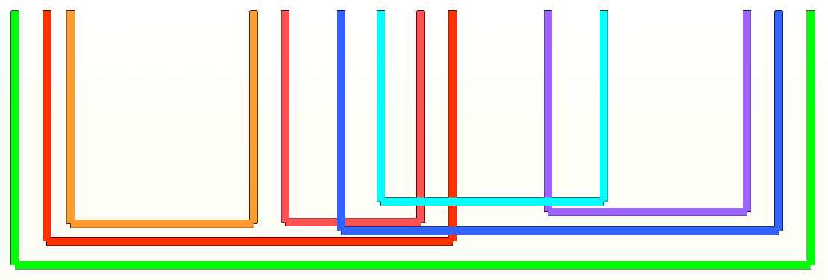
Protein Classes
Protein
Enzyme
Hydrolase
Transferase
...
Regulatory Protein
DNA-Binding Protein
Receptor
...

Slide 49
Protein Classes
The classification of proteins according to their function shows that there are proteins that play more than one role
There are no clear boundaries between the classes
Protein function classes have fuzzy boundaries

Slide 50
The consequence
Both in future main stream applications such as question answering systems and in scientific domains such as BioInformatics, reasoning beyond the capabilities of bivalent logic is indispensable.
We need more powerful semantics

Slide 51
Powerful Semantics
Fuzzy logics and probability theory are “complementary rather than competitive”*.
Fuzzy logic allows us to blur artificially imposed boundaries between different classes.
The other powerful tool in soft computing is probabilistic reasoning.
*Lotfi A. Zadeh. Toward a perception-based theory of probabilistic reasoning with imprecise probabilities.

Slide 52
Powerful Semantics
In order to use a knowledge representation formalism as a basis for tools that help in the derivation of new knowledge, we need to give this formalism the ability to be used in abductive or inductive reasoning.
*Lotfi A. Zadeh. Toward a perception-based theory of probabilistic reasoning with imprecise probabilities.

Slide 53
Powerful Semantics
The formalism needs to express probabilities and fuzzy memberships in a meaningful way, i.e. a reasoner must be able to meaningfully interpret the probabilistic relationships and the fuzzy membership functions
The knowledge expressed must be interchangeable, hence a suitable notation, following the layer architecture of the Semantic Web, must be used.
*Lotfi A. Zadeh. Toward a perception-based theory of probabilistic reasoning with imprecise probabilities.

Slide 54
How to power the semantics
A major drawback of logics dealing with uncertainties is the assignment of prior probabilities and/or fuzzy membership functions.
Values can be assigned manually by domain experts or automatically
Techniques to capture implicit semantics
  Statistical methods
  Machine Learning

Slide 55
What are powerful semantics?
Powerful semantics can be formal
Powerful semantics can capture implicit knowledge
Powerful semantics can cope with inconsistencies
Powerful semantics can formalize our perceptions
Powerful semantics can deal with imprecision

Slide 56
The long road to more power
Implicit Semantics
+ Formal Semantics
+ Soft Computing Technologies
= Powerful Semantics

Slide 57
For more information
http://lsdis.cs.uga.edu
  Especially see Glycomics project
http://www.semagix.com

