Slide 1



User Experiences of
Enterprise Semantic Content Management
Amit Sheth
Panel at Symposium on the User Experience of Business Intelligence & Knowledge Management,
IBM Almaden Research Center, San Jose, March 18, 2000.
University of Georgia

Slide 2
Advanced Content
Management Challenges
The Problem: Massive, disparate information everywhere
  Multiple isolated sources of information that are not shared or integrated
  Large variety of open source, partner, proprietary and extranet information
    Multiple formats (Text, HTML, XML, PDF, etc.)
    Diverse structure (structured, semi-structured, unstructured)
    Multiple media (Text, Audio, Video, Images, etc.)
    Diverse Communication Channels (FTP, extraction for source, etc.)
The Difficulty & Challenges: Inability to have timely actionable information
  Overwhelming amount of information -> in-context, relevant information
  Timely, accurate, personalized & actionable decisions

Slide 3
Knowledge Discovery/Management
Requirements
The Problem: Aggregation and corelation of passenger/flight information
Correlate/link huge volumes of information
Integrated knowledge applications with diverse response to different end users
Response in near real-time
The Challenge: To build a knowledge linking and discovery system that automatically detects hidden relationships
Intelligent analysis of multiple available sources of information
Customized knowledge applications targeting diverse needs of different users
Intelligent analysis of valuable information to provide actionable insight
Scalable and near real-time system

Slide 4
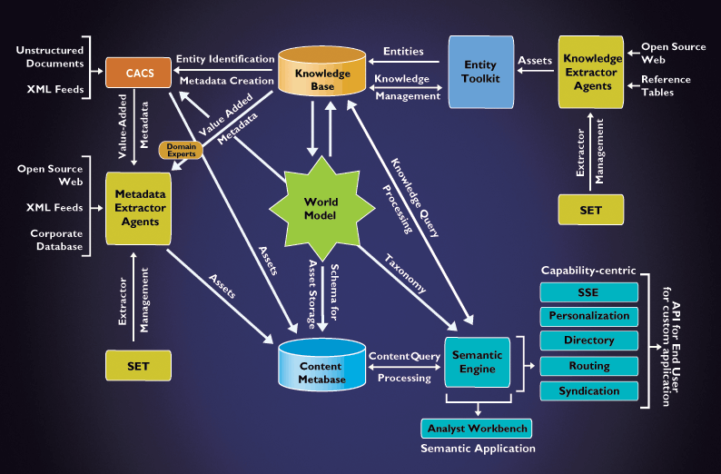
Voquette SCORE Technology
Architecture
Fast main-memory based query
engine with APIs and XML output
Distributed agents that automatically extract/mine
knowledge from trusted sources
Toolkit to design and maintain the Knowledgebase
Distributed agents that automatically extract relevant
semantic metadata from structured and unstructured content
Knowledgebase represents the real-world instantiation
(entities and relationships) of the WorldModel
CACS provides automatic classification (w.r.t. WorldModel)
from unstructured text and extracts contextually relevant metadata
WorldModel specifies enterprise’s
normalized view of information (ontology)

Slide 5
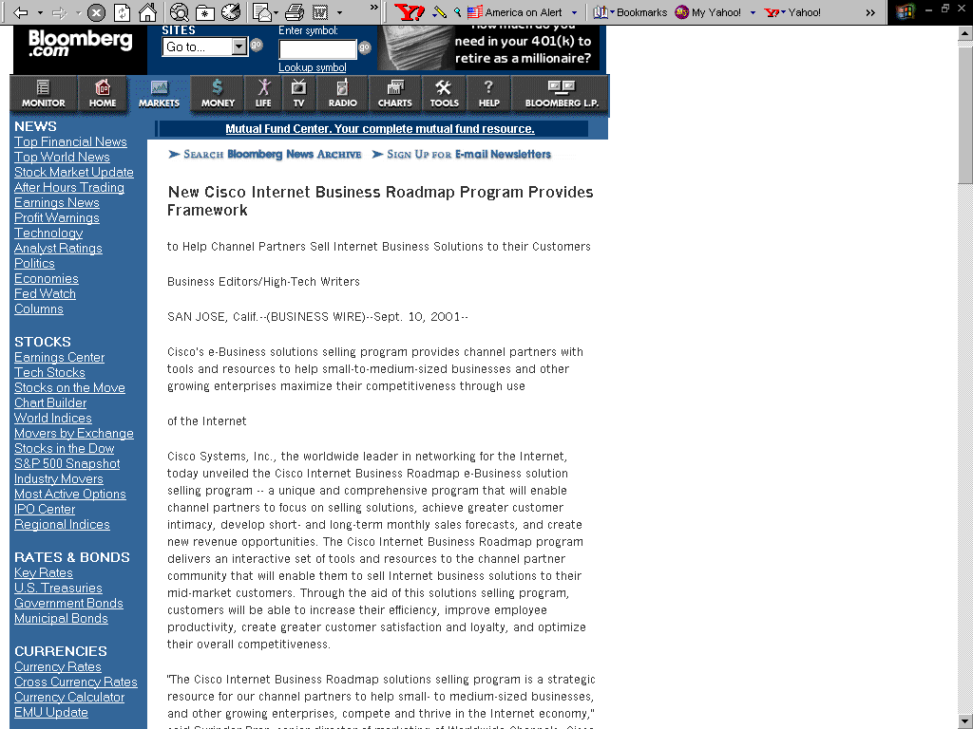
Content Enhancement Workflow
Syntax Metadata
Semantic Metadata

Slide 6
Content Asset Index Evolution
Asset
Syntax Metadata
Producer: BusinessWire
Source: Bloomberg
Date: Sept. 10 2001
Location: San Jose, CA
URL: http://bloomberg.com/1.htm
Media: Text
Semantic Metadata
Company: Cisco Systems, Inc.
Asset
Syntax Metadata
Producer: BusinessWire
Source: Bloomberg
Date: Sept. 10 2001
Location: San Jose, CA
URL: http://bloomberg.com/1.htm
Media: Text
Semantic Metadata
Company: Cisco Systems, Inc.
Topic: Company News
Creates asset (index)
out of extracted
metadata
Appends
topic
metadata
to asset
Scans text
for analysis
Extractor
Agent
for
Bloomberg
Scans text
for analysis
Categorization &
Auto-Cataloging
System (CACS)
Metadata
extracted
automatically
Classifies document into
pre-defined category/topic
Leverages
knowledge
to enhance
metatagging
Knowledge Base
Headquarters
Sector
Computer
Hardware
Syntax Metadata Asset
Producer: BusinessWire
Source: Bloomberg
Date: Sept. 10 2001
Location: San Jose, CA
URL: http://bloomberg.com/1.htm
Media: Text
Semantic Metadata
Company: Cisco Systems, Inc.
Topic: Company News
Ticker: CSCO
Exchange: NASDAQ
Industry: Telecomm.
Sector: Computer Hardware
Executive: John Chambers
Competition: Nortel Networks
Headquarters: San Jose, CA
San Jose
Enhanced
Content Asset
Indexed
Executives
CEO of
Industry
John Chambers
Cisco
Systems
Telecomm.
Company
XML Feed
Competes with
Exchange
Competition
NASDAQ
Ticker
Nortel Networks
CSCO
Semantic
Engine

Slide 7
Intelligent Content Empowers the User
End-User
Intelligent Content
Content which does
contain the words
the user asked for
Content which does not contain the words
the user asked for, but is about what he asked for.
Content the user did not think to ask for, but which he needs to know.
+
+
Extractor Agents
Value-added Metadata
Semantic Associations

Slide 8







Semantic Web – Intelligent Content
Intelligent Content =
What You Asked for +
What you need to know!
Related Stock News
COMPANY
Competition
COMPANIES in
INDUSTRY with Competing PRODUCTS
COMPANIES in Same or Related INDUSTRY
Regulations
Technology
Products
Impacting INDUSTRY or Filed By COMPANY
Industry
News
EPA
Important to INDUSTRY or COMPANY
SEC

Slide 9
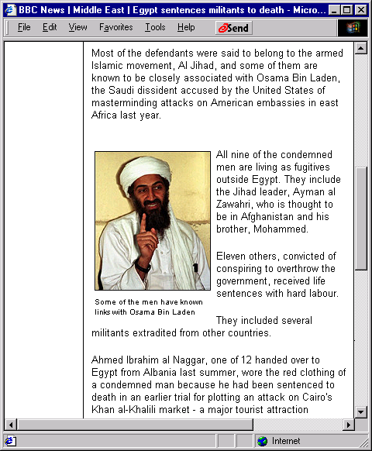
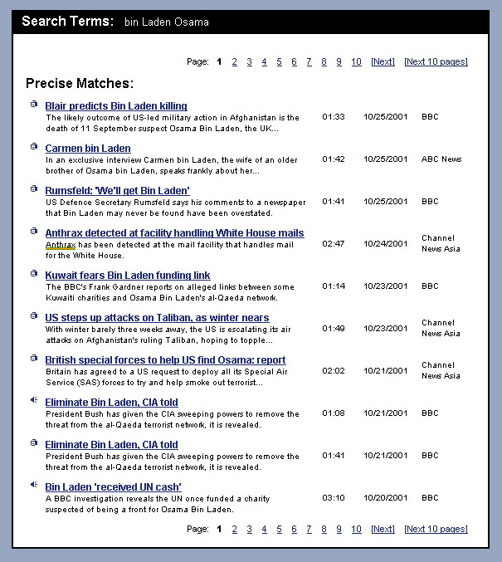
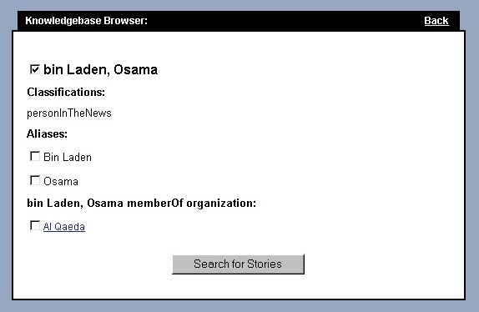
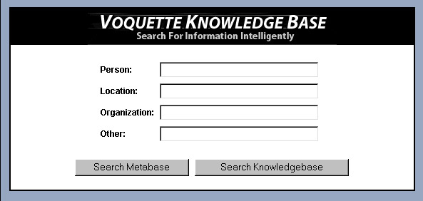
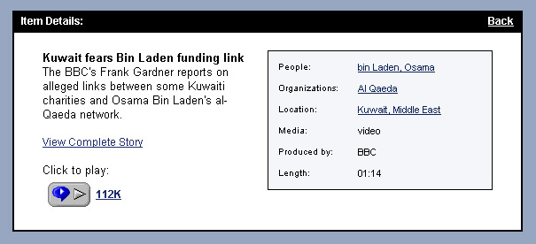
Intelligence Analysis Browsing
Scenario
Knowledge Browser Demo
Automatic Content _x000b_Enhancement Demo

Slide 10
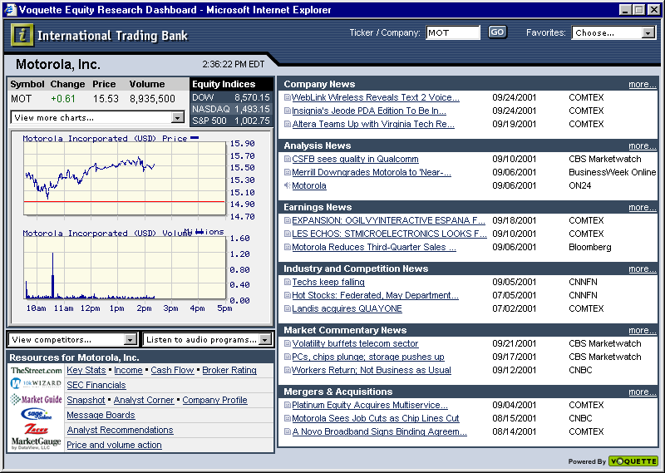
Semantic Application Example
– Financial Research Dashboard
Voquette Research Dashboard: http://www.voquette.com/demo
Automatic 3rd party content integration
Focused relevant
content organized
by topic
(semantic categorization)
Related relevant content not explicitly asked for (semantic associations)
Automatic Content
Aggregation
from multiple content providers and feeds
Competitive research inferred automatically

Slide 11











User Class 1: End Users
Boarding Gate
Airport
Airspace
Interrogation
Visionics
AcSys
Security Portal
ARC AvSec Manager
Data Management
Data Mining
Check-in
Voquette
Knowledgebase
Metabase
Threat Scoring
IPG
Airport LEO
Gov’t Watchlists
News Media
Web Info
LexisNexis
RiskWise
Different types of
users have different
information needs
Passenger Records
Reservation Data
Airline Data
Airport Data
Airline and Airport Data
Future and Current Risks

Slide 12
Innovations that affect
User Experience
BSBQ: Blended Semantic Browsing and Querying
  Ability to query and browse relevant desired content in a highly contextual manner
Seamless access/processing of Content, Metadata and Knowledge
  Ability to retrieve relevant content, view related metadata, access relevant knowledge and switch between all the above, allowing user to follow his train of thought
dACE: dynamic Automatic Content Enhancement
  Ability to provide enhanced annotation features, allowing the user to retrieve relevant knowledge about significant pieces of content during content consumption
Semantic Engine APIs with XML output
  Ability to create customized APIs for the Semantic Engine involving Semantic Associations with XML output to cater to any user application

Slide 13
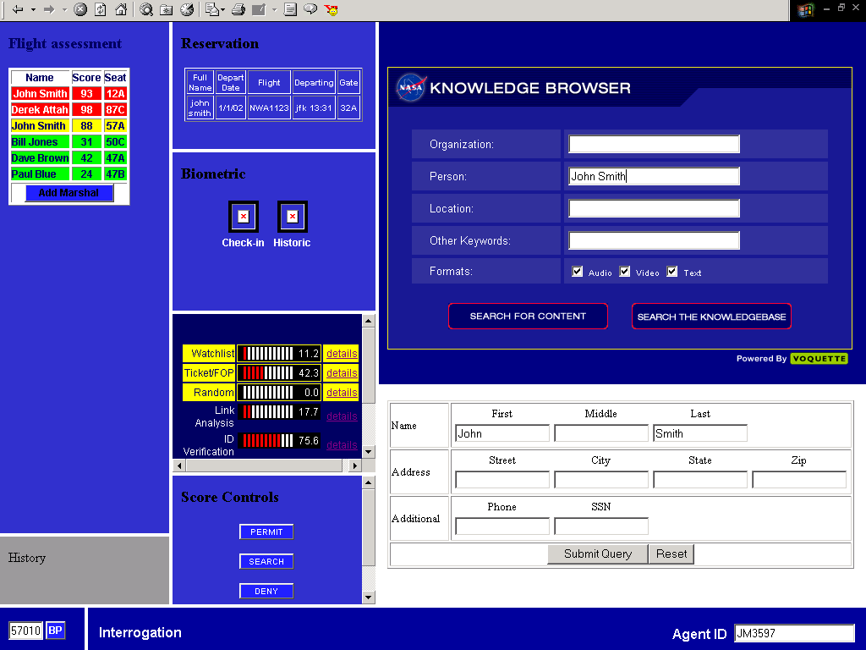
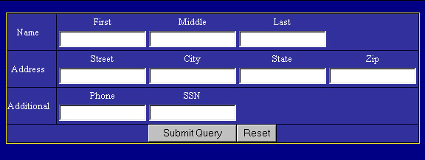
Voquette’s Solution for NASA
Voquette’s Semantic Technology enables flight authorities to :
- take a quick look at the
passenger’s history
- check quickly if the passenger is
on any official watchlist
- interpret and understand
passenger’s links to other
organizations (possibly terrorist)
- verify if the passenger has
boarded the flight from a “high
risk” region
- verify if the passenger originally
belongs to a “high risk” region
- check if the passenger’s name
has been mentioned in any news
article along with the name of a
known bad guy
John
Smith

Slide 14
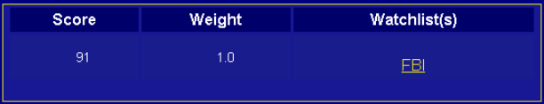
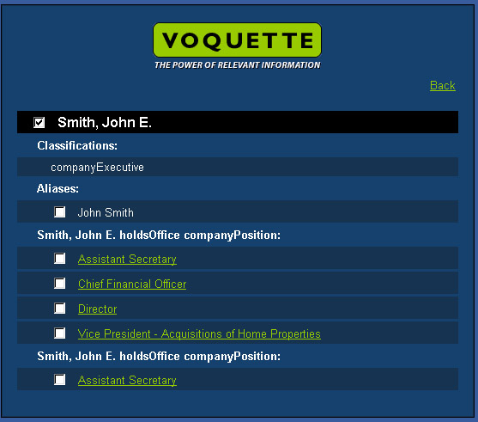

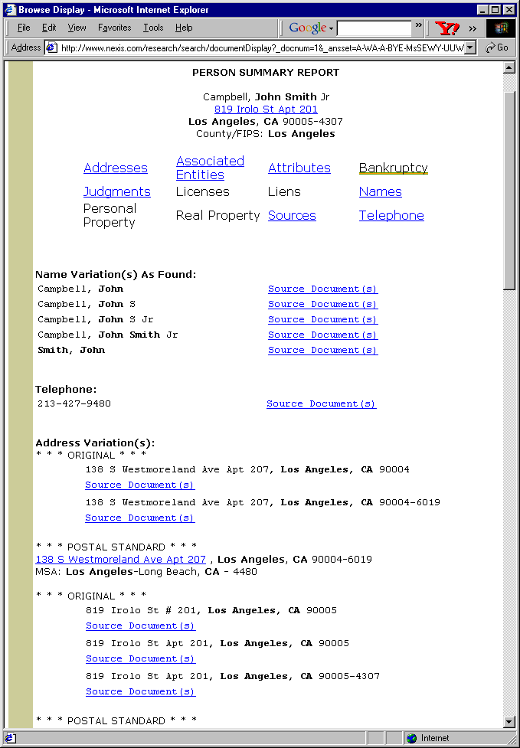
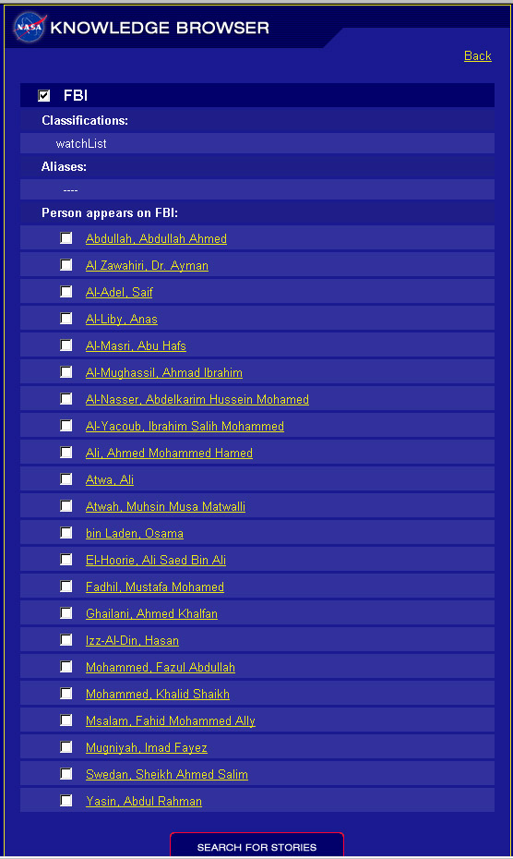
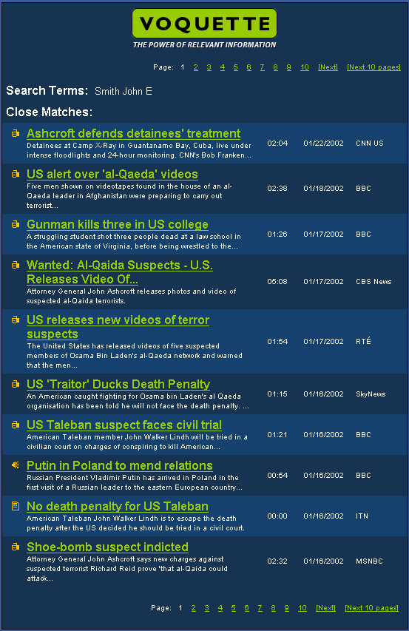
Threat Score Components of APITAS
(APITAS=Airline Passenger Identification and Threat Assessment System)
Flight Country Check 45 0.15
Person Country Check 25 0.15
Nested Organizations Check 75 0.8
Aggregate Link Analysis Score: 17.7
appearsOn watchList:
FBI
KNOWLEDGEBASE SEARCH
Action: Voquette’s rich knowledgebase is searched for this name and associated information like position, aliases, relationships (past or present) of this name to other organizations, watchlists, country, etc. are retrieved
Ability Proven: Ability to automatically aggregate relevant rich domain knowledge about a passenger and automatically co-relate it with other data in the knowledgebase to present a visual association picture to the flight official
John
Smith
METABASE SEARCH
Action: Voquette’s rich metabase is searched for this name and associated content stories mentioning the passenger’s name are retrieved
Ability Proven: Ability to automatically aggregate and retrieve relevant content stories, field reports, etc. about the passenger that can be used by flight officials to determine if the passenger has any connections with known bad people or organizations
LEXIS NEXIS ANNOTATION
Action: Information about or related to the passenger returned by Lexis Nexis is enhanced by linking important entities to Voquette’s rich knowledgebase
Ability Proven: Ability to automatically aggregate relevant rich domain knowledge, recognize entities in a piece of text and further automatically co-relate it with other data in the knowledgebase to present a clear picture about the passenger to the flight official
LINK ANALYSIS
Action: Semantic analysis of the various components (watchlist, Lexis Nexis, knowledgebase search, metabase search, etc.) to come up with an aggregate threat score for the passenger
Ability Proven: Ability to automatically aggregate relevant rich domain knowledge, recognize entities in a piece of text, automatically co-relate it with other data in the knowledgebase, search for relevant content to present an overall idea of the threat level fo the passenger, allowing him to take quick action
WATCHLIST ANALYSIS
Action: Voquette’s rich knowledgebase is automatically searched for the possible appearance of this name on any of the watchlists
Ability Proven: Ability to automatically aggregate relevant rich domain knowledge and automatically co-relate it and rank the threat factors to indicate threat level of the passenger on the watchlist front

Slide 15
Voquette’s Unique Capabilities
Semantics (understanding of content and user needs)
Extreme relevance
Knowledge inferencing (semantic associations)
Near real-time
Multiple applications/usage patterns (not just search)
Automation
Scalability in all aspects

Slide 16

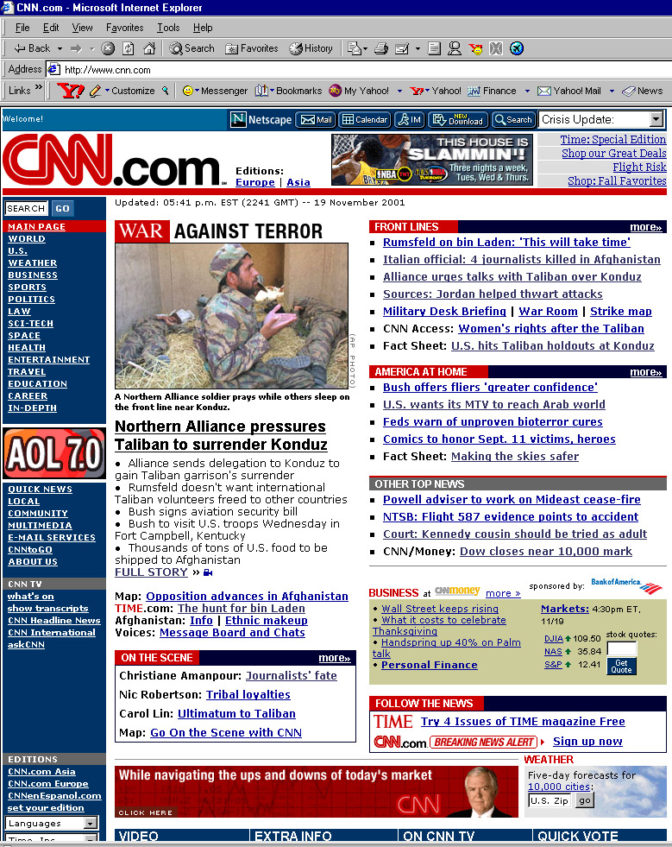




SCORE System
Architecture
Extractor
Toolkit
Extractor
Toolkit
Corporate Repositories
. . . . . .
. . . . . .
. . . . . .
. . . . . .
. . . . . . .
. . .. . .
. . . . . .
. . . . . .
. . . . . . .
. . . . . .
. . . . . .
. . . . . .
. . . . . .
. . . . . . .
. . .. . .
. . . . . .
. . . . . .
. . . . . . .
Proprietary Content
XML Documents
XML
. . . . . .
. . . . . .
. . . . . .
. . . . . .
. . . . . . .
. . .. . .
. . . . . .
. . . . . .
. . . . . . .
WorldModel
Corporate Web Sites
Metadata Extractor Agents
Structured
&
Semi-Structured
Content
Web Sites
. . . . . .
. . . . . .
. . . . . .
. . . . . .
. . . . . . .
. . .. . .
. . . . . .
. . . . . .
. . . . . . .
Knowledge Extractor Agents
Public Domain
Web Sites
. . . . . .
. . . . . .
. . . . . .
. . . . . .
. . . . . . .
. . .. . .
. . . . . .
. . . . . .
. . . . . . .
(Automated Maintenance)
Analysis
Subscription
Content
Reports
. . . . .
. . . . . .
. . . . . .
. . . . . .
. . . . . . .
. . .. . .
. . . . . .
. . . . .
. . .
Knowledge Toolkit
KnowledgeBase
. . . . .
. . . . . .
. . . . . .
. . . . . .
. . . . . . .
. . .. . .
. . . . . .
. . . . .
. . .
Mining
Trusted
Knowledge
Sources
Email
- - - -
- - - -
- - - -
C
Domain
Experts
Content
Enhancement
A
. . . .
. . . . . .
. . . . . .
. . . . . .
. . . . . .
. . . . . . .
. . .. . .
. . . . . . .
. . . . . .
Unstructured
Content
Word
Documents
C
Enhanced Metadata
S
Metabase
(Database of Richly
Indexed Metadata)
PowerPoint
Presentations
Metadata
Std.
APIs
Search
Content
Knowledge
APIs
Knowledge Browser
Personalization
and
Semantic Engine
Custom
Content
Dashboard
Analyst WB
ENTERPRISE USERS

Slide 17
User Class 2:
Enterprise Application Developer
Automation:
  KnowledgeBase (creation and maintenance)
  Dynamic content (metadata extraction and scheduled updates)
  Multiple techniques/technologies (DB, machine learning, knowledgebase, lexical/NLP, statistical, etc.)
  Content Enhancement (value-added metatagging and indexing)
Toolkits
  About 30 integrated tools for content/knowledge creation, processing, maintenance and management

Slide 18
Discussion/Questions?
Case Studies available http://www.voquette.com/demo

