Slide 1
AI AND INCLUSION
22nd June 2021

Slide 2


















COMPANY BACKGROUND
INTRODUCTION
COMPANY BACKGROUND
Established in 1992 working within the higher education and workplace sectors.
Helped over 500,000 disabled people to succeed
Operating in the UK, USA, South Africa and Middle East
1/4

Slide 3


Helping with client's accessibility needs
CLIENTS NEEDS
HELPING WITH CLIENT'S ACCESSIBILITY NEEDS
Actively involved in and founding member of the Business Disability Forum Tech Taskforce.
Helping organisations become accessible since 2010.
Provide services to 40 large enterprises for disability and physical/digital accessibility services.
Level 5 – Best Practice
2/4

Slide 4


Gaps in accessibility
GAPS
GAPS IN ACCESSIBILITY
When using online interactive services
Usability by disabled people e.g.
Authentication methods
Web accessibility checks as open data
Availability
Accessibility statements
Machine readable
3/4
Notes:
*** Rough notes only ***
GAPS IN ACCESSIBILITY
When using online interactive services
Usability by disabled people, for example
Authentication methods – when using online banking services or banking apps.
Web accessibility checks or testing as open data
It is important that these data sets are made available for independent analysis and research purposes.
Accessibility statements
Providing machine readable accessibility statements enables on going analysis of a public sector organisation web accessibility progress and areas for improvement by auditing bodies, such as the Central Digital & Data Office.
To lead into slide 4/4
Once you achieve accessibility how do you maintain it?
Authoring accessible content.
Awareness of assistive technology.
Lead into e-learning

Slide 5
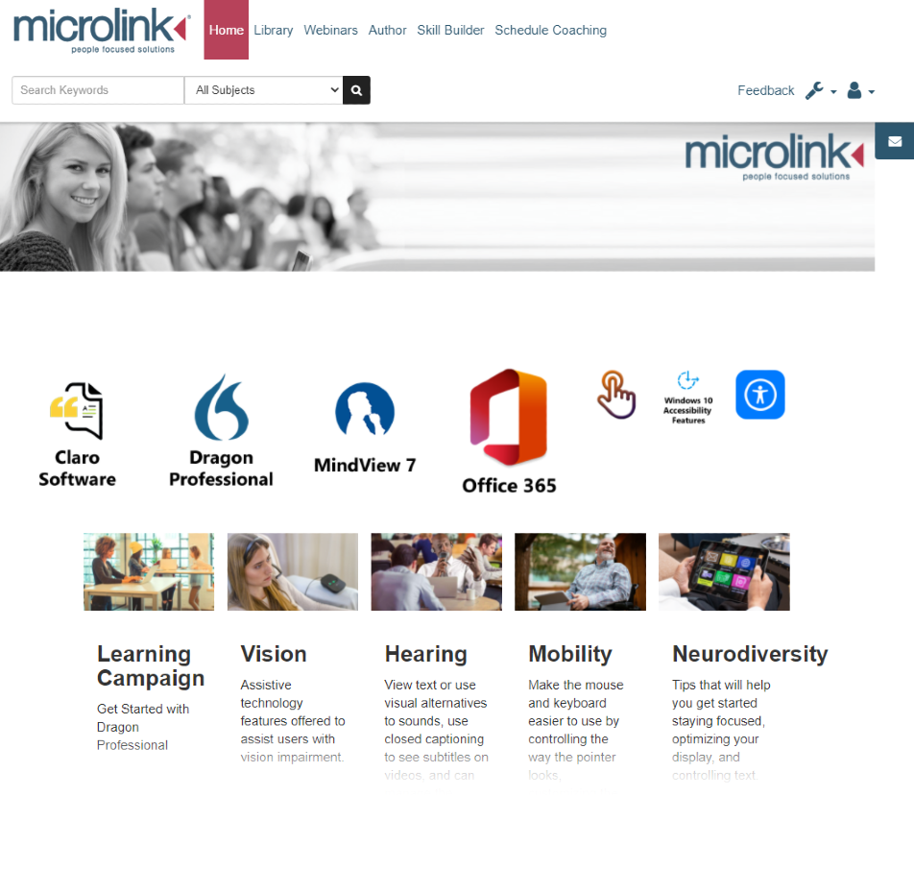


Preparing the population
ACCESSIBILITY E-LEARNING
PREPARING THE POPULATION
Creating accessible content using e-Learning.
4/4

Slide 6
Thank you
THANK YOU
Presented by
Dr Nasser Siabi, CEO
Microlink PC (UK) Ltd
Microlink house, Brickfield Lane, Chandler’s Ford, Hampshire
SO53 4DP
T: +44 (0)23 80240300
E: wpa@microlinkpc.com
www.microlinkpc.com
Company registered in England No. 03325643

