Slide 1


British Sign Language(BSL) User’s eye gaze patterns between hands and face
Nez Parr & Biao Zeng
School of Psychology and Therapeutic Studies
University of South Wales, UKbiao.zeng@southwales.ac.uk
https://www.italktonelab.co.uk/

Slide 2
COVID-19 and Web Inclusion
The COVID-19 pandemic has forced schools, universities, healthcare, businesses, and governments to adopt remote working practices to keep running efficiently.
Technologies might also create a system of exclusion. Activities, websites and digital media designed for a deaf audience would decrease social exclusion.
Working online will be part of future life. Understanding the communication pattern of deaf people when utilising online technologies will provide positive impacts going forward.

Slide 3

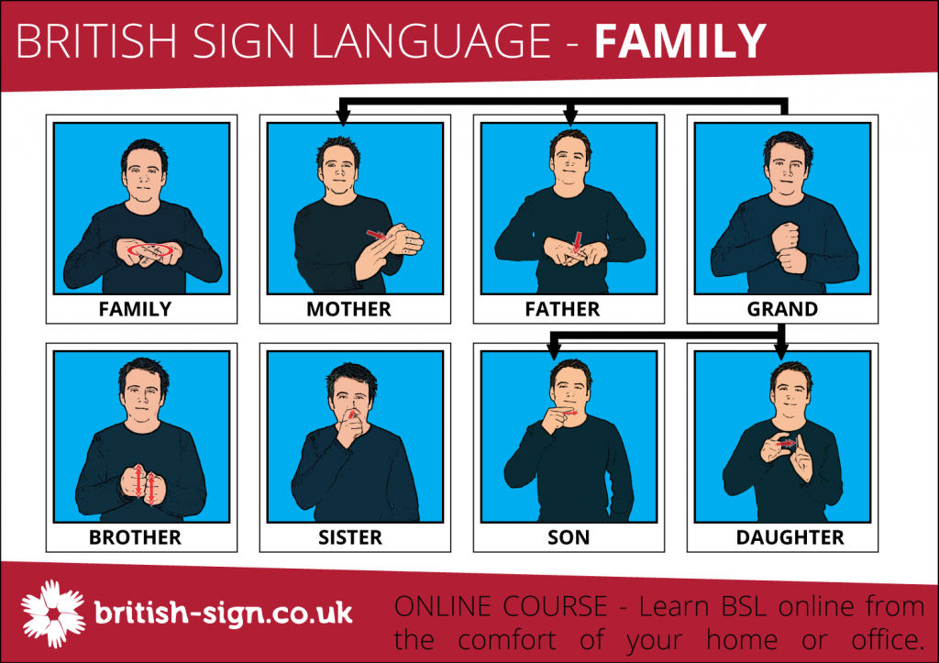
Facts about BSL
The fourth main minority language used in the United Kingdom after Polish, Punjabi, and Urdu (Batterbury, 2014).
15,000–20,000 people in the UK use BSL as their main language (ONS, 2013).
The UK government recognised BSL as an official language in 2003 but the language has not received protected status, unlike the six indigenous UK languages of Welsh, Scots, Ulster Scots, Scottish, Irish Gaelic and Cornish (Batterbury, 2014).

Slide 4
Elements of BSL
Hands, arms, trunk, the eyes, mouth and face generally are all key factors when communicating via signed languages, as are the shoulders, body posture and the head.
Location, handshape, and movement (Stokoe, 1960).
Battison (1978) suggested a fourth element of orientation pertaining to the rotation of the hands in relation to the rest of the body.
Change in one of these significant elements results in a change of meaning (Kyle & Woll, 1985).
Signing space

Slide 5
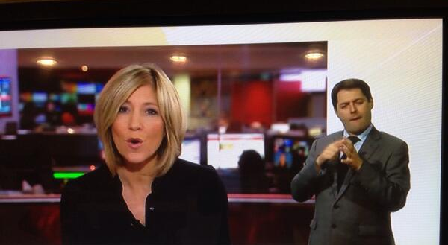
Speech Perception in Real World

Slide 6
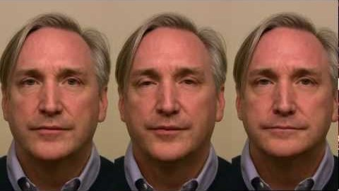
McGurk Effect

Slide 7
Hearing Lips and See Voices (1976)
Stimulus: /ga/(audio)+/ba/(visual)
Two types of Illusion
Fusion: /da/
Combination:/gabga/,/bagba/,/baga/,/gaba/
McGurk rate in different age groups
Preschool children: 59%
School children:52%
Adult: 92%
Speech perception is, at least, audio-visual bimodal.
Visual information is used even when auditory information is clear and undegraded.

Slide 8
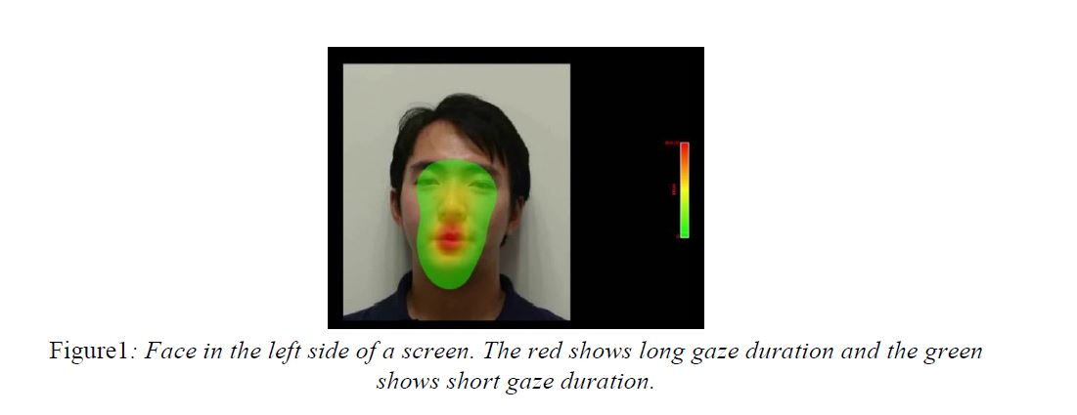
Primacy: mouth or eyes

Slide 9

BSL: mouth or hands?
“brother” | Hands-mouth matched | Hands unmatched | Mouth unmatched

Slide 10
Hypotheses
The face, as one region of interest (ROI), is the predominant information resource. At all matched and unmatched conditions, the eye gaze will be significantly directed at the face.
Where the mouth and the hands are both correct and therefore match (hands-mouth matched condition), the eye gaze will linger predominantly on the face for a longer duration. Similarly, when the mouth information is correct, but the hands information is incorrect (hands-unmatched condition), the eye gaze will linger predominately on the mouth, and for no longer than in hands-mouth matched condition.
When the mouth pattern is incorrect, but the hands are correct (mouth-unmatched condition), the eye gaze will predominately linger on the mouth for a longer duration than hands-mouth matched and hands-unmatched conditions. We assume the BSL users will increase their gaze towards the mouth in order to double check the information as they detect it might not be accurate, they may then gaze towards the hands.

Slide 11

Participants
Seven participants (aged from 24- to 53-years-old) attended this online study. There were five males and two females. All participants were fluent in BSL as they were profoundly deaf and considered it their first language.
The participants were of varied ethnicities, including Black British, Caucasian, Pakistani and White Asian and lived in South Wales from Newport in the East to Bridgend in the West. One participant was based in London.

Slide 12

Procedure and Stimuli

Slide 13
Stimuli and Design
Table 1. Duration (second) of 18 (6 signs × 3 conditions) BSL stimuli
Sign | Hands-mouth matched | Hands unmatched | Mouth unmatched
Brother | 2.20 | 2.25 | 2.25
Window | 2.85 | 3.10 | 3.15
Yellow | 2.85 | 2.00 | 2.55
Name | 2.30 | 2.30 | 2.40
Cat | 2.60 | 2.30 | 1.90
Mine ª | 2.00 | 2.60 | 2.15

Slide 14
Result: percentage of gaze duration
Conditions | Space | Face | Mouth
Hands-mouth matched | 97.96 (2.22) | 76.40 (15.13) | 34.37 (8.81)
Hands unmatched | 98.44 (.95) | 74.33 (15.79) | 36.10 15.30)
Mouth unmatched | 99.36 (.82) | 81.28(10.34) | 44.68(12.58)
A paired samples t-test was run in the data of percentage of gaze duration on mouth. The results showed no significant difference amongst each paired condition (matched vs. hands unmatched hands, t (4) =.50, p=.32, 1-tailed, Cohen’s d=.225; matched vs. unmatched mouth, t (4) = 1.63, p=.089, 1-tailed, Cohen’s d=.729; unmatched hands vs. unmatched mouth, t (4) =1.05, p=.176, 1-tailed, Cohen’s d=.470).
when the mouth cue was wrongly unmatched, a trend of gazing towards the mouth was evident.

Slide 15
Discussion
Spectrum of “mouth-eyes/hands”
Online eye tracker
Limitation
Attention and task (free-viewing)
randomisation
Sample size: only 7, no significant result
ROI and sign spacing

