Slide 1
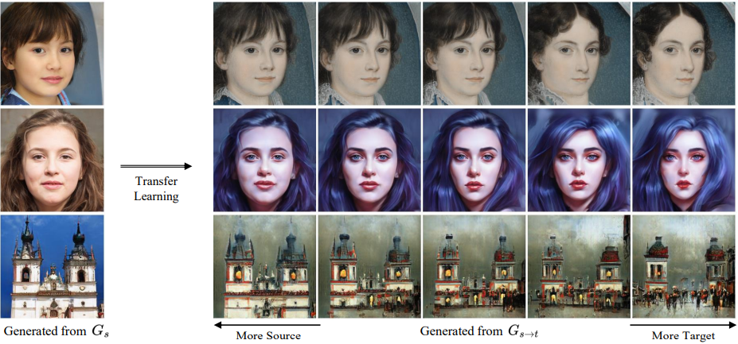
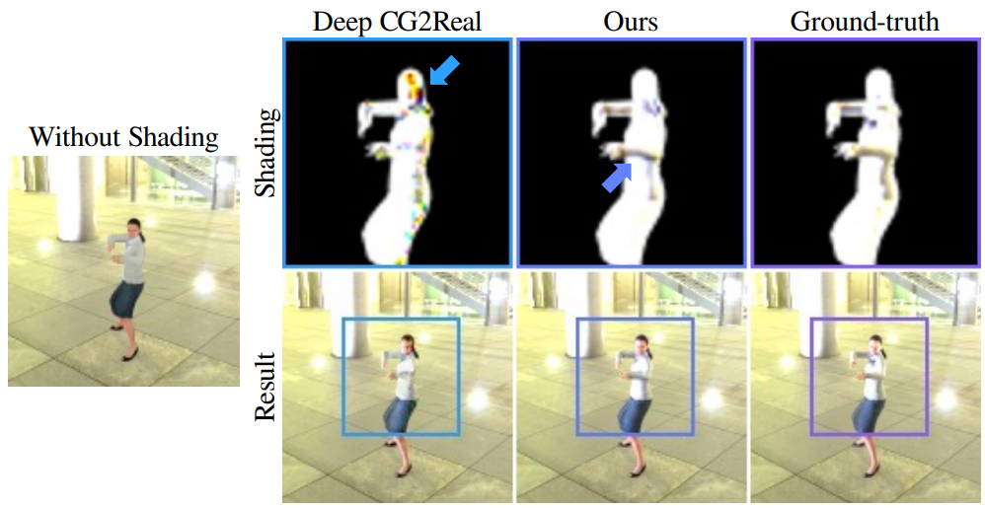
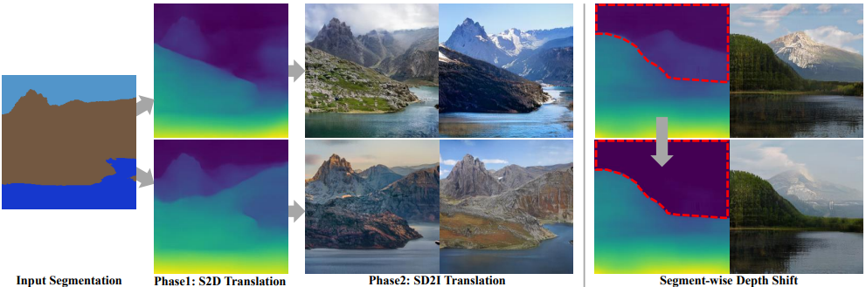
AI for Content Creation Workshop @ CVPR 2022 June 19th Room 208 ai4cc.net

Slide 2
AI for Content Creation Workshop @ CVPR 2022 June 19th Room 208

Slide 3
AI4CC @ CVPR 2022

