Slide 1
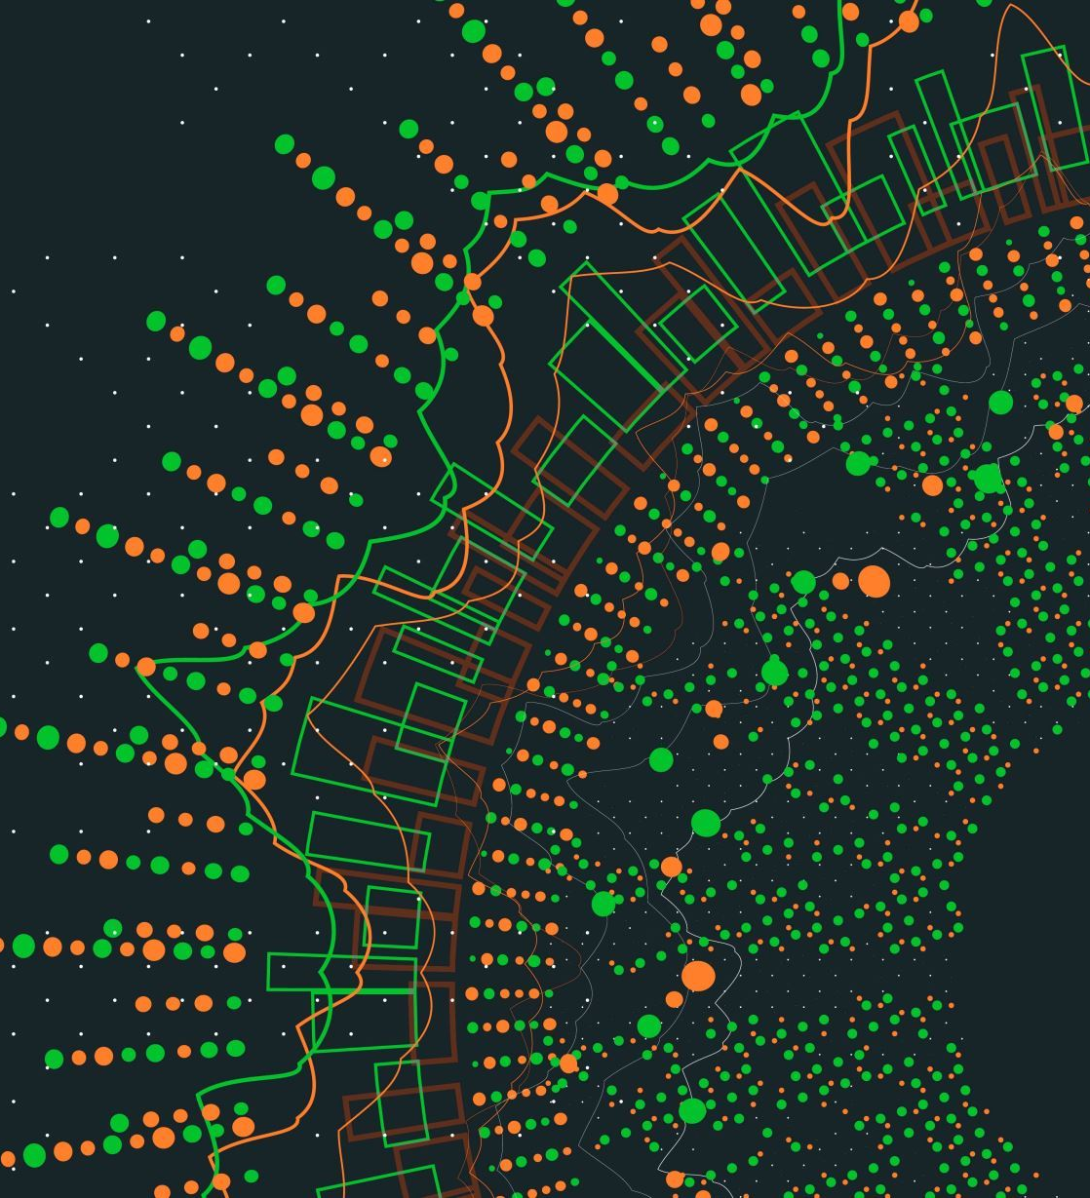
Multi-Machine Disruption Prediction for Fusion Energy
By Isaac Oluwafemi Ogunniyi
12/12/2023

Slide 2
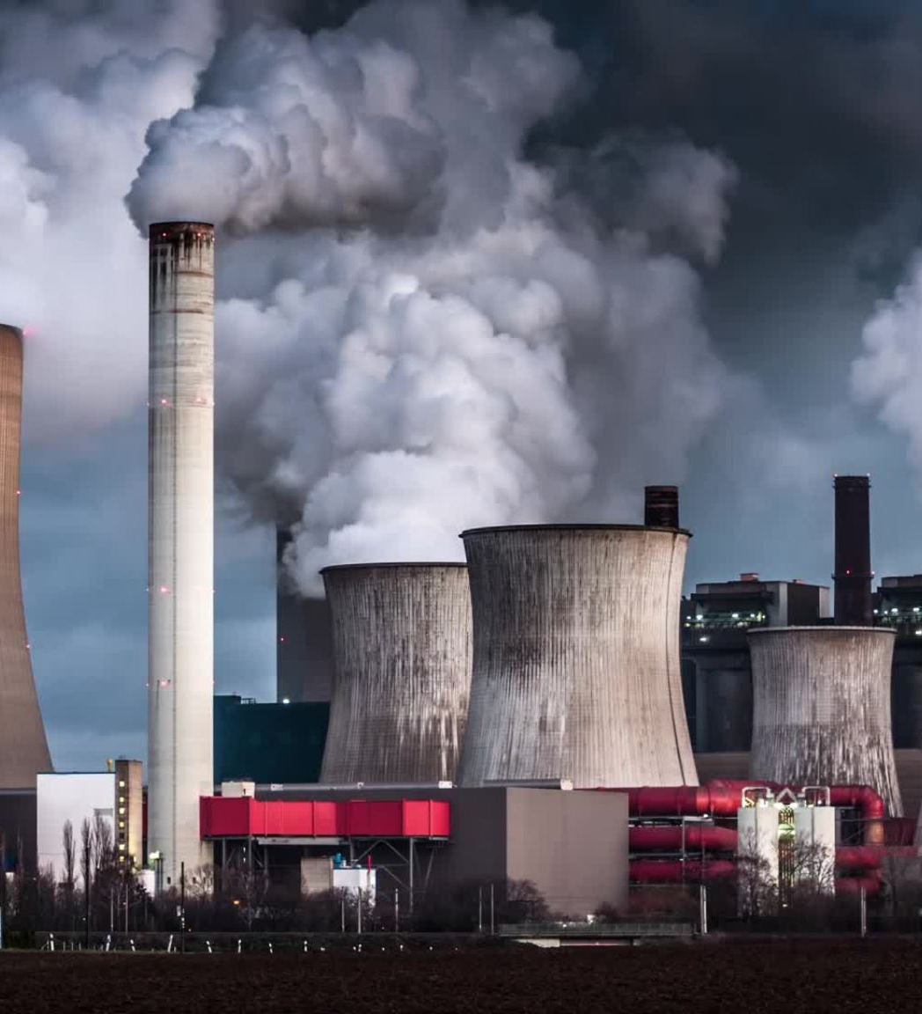
Problem Statement
Solving Global energy crisis by improving nuclear fusion prospects
Tackling the occurrence of disruptions in tokamaks
Predicting disruptions in future tokamaks using models built on current tokamaks' data

Slide 3

Methodology : Data
Data used were from 3 different tokamak types: Alcater CMod, J-Text and HL-2A.
J-Text and HL-2A designated the current tokamak types hence used for training.
Alcater CMod designated the future tokamak type hence used for validation and testing.

Slide 4
Methodology : Feature Engineering
Statistical measures of the observations in the diagnostic signal.
Statistical measures of a one-step differenced version of the observations in the line integral density (center chord) signal.
A boolean value representing the validity of the diagnostic signal of that particular shot file
A one-hot encoding of the type of tokamak

Slide 5
Methodology : Signal Selection
There was the need to select the diagnostic signal that would best help the model to generalize to tokamaks it has not been trained on.
The result of the experimentation resulted in the choice of Line integral (center chord) as the best signal.
Signal | Training tokamak score | Unseen tokamak score
Line integral (center chord) | 0.8805 | 0.6250
Loop voltage | 0.8793 | 0.6
Soft X-ray 05 | 0.8805 | 0.5385
Plasma current | 0.8711 | 0.5185

Slide 6
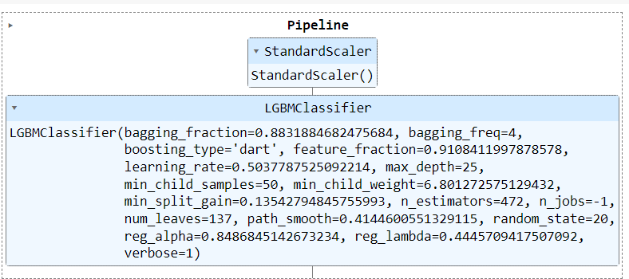
Model Structure
A two-step scikit-learn pipeline:
A StandardScaler object for scaling the data and making it more suitable for machine learning algorithms.
An LGBMClassifier instance to fit and learn the complex relationships between the engineered features and the occurrence of disruptions.

Slide 7
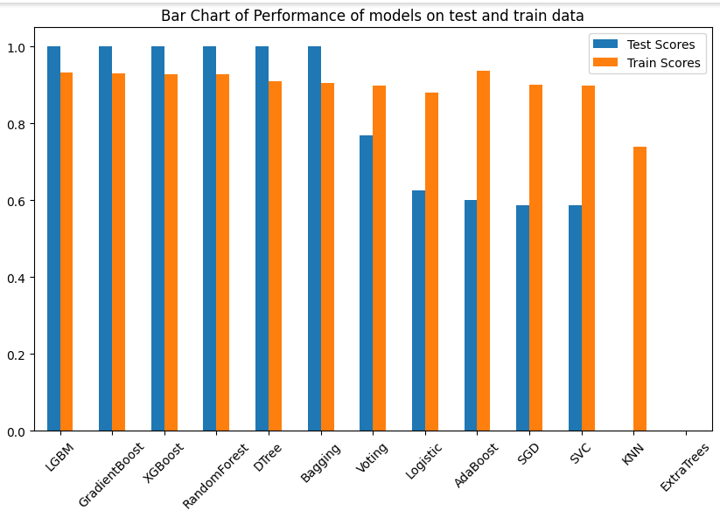
Model Evaluation
LGBMClassifier had the best train accuracy (0.933257) and a test accuracy (local) of 1

Slide 8
Conclusion
The solution demonstrates an effective approach to predicting disruptions in a tokamak with a final test accuracy of 0.9091.
Future work should consider making use of data from multiple signals per shot file either aggregated and treated as tabular data or stacked into a matrix and a neural network trained on it.

Slide 9
Thank you

