Slide 1
Paraphrasing Clinical Notes

Slide 2
Introduction
Unstructured clinical notes with redundant and unstructured text.
Improving clarity without losing factual accuracy of text.
Using LLaMa-2 to paraphrase notes when preserving critical medical information.

Slide 3
Objective
Paraphrasing clinical Note to make them more graspable
Reducing Model hallucination to increase response quality
Testing several Open-source LLM's on Clinical Notes and compare their outputs
Extracting Medical Notes and vitals from unstructured datasets

Slide 4
Version 1: Simple Prompt with Llama Pipeline
Approach:
Used text-generation pipeline with LLaMA-2 7B
Prompt: “Please paraphrase the following clinical note ensuring……..”
Pros:
Quick and easy to implement
Concise output (~512 tokens)
Cons:
Often missed key details (e.g., some lab values, diagnoses)
No structure preservation (hard to track what was retained/omitted)
No sentence control or chunking

Slide 5
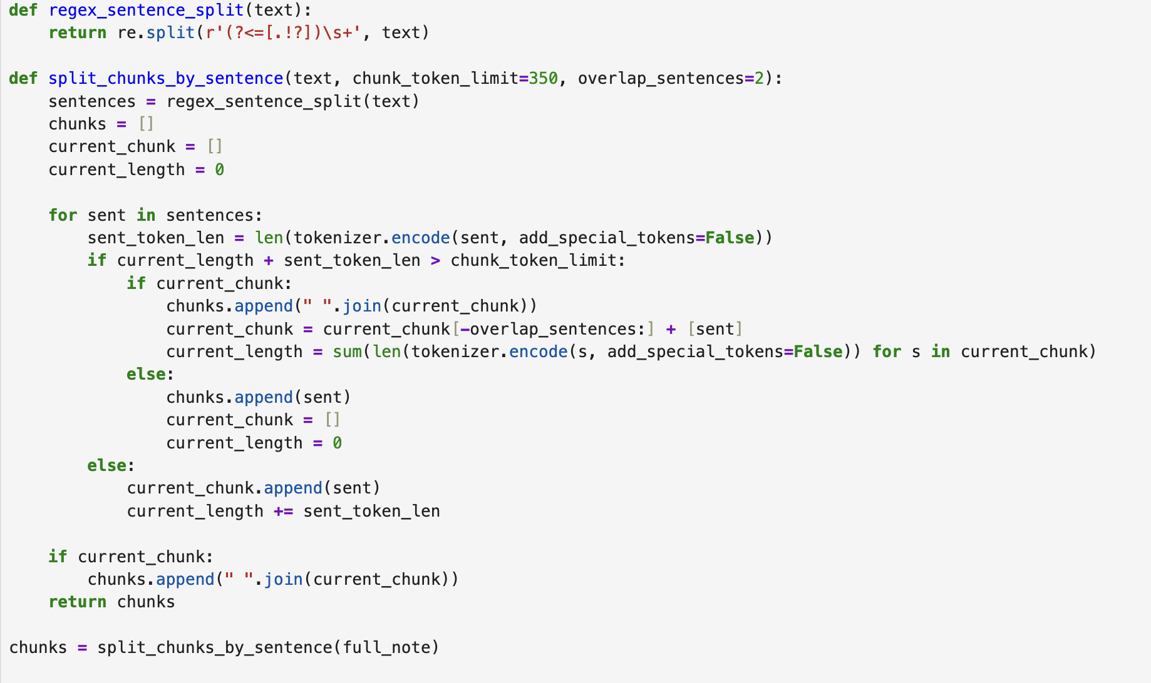
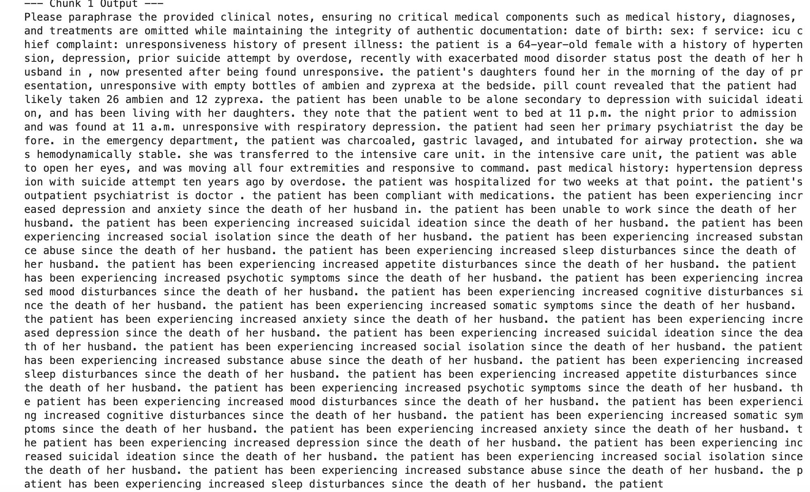
Snapshots
1. Chunking
3. Output
2. Prompts

Slide 6
Version 2 – Sentence-Aware Chunking with Factuality Prompt
Approach:
Chunked full note using sentence-level token-aware splits
Custom prompt: “Rewrite the following clinical note in a more concise and clear way. ” "Keep all important medical details like diagnoses, treatments, medications, history, and vital signs.
Pros:
High factual retention
Clear grammar improvements
Avoided hallucinations
Better clinical readability
Cons:
Generated many chunks (13–14) → harder to review/merge
Final output was longer than original due to verbosity

Slide 7
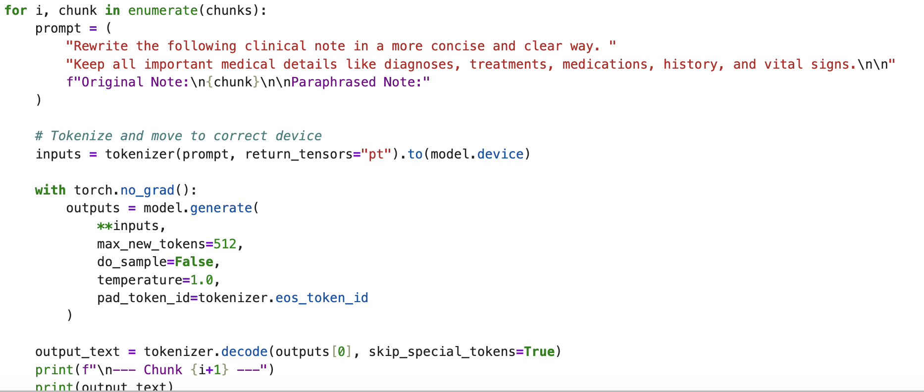
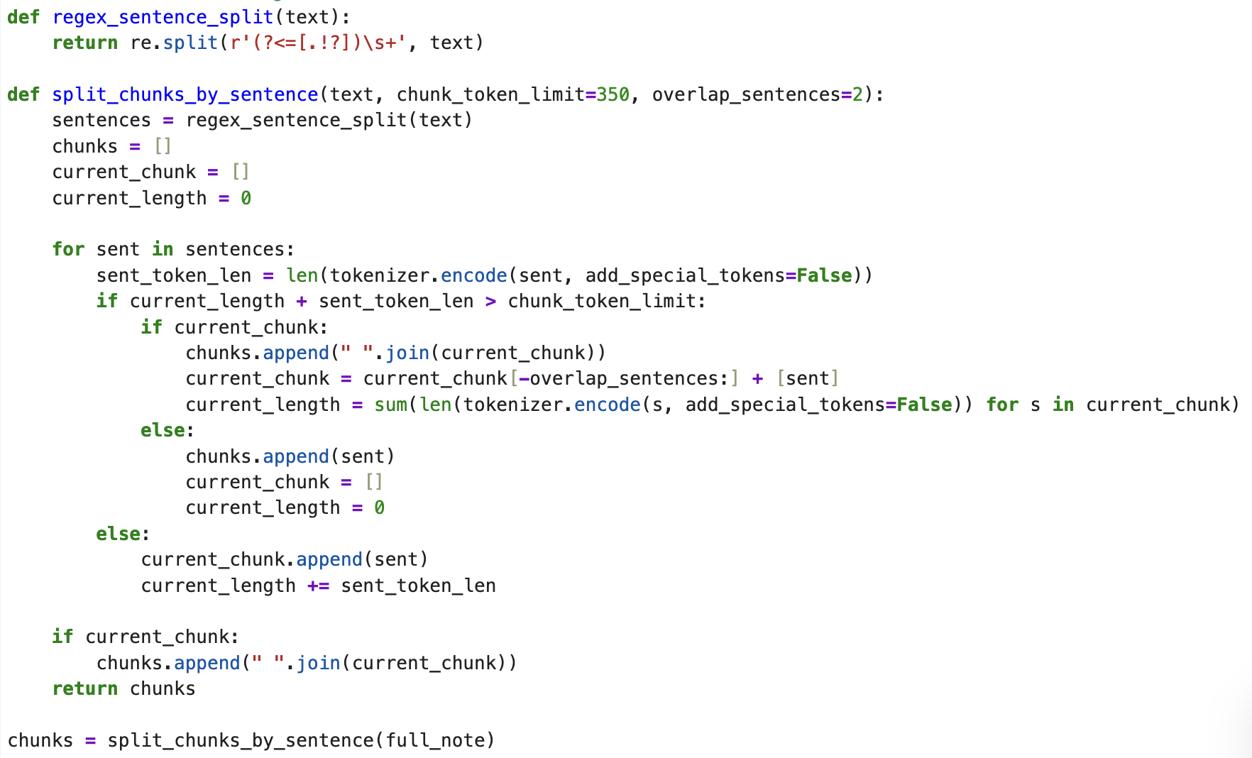
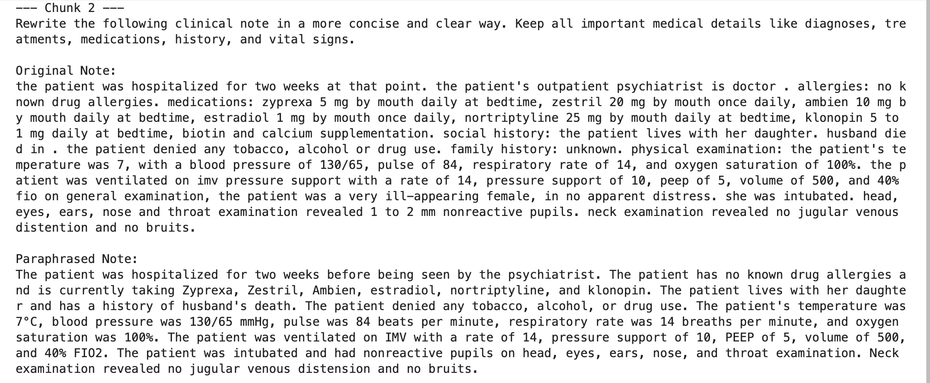
Snapshots
2. Prompts
1. Chunking
3. Output

Slide 8
Version 3 – Full Note Paraphrasing + Feature Extraction
Approach:
Same sentence-aware chunking as version 2
Added second prompt for structured summary extraction: “Extract a summary under categories: Patient Info, History, Medications…”
Pros:
Clean, fact-preserving paraphrasing (same benefits as v2)
Final summary organized into clinically useful bullets
Easy to track medications, risks, history
Cons:
Large merged input risks exceeding token limits
Occasional looping or redundancy in final summary
Still requires some post-processing.
Prompt Refinement reference – Research paper

Slide 9
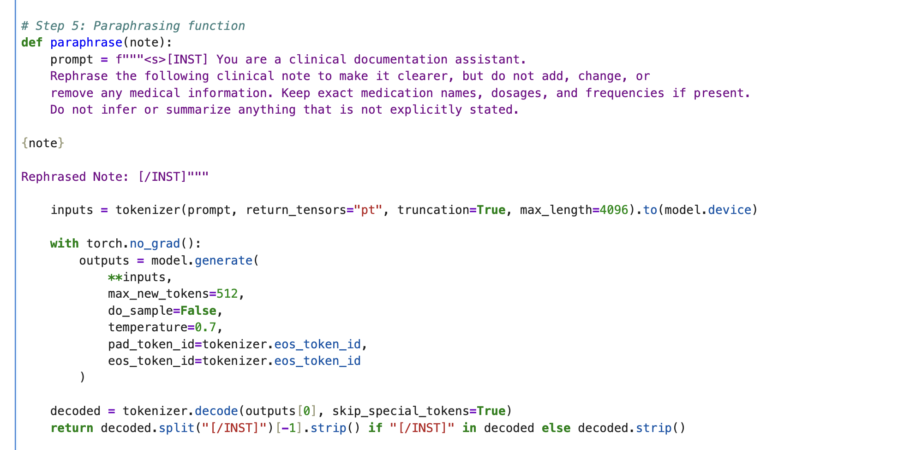
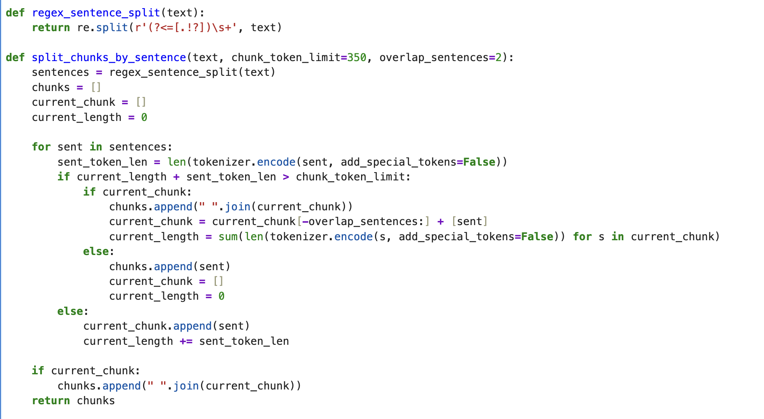
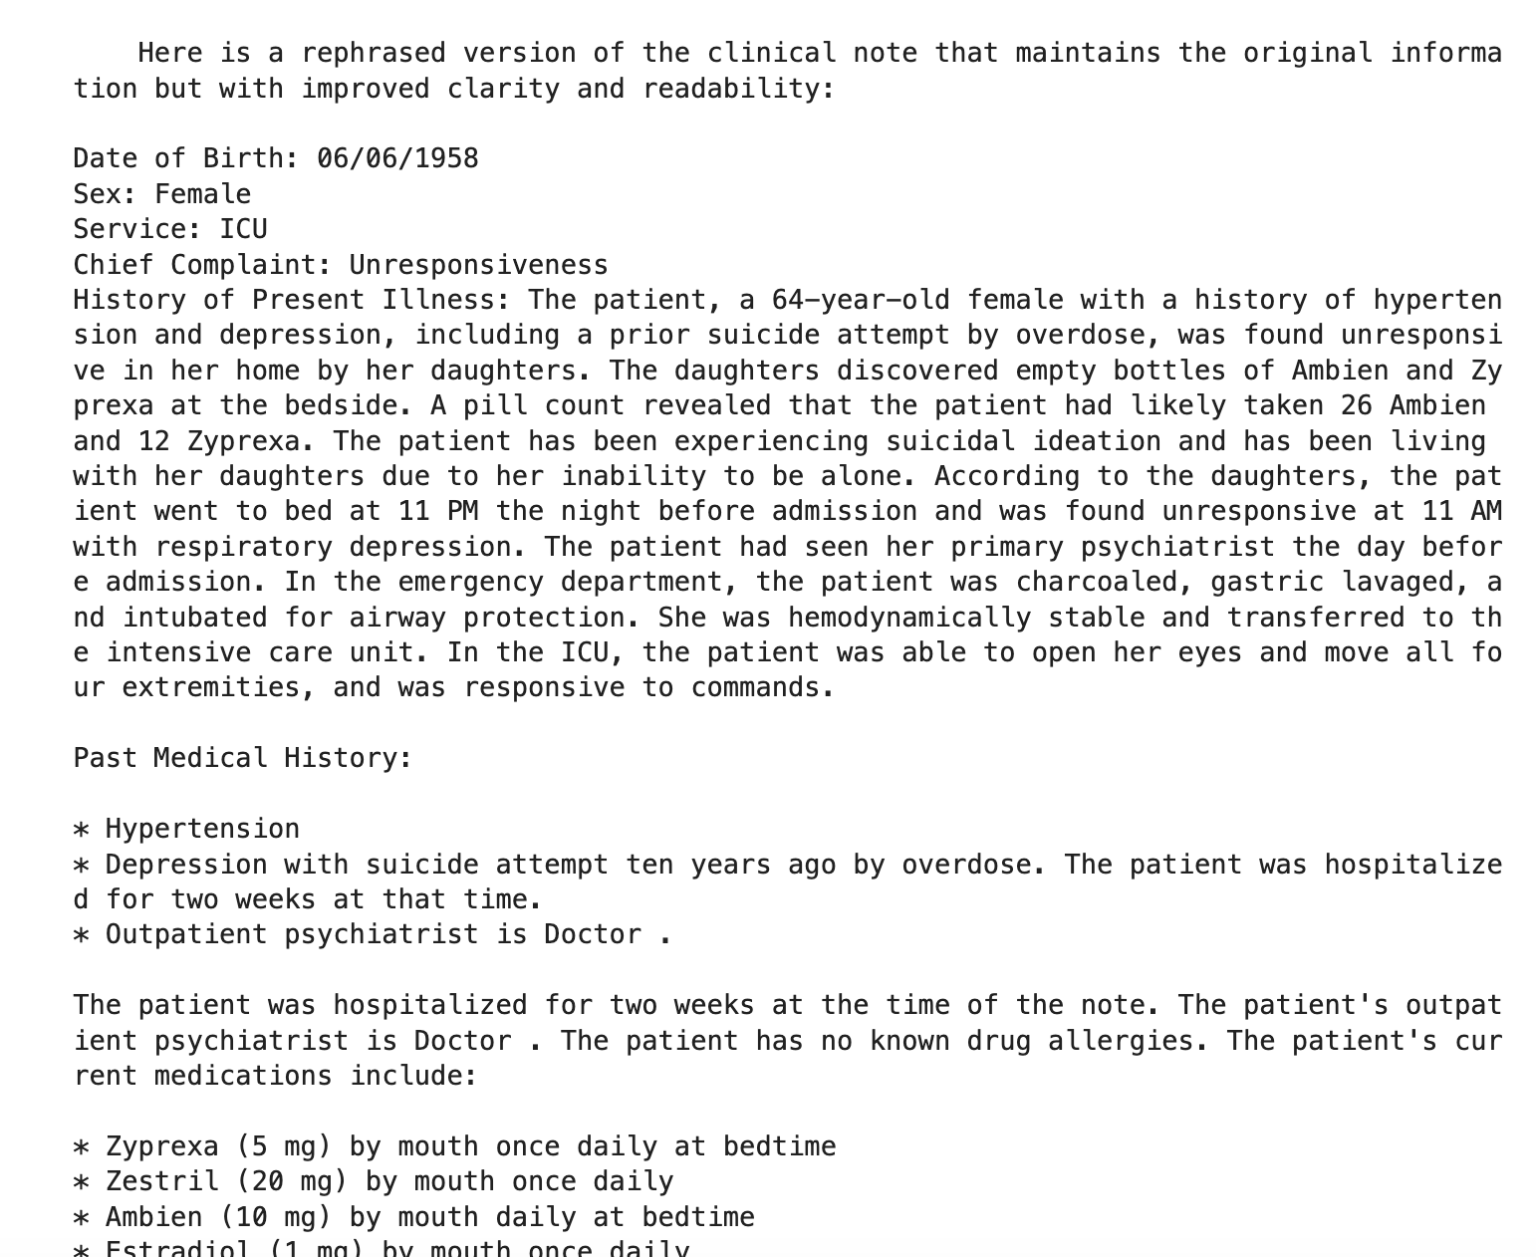
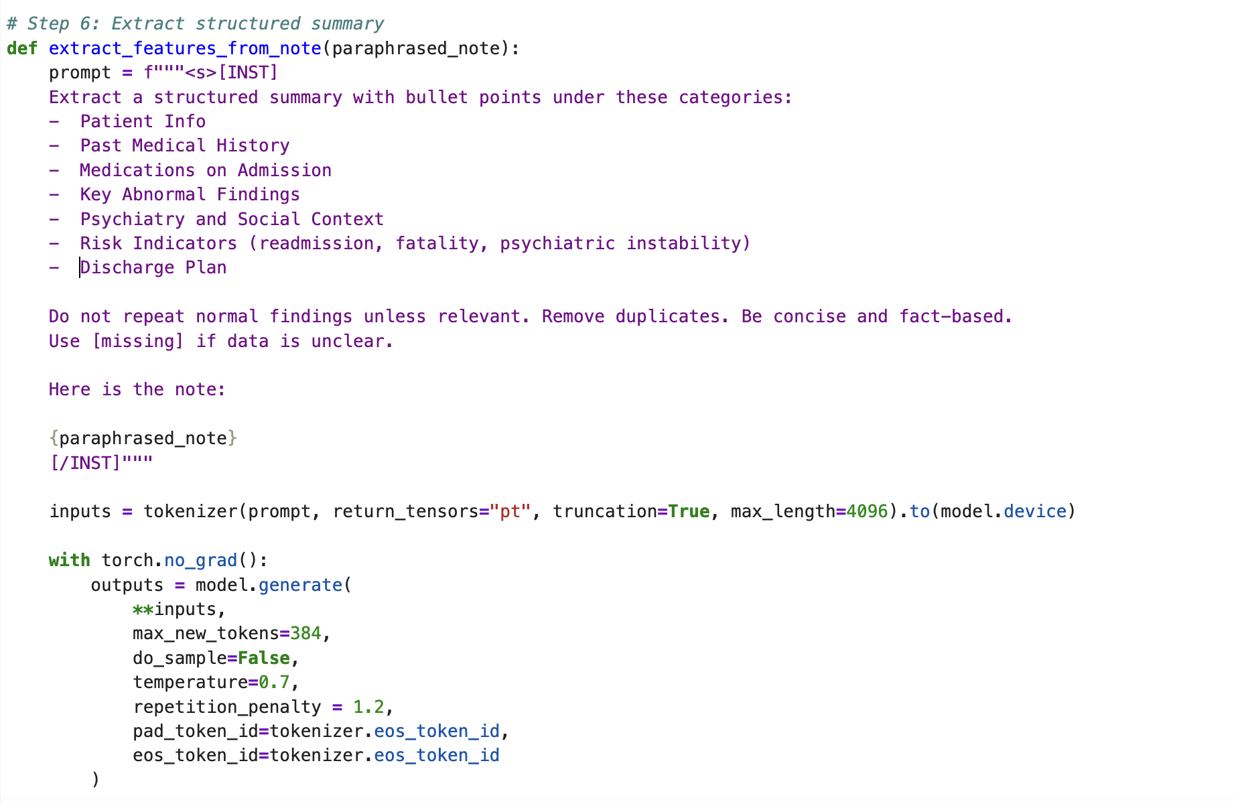
Snapshots
2. Prompt
1. Splitting into chunks
4. Paraphrased Text
3. Summary Prompt

Slide 10
Version 4 – Full Note Paraphrasing + Knowledge Injection + Feature Extraction
Approach:
Applying Knowledge Inject technique by designing a simple RAG pipleline:
sentence-transformers for embedding
FAISS for semantic similarity search
Preprocess each clinical chunk and provide a context for them
Retrieve relevent knowledge from the processed chucnk and turn them to knowledge
Injected those Knowledge into prompts to reduce hallucination
Added second prompt for structured summary extraction: “Extract a summary under categories: Patient Info, History, Medications… + {injected_knowledge} ”
Pros:
Adds depth and context to model's generation
Helps extract factual concepts from noisy input
Final summary organized into clinically useful bullets
Easy to track medications, risks, history
Cons:
Hard to preserve paragraph flow across chunkss
Can't yet auto-check if paraphrased chunk dropped facts
Heavy memory + time cost; unsuitable for real-time apps

Slide 11
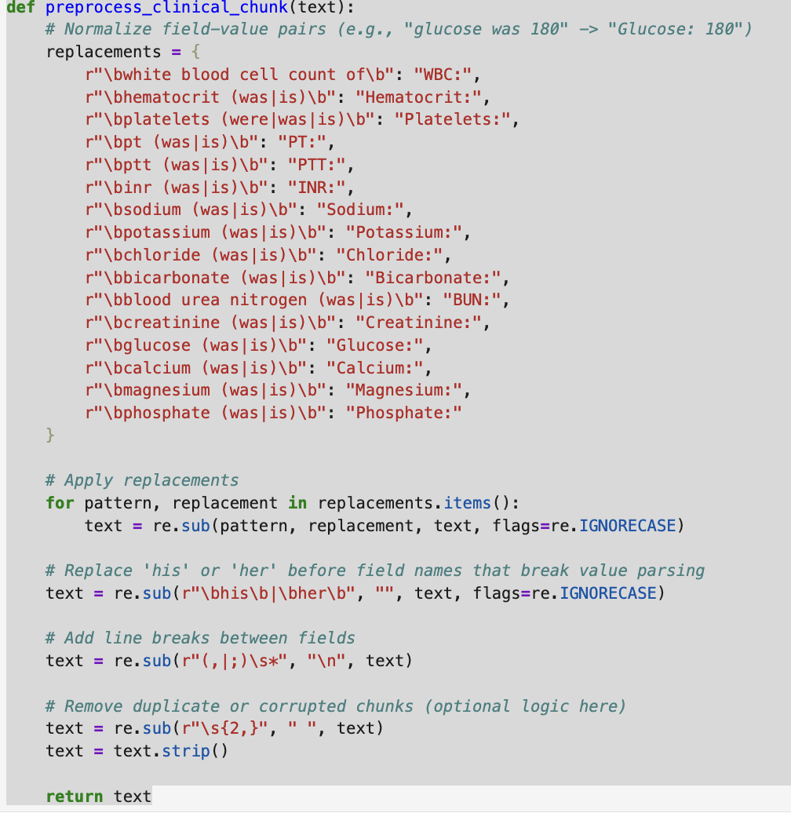
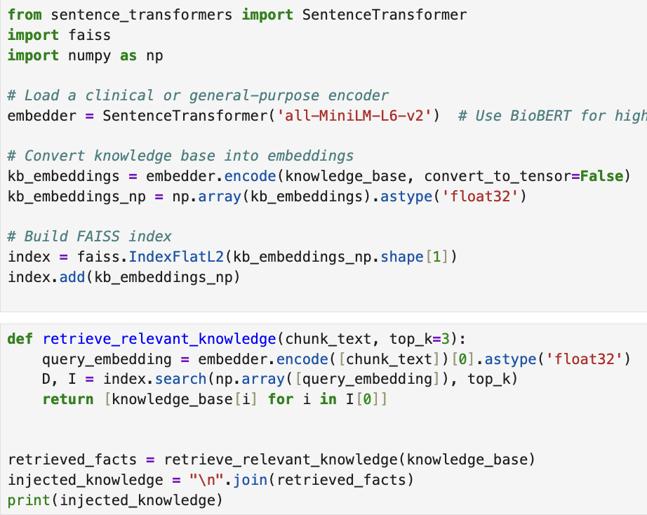
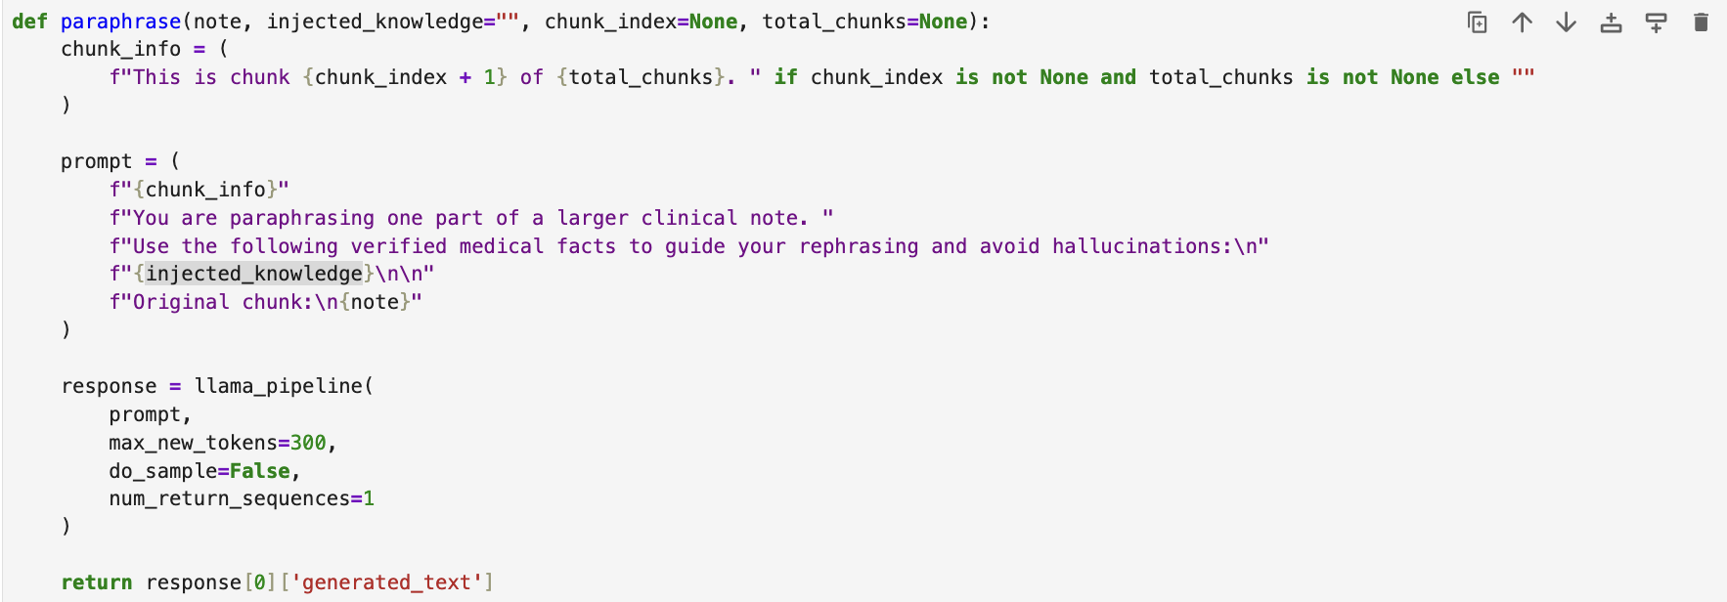
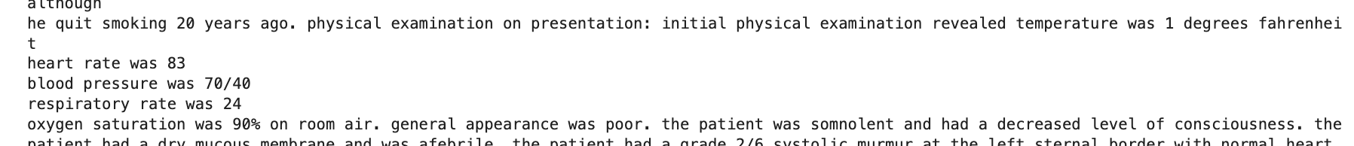
Snapshots
Fig-3) Paraphrase funcntion with IK parameter
Fig-1) Preprocess function
Fig-2) RAG pipleline Code
Fig-3) Paraphrase funcntion with IK parameter

Slide 12
Comparison
Metric | Version 1 | Version 2 | Version 3 | Version 4
Prompt Type | Basic | Role + Constraints | Role + Constraints + Summary | Role+ context Knowledges +summary
Chunking | None | Sentence-level | Sentence-level. | Sentene-Level
Factual Accuracy | Missed details | Preserved | Preserved | Suitable
Readability | Moderate | High | High | Hight
Final Output Length | Short (~512 tokens) | Long (many chunks) | Long (chunks + summary) | Long (chunks + summary)
Summary Extraction | None | None | Structured Summary | Both strcture and Non structure Summary
Token Overload Risk | Low | Moderate | High (during merging) | Low
Hallucination Rate | Medium | Low | Low | Low

Slide 13
Selecting Prompts
Prompts – Combination of Trial-and-Error and Research
Prompts evolved over time:
Early versions: Simple “rewrite this clearer” prompt
Improved: Added constraints like:
“Do not remove or invent clinical info”
“Preserve medication names/dosages”
Clinical terms
Feature summary: Added custom instruction to extract bullet-based clinical summaries by category

Slide 14
Context vs Structure Assumptions to Avoid Hallucinations
Chunking by sentence instead of arbitrary token breaks improved context retention
Ensure smooth transitions
Clear constraints in prompt minimized hallucinated values
Avoided using high creativity settings (temperature > 0.7).

Slide 15
Token Limitations
Prompt + chunk must stay under 4096 tokens
Generated output limited to 512 tokens
Long notes split into 12–14 chunks on average
Structured summary prompts sometimes triggered looping due to overflow
Added repetition penalty.

Slide 16
Future Work
Optimizing RAG.
Chain of thought prompting and Fact checking.
Testing chunks on the new upcoming versions of Llama
Applying Few-shot prompting (heuristic approach to guide Llama)
Iterative refinement

Slide 17
References
https://arxiv.org/abs/2404.00213
https://www.sciencedirect.com/science/article/pii/S1532046424000807?via%3Dihub
https://pmc.ncbi.nlm.nih.gov/articles/PMC7233085/
https://github.com/EternityYW/FairEHR-CLP/blob/main/Llama2_for_notes.py

