Slide 1

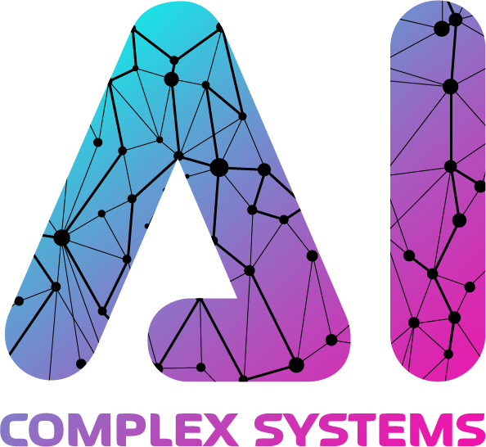

BananaGuard: A Comparative Analysis of AI Models for Firearm Detection in Crowded Environments
Rumeysa Kara, Betul Tok, Rawan AlMakinah, and M. Abdullah Canbaz
AI in Complex Systems Lab, University at Albany, SUNY
Department of Information Sciences and Technology
College of Emergency Preparedness, Homeland Security, and Cybersecurity
University at Albany, SUNY

Slide 2
Background & Motivation
Firearms have become the leading cause of death among American children and adolescents.
Firearm detection in crowded and dynamic environments remains a critical challenge for public safety due to:
Complex backgrounds
Crowded environment
Variable lighting
Dynamic movement
Differences in shape, size and configurations
and High stakes of false positives and negatives.
Conventional surveillance systems are limited in detecting threats.
The efficiency of these systems relies on human operators prone to cognitive fatigue, perceptual biases, and limited attention spans
Existing solutions often fail to balance accuracy, computational efficiency, and real-time applicability in resource constrained settings.
Solution: “BananaGuard” utilizes the power of object detection driven by advancements in machine learning (ML) and deep learning architectures to provide a real-time analytical system that can outperform traditional surveillance methods.
Notes:
"Let me begin by highlighting a stark reality
—firearms have become the leading cause of death among children and adolescents in the U.S.
This is not just a statistic; it’s a public safety crisis.
Also, In dynamic, crowded environments like schools or public events, firearm detection becomes incredibly challenging.
Factors like complex backgrounds, variable lighting, and different firearm appearances make traditional surveillance systems unreliable.
Also, human operators—while essential—are prone to fatigue, biases, and limited attention spans.
Our goal is to address these limitations with a system that not only detects threats more accurately but does so in real-time.
This is where 'BananaGuard’ comes as a solution.

Slide 3
Related Work
Studies have explored the application of state-of-the-art deep learning models for firearm detection, however they often:
Focus on individual model evaluations
Lack comprehensive benchmarking across diverse scenarios
Rely on synthetic or limited datasets, which fail to capture the variability of real-world conditions
→ Critical gaps in current research
Notes:
Existing research has explored the use of deep learning for firearm detection.
But They either evaluate single models in isolation----
ignore real-world variability by relying on synthetic datasets----
Or lack comprehensive benchmarking across diverse conditions.
This creates critical gaps in reliability and applicability.

Slide 4
State of the art Models
You Only Look Once (YOLO): Known for
speed and efficiency.
BUT! performance often deteriorates under challenging conditions, such as the presence of occlusion or firearms with unconventional appearances, and the issue of inaccurate identification of overlapping objects.
Transformer-based models like DEtection TRansformer (DETR):
introduced advancements in contextual reasoning and precision, eliminating the need for non-maximum suppression.
YET!! their high computational demands often render them impractical for real-time or edge-based surveillance applications.
Notes:
The models that we considered for this work are:
YOLO: which is known for speed and computational efficiency, making it ideal for real-time systems.
But under difficult conditions like occlusion or when guns have unconventional shapes, YOLO’s performance drops.
Then we have transformer-based models like DETR.
These offer more contextual reasoning and accuracy, especially in complex scenes-----
but they’re resource-intensive and impractical for real-time or edge-device use.
Each model comes with its own trade-offs, which is central to our evaluation.

Slide 5
Dataset and Models
Publicly available annotated dataset (44,753 annotated images) + web-scraped = 51,000 images focused on the firearm.
YOLOv10: lightweight object detection model, prioritize computational efficiency and real-time inference. it achieves a balance between detection accuracy and speed (an ideal choice for edge applications).
YOLOv11: Building upon the architectural foundations of YOLOv10, improving detection accuracy, particularly for small and partially occluded objects.
Real-Time DEtection TRansformer (RT-DETR)
Transformer-based architecture with contextual reasoning capabilities.
Using rigorous benchmarking process with consistent training pipelines and hyperparameters across all models to ensure comparability.
Evaluate their performance under challenging conditions, such as occlusion and unconventional firearm appearances, while analyzing trade-offs in accuracy, inference speed, and resource requirements.
YOLOV11 PERFORMANCE COMPARISON (8K VS. 51K IMAGES)
Dataset Size | mAP50(B) | mAP50-95(B)
8,000 | 0.99235 | 0.77878
51,000 | 0.99263 | 0.76836
Overfitting
Notes:
Our dataset included over 51,000 firearm-focused images—44,753 from a publicly available source, supplemented with additional web-scraped data.
However, we observed that while mAP50—which measures mean Average Precision at a 50% Intersection over Union threshold—remained high, the mAP50-95, which evaluates performance across a range of stricter IoU thresholds, began to decline. (Which mean we have overfitting)
This indicated that the models were struggling to generalize.
After several rounds of experimentation, we found that training on a curated subset of 8,000 images significantly mitigated overfitting and enhanced generalization.
Possible reasons of this issue might be having redundant samples or noisy labels in the larger dataset.
We trained three models:
YOLOv10, a lightweight model optimized for real-time performance in resource-constrained environments;
YOLOv11, which improves upon YOLOv10 by enhancing detection of small or partially occluded objects;
RT-DETR, a transformer-based model that offers strong contextual reasoning capabilities but requires greater computational resources.
We conducted a rigorous benchmarking process,
We were trying to ensure consistent training pipelines and hyperparameters across all models to maintain fairness and comparability.

Slide 6
Training Configuration and Optimization Parameters
NVIDIA GPU and CUDA-enabled acceleration.
150 epochs with a batch size = 16.
Data augmentation:
random scaling with a scale factor = 0.5.
horizontal flipping with 50% probability.
and auto random augmentation.
Erasing augmentation = 0.4.
initial learning rate= 0.01
Momentum = 0.937
Weight decay = 0.0005.
Three epoch warmup period with a warmup momentum of 0.8 and a warmup bias learning rate of 0.1.
The models used a box loss weight of 7.5, a classification loss weight of 0.5, and a distribution focal loss weight of 1.5.
Notes:
Our training was powered by NVIDIA GPUs and CUDA acceleration.
We ran training for 150 epochs with a batch size of 16.
Augmentation techniques included random scaling, horizontal flipping, and erasing.
We also used a learning rate schedule with warmup to stabilize early training.

Slide 7
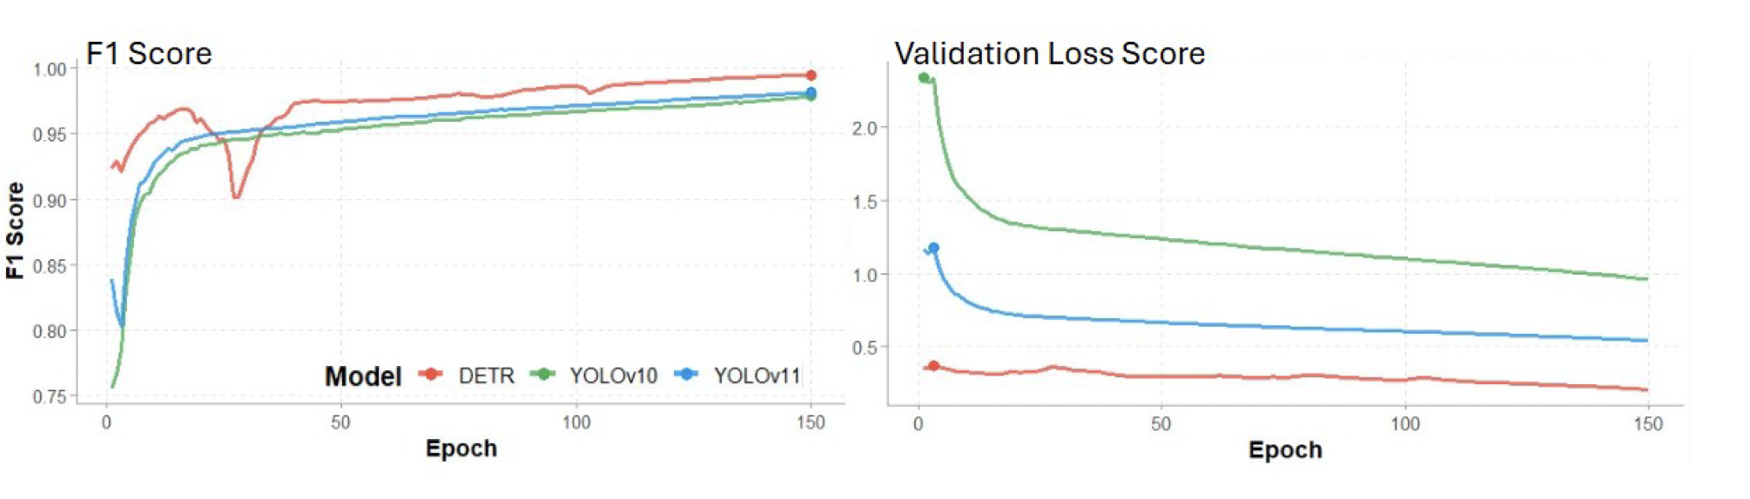
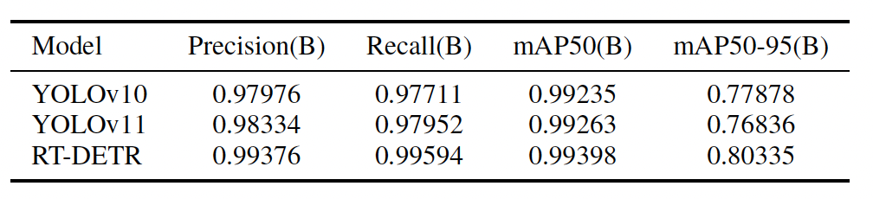
Experimental Result
MODEL PERFORMANCE ON VALIDATION SET
Notes:
Left Graph: F1 Score vs Epoch
F1 Score measures model accuracy by combining precision and recall (higher is better).
Red Line (DETR) starts strong and ends with the best performance (close to 1.0).
Blue Line (YOLOv11) and Green Line (YOLOv10) improve steadily but stay slightly below DETR.
Around epoch 40, DETR briefly dips—possibly due to overfitting or a learning rate issue—but then recovers.
✅ Takeaway: DETR ends with the best F1 score, meaning it’s most accurate overall.
Right Graph: Validation Loss vs Epoch
Validation Loss shows how well the model performs on unseen data (lower is better).
DETR (red) consistently has the lowest validation loss, indicating strong generalization.
YOLOv11 (blue) performs better than YOLOv10 (green) but worse than DETR.
✅ Takeaway: DETR generalizes best, YOLOv11 is better than YOLOv10, but both trail DETR.
Overall Conclusion:
DETR outperforms both YOLO models in accuracy (F1) and generalization (validation loss).
YOLOv11 is a clear improvement over YOLOv10 but still not as strong as DETR.

Slide 8
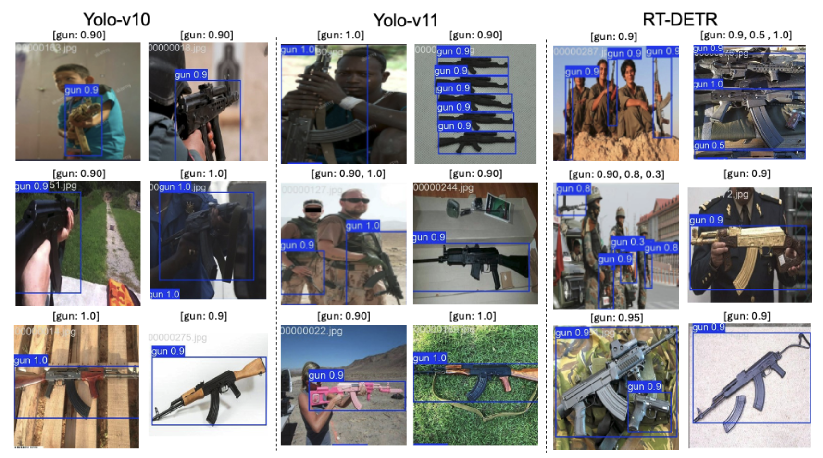
The sample of model’s gun detection predictions
Notes:
This Figure compares firearm detection performance across the three models in various real-world scenarios.
Each model’s predictions are shown with bounding boxes and confidence scores,
YOLOv11 stands out for its high accuracy and robustness, even in scenes with occlusion and dynamic lighting—
YOLOv10 performs well in simpler environments, however it may miss partially obscured firearms.
RT-DETR delivers the best accuracy in cluttered or complex scenes,

Slide 9
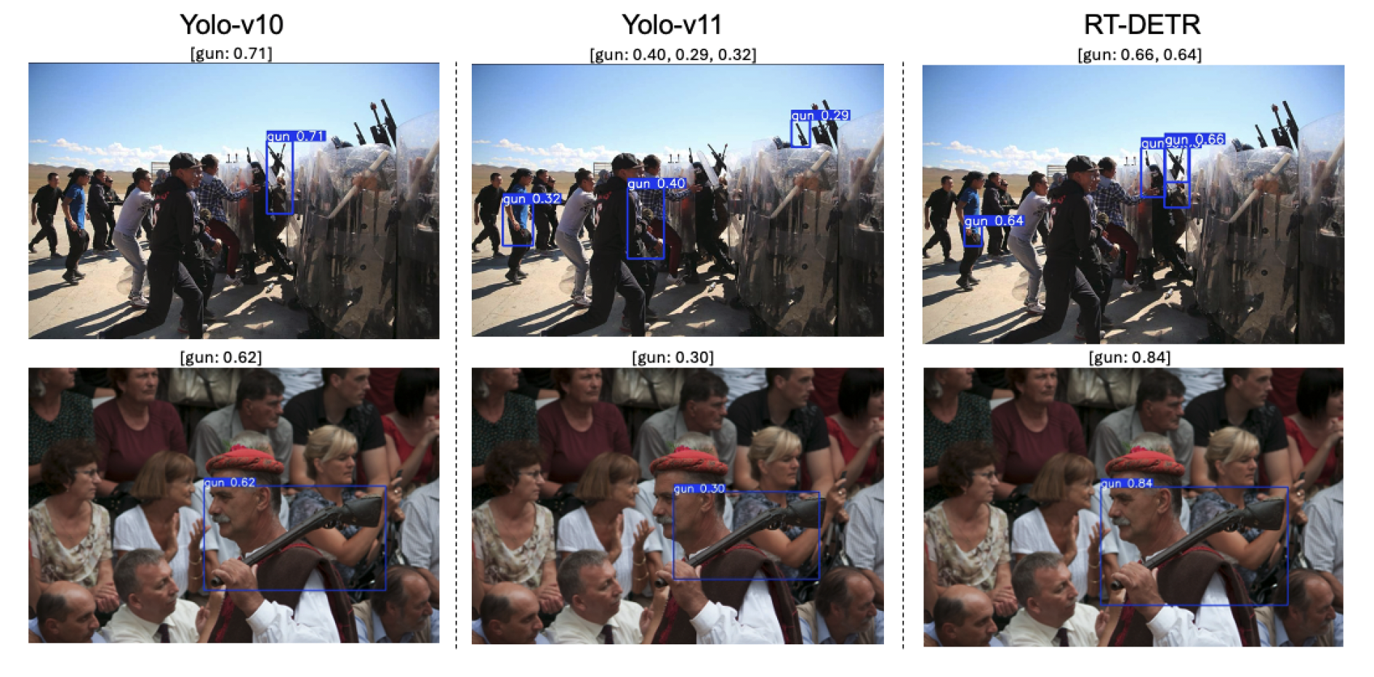
The sample of model’s gun detection predictions in crowded images
Notes:
This figure Figure compares how the three models perform in crowded, visually complex scenes—
conditions that make firearm detection difficult due to overlapping objects, varied lighting, and background distractions.
YOLOv10 manages to detect a single firearm with moderate confidence but struggles to identify multiple weapons.
YOLOv11 detected more firearms, but with lower confidence scores,
Which means it’s better at spotting objects but less certain under visual clutter.
RT-DETR performs the best in detecting multiple firearms with higher confidence,
which excels at understanding the broader visual context.
In a second example:
YOLOv10 detects the firearm with decent accuracy,
YOLOv11 identifies it with less confidence,
RT-DETR again delivers the most confident result.

Slide 10
General Takeaway
Our findings underscore the importance of selecting models based on application requirements, whether they prioritize real-time deployment, resource constraints, or high localization precision.
YOLOv10 is a reliable option for environments with limited computational resources, though it may require additional regularization or augmentation to address its susceptibility to overfitting.
YOLOv11 effectively balances real-time performance and accuracy positioning it as the optimal choice for real-time applications where both precision and recall are critical.
RT-DETR excels in nuanced detection tasks requiring greater computational resources.
Notes:
To wrap up, the choice of model should be guided by the specific application.
YOLOv10 is great for systems with limited computational power, though it might need more tuning to avoid overfitting.
YOLOv11 strikes a solid balance between speed and accuracy, it’s better at spotting objects but less certain under visual clutter, making it ideal for real-time detection in critical environments.
RT-DETR, while powerful, is better suited for settings where computational resources are not a constraint.
Overall, BananaGuard demonstrates that with the right combination of model architecture, dataset quality, and training strategy, we can significantly advance firearm detection systems and improve public safety.

Slide 11
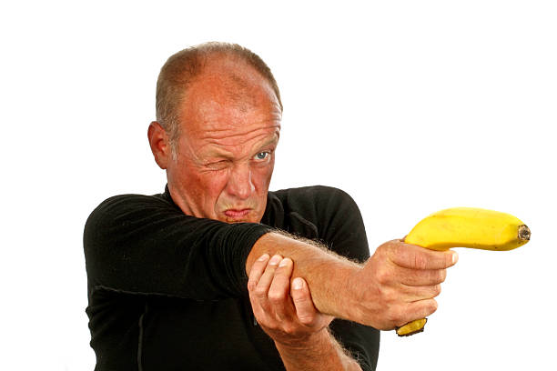

rkara, btok, ralmakinah, mcanbaz @albany.edu
BananaGuard Github Repo
Questions?

