Slide 1
Better & Faster Large Language Models via Multi-token Prediction
https://arxiv.org/abs/2404.19737

Slide 2
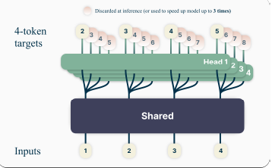
Multi-Head Tokens

Slide 3




Benefits
No train/memory overhead
Beneficial at Scale
3x Faster Inferencing
High Sample Efficiency
The relationship between the amount of data used and the model's performance on a given task
Larger the model, better the gain
Enables self speculative decoding for 3x faster inferencing
Due to the forward/back architecture

Slide 4
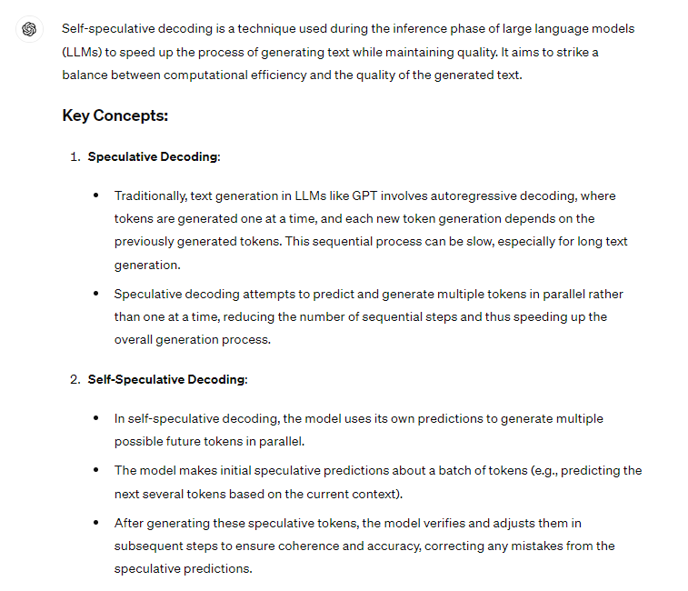
Terminology
SPECULATIVE DECODING

Slide 5
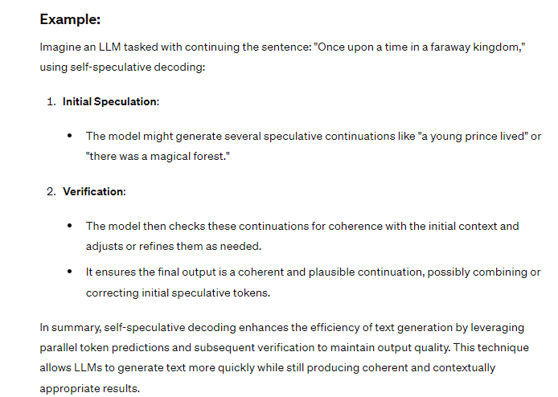
Terminology
SPECULATIVE DECODING

Slide 6
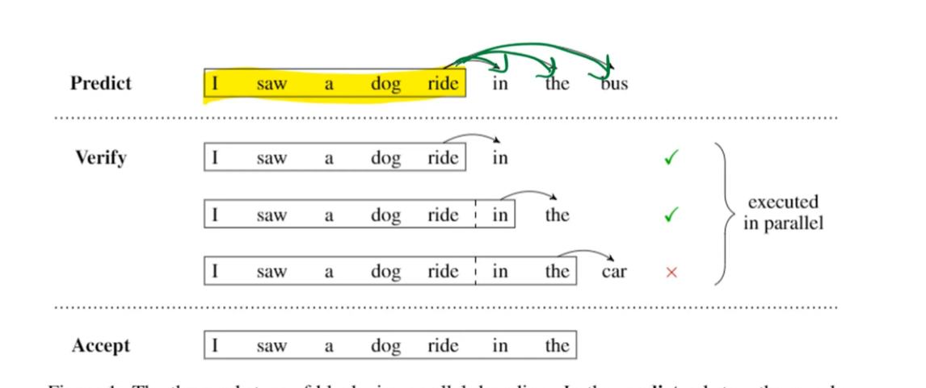
Terminology
Blockwise Parallel Decoding for Deep Autoregressive Models
Refer - https://www.youtube.com/watch?v=3Tqp_B2G6u0

Slide 7
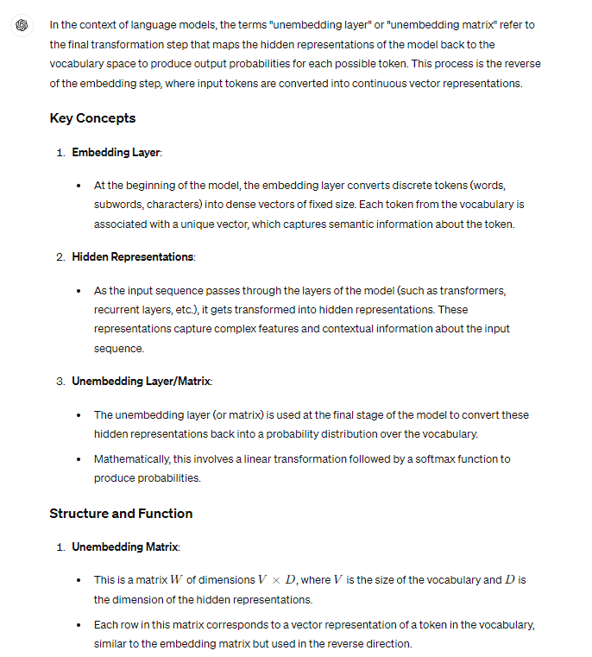
Terminology
Unembedding matrix/unembedding layer

Slide 8
Naïve Multitoken - GPU - O(n V + d)
n=1
V logits
N = Tokens; V = Vocabulary size; 'd' dimensions per token
n=2
n.V logits
V logits
n=3
V logits
n.V Gradients to be stored
d -represenatation at shared trunk
n=4
V logits

Slide 9
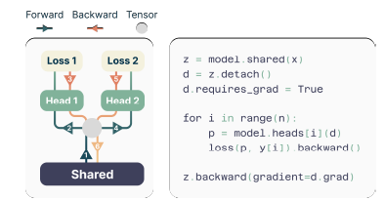
Fast Multitoken – O(V + d)
O(V + nd) ??

Slide 10
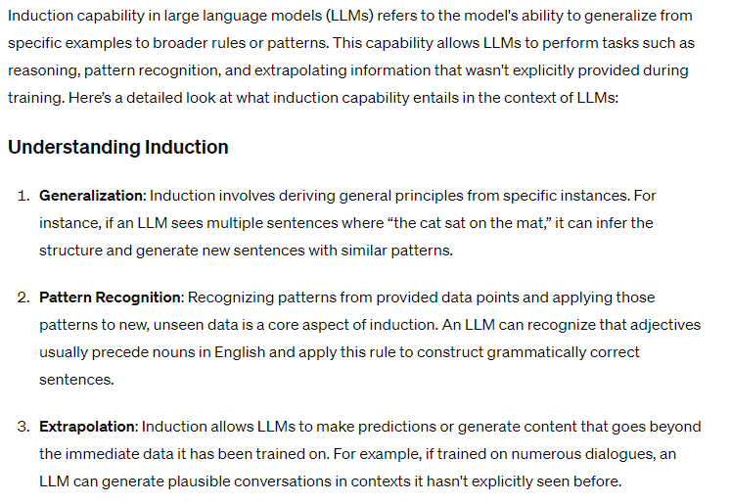
Terminology
INDUCTION

Slide 11
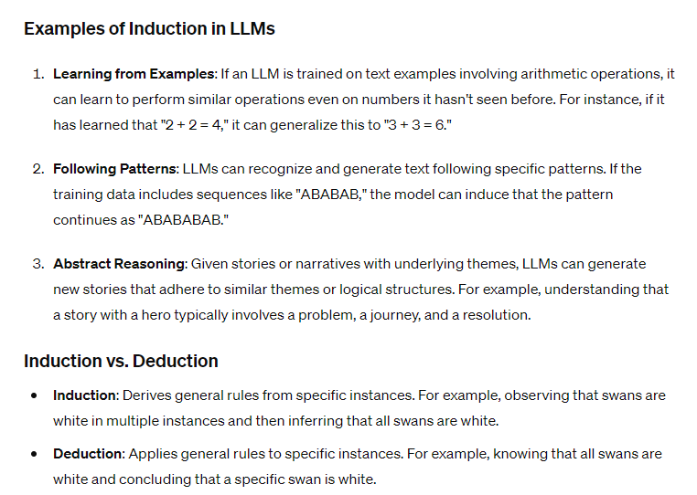
Terminology
INDUCTION EXAMPLE

Slide 12
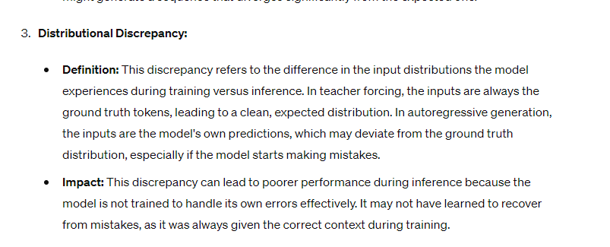
Terminology
DISTRIBUTION DISCREPANCY

