Slide 1

Multimodal learning (Structured + Unstructured data)

Slide 2
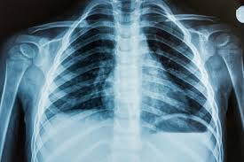
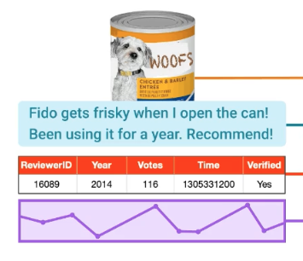
Data
x-ray
MIMIC-IV
Amazon Product
vitals
Variable | 8 pm | 9 pm | 10 pm | 11 pm | 12 am | 1 am | 2 am
Blood pressure | 100 mmHg | 100 mmHg | 100 mmHg | 100 mmHg | 102 | 104 | 108
Heart rate
notes
John Doe, a 44-year-old male, presents to the clinic with a chief complaint of intermittent chest pain for the past two weeks. The pain is described as a pressure-like sensation located in the center of the chest, radiating to the left arm. The pain typically occurs during physical exertion and is relieved by rest. He denies any shortness of breath, nausea, or sweating. He has a history of hypertension and hyperlipidemia. He is currently on lisinopril 10 mg daily and atorvastatin 20 mg daily. He denies smoking, alcohol use, and illicit drug use

Slide 3
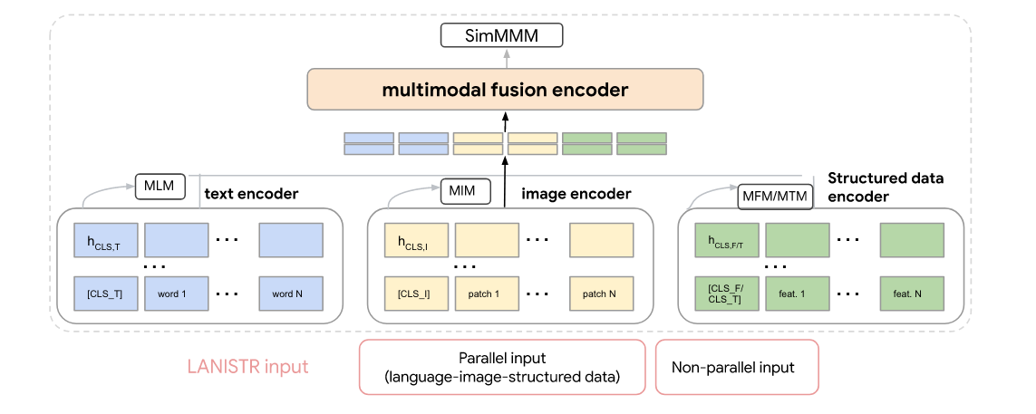
Architecture - LANISTR
Cross attention
Loss components
TabNet /Custom
Unimodal masking
BERT
VIT
Multimodal masking

Slide 4
Multimodal Fusion Encoder
Is Cross-Attention Preferable to Self-Attention for Multi-Modal Emotion Recognition? (https://arxiv.org/abs/2202.09263)
Attention Bottlenecks for Multimodal Fusion (https://arxiv.org/abs/2107.00135)

Slide 5

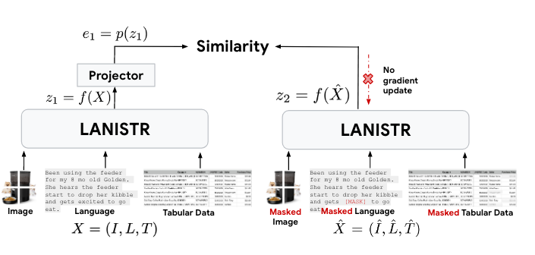
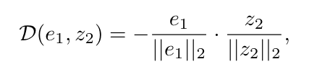
Loss Function - LANISTR
Stop gradient operation.
Smooth convergence.
X_hat does not receive gradients from Z2.

Slide 6
Fine Tuning - LANISTR
Unimodel encoders
Multimodel encoders
MLP classification layer
Frozen
Trainable

Slide 7
Results - LANISTR
MIMIC-IV :
Predict - (1/0) in hospital mortality (after first 48 hours in ICU)
Data – clinical notes + clinical time series (vitals) + last X-ray image
AUROC (87.37)
Amazon product review :
Predict – star rating out of 5
Data – product image + text (reviews, text summaries) + tabular data ( product id, review verification status, review ratings count, timestamp)
Accuracy (76.27 (Beauty) / 75.15 (Fashion))

Slide 8
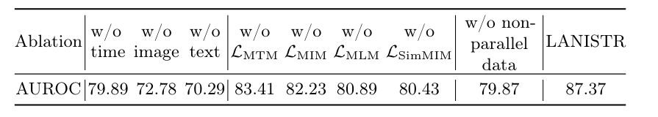
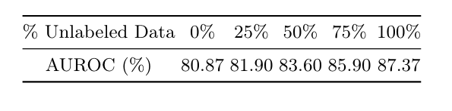
Ablation studies - LANISTR

Slide 9
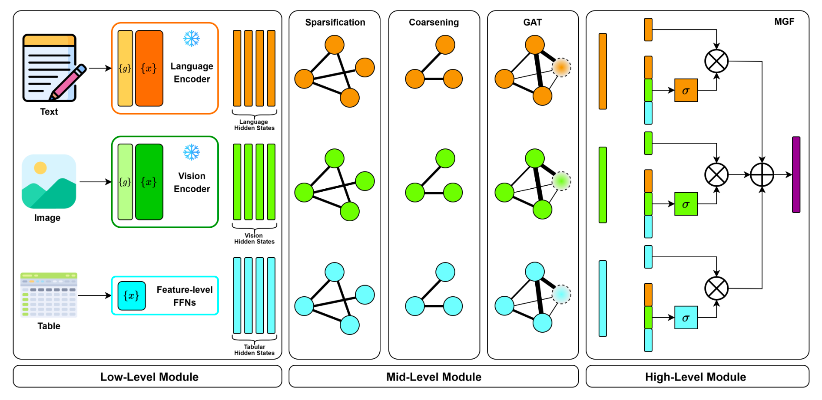
Architecture - MAGNUM
Loss:
Classification loss function
Low-Level Module:
Unimodal hidden states to same dimensional space.
Frozen pretrained architecture – learnable prompts g.
Feed forward neural network where pretrained model not available.
Default – dimension 256.
Mid-Level Module:
GNN processing.
Input : Hidden states as nodes in graph
Output : 1 learned node.
High-Level Module:
Multimodal Gated Fusion.
GRU /LTSM inspired.
Final aggregated state.
Apply a FFN layer on top of it.

Slide 10
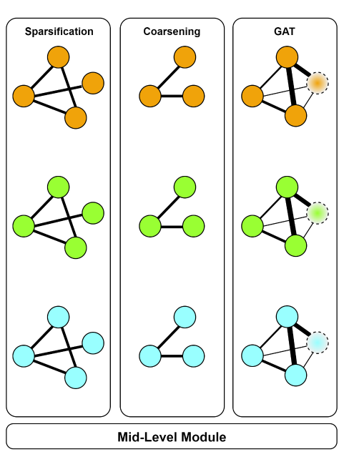
Mid-Level Module
Sparsification
estimates set of edges. (kNN based algorithm).
Sparse adjacency matrix.
Coarsening
merge nodes via edge pooling operation and learnable edge pooling layer.
torch_geometric.nn.EdgePooling
Attention
add a virtual node + full connected graph.
dynamic graph attention variant.
hidden states are the input and edge weights are estimated.
torch_geometric.nn. GATv2Conv

Slide 11
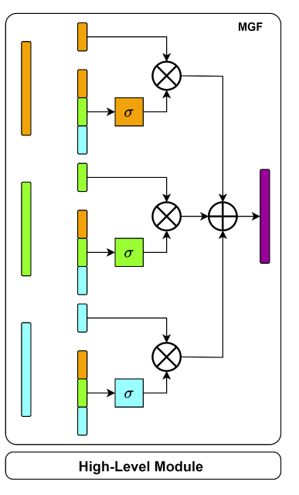

High-Level Module
Each modality has gated neuron controls contribution of a modality hidden state to final representation.
FFN1
TANH
*
FFN2
SIGMOID

Slide 12
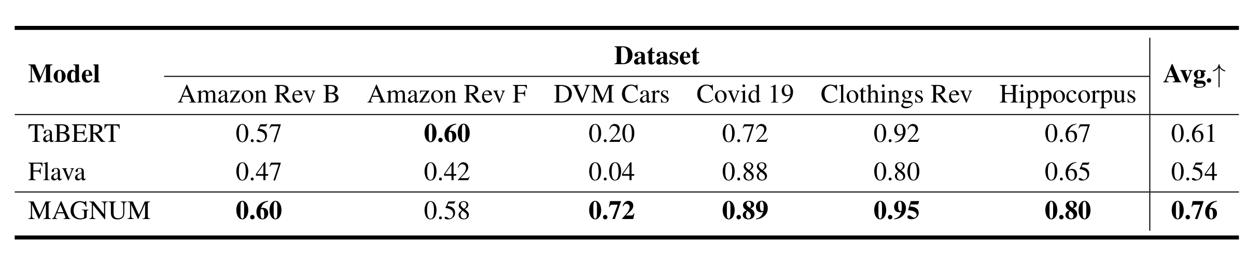
Results - MAGNUM

Slide 13
Differences ?
LANISTR
MAGNUM
Learn representation irrespective of downstream task.
Representations for a downstream task.
Pre-training - Unfrozen encoders
Fine-tuning - frozen encoders
Use of learnable prompts but frozen encoders.
Pre -training objective - masking
Fine-tuning objective - classification
Training objective - classification
Cross Attention mechanism
GRU Gated Unit

