Slide 1
Hypothesis 8 for Certus
Pipelined Bounce vs Direct P2P for KV-Cache Loading
Using Nous to answer a systems performance question
The Problem
Certus needs to move KV-cache data from storage to GPU memory as fast as possible.
Two paths:
1) Pipeline Bounce through host DRAM
2) Direct P2P DMA from SSD to GPU.
We used Nous to find out which is faster and whether it can design and implement what's missing to test this hypothesis.
Meta-Question
With minimal direction, can Nous autonomously answer this?
If not — how explicit do we need to be, and at what point does it produce useful implementations?
11 campaigns · ~$139 total · Opus for design, Sonnet for execute
1 / 8

Slide 2
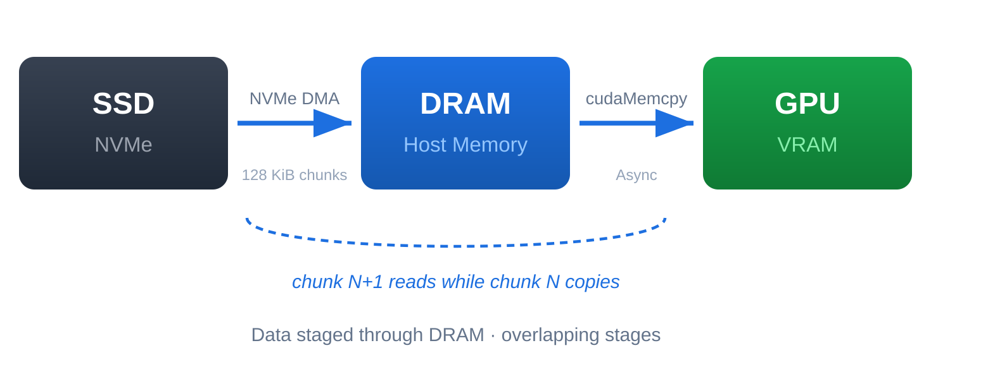
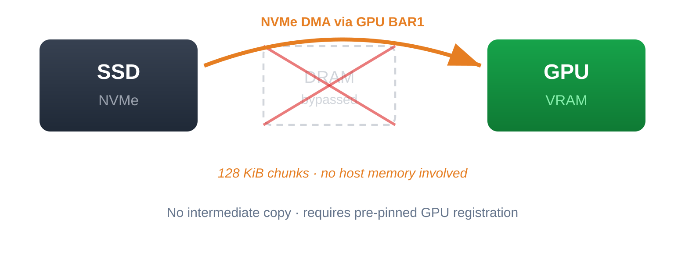
The Question We Asked Nous
HYPOTHESIS
SCOPE
Pipelined bounce-buffer (SSD→CPU→GPU) transfers outperform direct SSD→GPU P2P DMA for 4 MiB objects at 128 KiB NVMe chunk size.
— Neither dispatcher v0 nor v1 has P2P or efficient pipelining
— Nous must discover this and implement what's missing
— Full production stack: certus-server, SPDK, CUDA
Path A — Pipelined Bounce
Path B — Direct P2P DMA
System: AMD EPYC 7343 | 7× Intel DC NVMe (SPDK) | NVIDIA A30 | 512 MiB CUDA-pinned DRAM cache
What is in repo:
— certus-server — production binary (gRPC → dispatcher → NVMe → GPU)
— Dispatcher v0 — SSD→DRAM→GPU, single buffer, no pipelining
— Dispatcher v1 (Memory Tier) — ring of 4 DMA buffers for pipelining (optimized version of v1)
— gpu-p2p-server — standalone bounce/P2P/P2P-cold test binary but NO PIPELINING (Bypassess entire dispatcher stack).
— test_client.py — gRPC benchmark for client-server. Reports latency and throughput (Through dispatcher)
— QD (queue depth) — NVMe reads in-flight simultaneously
2 / 8

Slide 3
More Direction = Better Outcome
10 campaigns · ~$124 · Each row adds one constraint/direction — watch what changes
Campaign
What Nous implemented
Measured result
Verdict
No system constraint · 3 runs · ~$35
Nous found gpu-p2p-server — easiest binary in the repo. Results invalid.
Implemented: New modes in gpu-p2p-server: bounce-pipeline (cudaHostAlloc + CUDA stream), p2p-seq, bounce-seq.
h8-transfer-path
Ran existing bounce/P2P/cold modes in gpu-p2p-server.
P2P 2× faster (isolation)
Wrong binary (Hypothesis not aligned: No pipeline)
h8-pipelined
New bounce-pipeline: double-buffered ReadAsync + cudaMemcpyAsync.
Pipeline 2.4–3× over seq
Wrong binary (Hypothesis not aligned: No pipeline)
h8-dispatcher-p2p
New p2p-seq / bounce-seq modes in gpu-p2p-server.
P2P-seq 1.47× faster
Wrong binary (Hypothesis not aligned: No pipeline)
+ Must use certus-server · 2 runs · ~$24
Cold pinning (5–9 ms/call) negates DMA savings.
Implemented: P2P path in dispatcher v0 and v1. Per-request cudaHostRegister + spdk_mem_register on each call.
h8-v0-vs-p2p
P2P read path in dispatcher v0 (323-line patch, 4 files).
Bounce 13.8ms · P2P 18.4ms
Bounce 1.33×
h8-v1-vs-p2p
P2P read path in dispatcher v1 (6 files).
Bounce 13.0ms · P2P 15.3ms
Bounce 1.18×
+ Pre-pin GPU memory · 2 runs · ~$26
Opus read prior .nous/ results autonomously — cross-campaign learning.
Implemented: GPU buffer cache with one-time registration. Autonomously read prior .nous/ findings to design fix.
h8-v0-pinned
Interface change cascaded to 12 files — never compiled.
No data (240 turns, budget exhausted)
No data
h8-v1-pinned
GPU buffer cache in v1 — register once, reuse across lookups.
P2P 9.3ms · Bounce 18.8ms
P2P 2.02×
+ True pipelining / target reference · 3 runs · ~$38
Hypothesis answered. $3 run matched $35 result — reference input is 10–40× cheaper.
Implemented: Double-buffered cudaHostAlloc pipeline (v0); cudaHostAlloc + cudaMemcpyAsync (v1); parallel ReadAsync QD=2 + 2 CUDA streams.
h8-evolve-v0-pipeline
Double-buffered cudaHostAlloc + cudaMemcpyAsync on CUDA stream.
Bounce 9.7ms · P2P 20.1ms (cold)
Bounce ≈ P2P
3 / 8
h8-v1-true-pipeline
cudaHostAlloc pipeline in v1. NVMe dominates 10–100×.
0–10% gain (within noise)
Refuted
h8-v1-optimized
Parallel ReadAsync QD=2 + 2 CUDA streams (reference pattern).
15.4ms → 7.9ms (~2×)
Confirmed 2×
Final: Bounce ≈ P2P (9.3 ms vs 9.7 ms) when both properly implemented. What Nous missed: dispatcher at ~300 MB/s — hardware ceiling 3,200 MB/s. 10x gap never flagged.
Notes:
— Cold pinning — per-request cudaHostRegister + spdk_mem_register, 5–9 ms/call

Slide 4
The Real Gap
Nous showed bounce ≈ P2P — but throughput was terrible. We built other benchmarks to find exactly where the gap was.
Benchmark | What it measures | Throughput (16 MiB)
gpu-bb-vs-p2p (bounce) | Hardware ceiling — NVMe read + GPU DMA, no server, no gRPC | 3,258 MB/s
gpu-bb-vs-p2p (P2P) | Same via GDRCopy | 3,072 MB/s
dispatcher_hw_benchmark warm | DRAM → GPU, no SSD (memory-tier hit) | 3,145 MB/s
dispatcher_hw_benchmark cold QD=16 | Dispatcher pipeline as-shipped | 886 MB/s
certus-server via test_client.py | Full stack – (System overhead) | ~300 MB/s
The gap: 886 vs 3,258 MB/s = 3.7× below hardware ceiling.
4 / 8

Slide 5
Campaign 11 — Nous on the Remaining Gap
$14.60 · Goal: Optimize dispatcher v1. Additional constraint to nou: "Match gpu-bb-vs-p2p throughput as for reference point"
Iteration | What Nous tried | Result
Iter-1 | Lock-free GPU state flag, QD=32 (rediscovered), batch sync every 32, pre-alloc buffers | +8.9% one run, high variance. No real improvement.
Iter-2 | All NVMe reads on single deep queue + deferred GPU DMA | 29% regression at 16 MiB.
Nous's diagnosis
Interesting finding
Pool eviction variance dominates measurement. Optimized pipeline-level code in pipeline.rs. Couldn't see past the single file?
Nous discovered different NVMe queue routing at 128 KiB batch size gives 3.6× speedup — a discovery worth investigating.
The pattern: Nous optimizes what it can see in one file. The remaining gap likely lives in system topology invisible from a single file.
5 / 8

Slide 6
What Nous Got Wrong
Failure | Impact | Fix difficulty
Accepted impossible result (SSD faster than DRAM) | Reported CONFIRMED on physically invalid data | Easy — validation rules
Used wrong binary for 4 runs (gpu-p2p-server not certus-server) | $35 wasted on irrelevant measurements | Easy — constraints field
Deepened the winning path instead of strengthening the loser | Bounce with true pipelining ties P2P (9.7ms vs 9.3ms) — Nous nearly reached the wrong conclusion | Medium — A/B discipline
Misattributed 2× gain (said async overlap, was buffer pre-alloc) | Wrong conclusion in experiment findings | Medium — ablation enforcement
Never noticed pipeline code is actually sequential | Missed core code bug across 7 campaigns | Hard — deep code reasoning
Never flagged 10× gap between system and hardware ceiling | Missed the real performance problem entirely | Hard — layered benchmarking
Iter-2 abandoned working iter-1 without understanding why | Wasted iteration, lost compounding progress | Hard — experimental discipline
Pattern: Nous answers the question you ask. It doesn't ask "is this the right question?" or "is there a bigger problem here?"
6 / 8

Slide 7
Recommendations & Ideas
For the Nous product
For how we structure campaigns
1. Constraints field in campaign schema
1. Sanity-check gate on results
must_use_binary, max_files_modified, must_not_modify — hard rules validated before execution
SSD < DRAM? Throughput > PCIe max? → flag IMPOSSIBLE. Would have caught false CONFIRMED
2. Weight keywords in hypothesis
2. Hardware ceiling comparison before optimizing
Flag if experiment doesn't address them
If system < hardware / 3 → flag "system overhead dominates, optimization may be at wrong level"
3. Hypothesis-to-experiment alignment gate
3. Reference implementation as default input
Reject bundle if it doesn't test what's stated — 4/11 campaigns tested a different question
Campaign 10: $3 vs $35 for same insight (10–40×). Always include working example; if none, write 50–100 line version
4. Blast radius estimation before implementation
4. Write reference / target performance first
Enumerate files that must change; if >5 → flag for human. Prevented campaign 6's $14 blowout
Concrete number to match is far cheaper than describing strategy. Eliminates design search
5. Profiling-first workflow
5. Architecture map as campaign input (Certus knowledge base)
Run perf/flamegraph BEFORE experiment design — campaign 11 optimized pipeline.rs when bottleneck was actor scheduling
Component + thread model + data flow. Campaign 11: Nous couldn't reason about actor/channel topology
6. "Zoom out" checkpoint after iter-1
6. Attach flamegraph as campaign input
"Is bottleneck local (this file) or systemic (topology)?" — breaks tunnel vision
Eliminates wrong-bottleneck failures — workaround until Nous can profile natively
7. Iter-2 must explain iter-1 before changing
7. Declare architecture explicitly
If iter-1 gained, ablate the mechanism first. Campaign 8: lost 2× gain by switching to BatchSubmit
"6 NVMe drives on 1 thread, message-passing between components" — context Nous can't discover from code
8. Ensure A/B parity before concluding
8. Split diagnosis vs implementation
Both arms must have their best implementation. Pre-pinned P2P vs cold bounce is not a valid test
Campaign A: "what's the bottleneck?" Campaign B: "fix this specific thing" — matches Nous's strengths
Savings estimate: sanity gates + constraints alone would have saved ~$49 (35% of total spend). Reference impl input = proven 10–40× cost reduction.
7 / 8
Notes:
Recs 1-3 are from campaigns 1-9, confirmed by 10-11. Recs 4-8 (product) and 3-8 (campaigns) are new from campaigns 10-11. Hardware ceiling comparison is cheapest to implement and would have caught the biggest miss. Reference implementation as input is highest ROI (proven 10-40x).

Slide 8
Nous assessment on Hypothesis-8
Nous is good for:
Confirming/refuting specific hypotheses
Finding CUDA/SPDK integration issues
Cross-campaign learning — reads prior .nous/ results, compounds knowledge
Novel discoveries (cold-pinning cost, queue routing speedup at 128 KiB)
Adapting to a target performance baseline cheaply
Single-file CUDA + SPDK implementation with no hand-holding
Not good for (today)
Identifying the right question to ask
Multi-file architectural changes
Closing system-level performance gaps
Flagging when system is far below hardware ceiling (This might be not Nous’s responsibility)
8 / 8
Notes:
The framing is collaborative — Nous answered what we asked, we learned we were asking the wrong question, and now we know how to ask better questions.

