Slide 1
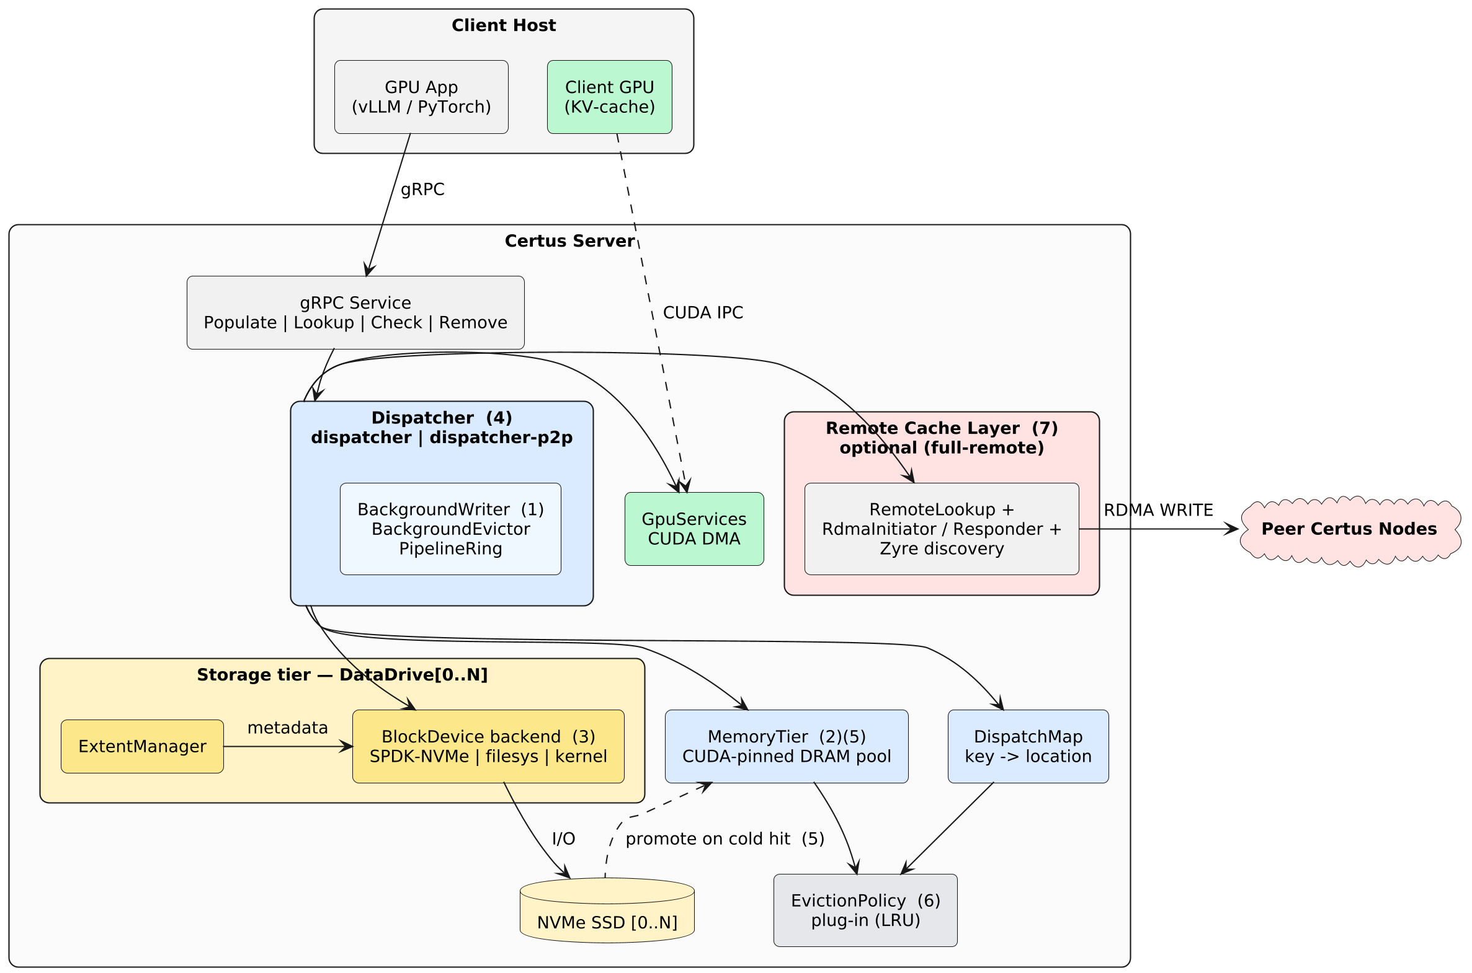
Certus — High-Level Architecture & Key Features
Key features
(1) Lazy write-through — Populate returns once the block is in the DRAM tier; SSD persistence happens asynchronously via the background writer.
(2) Memory-tier-full handling — When DRAM is saturated, LRU blocks with completed write-through demote to SSD-only; cold data is then served straight from SSD.
(3) Pluggable block-device backends — Any IBlockDevice impl — SPDK userspace NVMe, filesystem-backed, or kernel block device — paired with an ExtentManager.
(4) Optional GPUDirect P2P — The dispatcher-p2p variant streams SSD ↔ GPU through a BAR1-mapped ring, bypassing the DRAM staging copy (profile full-p2p).
(5) Cold-hit promotion — A lookup that misses DRAM but hits SSD is pipelined into DRAM and re-registered as a warm memory-tier entry.
(6) Pluggable eviction policy — MemoryTier and DispatchMap delegate victim selection to an IEvictionPolicy plug-in (LRU today).
(7) Remote peers via RDMA — In full-remote, local misses query peers (Zyre discovery); the holding peer RDMA-writes the value directly into local memory — one-sided, no CPU on the requester's critical path.

