Slide 1
Archon
Turning code changes into architectural insights

Slide 2
The idea
A code repository contains the complete evolution of a software system -> its source code, commits, branches, and pull requests.
Notes:
So how software development works today is you have A Git repository that contains the complete history of a software system—its source code, commits, branches, and pull requests.

Slide 3
The idea
A code repository contains the complete evolution of a software system—its source code, commits, branches, and pull requests.
Pull requests are the primary mechanism for reviewing and merging changes.
Notes:
Whenever a developer proposes a change, they open a pull request, which becomes the primary mechanism for review before the change is merged.

Slide 4
The idea
A code repository contains the complete evolution of a software system—its source code, commits, branches, and pull requests.
Pull requests are the primary mechanism for reviewing and merging changes.
Today, reviewers inspect textual diffs: lines of code added, removed, or modified.
Notes:
"Today, reviewers inspect textual diffs. They look at which lines were added, removed, or modified. Or thats not completely true if u launch a clade process to look at the pr but the idea is if u wanted to understand what happened you would have to inspect the file/code changes

Slide 5
The idea
A code repository contains the complete evolution of a software system—its source code, commits, branches, and pull requests.
Pull requests are the primary mechanism for reviewing and merging changes.
Today, reviewers inspect textual diffs: lines of code added, removed, or modified.
However, developers also care about the system's architecture: module boundaries, dependencies, interfaces, and the overall design.
Notes:
However, that's usually not what reviewers actually care about. They're trying to understand whether the architecture changed. Did new dependencies appear? Did we introduce coupling between previously independent components?

Slide 6
The idea
A code repository contains the complete evolution of a software system—its source code, commits, branches, and pull requests.
Pull requests are the primary mechanism for reviewing and merging changes.
Today, reviewers inspect textual diffs: lines of code added, removed, or modified.
However, developers also care about the system's architecture: module boundaries, dependencies, interfaces, and the overall design.
That architectural view is typically maintained as hand-drawn diagrams or documentation, which quickly becomes outdated as the code evolves.
Notes:
The problem is that our architectural understanding usually lives in diagrams or documentation created manually. As the system evolves, those diagrams quickly become outdated and drift away from the implementation

Slide 7
The idea
ARCHON bridges this gap by deriving an architectural graph from the codebase and computing an architectural delta for every pull request.
Instead of reviewing only lines of code, reviewers can understand what changed in the system's design.
Notes:
ARCHON closes this gap by deriving an architectural graph directly from the codebase and computing an architectural delta for every pull request.
Instead of reviewing only changed lines, reviewers can understand what changed in the system's design

Slide 8
What it is
ARCHON represents software as a typed architectural graph and reviews changes using architectural deltas instead of textual diffs.

Slide 9
What it is
ARCHON represents software as a typed architectural graph and reviews changes using architectural deltas instead of textual diffs.
Current code review asks:
What lines changed?
Which files changed?
Does the code compile?
ARCHON asks:
What architectural boundaries changed?
Which module dependencies changed?
Which contracts changed?
Is this change safe to automate?
Notes:
"Current code review is largely code-centric. We ask questions like: what lines changed, what files changed, and does the code compile?"
"ARCHON shifts the focus to architecture. It asks: did dependencies change? Were there any architectural violations? And ultimately, is this change safe enough to automate or should it require human review?"

Slide 10
What it is
ARCHON represents software as a typed architectural graph and reviews changes using architectural deltas instead of textual diffs.
Current code review asks:
What lines changed?
Which files changed?
Does the code compile?
ARCHON asks:
What architectural boundaries changed?
Which module dependencies changed?
Which contracts changed?
Is this change safe to automate?
Code
↓
Architectural Graph
↓
Architectural Delta
↓
Review / Policy / Automation
Notes:
Conceptually, the workflow is simple. Starting from the codebase, ARCHON constructs an architectural graph. For every pull request, it computes the difference between the old and new graphs—what we call the architectural delta. That delta then becomes the primary artifact used for review

Slide 11
Problem: Large textual change ≠ Large architectural change
Github might show:
100 files changed
↓
Architectural Delta = ∅
Actually the developer only
renamed packages
moved files
reorganized folders
split modules
Result:
✅ Same architecture
✅ Same interfaces
✅ Same dependencies
Notes:
The first problem is that textual size doesn't necessarily correspond to architectural impact."
"Imagine a developer reorganizes the repository. They rename packages, move files into different folders, split modules, and clean up the project structure."
"GitHub might report that 100 files changed, making the pull request appear enormous."
"Architecturally, though, nothing changed. The same packages communicate in the same way, the interfaces remain the same, and the dependencies are unchanged."
"So what looks like a massive pull request is actually just an internal refactor with essentially zero architectural impact

Slide 12
Problem: Large textual change ≠ Large architectural change
Github might show:
100 files changed
↓
Architectural Delta = ∅
Actually the developer only
renamed packages
moved files
reorganized folders
split modules
Result:
✅ Same architecture
✅ Same interfaces
✅ Same dependencies
A massive textual diff can correspond to almost no architectural change.

Slide 13
Tiny textual change ≠ Tiny architectural change
+ import grpc -> looks harmless
But suddenly
Module A
depends on
Module B etc.
Notes:
"The opposite can also happen."
"Suppose someone adds a single line like import grpc."
"Textually, that's almost insignificant."
"But architecturally, that one line might introduce a completely new dependency between modules, a new communication protocol, or an external runtime dependency."
"A tiny textual change can fundamentally alter the system architecture."

Slide 14
Tiny textual change ≠ Tiny architectural change
+ import grpc -> looks harmless
But suddenly
Module A
depends on
Module B etc.
A one-line code change can fundamentally change the architecture

Slide 15
AI amplifies the problems
Claude Code
↓
135 files modified
↓
GitHub
135 textual diffs
What reviewers actually want to know
✓ Did module boundaries change?
✓ Did APIs change?
✓ Did new dependencies appear?
✓ Did security boundaries change?
✓ Is this an internal refactor?
Notes:
"This becomes much more important with AI coding agents."
"An agent like Claude Code can easily modify over a hundred files in a single pull request."
"GitHub shows hundreds of textual diffs, but reviewers aren't interested in reading every line. They want answers to much higher-level questions."

Slide 16
AI amplifies the problems
Claude Code
↓
135 files modified
↓
GitHub
135 textual diffs
What reviewers actually want to know
✓ Did module boundaries change?
✓ Did APIs change?
✓ Did new dependencies appear?
✓ Did security boundaries change?
✓ Is this an internal refactor?
Humans review architecture, not text. AI agents generate lots of text.

Slide 17
Archon’s solution
AI proposes change
↓
Compute Architectural Delta
|
Empty boundary delta?
/ \
Yes No
| |
Automatic Human Review
Admission Reviews Delta
Notes:
ARCHON computes the architectural delta first."
"If the change is entirely internal and doesn't alter architectural boundaries, it can potentially be admitted automatically."
"If the change crosses architectural boundaries, it requires human review."

Slide 18
Archon’s solution
AI proposes change
↓
Compute Architectural Delta
|
Empty boundary delta?
/ \
Yes No
| |
Automatic Human Review
Admission Reviews Delta
Instead of
file diff
line diff
ARCHON computes
dependency changes
boundary changes
contract changes
Notes:
"Instead of reasoning about files and lines, reviewers reason about dependency changes, boundary changes, and contract changes."

Slide 19
Archon’s solution
AI proposes change
↓
Compute Architectural Delta
|
Empty boundary delta?
/ \
Yes No
| |
Automatic Human Review
Admission Reviews Delta
Instead of
file diff
line diff
ARCHON computes
dependency changes
boundary changes
contract changes
The architectural delta becomes the primary review artifact.
Notes:
"The architectural delta becomes the primary review artifact."

Slide 20
Benefits
Better code review
Review architectural intent instead of thousands of changed lines.
Living documentation
Architecture diagrams are generated from code.
No documentation drift.
Continuous conformance
Architectural policies checked every commit.
Detect violations immediately.
Safe autonomous development
AI agents can evolve implementations while respecting architectural boundaries.
Notes:
Better code review
"The first benefit is simply better reviews. Instead of reading thousands of changed lines, reviewers immediately see the architectural intent of the change."
Living documentation
"Second, the architecture graph is generated directly from the codebase, so documentation stays synchronized automatically. There's no manual architecture diagram that becomes outdated over time."
Continuous conformance
"Third, architectural rules can be checked continuously. For example, if the UI layer is not allowed to directly access the database, ARCHON can detect that violation automatically whenever a new pull request is opened."
Safe autonomous development
"Finally, this creates a path toward safe AI-assisted development. AI agents can freely evolve internal implementations, while changes that modify architectural boundaries are automatically escalated for human review."

Slide 21
Goals
(1) make architectural change first-class and reviewable
(2) keep documentation from drifting
(3) give agents a checkable boundary for safe autonomy
(4) work on messy brownfield repos, not just clean greenfield.
Notes:
Goal 1 – Make architectural change first-class and reviewable
"The main idea is to review architectural changes, not just code changes. Instead of focusing on modified lines, reviewers can immediately understand how the system's design evolved."
Goal 2 – Keep documentation from drifting
"Since the architecture graph is generated directly from the code, documentation stays synchronized automatically and doesn't become outdated over time."
Goal 3 – Give agents a checkable boundary for safe autonomy
"ARCHON gives AI agents clear architectural boundaries. Internal changes can be automated, while changes that modify the architecture are flagged for human review."
Goal 4 – Work on messy brownfield repositories
"Finally, ARCHON is designed for existing industrial codebases, not just new greenfield projects. It can extract the current architecture and help teams gradually improve it over time instead of requiring a perfect design from day one."

Slide 22
More concrete: what would the graph look like
Repository
├── package: api
│ ├── module: routes.py
│ ├── function: create_user()
│ └── endpoint: POST /users
├── package: auth
│ ├── module: jwt.py
│ └── function: verify_token()
├── package: db
│ └── table/model: User
└── config: settings.yaml

Slide 23
More concrete: what would nodes look like
repo
package
module/file
class
function
API endpoint
config key
database table
queue/topic
metric
trace span
external service
permission/capability
runtime platform
Notes:
"The graph isn't limited to source code."
"Nodes can represent packages, classes, functions, API endpoints, configuration keys, database tables, message queues, metrics, trace spans, external services, runtime platforms, and permissions."
"The goal is to capture architecture rather than just program syntax.

Slide 24
edges
api.routes imports auth.jwt
api.create_user calls auth.verify_token
api.create_user reads config.DB_URL
api.create_user writes db.User
Notes:
"Edges represent relationships between those nodes."
"Some are traditional software relationships, such as imports and function calls."
"Others are operational relationships—for example reading configuration values, accessing databases, emitting metrics, or communicating with external services."
"These richer edge types allow the graph to represent the operational architecture of the system, not just its source code structur

Slide 25
One issue: some edges might only appear when the system runs
Examples:
Actual external services contacted (eg Stripe authentication)
Dynamically loaded plugins/modules
Runtime network communication
Database connections
Distributed trace interactions
Notes:
One challenge is that not every architectural relationship can be discovered statically."
"Some dependencies only become visible when the application runs."
"For example, the application might dynamically connect to Stripe, load plugins at runtime, establish database connections, or communicate with services discovered dynamically."
"One possible extension is to augment the static graph using runtime traces—such as OpenTelemetry—to discover and validate these runtime-only edges."

Slide 26
Related work (1) ArchUnit / import-linter
What they do
Developers manually define architecture rules
Every commit is checked against those rules
The build passes or fails depending on whether the rules are violated
How ARCHON is different
No need to manually define the architecture
Automatically derives the architecture from the codebase
Shows how the architecture changed between two commits
Notes:
So there are tools for enforcing architecture rules. For example, a team might define a rule saying the UI layer is not allowed to directly access the database. Every time someone commits code, the tool checks whether that rule was violated. If it was, the build fails."
"The important point is that these tools only check rules that developers have already written. They don't tell you how the architecture itself changed."
"ARCHON takes a different approach. It first derives the architecture automatically from the codebase, then compares the old and new versions of that architecture. Instead of simply saying 'a rule was broken,' it tells reviewers what architectural change the PR actually introduced."

Slide 27
Related work (2) GumTree / RefactoringMiner
What they do
Detect renames, moves, and other refactorings
Match the same code across different versions
Reduce false differences caused by refactoring
How ARCHON is different
Uses these matches to compare 2 architectures
Focuses on the architectural impact of the change
Reviews architectural evolution, not just code refactorings
Notes:
"These tools detect things like renaming a class or moving a file. So if you simply rename UserService to AccountService, they know it's still the same piece of code instead of thinking you deleted one file and created another."
"ARCHON builds on that. It uses this information to compare the architecture before and after the change, and asks whether the architecture actually changed or whether it was just a refactoring."

Slide 28
Open questions
How should the architecture graph be built?
What should be included as nodes and edges?
How detailed should the graph be?
Can we capture all architectural relationships?
Some dependencies only appear when the system is running.
Do we need runtime information in addition to static analysis?
How well will this work across different languages?
Can the same approach handle Python, Go, Rust, C++, and mixed-language projects?

Slide 29
Open questions
4. Can architecture alone guarantee safe changes?
A change may preserve the architecture but still change the system's behavior.
Is the architectural delta enough for automatic approval?
5. Can it scale to real industrial codebases?
Will graph extraction and comparison remain fast for very large repositories?
6. How should ARCHON be evaluated?
Does it actually improve code reviews?
Does it reduce review effort without missing important architectural changes?
Notes:
Start with 6
What doe success loook like
Scenairo a -> expect a
Scenario b
How can u quantify
How nodes and edges look like
Property testing
Can we mix that in
Code must do
Linting more than that
Red green blue
Deletes changes additions
Maybe just refacotring
Pre and post pr

Slide 31
extra
Problem.
How do you know it didn't quietly do
UI
↓
Database
?
Today's answer
Run tests.
ARCHON says
Not enough.
Also check
Did the architecture change?

Slide 33
Recap of the problem
When you review a pull request, the tool shows a textual diff:
"9 files changed, 174 insertions."
That tells you what text moved, not what the design did.
A 90,000-line PR can be pure docs (no design change)
A 30-line PR can insert a whole new caching layer
Reviewers can't tell these apart from the diff.
Notes:
today, when someone opens a pull request, the review is driven by a textual diff—things like '9 files changed' or '174 lines added.' That tells us what code changed, but not what changed in the system's design.

Slide 34
The idea
ARCHON builds a picture of the system's architecture and shows, for any change, the architectural delta:
Did a new part appear or disappear?
Did a dependency form between parts?
Did a public interface change?
Did one part start implementing another's contract?
This delta is smaller and more meaningful to review
Notes:
The idea behind ARCHON is to review changes at the architecture level instead of just the code level. Rather than showing every modified line, ARCHON builds a picture of the system and highlights only the architectural changes. For example, did a new component appear? Did two components become connected? Did a public interface change? The goal is to give reviewers a much smaller and more meaningful summary of what actually changed."

Slide 35
What we have implemented so far
What ARCHON supports today:
archon-go extract <repo> <commit>
archon-go delta <repo> <before-commit> <after-commit>
archon-go render <repo> <commit>
Notes:
We currently have a working Go prototype with three main commands. The first extracts the architecture graph for a specific commit. The second compares two commits and produces the architectural delta. And the third renders the graph as a visual diagram. Everything I'll show today is built using these three commands."

Slide 36
Evaluating archon on blis - method
For the last 80 merged PRs, we:
Compared the repository before and after each merge.
Extracted an architecture graph for both versions containing:
Packages
Import dependencies
Public interfaces
Computed the architectural delta by diffing the two graphs.
Compared the architectural delta against the normal Git diff (files/lines changed).
Notes:
I started with the BLIS repository. One reason i chose this is because BLIS is written in Go, and in go, packages map naturally to different architectural modules. So For each of the last 80 merged changes, we looked at the repository before and after the change, built an architecture graph for each version, computed the architectural delta, and then compared that against the normal Git diff."
—-
Since BLIS squash-merges PRs, each merged PR appears as a single commit on the main branch. So for every merged change we compare the parent commit ("before") against the merge commit ("after").

Slide 37
How archon analyzes a change
parent commit target commit
↓ ↓
before graph after graph
└──────── diff ────────┘
↓
architectural delta
Notes:
For every change, the process is always the same. We take the parent commit, build its architecture graph, then build another graph for the new commit. We compare those two graphs to find the architectural delta. Finally, we compare that architectural delta with the normal Git diff to see how much smaller the architectural review becomes."
—----
We used commits because commits are exact, reproducible snapshots of code. For BLIS, this approximates PRs because the project squash-merges, so one main-branch commit roughly corresponds to one merged PR.

Slide 38
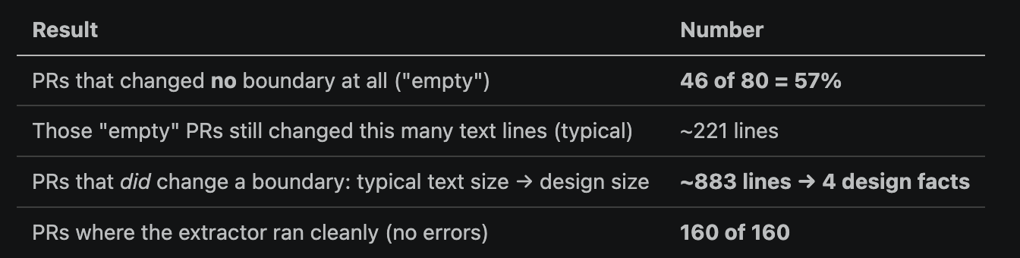
Initial results
PR #1322 -> 88,873 changed lines -> 162 modified files -> architectural delta empty (most of themw ere just md files)
Notes:
So some Key observations
57% of recent PRs did not modify package boundaries, despite still changing around 220 lines of code on average.
When a PR did modify the architecture, the review object shrank from roughly 883 changed lines to about 4 architectural facts (e.g., dependency added, public interface changed).
Example
PR #1322 — "Ignore docs/plans/"
88,873 changed lines
162 modified files
Every file was Markdown
➡️ Architectural delta: Empty
Even though Git reports a massive textual diff, ARCHON correctly reports no architectural change.
Why 160 extractions?
Title: 80 changes means 160 graph extractions
For each change:
1 before graph + 1 after graph = 2 graph extractions
For 80 BLIS changes:
80 before graphs
+ 80 after graphs
= 160 total graph extractions
Result:
160 / 160 extracted successfully
Meaning:
ARCHON successfully built the architecture graph for every before/after snapshot
Takeaway:
More than half of recent BLIS changes modified code without changing the modeled architecture. When architecture did change, ARCHON reduced a large textual diff into a few reviewable design facts.

Slide 39
Choosing a repository with known architectural changes
Selected: todo-api-microservice-example (Mario Carrion)
Why?
Built specifically to teach software architecture.
Every major architectural evolution is documented.
Documentation links architectural changes to specific commits.
Examples include:
Cache-aside layer
Elasticsearch search engine
RabbitMQ
Kafka/event streaming
Notes:
But an issue with using blis here is we dont really have the ground truth so i dont really know for sure if what archon is saying is correct and so i wanted to find a repo where somehow the architecture is known so i have some ground truth
And we found this mciroserveice rpeo where every major architectural evolution is documented and linked to a specific commit, so i could compare archon against it
—-
Instead of guessing what is "architectural," we can compare ARCHON's output against the maintainers' own explanation.

Slide 40
Microservice repo
Ground Truth
Project documentation states this commit introduced a Cache-Aside caching layer.
Code change
174 changed lines
8 modified files

Slide 41
How archon builds the architecture graph
Repository @ Commit
│
Load and analyze the Go project
│
┌─────────────────────────────┐
│ Architecture Graph │
└─────────────────────────────┘
Nodes Edges
• Go packages • Imports
• External deps • Calls
• Interface implementation
Notes:
For each commit, we first build an architecture graph. Instead of parsing Go ourselves, we use Go's go/packages library—the same infrastructure used by the Go compiler—to understand the project. It resolves packages, imports, function calls, and interface implementations. ARCHON then extracts the architectural relationships it needs, builds a graph for each commit, and compares the two graphs to find the architectural delta

Slide 42
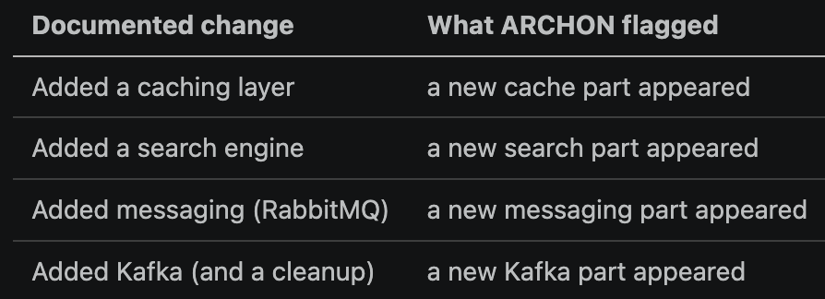
What we ran
For 4 documented changes:
we ran ARCHON on the commit before and the commit after
and checked whether its delta matched what the maintainers said they did
We found:
Notes:
For each documented architectural change, we ran ARCHON on the commit before the change and the commit after it. We then compared ARCHON's architectural delta against what the project maintainers themselves said they had changed. This lets us evaluate correctness rather than just compression

Slide 43
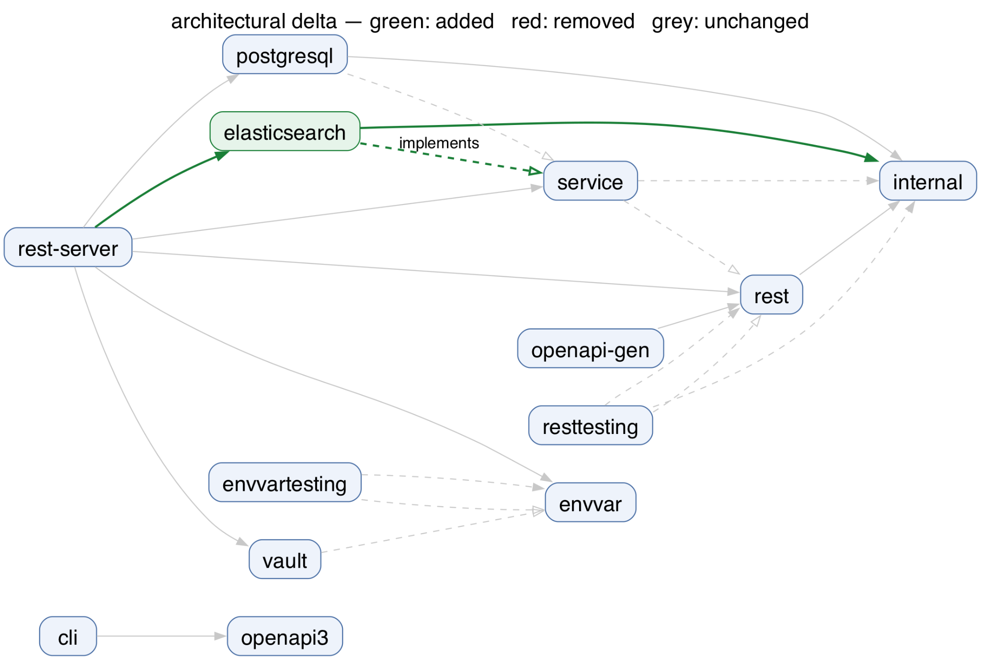

Slide 44
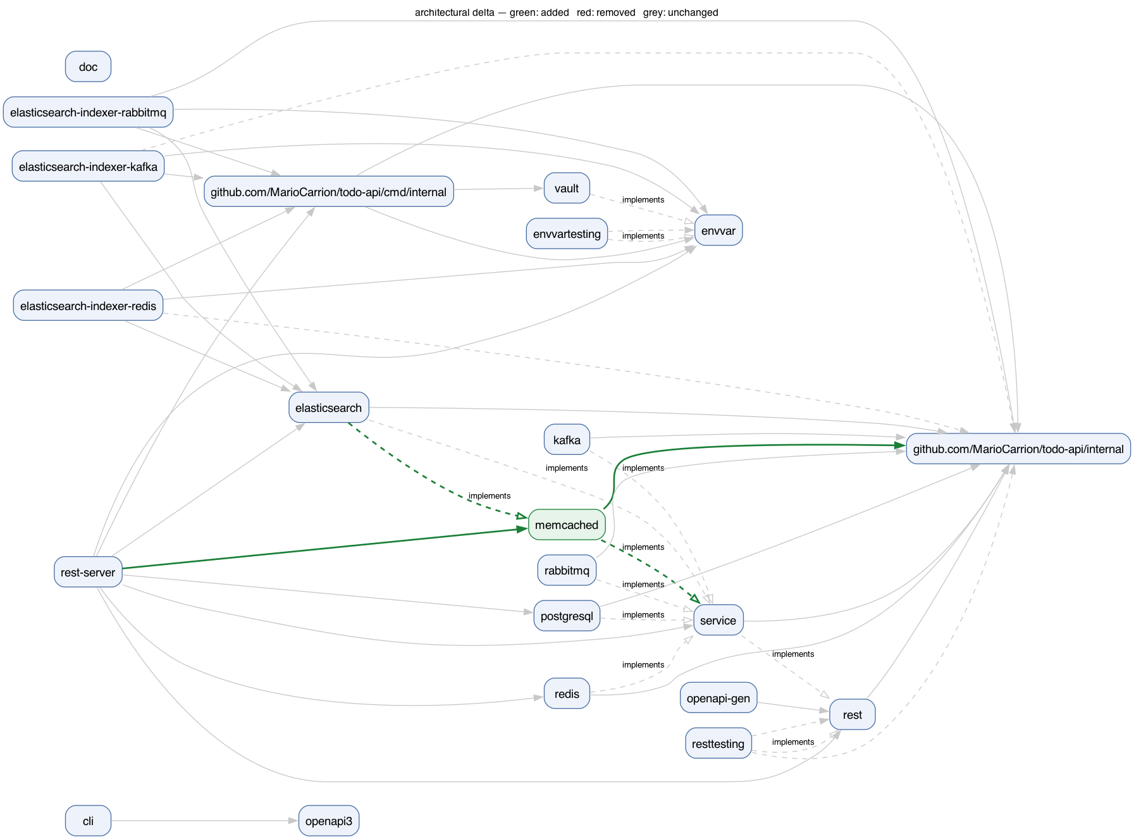
Notes:
Here we're looking at the architecture before and after the caching change.

Slide 45
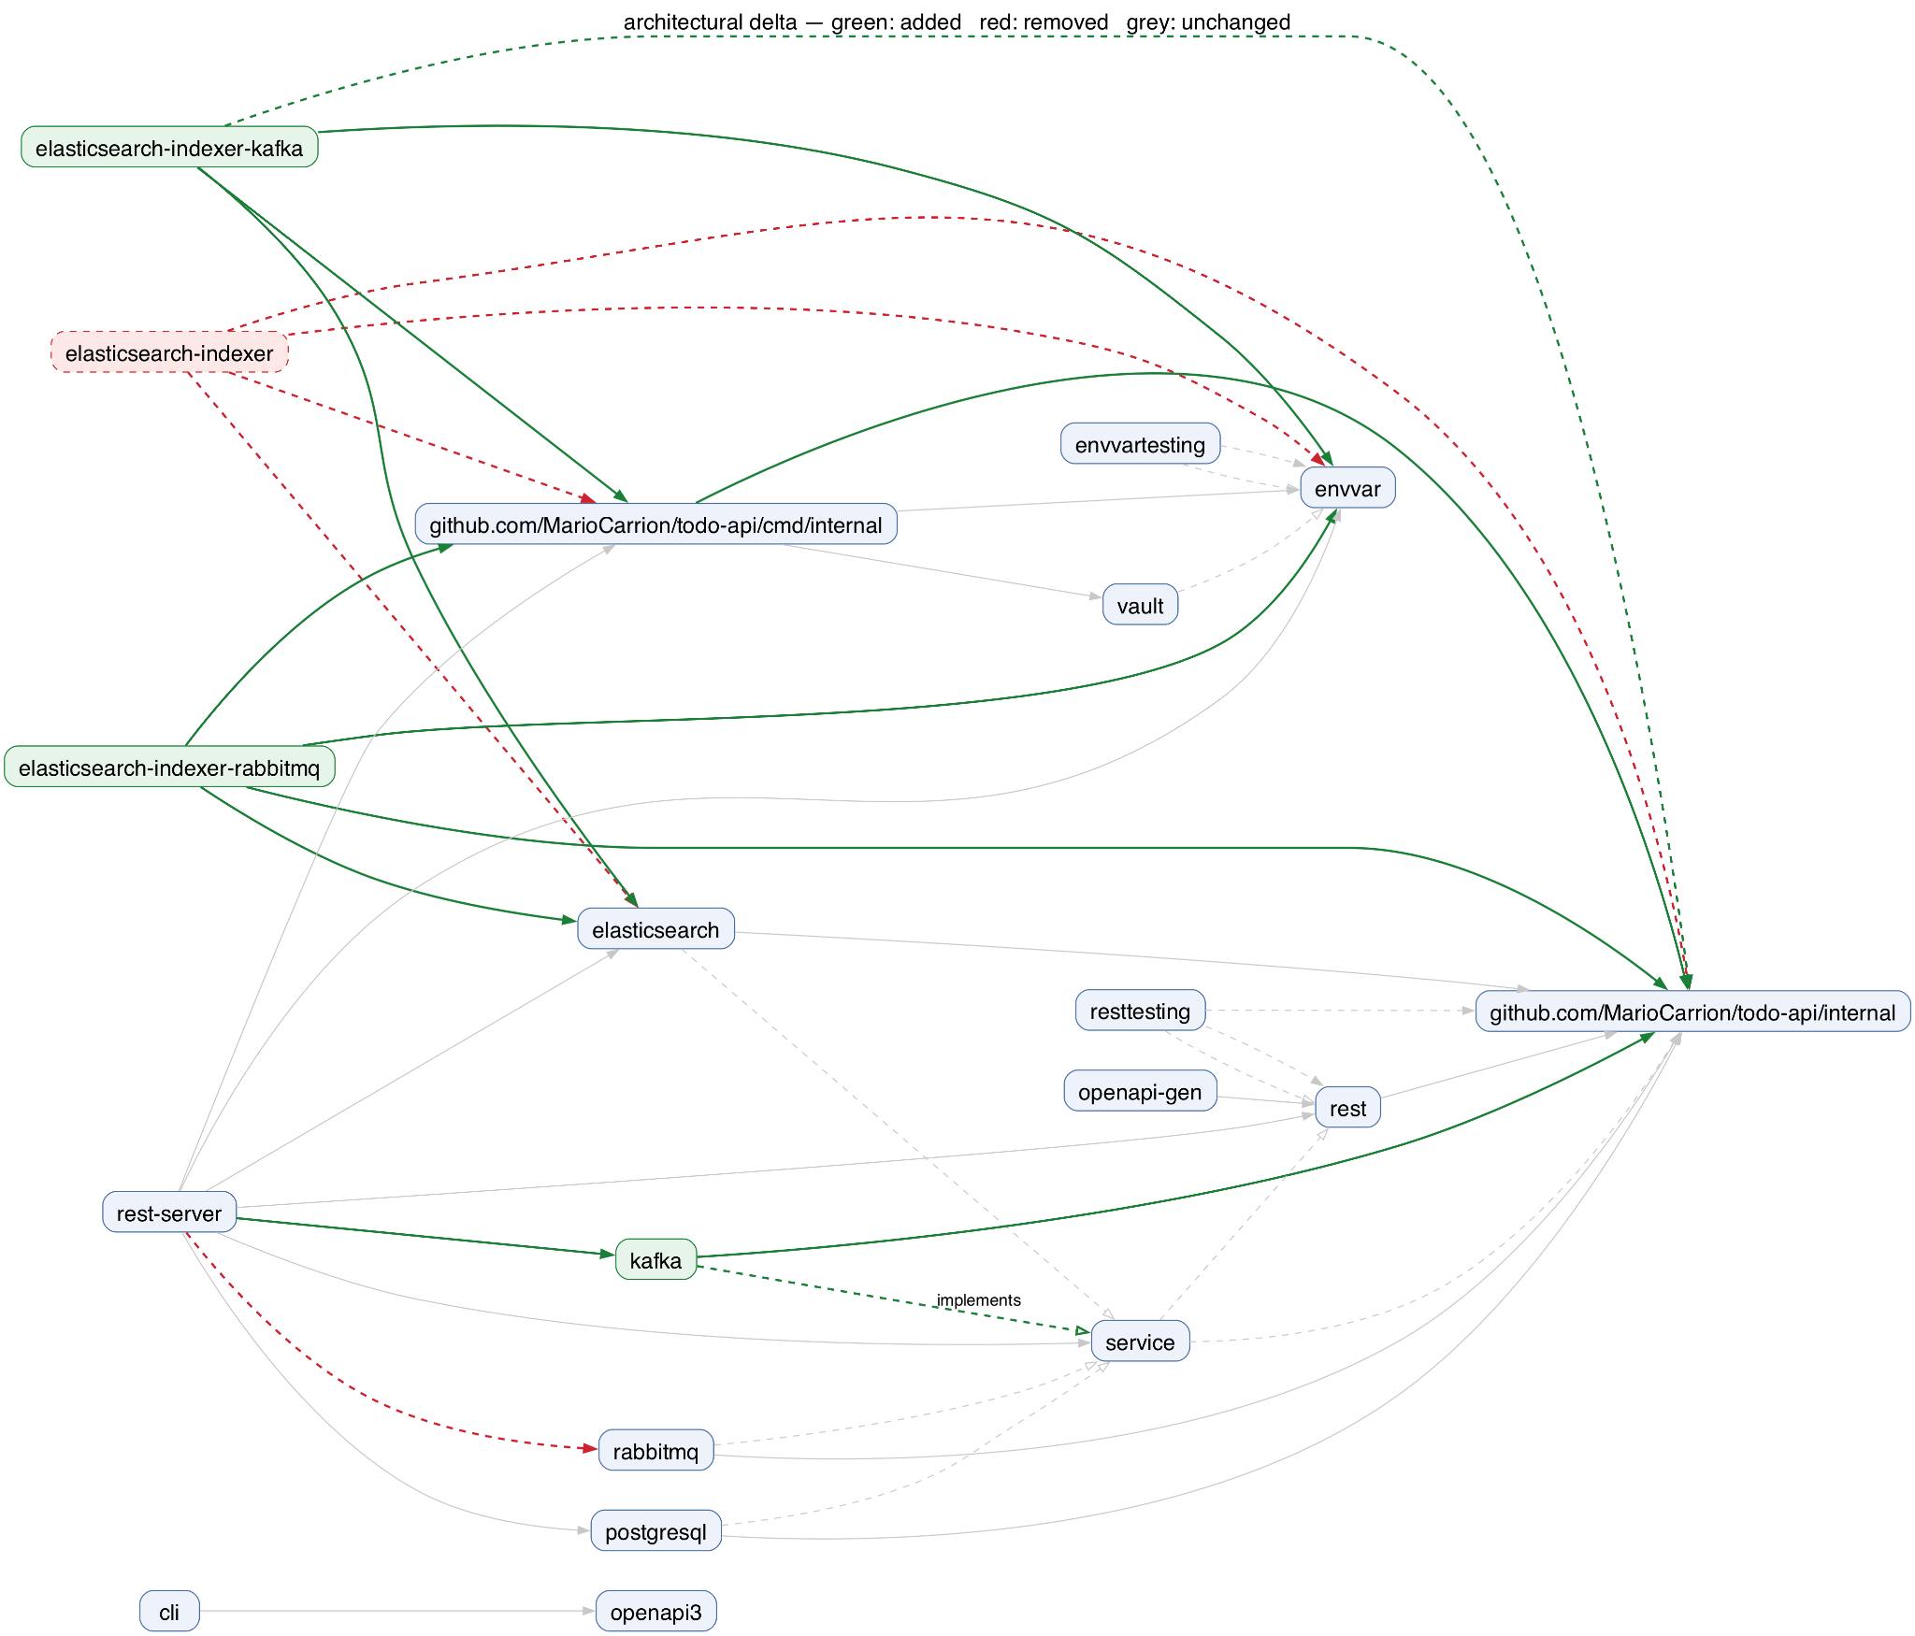
Notes:
Here the developers added kafka support
This combined delta view makes the architectural evolution much easier to understand than reading hundreds of changed lines. Instead of manually reconstructing the design from code, reviewers immediately see which components were added, removed, or rewired

Slide 46
Control experiment
Test whether archon stays quiet when NO architectural changes are made
These commits only changed some versions of their dependencies
Archon found no architectural changes
Notes:
Test whether archon stays quiet when NO architectural changes are made because i wanted to see if it just flags eveyrthing

Slide 47
Next steps
Richer graph attributes?
Today, ARCHON models structural relationships such as:
Packages
Imports
Calls
Interface implementations
Need to capture operational architecture, including:
Configuration / CLI flags
Protocols and APIs
External systems
Platform & deployment dependencies
Notes:
Many architectural decisions aren't visible from imports alone. For example, adding a new configuration flag, changing a protocol, or introducing a GPU backend can all be important architectural changes even though the package structure barely changes. We'd like ARCHON to model those relationships as well

Slide 48
Next steps - connecting architecture to property testing
Today, archon tells us: What changed in the architecture?
Future: ARCHON could also tell us:
What guarantees should still hold?
What new guarantees should be checked?
For example:
Internal implementation change -> existing tests/invariants should still pass.
New architectural component -> reviewers may need to verify new system guarantees.
Notes:
Right now, ARCHON identifies architectural changes. Ideally, we'd like it to connect those changes to the system's guarantees and invariants that could help reviewers udnerstand when existing tests should still be sufficient, and when a new architectural change requires new properties to be checked.

Slide 49
other relaitonships
functions vairables touching that
static anaylsis building graphs
is thismpr safe to merge
does it require human review vs agent
ci tool -> arhcon running on pr
if we want to sue ai at all int he tool
if we od when is it useul

Slide 50
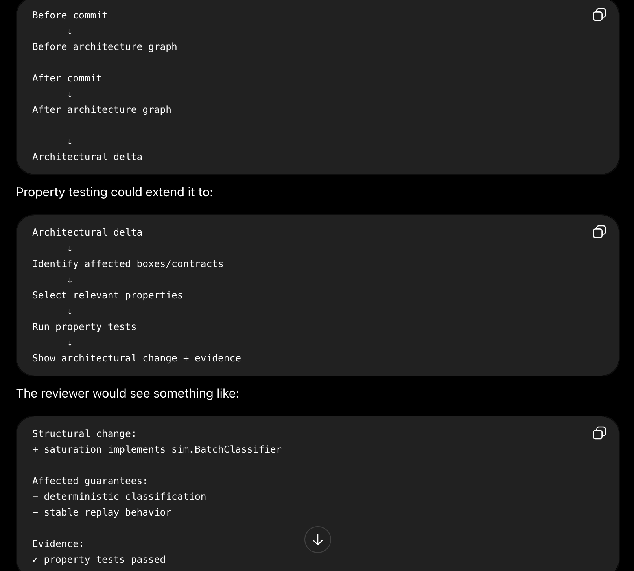

Slide 51
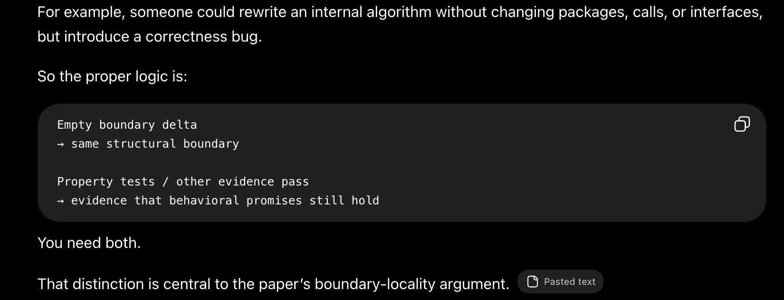

Slide 52
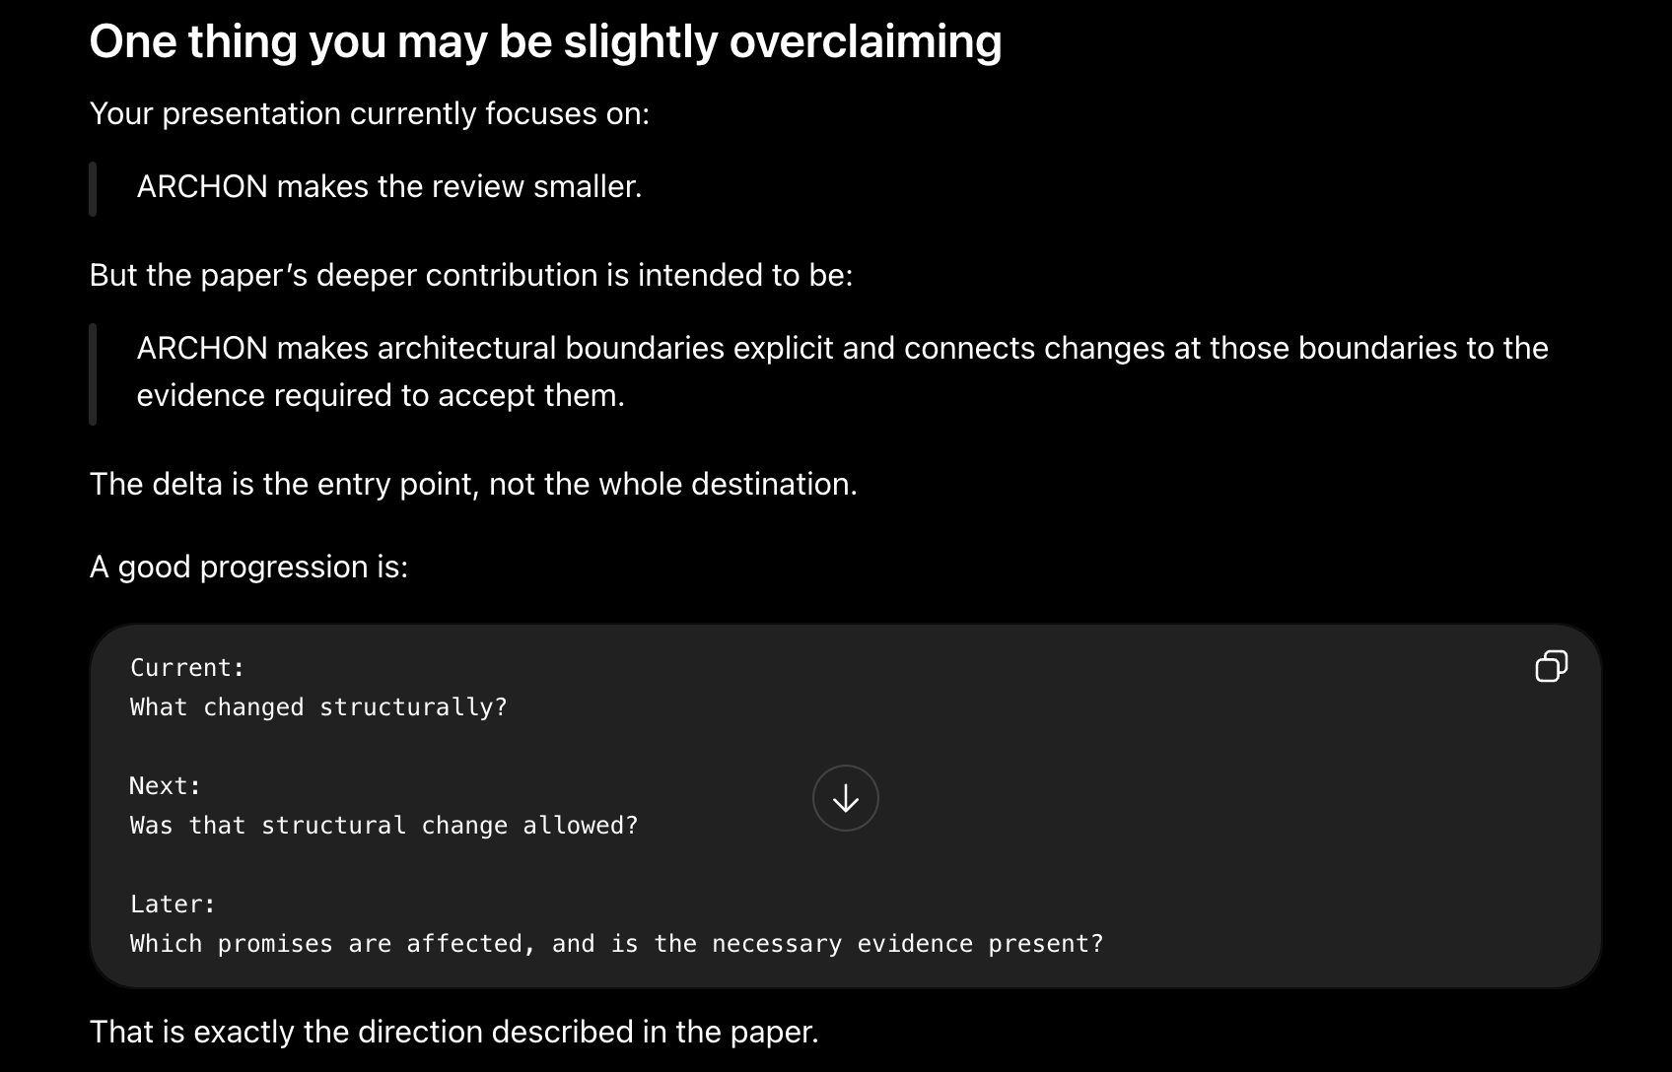

Slide 53
Speaker notes check
Notes:
I think this is actually the hardest conceptual leap in the whole paper. The word "invariant" sounds mathematical, but in your context it just means:
A property of the system that should always remain true, regardless of how the implementation changes.
Think of it as a promise the system makes.
Let's forget ARCHON for a second
Suppose you write a stack.
push(5)
push(10)
pop()
One invariant is
The last item pushed is always the first one popped (LIFO).
You can completely rewrite the implementation:
linked list
array
vector
Doesn't matter.
The invariant is still
A stack behaves like a stack.
Now let's use BLIS
Suppose BLIS has
Request Generator
↓
Simulator
↓
Results
One invariant might be
Given the same seed and same input,
the simulator always produces
the same output.
Notice this says nothing about the implementation.
Maybe today the code is
for ...
Tomorrow
goroutines
Next week
channels
Doesn't matter.
The promise is still
Same input
↓
Same output
That is an invariant.
Another BLIS invariant could be
Run mode and Replay mode
produce identical results.
Again
Nothing about
imports
interfaces
packages
It's purely
"This behavior should always be true."
Another example
Suppose you add a cache.
Before
User
↓
Database
No cache.
One invariant is
Database returns correct data.
Now architecture changes
User
↓
Cache
↓
Database
The architecture has changed.
But now you have a new promise.
The cache must satisfy
Cache returns exactly
the same data
the database would.
That promise didn't exist before.
It is a new invariant.
So what does
"Architecture changes"
mean?
Suppose the PR adds
Cache
or
Kafka
or
RabbitMQ
or
GPU backend
The graph changes.
ARCHON detects
+ new box
+ new dependency
+ new interface
Then
"Behavioral invariants evolve"
This is the important step.
The graph changed.
Ask yourself:
What new promises does the system now need to make?
Before
User
↓
Store
Maybe only one invariant existed.
Store always returns correct data.
After
User
↓
Cache
↓
Store
Now there are more promises.
For example
Cache returns the
same value
as Store.
Cache invalidation
works correctly.
No stale data
is returned.
These invariants literally didn't exist before because there was no cache.
So
Architecture changes
↓
Behavioral invariants evolve
means
The architecture introduces new behaviors that now need to be guaranteed.
Then
"Property tests evolve"
Now ask
How do we check these new promises?
Before
Maybe you only had
TestStoreCorrectness
Now you need
TestStoreCorrectness
TestCacheConsistency
TestCacheInvalidation
The property tests changed because
the promises changed.
Finally
"CI proves those invariants still hold"
This is what your manager clarified.
ARCHON is not responsible for running tests.
CI already does that.
Imagine GitHub Actions runs
✓ TestStoreCorrectness
✓ TestCacheConsistency
✓ TestCacheInvalidation
All ARCHON says is
The architecture introduced
these new promises.
Here is the evidence
that those promises still hold.
The whole story
Suppose today
Architecture
User
↓
Store
Current promise
Store always returns
correct data.
Evidence
TestStoreCorrectness
A developer opens a PR.
They add
User
↓
Cache
↓
Store
ARCHON computes
Architectural delta
+ Cache
Then it reasons
If there is now a cache...
↓
The system has a new promise.
↓
The cache must behave
correctly.
So now
the invariant becomes
Store returns correct data.
AND
Cache returns
the same data
the Store would.
Then
the property tests become
TestStoreCorrectness
TestCacheConsistency
Finally
CI runs
✓ TestStoreCorrectness
✓ TestCacheConsistency
Now ARCHON can report
Architecture changed.
↓
New invariant introduced.
↓
Evidence exists.
↓
Evidence passes.
Why your manager said "invariants evolve"
This is the sentence that confused you:
"invariants should evolve as the architecture evolves."
He didn't mean
Every architecture change
automatically generates
property tests.
He meant
Every architecture change
↓
may introduce
new promises
↓
those promises should be
captured as invariants
↓
those invariants should be
enforced by property tests
The invariant is the promise.
The property test is the executable check that the promise still holds.
I think there is still one unanswered research question
Even after your manager's reply, there is one major design question that hasn't been answered:
Who decides what the new invariants are?
For example, when ARCHON detects:
+ Cache
who writes:
Invariant:
"The cache must always return the same value as the store."
Possible answers include:
The developer (adds/updates invariants as part of the PR).
The maintainer/reviewer (reviews and approves invariant changes).
ARCHON/AI suggests likely invariants based on the architectural change, and a human confirms them.
Your manager explained what should happen (invariants evolve with architecture), but not yet who is responsible for evolving them. That's a design decision you'll likely want to discuss before implementing this part.

Slide 54
Check sn
Notes:
So where does ARCHON fit?
Suppose someone adds a cache.
Without ARCHON:
Developer pushes code
↓
GitHub
↓
Run tests
↓
PASS
That's all.
With ARCHON:
Developer pushes code
↓
ARCHON computes architectural delta
↓
"Cache added"
↓
"Cache consistency invariant introduced"
↓
GitHub runs all property tests
↓
PASS
↓
Reviewer sees
Architecture changed
+
Evidence passed
ARCHON itself isn't running the tests.
GitHub (or another CI system like Jenkins or GitLab CI) is.
ARCHON is interpreting the architecture and helping explain what changed.

Slide 55
unresolved
What is still unresolved
do not yet tell you exactly how ARCHON knows a test belongs to an interface or implementation.
Notes:
Edn to end process
Developer opens PR
↓
ARCHON builds before/after graphs
↓
ARCHON computes architectural delta
↓
Did interface membership or a boundary change?
↓
Check whether relevant invariant definitions/tests
were added, modified, or removed in the same PR
↓
Flag missing contract-test updates
↓
CI runs all unit, integration, and property tests
↓
Reviewer sees:
- architecture delta
- invariant delta
- missing coverage obligations
- CI results

Slide 56
What is missing?
This is the entire next research problem.
Missing piece 1
Today
Package
↓
Property tests
The mentor wants
Architecture
↓
Invariant
↓
Property test
Notice
the important thing is now
the invariant.
Missing piece 2
Suppose
Store
has
TestStoreContract
How does ARCHON know that?
That's still undecided.
Possibilities
annotation
metadata
automatic inference
This is probably the biggest design decision.
Missing piece 3
Suppose
ARCHON knows
Store
↓
MemoryStore
RedisStore
KafkaStore
and
TestStoreContract
How does it know
the test actually exercises
all three?
Another open design.
Missing piece 4
Behavioral contracts.
Today
a box roughly contains
Surface
Allow-list
Tests
The paper says
it should also contain
Behavioral Contract
but we haven't implemented
what that actually looks like.

Slide 57
ARCHON would report three kinds of information.
1. Structural change
+ MemcachedStore implements Store
+ API now calls Cache
2. Contract or invariant change
~ cache-consistency invariant modified
- replay-parity invariant removed
3. Evidence status
TestStoreContract passed
TestCacheConsistency missing
MemcachedStore not covered by Store contract test
CI would run all property tests. ARCHON would connect the results to the architectural contracts and report missing or stale evidence.

