Slide 1
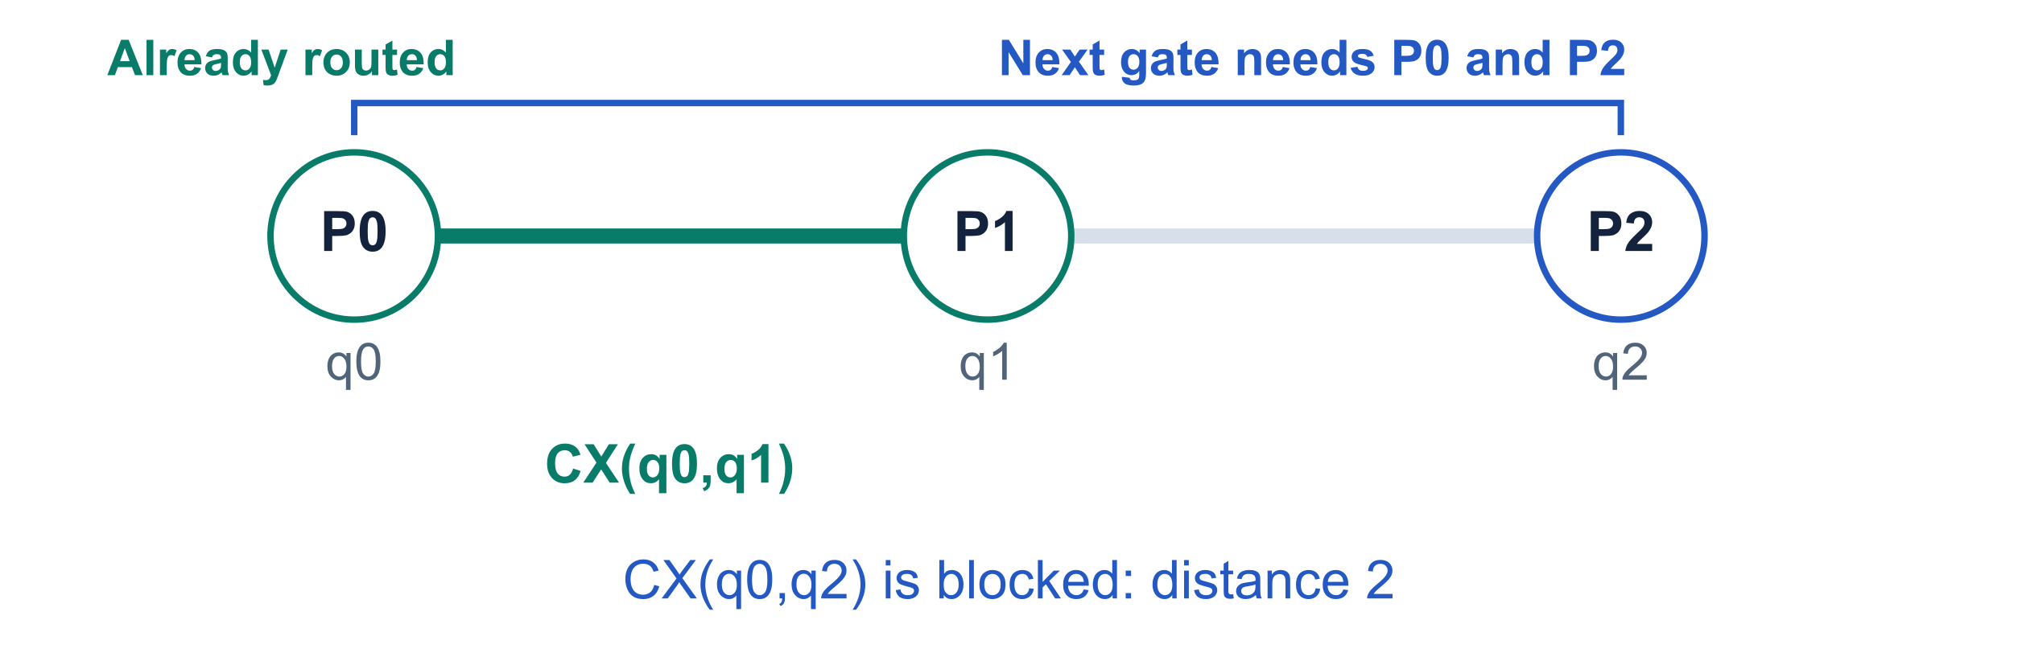
SABRE best-swap scoring
Gate fusion credit and physical-wire readiness
Which adjacent SWAP should we insert next?
Existing signals
Pending-gate distance
Lookahead and optional decay
Added signals
Can a prior block absorb it?
When are its wires free?
π maps logical qubits q to physical wires P. SWAPs change π.
The router still scores adjacent edges touching the front layer and chooses the lowest score.
1
Notes:
SABRE routes a two-qubit interaction when its physical operands are connected. If the front layer is blocked, it enumerates neighboring SWAPs touching at least one active qubit. The change adds backward-looking synthesis history and estimated wire availability. It retains candidate enumeration, distance scoring, optional decay, epsilon ties, seeded randomness, and the release valve. This opening uses the fusion example developed on slide 20.
Sources: design/sabre_best_swap_codex.md; design/sabre_best_swap_cladue.md. Commit 90ccaac29b2a547592e870797265007a128a02eb. route.rs:963–1056; codex note sections 1–3 and walkthrough A.

Slide 2
Decay: a temporary penalty for wire reuse
SABRE remembers recent SWAPs to discourage using the same physical wires repeatedly.
Why it helps
What the decay preset remembers
SWAPs sharing a wire must run in sequence.
Spreading SWAPs across different wires
can help keep the routed circuit shallower.
Each physical wire starts at 1.0.
A chosen SWAP adds 0.001 to both
endpoints, except when the step resets.
How it affects a choice
A candidate uses the larger decay value of its two endpoint wires as its multiplier.
Example: both candidates have the same positive score of 4.2 before decay.
Candidate | Endpoint history since reset | Multiplier | Score after decay
A: preferred | No endpoint increments | 1.000 | 4.2000
B | One endpoint increment | 1.001 | 4.2042
Values reset to 1.0 every 5 search SWAPs and after routing makes progress.
Decay is a dimensionless multiplier. The code adds the separate readiness penalty afterward.
2
Notes:
Decay is optional routing state that remembers recent reuse of physical wires. SWAPs sharing a physical wire cannot execute simultaneously, so discouraging repeated reuse can encourage more parallel routing and lower depth. This is a heuristic preference, not a guarantee of lower depth. The exact implementation is described on slides 3–5 and its extension with fusion credit and wire readiness is on slide 19.
This slide uses the local SabreSwap named decay preset: increment 0.001, reset interval 5. It enables basic and lookahead distance components plus decay. A custom Heuristic may also enable decay, with other parameter values. State::begin sets decay[q]=1.0 for every physical wire. Scoring a candidate does not update these values. A candidate takes max(decay[a],decay[b]) as its multiplier. After selecting a heuristic SWAP, the search-step counter increases. If it reaches the reset interval, the code resets all values to 1.0 and the counter to zero, without applying endpoint increments on that step. Otherwise both selected endpoints increase by 0.001. The code also resets all decay values after update_route makes progress. That progress reset does not reset the search-step counter.
The illustrative comparison assumes both candidates have the same positive score 4.2 before the decay multiplication and equal readiness penalties. Candidate A has no endpoint increments since reset, giving multiplier 1.0 and score 4.2. Candidate B has one increment at one endpoint, giving multiplier 1.001 and score 4.2042. Lower wins. These are illustrative scores, not a benchmark or complete routing trace. The positive-score condition matters: the new fusion credit can alter the quantity inside the multiplier. The current implementation multiplies absolute_score plus the accumulated candidate score, then adds READY_WEIGHT times the maximum endpoint readiness. Decay values are dimensionless and separate from the approximate ready-time clocks.
Sources: qiskit/transpiler/passes/routing/sabre_swap.py:222–227; crates/transpiler/src/passes/sabre/route.rs:696, 1033–1046, 1180–1189, 1206–1210; crates/transpiler/src/passes/sabre/heuristic.rs:140–153. Local implementation at commit 90ccaac29.

Slide 3
Distance scores in the implementation
choose_best_swap computes distance changes for each candidate s = (a, b).
Distance in one layer
F: blocked front-layer 2q interactions
Eℓ: future interaction layer ℓ
L: one layer, either F or Eℓ
g.q₁, g.q₂: gate g’s logical operands
S
L
(π) = Σ
g∈L
D(π(g.q₁), π(g.q₂))
D = shortest-path edge count on the hardware.
π maps logical qubits to physical wires.
πₛ is the layout after the candidate SWAP.
H₀: baseline before any candidate SWAP
The current layout’s weighted distance sum.
Computed once per choose_best_swap call.
The same H₀ applies to every candidate.
H₀ = α S
F
(π) + Σ
ℓ
β
ℓ
S
Eℓ
(π)
Δ(s): distance change caused by candidate s
Layer::score returns the distance change.
It checks only interactions affected by s.
A negative Δ improves the distance score.
Δ
L
(s) = S
L
(π
s
) − S
L
(π)
Δ(s) = α Δ
F
(s) + Σ
ℓ
β
ℓ
Δ
Eℓ
(s)
H₀ is absolute_score in the code. α and βℓ are the effective weights explained on the next slide.
3
Notes:
These formulas describe this checkout's Rust implementation, not the paper's normalization. s=(a,b) is a candidate physical edge touching an active front-layer qubit. D is the shortest-path edge-count matrix. F contains blocked front-layer two-qubit interactions; already executable nodes are routed before candidate selection. The lookahead collection can contain multiple configured layers Eℓ. S_L is exactly Layer::total_score(layout, dist). For a given candidate, Layer::score(swap, dist) returns Δ_L, evaluating only interactions affected at the endpoints, with zero contribution for inactive endpoints and zero when the two endpoints form the same interaction. It does not construct a full trial circuit or rescan the whole layer per candidate. α and βℓ denote effective weights after SetScaling. H₀ is the code variable absolute_score, accumulated from current-layout totals once per choose_best_swap call. The current implementation accumulates it even when decay is disabled, but consumes it only in the decay branch. H₀ is shared by candidates within the call, and is recomputed when the method runs again. For empty Size-scaled layers, the effective weight is zero. The basic-enabled case shown here covers all three SabreSwap named presets.
Sources: crates/transpiler/src/passes/sabre/layer.rs:239–265; crates/transpiler/src/passes/sabre/route.rs:997–1037; qiskit/transpiler/passes/routing/sabre_swap.py:209–228. Local checkout at commit 90ccaac29.

Slide 4
How the code selects a SWAP
Qold(s) names the score before fusion credit and wire readiness were added.
SabreSwap preset | Front weight α | Lookahead weight β₁ | Decay multiplier
basic | 1 / |F| | None | None
lookahead | 1 | 0.5 / N | None
decay | 1 | 0.5 / N | dₛ
N = physical-qubit count. The named presets use one lookahead layer, except basic.
Custom Size scaling divides a weight by its layer size (empty: 0). Constant scaling keeps the weight.
Without decay: basic or lookahead
With decay enabled
Q
old
(s) = Δ(s)
Q
old
(s) = d
s
[H₀ + Δ(s)]
Where Hlookahead and Hdecay fit
For lookahead / decay presets, these labels describe code steps. They are not separate functions.
H
lookahead
(π
s
) = H₀ + Δ(s)
H
decay
(s) = d
s
H
lookahead
(π
s
)
Lookahead compares the change Δ. Decay compares the multiplied total. Lowest score wins.
4
Notes:
Q_old is explanatory notation for the numerical score used by choose_best_swap before commit 90ccaac29, not a code variable or a quantum operator. The parent implementation initializes every candidate score to zero, adds effective-weight × front.score and effective-weight × lookahead layer.score, then, if decay is configured, replaces score with (absolute_score + score) × max(endpoint decay). It compares all candidate scores, retains the lowest within best_epsilon, and uses the seeded random generator to choose among ties. The current version extends this same process with fusion credit C(s) and readiness λTₛ, explained on slide 19.
The table is exactly the Python SabreSwap named presets in this checkout. Basic uses weight 1 and SetScaling.Size, giving α=1/|F|. Lookahead and decay use α=1 and one Constant-scaled future layer β₁=0.5/N. They do not divide that lookahead sum by |E|. All other βℓ are absent in those presets. An empty lookahead contributes zero. Custom Heuristic objects can configure multiple lookahead weights and Constant or Size scaling.
For the lookahead and decay presets only, define the explanatory code-based label H_lookahead(π)=S_F(π)+(0.5/N)S_E₁(π). Hence H_lookahead(π)=H₀ and H_lookahead(πₛ)=H₀+Δ(s). The lookahead preset compares Q_old(s)=H_lookahead(πₛ)−H_lookahead(π)=Δ(s), which has the same ordering as its absolute score because H₀ is common. The decay preset uses Q_old(s)=H_decay(s)=dₛH_lookahead(πₛ). These H labels are descriptions of the corresponding Rust branches; the code has no functions named H_lookahead or H_decay. They are alternative scoring configurations, not separately added terms. The code's basic and lookahead branches accumulate deltas, and the decay branch transforms that accumulated score. Selection tolerates best_epsilon differences (default 1e-10). Across completed trials, a separate step chooses the trial with the fewest inserted SWAPs.
Sources: qiskit/transpiler/passes/routing/sabre_swap.py:209–228; crates/transpiler/src/passes/sabre/route.rs:997–1056 and parent of commit 90ccaac29, choose_best_swap; crates/transpiler/src/passes/sabre/heuristic.rs:213 and 243–271.

Slide 5
Decay calculation and a worked example
Decay penalizes recent wire reuse. The separate readiness term Tₛ estimates SWAP start time.
Decay state in the code
Example before fusion / readiness
d
s
= max(decay[a], decay[b])
Illustrative layer sums, N = 5 and α = 1.
β₁ = 0.5 / 5 = 0.1. Current S_F = 5, S_E = 2.
Start every decay[q] at 1.0.
After a chosen SWAP, add 0.001 to
its endpoints, unless that step resets.
Reset all values to 1.0 every 5 search
SWAPs and after routing makes progress.
H₀ = 1 × 5 + 0.1 × 2 = 5.2
Both candidates: ΔF = −1, ΔE = 0, so Δ = −1.
Candidate | dₛ | H₀ + Δ | Qold
A: reused | 1.002 | 4.2 | 4.2084
B: fresh | 1.000 | 4.2 | 4.2000
decay[q] = 1 + 0.001 n
q
nq counts endpoint increments since the last reset.
For two increments: decay[q] = 1.002.
Decay is a dimensionless multiplier.
B wins: 4.2000 < 4.2084
Why keep H₀? Multiplying Δ alone gives A = −1.002 and B = −1, which would favor the reused wires.
The new score keeps this decay step and adds λTₛ afterward, outside the multiplier (slide 19).
5
Notes:
The named decay preset has increment=0.001 and reset=5. State::begin initializes every physical qubit decay value to 1.0. Candidate scoring reads current decay values and sets dₛ=max(decay[a],decay[b]); merely evaluating a candidate never increments the counters. After a heuristic-selected swap, num_search_steps increases. If it reaches the reset interval, all decay values become 1.0 and num_search_steps becomes 0, with no endpoint increment on that reset step. Otherwise both chosen endpoint values increase by increment. At the end of an episode, after update_route routes newly enabled nodes, the code also fills all decay values with 1.0. That progress reset does not set num_search_steps to zero. Thus n_q is the number of increment operations on q since the most recent decay-value reset; it is not the total number of times q has appeared in the circuit. The preset formula is decay[q]=1+0.001 n_q. Custom decay settings can use other increments and reset intervals.
Illustrative arithmetic uses the actual named-preset weights: N=5, α=1, β₁=0.1. Current front total 5 and future total 2 give H₀=5.2. Both candidate swaps change the front total by −1 and the future total by 0, giving Δ=−1 and absolute post-swap distance 4.2. For A, assume max endpoint decay=1.002 (two increments since reset); for B, both endpoint values are 1.0. A scores 1.002×4.2=4.2084; B scores 1×4.2=4.2. B wins. Multiplying the negative delta alone would score A=−1.002 and B=−1, reversing the intended reuse penalty. This is why absolute_score must be restored before multiplying. These are illustrative layer sums and endpoint states, not a measured benchmark or a full routing trace.
Decay is dimensionless and discourages repeated use of physical wires. It is distinct from the new readiness clocks, which approximate schedule layers from the schedule origin. In the current code, decay multiplies H₀+U(s), while READY_WEIGHT×max(ready[a],ready[b]) is added afterward and does not receive a decay multiplier.
Sources: crates/transpiler/src/passes/sabre/route.rs:696, 1033–1046, 1180–1189, 1206–1210; qiskit/transpiler/passes/routing/sabre_swap.py:222–227; crates/transpiler/src/passes/sabre/heuristic.rs:140–153.

Slide 6
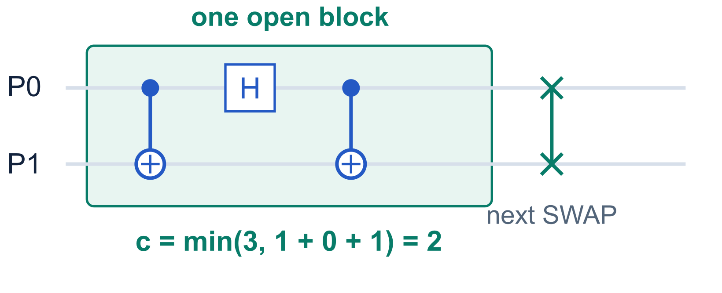
Blocks, c, and fusion credit
A block is a consecutive run on one physical pair. Single-qubit gates can be inside it.
c = estimated native 2q cost
Stored cost is 1, 2, or 3.
It is capped at three CX-like gates.
It is an estimate of the block cost.
Open means both endpoints agree
last_block[a] = (b, c)
last_block[b] = (a, c)
Fusion credit C(s) = −[3 − (min(3, c + 1) − c)] / 3
c | Separate cost | Fused estimate | Credit C(s)
1 | 1 + 3 = 4 | 2 | −2/3
2 | 2 + 3 = 5 | 3 | −2/3
3 | 3 + 3 = 6 | 3 | −1
A third-wire interaction or a boundary
(measurement, reset, barrier, etc.)
closes the block. No eligible block: C = 0.
6
Notes:
A block is a contiguous run involving at most the same two physical wires, with one-qubit gates allowed and no intervening operation that prevents consolidation. In this tracker an open block requires reciprocal last_block partners. The code checks reciprocal partners, rather than comparing c values; valid updates write the same c to both. A third-wire gate overwrites its endpoint, making any old partner entry stale. The reciprocal test rejects such stale entries. An inserted SWAP may fuse with the previous block in later optimization, but advance_swap closes tracked history on both endpoints. The credit models separate cost c+3 and combined cost min(3,c+1). Dividing saved native gates by 3 expresses the saving in SWAP-cost units. For c=1 the simple CX+SWAP cancellation is exact. For general blocks it is a heuristic, not a guaranteed synthesis count.
Sources: design/sabre_best_swap_codex.md; design/sabre_best_swap_cladue.md. Commit 90ccaac29b2a547592e870797265007a128a02eb. dag.rs:79–113; route.rs:728–757 and 971–995; codex note sections 4, 6, 8; cladue note section 2.4.

Slide 7
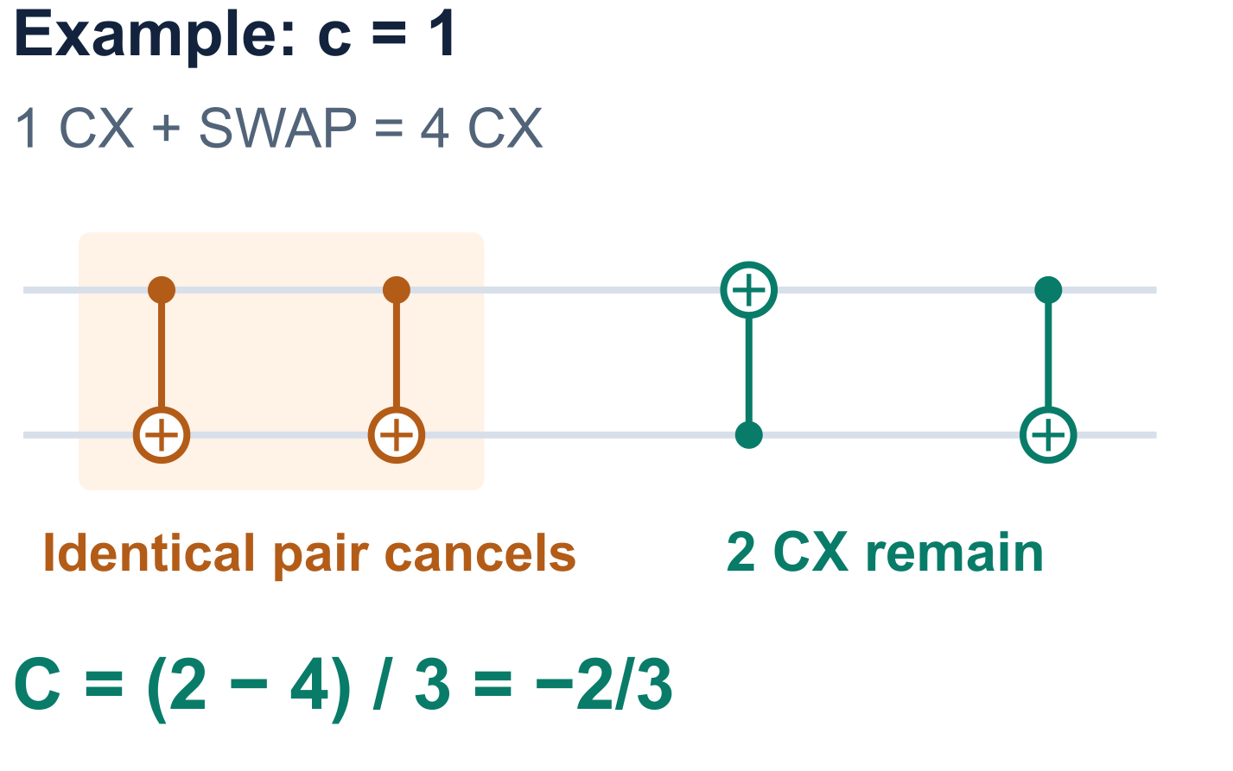
Fusion credit, step by step
A discount for the CX-like gates we expect to save by combining a block with its next SWAP.
C(s) = [estimated combined cost − separate cost] / 3
C(s) = [min(3, c + 1) − (c + 3)] / 3
Separate cost: c + 3
c = cost of the preceding block
3 = cost of a standalone SWAP
Combined estimate: min(3, c + 1)
The model adds one gate to the block,
then caps the total at three.
Negative rewards savings. Dividing by 3 expresses the saving in units of one standalone SWAP.
7
Notes:
Read the credit as (estimated combined cost minus separate cost) divided by three. c is the estimated native two-qubit cost of the preceding open block, taking values 1, 2, or 3. Separate implementation costs c+3. The heuristic models the combined cost as min(3,c+1): one extra CX-like gate, capped at three. This is a model, not an exact synthesis calculation for arbitrary blocks. For c=1 and a preceding CX, the illustration is exact: expand the SWAP into three CX gates with the first matching the preceding CX. Two identical consecutive CX gates cancel, leaving two CXs. Therefore separate cost is four, combined cost is two, and credit is (2-4)/3=-2/3. A negative credit lowers the score because SABRE minimizes it. Division by three expresses saved CX gates in standalone-SWAP units. The credit applies only to an eligible reciprocal open block on the same physical pair; otherwise C(s)=0. The two-qubit consolidation/synthesis pass realizes the saving later.
Sources: design/sabre_best_swap_codex.md, section 8 and visual walkthrough A10; design/sabre_best_swap_cladue.md, section 9.2; crates/transpiler/src/passes/sabre/route.rs:971–995. Commit 90ccaac29.

Slide 8
How circuit gates become a SABRE node
The builder groups logical operations before routing. One node can hold many original gates.
SabreNode field | What it stores
indices | Ordered IDs of the original circuit operations inside the node.
kind | TwoQ([q0,q1]) identifies the logical pair that must become adjacent.
block | Some(n): estimated 2q contribution n. None: contains a fusion boundary.
The builder scans gates in dependency order
It checks which existing SABRE node precedes the gate on each incoming wire.
All wires point to one node: fold a Synchronize operation (such as a 1q gate or barrier),
or fold a TwoQ operation after a TwoQ node. Append the gate ID and update block.
Different predecessors, or a kind that cannot fold: create a new node and dependency edges.
A first 2q gate starts a node. Leading 1q gates go into the initial operations list.
Some(0) is a valid zero contribution. None prevents that node from providing a fusion credit.
Folding retains every original gate. The router later emits the stored indices in order.
8
Notes:
This section replaces the earlier compact description with a single end-to-end example. A source operation, a compressed SabreNode, and State.last_block are three different objects. Construction of SabreDAG happens before a routing trial. SabreNode.indices retains the IDs of all source operations folded into that node. SabreNode.kind records the routing interaction requirement, expressed using virtual/logical qubits. SabreNode.block is the precomputed contribution of that compressed node to a later physical block. State.last_block is separate, mutable, indexed by physical wires, and updated only as the router commits nodes or SWAPs.
SabreDAG::from_dag traverses topological_op_nodes(false), so all input dependencies have already been considered. Its wire_pos map associates each DAG wire with its current preceding SABRE node. The predecessor classifier returns AllUnmapped when every incoming wire is unmapped, Single when every wire points to the same SABRE node, and Multiple when the incoming mappings differ, including one mapped wire and one previously unused wire. For Single, the builder folds any incoming InteractionKind::Synchronize, or an incoming TwoQ when the previous node is also TwoQ. It appends the original DAG operation ID to prev.indices, keeps the existing kind, and updates prev.block with the capped sum if both contributions are Some. If either is None, prev.block becomes None. Unmatched kinds or Multiple create a new node with indices=[current operation], kind=current kind, block=current contribution and dependency edges to mapped predecessors. AllUnmapped creates a first-layer interaction node, while layout-independent Synchronize operations such as leading 1q gates go in the initial list. Control flow has its own recursive classification; the example uses ordinary gates only.
Some(n) is Rust's Option wrapper for a present numeric estimate. Some(0) carries a valid zero contribution and can preserve an existing block cost. None is a boundary marker and is not interchangeable with numeric zero. A positive stored c in last_block is created later during routing from node.block. None in a routed TwoQ node clears the physical-pair entries. The original source gates remain in indices and are emitted in their stored order when the routing result is rebuilt.
Local implementation at commit 90ccaac29. Sources: crates/transpiler/src/passes/sabre/dag.rs:29–113, 137–246; crates/transpiler/src/passes/sabre/route.rs:54–60, 599–607, 703–755, 963–1056, 1161–1208.

Slide 9
Two cost updates: construction and routing
node.block is built on logical qubits. Routing uses it to update c on a physical pair.
1. Build the contribution node.block
2. Route the node and update physical c
CX / CY / CZ / ECR → Some(1)
Other 2q gates → Some(3)
A 1q gate → Some(0); a boundary → None
Use its physical endpoints a and b.
open = old c if the stored partners agree;
otherwise, open = 0.
When a gate folds into an existing node:
node.block = Some(g): c = min(3, open + g)
node.block = None: c = 0
Some(n) + Some(g) → Some(min(3, n + g))
If either value is None → None
For c > 0, store reciprocal (partner, c) entries.
For c = 0, clear both entries to None.
Previous physical history | open | node.block | New c
No reciprocal block | 0 | Some(2) | 2
Same pair, old c = 2 | 2 | Some(2) | 3 (capped)
Boundary inside the node | Any | None | 0 (clear both)
Other routed node kinds clear block history on their affected wires. Readiness is updated separately.
9
Notes:
These are the two different update sites in the implementation. During SabreDAG::from_dag, block_gates classifies each incoming operation. It checks boundary operation types first: ControlFlow, StandardInstruction (including barrier, measurement and reset), Store and PauliProductMeasurement return None. Otherwise one-qubit operations contribute Some(0), the native CX/CY/CZ/ECR gate variants contribute Some(1), other two-qubit operations contribute Some(3), and other arities return None. If the gate can be folded into the preceding SABRE node, prev.block.zip(gates).map(|(n,gates)| (n+gates).min(3)) combines the two present values. Either None makes the result None. A newly created node gets its own contribution directly.
Later, advance_routed handles a compressed TwoQ node using its operands mapped through the current layout. It reads open only if last_block[a] stores partner b and last_block[b] stores partner a. Otherwise open is zero. The actual expression node.block.map_or(0, |gates| (open+gates).min(3)) yields c. A positive result is stored as reciprocal entries at a and b. Zero clears both entries. A non-TwoQ routed node clears the physical block history on every qubit in its stored original operations. This operation does not modify the original node.block.
The table gives generic physical-history inputs to the update, not extra steps in the long example. Some(0) is numeric zero and can preserve an existing positive open cost; None forces c=0. Readiness is a separate approximation, incrementing once per compressed TwoQ node. Local implementation at commit 90ccaac29. Sources: crates/transpiler/src/passes/sabre/dag.rs:29–113, 137–246; crates/transpiler/src/passes/sabre/route.rs:54–60, 599–607, 703–755, 963–1056, 1161–1208.

Slide 10
Long block: build node A gate by gate
An append updates A.block to Some(min(3, old value + gate contribution)).
g1 creates A. Every later gate below has A as its only preceding routing node.
Step | Original circuit operation | Added cost | A.block after step
g1 | CX(q0, q1) | 1 | Some(1)
g2 | H(q0) | 0 | Some(1)
g3 | RZ(π/4, q1) | 0 | Some(1)
g4 | CZ(q0, q1) | 1 | Some(2)
g5 | RX(π/3, q0) | 0 | Some(2)
g6 | CX(q1, q0) | 1 | Some(3)
g7 | H(q1) | 0 | Some(3)
g8 | CY(q0, q1) | 1 | Some(3)
g9 | RZ(π/7, q0) | 0 | Some(3)
g10 | CZ(q0, q1) | 1 | Some(3)
A.indices = [g1, …, g10], A.kind = TwoQ([q0,q1]), A.block = Some(3).
The node retains all 10 original gates. Its estimate stops increasing at 3, including later 2q gates.
10
Notes:
The complete main example uses three logical qubits. Source operations g1 through g10, in dependency order, are: CX(q0,q1); H(q0); RZ(pi/4,q1); CZ(q0,q1); RX(pi/3,q0); CX(q1,q0); H(q1); CY(q0,q1); RZ(pi/7,q0); CZ(q0,q1). Labels g1 etc. are explanatory labels for original DAG operation IDs, not a claim about the numeric NodeIndex values. Rotation angles are illustrative; they do not affect block_gates contributions.
At g1 both incoming quantum wires are unmapped, so the builder creates A with indices=[g1], kind=TwoQ([q0,q1]), block=Some(1), and both wire_pos entries pointing to A. Each of g2 through g10 depends only on A along every incoming wire. The 1q operations have Synchronize interaction kind and fold into A. Each later 2q operation is TwoQ after TwoQ and also folds into A; reversed CX direction does not change the pair or the predecessor condition. Every append pushes the gate's ID into indices. block_gates gives one to each CX, CZ and CY here, and zero to the unitary 1q gates. The cumulative estimates are 1,1,1,2,2,3,3,3,3,3. The last two 2q gates still enter indices even though the estimate has reached the cap.
After step k, A.indices contains g1 through gk. After g10, the node holds ten original operations, including five 2q operations, but its cost estimate is three. This cap is a routing heuristic estimate and does not perform gate synthesis or promise an exact final native gate count. A.block is computed during construction. It does not grow again simply because the routing trial later visits those ten stored operations. Routing A calls the physical-history update once for the compressed TwoQ node.
Local implementation at commit 90ccaac29. Sources: crates/transpiler/src/passes/sabre/dag.rs:29–113, 137–246; crates/transpiler/src/passes/sabre/route.rs:54–60, 599–607, 703–755, 963–1056, 1161–1208.

Slide 11
Route A, then stop at the next interaction
Hardware: P0–P1–P2. Initial layout: π(q0)=P0, π(q1)=P1, π(q2)=P2.
g11 = CX(q0, q2) starts a new node B
q0’s incoming wire points to A. q2 has no preceding routing node.
The mappings differ, so the builder creates B and records that B depends on A.
Built node | Original operations | Logical pair | block
A | g1 through g10 | q0, q1 | Some(3)
B | g11 | q0, q2 | Some(1)
Route A: its physical operands P0 and P1 are adjacent
open = 0, node.block = Some(3), c = min(3, 0 + 3) = 3
last_block[P0] = (P1, 3), last_block[P1] = (P0, 3)
ready = [1, 1, 0]. The entire compressed node advances the two clocks once.
B remains blocked: q0 and q2 occupy P0 and P2, at distance 2. A.block stays Some(3).
11
Notes:
Append g11=CX(q0,q2) after the ten-gate sequence on the preceding slide. Its q0 incoming wire maps to A, while q2 is still unmapped in wire_pos. Therefore predecessors returns Multiple. The builder creates node B, sets B.indices=[g11], B.kind=TwoQ([q0,q2]), B.block=Some(1), and adds a dependency edge from A to B. It updates the relevant wire_pos entries to B. The complete compressed graph for this example has just A followed by B, even though the source circuit has eleven operations.
Routing uses a three-wire line with edges P0-P1 and P1-P2 and initial identity layout. No control flow, boundary, or additional operations are present in this main example. A is initially routable because its logical pair q0,q1 maps to adjacent P0,P1. All ten source operations in A become part of the routed order. Initially ready is [0,0,0] and every last_block entry is None. State::begin eventually calls advance_routed on the routed order. For A, no reciprocal history exists, so open=0. With A.block=Some(3), new c=min(3,0+3)=3. It writes reciprocal entries last_block[P0]=(P1,3) and last_block[P1]=(P0,3), while P2 remains None.
The ready update runs once for the compressed TwoQ node A, setting P0 and P1 to max(0,0)+1=1. It does not use the ten source operations or the cost c=3 as the duration. Thus ready=[1,1,0]. B has satisfied its logical dependency on A but is not yet physically routable: q0 is on P0 and q2 is on P2, with distance two. B is the only front-layer interaction. A.block remains the immutable precomputed value Some(3); the new physical-pair c lives in State.last_block.
Local implementation at commit 90ccaac29. Sources: crates/transpiler/src/passes/sabre/dag.rs:29–113, 137–246; crates/transpiler/src/passes/sabre/route.rs:54–60, 599–607, 703–755, 963–1056, 1161–1208.

Slide 12
Score both SWAPs using A’s completed block
Basic preset: α = 1. No lookahead or decay. B is the only blocked interaction.
Candidates: s₁ = SWAP(P0, P1), s₂ = SWAP(P1, P2)
Both edges touch a front-layer operand. Either SWAP reduces B’s distance from 2 to 1.
s₁ finds A’s reciprocal block, c = 3
s₂ has no reciprocal block
C(s₁) = [min(3, 4) − 6] / 3 = −1
C(s₂) = 0
Score component | s₁: SWAP(P0, P1) | s₂: SWAP(P1, P2)
Distance change ΔF | −1 | −1
Fusion credit C(s) | −1 | 0
Start time Tₛ = max endpoint ready | 1 | 1
Readiness penalty 0.000022 × Tₛ | 0.000022 | 0.000022
Qnew = ΔF + C(s) + 0.000022 × Tₛ | −1.999978 chosen | −0.999978
Scoring only reads the stored state. Evaluating a candidate does not change ready or last_block.
12
Notes:
Continue the exact main example from slides 10–11. B is the only front-layer interaction, so the basic preset's Size-scaled weight is α=1/|F|=1. The preset has no lookahead and no decay. Initial physical state after A: ready=[1,1,0], last_block[P0]=(P1,3), last_block[P1]=(P0,3), last_block[P2]=None. B connects q0 and q2 on P0 and P2.
The candidate hardware edges are {P0,P1} and {P1,P2}, each touching an active operand of B. The slide writes each SWAP with increasing endpoint labels for readability; the implementation may enumerate the second as [P2,P1] because P2 is the active endpoint. SWAP is symmetric. Both candidates change the front-layer distance from two to one, so ΔF=-1. Candidate s1 on P0,P1 finds the reciprocal history with c=3, giving C(s1)=(min(3,3+1)-(3+3))/3=(3-6)/3=-1. Candidate s2 involves P2 with no open-block history, giving zero.
Both candidates have Tₛ=1: s1 uses ready values 1 and 1, while s2 uses 1 and 0. The readiness penalty is therefore 0.000022 for both. With α=1 and no lookahead/decay, the exact new comparison score is ΔF+C(s)+READY_WEIGHT*Tₛ. s1 scores -1.999978. s2 scores -0.999978. s1 wins clearly; there is no epsilon tie. The scoring function reads the existing last_block and ready values and initializes candidate scratch scores, but it does not mutate the physical history during candidate evaluation. The chosen SWAP is applied afterward.
The fusion credit estimates a later synthesis benefit. This example does not assert that the ten-gate prefix plus SWAP has an exactly measured three-CX realization. It illustrates the scoring formula implemented by the code.
Local implementation at commit 90ccaac29. Sources: crates/transpiler/src/passes/sabre/dag.rs:29–113, 137–246; crates/transpiler/src/passes/sabre/route.rs:54–60, 599–607, 703–755, 963–1056, 1161–1208.

Slide 13
Apply s₁, then route B and open a new block
The winner SWAP(P0,P1) exchanges the physical positions of logical qubits q0 and q1.
After s₁: q0 is on P1, q1 is on P0, and q2 stays on P2
Save both endpoint snapshots in ready_undo. Clear both last_block entries.
Set ready[P0] = ready[P1] = max(1, 1) + 3 = 4.
B now routes on adjacent P1 and P2
Checkpoint | ready [P0,P1,P2] | last_block[P0] | last_block[P1] | last_block[P2]
After A | [1, 1, 0] | (P1, 3) | (P0, 3) | None
After chosen s₁ | [4, 4, 0] | None | None | None
After routing B | [4, 5, 5] | None | (P2, 1) | (P1, 1)
B sets ready[P1] = ready[P2] = max(4, 0) + 1 = 5.
B.block = Some(1), open = 0, so the new c = min(3, 0 + 1) = 1.
A.block stays Some(3). It is node metadata. The physical-pair history changed during routing.
13
Notes:
The selected candidate s1=SWAP(P0,P1) is applied after scoring. apply_swap updates the layout and layer structure, moving logical q0 to P1 and q1 to P0. q2 stays at P2. advance_swap pushes snapshots (P0,1,Some((P1,3))) and (P1,1,Some((P0,3))) onto ready_undo. The .take() calls clear both last_block entries. Both endpoint clocks become max(1,1)+3=4, giving ready=[4,4,0]. Physical history is cleared rather than rewritten to the heuristic's estimated min(3,c+1). A.block itself remains Some(3), because it is build-time node metadata.
After this SWAP, B=CX(q0,q2) has operands on adjacent P1,P2 and can be routed. Its ready update gives max(ready[P1]=4,ready[P2]=0)+1=5 for both, resulting in [4,5,5]. Its endpoints have no reciprocal open block, so open=0. B.block=Some(1), so c=min(3,0+1)=1. It writes last_block[P1]=(P2,1), last_block[P2]=(P1,1), while P0 remains None. The stored c=3 from A does not carry across the chosen SWAP. The source metadata A.block=Some(3) and B.block=Some(1) remains unchanged throughout.
This main example succeeds immediately after one SWAP, so the undo snapshots are not popped. They are available if a search needs rollback, as discussed later in the deck. The table is a full state trace for the gates and hardware specified in this section. It is independent of seeded tie-breaking because the winning candidate had a strictly smaller score. Trial selection is separate from the per-candidate score and is not part of this trace.
Local implementation at commit 90ccaac29. Sources: crates/transpiler/src/passes/sabre/dag.rs:29–113, 137–246; crates/transpiler/src/passes/sabre/route.rs:54–60, 599–607, 703–755, 963–1056, 1161–1208.

Slide 14
A boundary can stay inside the node
Variant: insert a barrier after g10, then another CX(q0,q1) before the interaction with q2.
The builder keeps folding into A, but block becomes None
The barrier has kind Synchronize and every input wire points to A.
Its ID appends to A.indices. Its boundary marker changes A.block to None.
Original operation | Builder action | Node | block afterward
g1–g10: the long sequence | Create and extend | A | Some(3)
g11: barrier(q0,q1) | Append | A | None
g12: CX(q0,q1) | Append | A | None
g13: CX(q0,q2) | New predecessors | B | Some(1)
None stays None for later gates folded into the same node
Routing A uses c = 0 and clears the physical-pair entries. SWAP(P0,P1) gets C(s) = 0.
The extra CX after the barrier does not restore a numeric estimate inside A.
B starts with its own Some(1). A retains all 12 original operations, including the barrier.
14
Notes:
This is a variant of the main long-block example, not an additional step after the SWAP trace. Keep the original g1 through g10 on q0,q1. Replace the next-operation tail with g11=barrier(q0,q1), g12=CX(q0,q1), g13=CX(q0,q2).
After g10, both wire_pos entries point to node A and A.block=Some(3). A barrier is classified as InteractionKind::Synchronize and block_gates returns None for its StandardInstruction representation. Every incoming wire of this barrier has the same SABRE predecessor A, so the Single folding branch appends the barrier to A.indices. prev.block.zip(gates) now receives Some(3) and None, producing None. It does not force creation of a new node. The next CX(q0,q1) also has only A as predecessor, and both previous/incoming kinds are TwoQ because folding a Synchronize operation did not change A.kind. Its ID appends to A, but None.zip(Some(1)) is still None. Therefore the same node retains None even after a later numeric contribution. A.indices now contains twelve original operations.
The final CX(q0,q2) has a mapped q0 wire and previously unmapped q2 wire, creating a new node B with block=Some(1), exactly as in the main example's node-boundary logic. This is a fresh estimate independent of A's None.
When A is routed on P0,P1, advance_routed sees A.block=None and computes c=0, clearing the physical-pair block entries. The node is still routable as a compressed TwoQ interaction and its original gates, including the barrier and following CX, are retained for output. It advances the approximate ready clocks once. The router's conservative tracking gives this entire node no fusion credit, even though the suffix after the barrier contains a CX. Thus SWAP(P0,P1) receives C=0 at the next candidate-scoring point. A newly created later node can carry its own Some value. None is a persistent boundary marker within a compressed node, whereas Some(0) would preserve a preceding numeric value under addition.
Local implementation at commit 90ccaac29. Sources: crates/transpiler/src/passes/sabre/dag.rs:29–113, 137–246; crates/transpiler/src/passes/sabre/route.rs:54–60, 599–607, 703–755, 963–1056, 1161–1208.

Slide 15
ready[q]: when a physical wire becomes free
Times are approximate 2q schedule layers, measured from the start of the routing trial.
Clocks belong to physical wires and start at 0
They stay on the same wires when SWAPs move logical qubits. Candidate scoring only reads them.
For an operation on (a, b), its earliest start is t = max(ready[a], ready[b]).
Route one TwoQ node
Apply a chosen SWAP
ready[a] = ready[b] = t + 1
ready[a] = ready[b] = t + 3
Event, starting from all zeros | Start t | Finish | ready[P0, P1, P2, P3]
Route CX(P0, P1) | 0 | 1 | [1, 1, 0, 0]
Route CX(P2, P3) | 0 | 1 | [1, 1, 1, 1]
Apply SWAP(P1, P2) | 1 | 4 | [1, 4, 4, 1]
Candidate s starts at Tₛ = max(ready[a], ready[b]). Add 0.000022 × Tₛ to its score after decay.
One compressed TwoQ node counts as +1. Every SWAP counts as +3, even when it earns fusion credit.
15
Notes:
ready[q] is a u32 value indexed by PhysicalQubit, representing the approximate two-qubit schedule time when that physical wire next becomes free. All values initialize to zero, then advance_routed accounts for the gates routed during State::begin. The values remain attached to physical wires: apply_swap changes the logical layout and distance-layer state but does not exchange the ready or last_block array entries. Times are measured from the estimated schedule origin, not wall-clock time. Candidate scoring does not subtract a global current time.
advance_routed handles each routed InteractionKind::TwoQ node at its current physical operands a and b. It sets both clocks to max(ready[a],ready[b])+1. This counts one compressed SABRE TwoQ node as one layer even if multiple circuit gates were folded into that node. Other node kinds do not advance these clocks. Thus this is a routing heuristic, not a duration-calibrated hardware schedule.
advance_swap runs only for SWAPs actually applied to the routing search, including fallback SWAPs. It saves the previous endpoint clocks and blocks in ready_undo, clears the endpoint block entries, and sets both endpoint clocks to max(ready[a],ready[b])+SWAP_DEPTH, where SWAP_DEPTH=3. That increment remains three even when the selected SWAP received a fusion credit. Scoring candidate SWAPs merely reads the clocks. For candidate s=(a,b), Tₛ=max(ready[a],ready[b]) is its estimated start time. choose_best_swap adds READY_WEIGHT*Tₛ after the optional decay multiplication, with READY_WEIGHT=2.2e-5. The penalty uses the start time, not the completion time t+3.
Example update trace, starting from [0,0,0,0]: route a standalone CX on P0,P1, yielding [1,1,0,0]. Route a standalone CX on disjoint P2,P3, yielding [1,1,1,1]; its start can also be zero because its wires were unused. Apply SWAP(P1,P2), starting at max(1,1)=1 and ending at 4, yielding [1,4,4,1]. A candidate with Tₛ=1 pays 0.000022 before being applied. This illustrates the state updates and is not a complete routing trace for a particular front layer. The two independent CX nodes are assumed to remain separate SABRE nodes.
Sources: crates/transpiler/src/passes/sabre/route.rs:54–60, 599–607, 703–709, 715–755, 762–765, 945–948, 1040–1046. Local implementation at commit 90ccaac29.

Slide 16
Ready and decay: why use both
Both can discourage reuse of the same wires. They retain different information.
In the code | ready[q] | decay[q]
Tracks | Approximate wire availability | Recent SWAP use
Updated by | SWAPs (+3) and routed TwoQ nodes (+1) | Selected search SWAPs (+increment)
Lifetime | Persists. Rollback restores old values. | Resets periodically and after progress
With decay enabled: Q(s) = D(s) × R(s) + 0.000022 × T(s)
D(s) = max(decay[a], decay[b]), T(s) = max(ready[a], ready[b]), s = (a, b).
R(s) = absolute_score + score[s], including distance, lookahead and fusion credit.
Why both are useful
Decay temporarily discourages repeated SWAP use during a search.
Ready retains timing from earlier gates and SWAPs when decay resets.
After routing succeeds: decay = [1, 1, 1], while ready can remain [4, 5, 5].
Decay is optional. The two biases can reinforce each other. Their joint benefit needs benchmarking.
16
Notes:
This comparison describes the implementation in this checkout, not the paper's abstract heuristic. Physical-wire readiness and decay partially overlap: a selected SWAP raises both endpoint ready clocks and usually both endpoint decay factors. Both can therefore discourage further use of those wires. Their state, history and score effects differ.
State::begin initializes ready to zero and decay to one. advance_swap sets both endpoint ready clocks to max(old ready[a], old ready[b]) + SWAP_DEPTH, where SWAP_DEPTH=3. It records the prior endpoint clocks and block history in ready_undo. advance_routed sets the clocks for each routed compressed TwoQ node to the maximum endpoint clock plus one. This increment is per SABRE node, not per original operation folded into that node. The +3 and +1 in the table are increments above the maximum endpoint clock, not independent additions to each endpoint's former value. Non-TwoQ routed node kinds do not advance ready in this function. Readiness persists across routing progress. Rollback restores the saved clocks for discarded search SWAPs.
When decay is enabled, each heuristic-selected search SWAP increments the search-step count. If that count reaches the configured reset interval, all decay values become one and the count becomes zero. Otherwise, the selected SWAP's two endpoints gain the configured increment. After routing progress, all decay values reset to one again. The decay preset in sabre_swap.py uses increment 0.001 and reset interval 5. Fallback SWAPs advance readiness through advance_swap but are not separately processed by the search-loop decay increment. The deck's worked example uses the basic preset; the state values on this slide illustrate the same ready trace with decay enabled, after the successful route resets decay.
In choose_best_swap, before decay, score[s] contains the candidate's weighted distance changes and fusion credit. absolute_score contains the current weighted distance baseline for the basic and lookahead terms. Thus R(s)=absolute_score+score[s] is the baseline plus the candidate adjustment, with the code's fusion estimate included. The notation score[s] labels the scratch score belonging to candidate s in swap_scores; it is explanatory notation rather than a Rust indexing expression. With decay enabled the function computes D(s)*R(s), then adds READY_WEIGHT*T(s), where READY_WEIGHT=2.2e-5. Readiness is not multiplied by decay. Candidate comparison favors smaller scores, subject to best_epsilon. Decay's intended penalizing effect assumes a positive underlying routing score. The exact expression, including any credit, governs edge cases.
The rationale for retaining both is complementary information. Decay supplies a temporary bias related to recent search SWAPs. Readiness supplies an approximate accumulated scheduling signal that also includes routed TwoQ nodes and survives decay resets. Neither state can be reconstructed from the other. Neither mechanism is necessary for routing correctness, and decay is optional: readiness also applies in basic and lookahead presets. A performance claim that the combination always yields better circuits would require comparative benchmarks. This slide states the design rationale without claiming such evidence.
Sources: crates/transpiler/src/passes/sabre/route.rs:54–60, 690–755, 963–1056, 1161–1210; qiskit/transpiler/passes/routing/sabre_swap.py:217–227. Local code at commit 90ccaac29.

Slide 17
last_block and ready_undo: fusion and rollback
The block history determines fusion eligibility. The undo log restores a failed SWAP search.
last_block[q] = (partner, c) or None
ready_undo saves the previous state
q and partner are physical wire indices.
c is the estimated 2q block cost, capped at 3.
Both endpoint entries must name each other.
Each applied SWAP saves two snapshots:
(q, old_ready, old_last_block).
Then it clears both endpoint block entries.
A routed 2q node updates the block.
A different partner or a boundary breaks
its eligibility for fusion with the next SWAP.
If the attempt limit is exceeded with no
routable node, undo the attempted SWAPs
and restore snapshots in reverse order.
Example: CX(P0, P1), then SWAP(P0, P1)
Saved snapshots: (P0, 1, (P1, 1)) and (P1, 1, (P0, 1)).
State | Before SWAP | After SWAP | If search rolls back
ready[0], ready[1] | 1, 1 | 4, 4 | 1, 1
last_block[0], last_block[1] | (1, 1), (0, 1) | None, None | (1, 1), (0, 1)
The log clears at the next search episode. Fallback routing starts from the restored state.
17
Notes:
last_block[q] is Option<(PhysicalQubit,u8)> and starts as None. A positive pair (partner,c) records the most recently open two-qubit block and its estimated native two-qubit gate count c, capped at three. For a candidate SWAP(a,b), the fusion-credit code requires both entries to refer reciprocally to the same physical pair. A stale partner entry alone is insufficient. These values are attached to physical wires, independently of the logical layout.
When a TwoQ node is routed, advance_routed checks whether both endpoint entries name each other. If so, open equals their current cost; otherwise open is zero. When node.block is Some(gates), the new c is min(3,open+gates). For node.block=None, c is zero. A positive c writes reciprocal entries; zero clears them. Other interaction kinds clear last_block on the affected physical wires without advancing the ready clocks. A gate involving a third wire may leave an old partner entry in memory, but reciprocal checking prevents reuse of the stale history. Fusion details and the meaning of c are already explained on slides 6–7.
ready_undo is a Vec<(PhysicalQubit,u32,Option<(PhysicalQubit,u8)>)> used as a last-in-first-out stack. advance_swap pushes a snapshot for each endpoint: physical q, its old ready time, and its old last_block entry. The .take() operation both saves and clears the block entry. It then advances both endpoint clocks by the +3 rule on slide 15. Each additional attempted SWAP appends two more snapshots. Candidate evaluation alone writes no snapshots.
If the search exceeds attempt_limit without producing a routable node, the release valve first reverses attempted SWAPs to restore layout and layer state. It then pops ready_undo, restoring each saved ready and last_block value. Reverse order matters because the same wire may appear in several attempted SWAPs. After restoring state, force_enable_closest_node chooses fallback SWAPs; those also use apply_swap and advance_swap. If the search succeeds, the endpoint state remains and the log is cleared at the beginning of the next search episode.
The table is an illustrative state transition after one routed standalone CX(P0,P1), giving ready=(1,1) and last_block[0]=(1,1), last_block[1]=(0,1). Applying SWAP(P0,P1) saves (P0,1,(P1,1)) and (P1,1,(P0,1)), sets both ready values to 4 and clears both blocks. The candidate can receive fusion credit before this clearing, but a later SWAP cannot reuse that same tracked block. If the containing search is rolled back, the saved clocks and reciprocal block entries return. This is a rollback illustration, not a claim that the pictured SWAP necessarily fails to enable a front-layer gate.
Sources: crates/transpiler/src/passes/sabre/route.rs:599–607, 703–705, 715–755, 981–992, 1161–1169, 1190–1205. Local implementation at commit 90ccaac29.

Slide 18
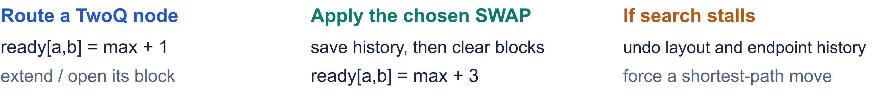
New metadata and routing state
Existing node indices, interaction kind, layout, distance layers, and decay remain in place.
Added field | Meaning and initialization
SabreNode.block: Option<u8> | Node contribution: Some(0..3), or None for a boundary
State.ready[q]: u32 | Physical wire’s available time, initially 0
State.last_block[q]: Option<(partner, c)> | Most recent pair and cost, initially None
State.ready_undo: Vec<(q, time, block)> | Previous endpoint values, initially empty
Build time
CX / CY / CZ / ECR: 1 Other 2q: 3 1q: 0 Boundaries: None
Fold existing node contributions with min(3, sum). Any None makes node.block None.
18
Notes:
Types abbreviate the VecMap index: q is always a PhysicalQubit. block_gates classifies ControlFlow, StandardInstruction, Store, and PauliProductMeasurement as None, then assigns 0 to one-qubit operations, 1 to standard CX/CY/CZ/ECR, 3 to other two-qubit operations, and None to other arities. Existing DAG compression sums contributions, capped at 3, while propagating None. only_interactions copies block metadata into layout trials. ready and last_block are indexed by physical wires, so they do not swap with logical occupants. On a routed TwoQ node, both clocks become max+1, and c becomes min(3, open+node.block) when valid. Synchronize/control-flow nodes invalidate affected block history without advancing these clocks. On every selected SWAP, two undo records save the old clocks and blocks, blocks clear, and clocks become max+3 even when the SWAP earned credit. On release-valve rollback, the router restores the layout and pops history records in reverse, then accounts for fallback swaps through the same updates. One compressed TwoQ node advances by one regardless of the number of folded gates.
Sources: design/sabre_best_swap_codex.md; design/sabre_best_swap_cladue.md. Commit 90ccaac29b2a547592e870797265007a128a02eb. dag.rs:79–113, 193 onward, only_interactions; route.rs:600–607, 715–760, 1163–1205.

Slide 19
New candidate score
For candidate s = (a,b), smaller scores still win. The basic component is enabled below.
Fusion changes the weighted distance term
U(s) = α [Δ
(s) + C(s)] + Σ
β
Δ
(s)
F
ℓ
ℓ
Eℓ
Wire readiness adds an estimated start-time penalty
Tₛ = max(ready[a], ready[b]) λ = 2.2 × 10⁻⁵
Without decay
Q
(s) = U(s) + λ T
new
s
With decay
Q
(s) = d
[H₀ + U(s)] + λ T
new
s
s
dₛ = max(decay[a], decay[b])
α scales the fusion credit. Decay uses the absolute baseline H₀. Readiness is added last.
19
Notes:
This is the exact comparison formula in choose_best_swap when the basic component exists, including the three standard Python presets. α and βℓ are effective weights after SetScaling. H₀ and the deltas are defined on slide 3. Fusion starts the candidate buffer with C(s), and the basic step assigns α(C+ΔF). Lookahead adds βℓΔEℓ. Decay restores H₀ and multiplies the bracket by dₛ. Readiness adds λ times max endpoint ready outside the decay multiplication. Tₛ is measured from the origin of the estimated schedule; the code does not subtract a global current time. Readiness is a real additive term and can outweigh small nonzero lookahead differences, not just exact ties. If a custom Heuristic omits the basic component entirely, use U=C+ΣβℓΔEℓ and omit the front term from H₀. This differs from an enabled basic component with zero weight, which zeros the fusion credit. Epsilon ties and seeded random selection are unchanged.
Sources: design/sabre_best_swap_codex.md; design/sabre_best_swap_cladue.md. Commit 90ccaac29b2a547592e870797265007a128a02eb. route.rs:963–1056; codex note section 9.

Slide 20
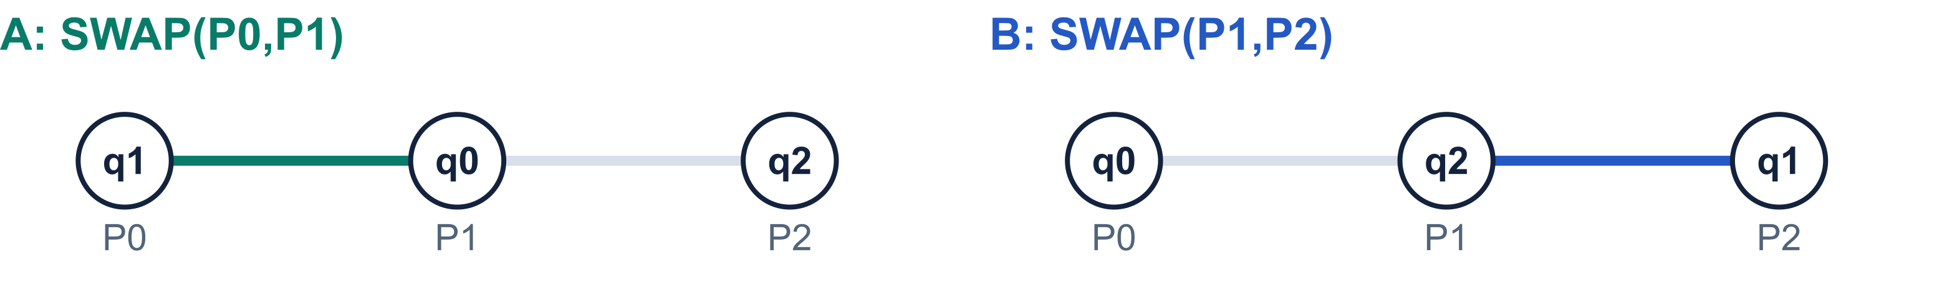
Worked example: fusion chooses the SWAP
Line P0–P1–P2. CX(q0,q1) routed, CX(q0,q2) pending. α = 1, no lookahead or decay.
Score component | A: prior block on P0,P1 | B: no block on P1,P2
Old distance score ΔF | 1 − 2 = −1 | 1 − 2 = −1
Fusion credit C | −2/3 (c = 1) | 0
Readiness λT | 0.000022 × 1 | 0.000022 × 1
New total | −1.6666447 chosen | −0.999978
Later synthesis
CX + SWAP: 1 + 3 = 4 CX 2 CX after cancellation
20
Notes:
Source-derived trace of the three-qubit fusion regression. Initially q0=P0, q1=P1, q2=P2. The routed CX on P0,P1 creates ready=[1,1,0] and reciprocal last_block entries with c=1. The only candidates touching active P0/P2 are edges P0,P1 and P1,P2. Both make the front interaction adjacent, so their old score is -1. Both T=1. Candidate A earns -2/3 and wins with -1.666644666… versus -0.999978. After A, q0 resides at P1, and the pending gate becomes CX(P1,P2). advance_swap still uses three clock units and clears block history. For the pair CX(P0,P1)+SWAP(P0,P1), choose the SWAP decomposition whose first CX matches the original CX. These consecutive identical CXs cancel, leaving two CX gates. Including the final routed CX gives three CXs. The fusion happens in later ConsolidateBlocks/UnitarySynthesis, while SABRE only anticipates the saving.
Sources: design/sabre_best_swap_codex.md; design/sabre_best_swap_cladue.md. Commit 90ccaac29b2a547592e870797265007a128a02eb. codex note walkthrough A and section 14.1; test/python/transpiler/test_sabre_swap.py fusion test.

Slide 21
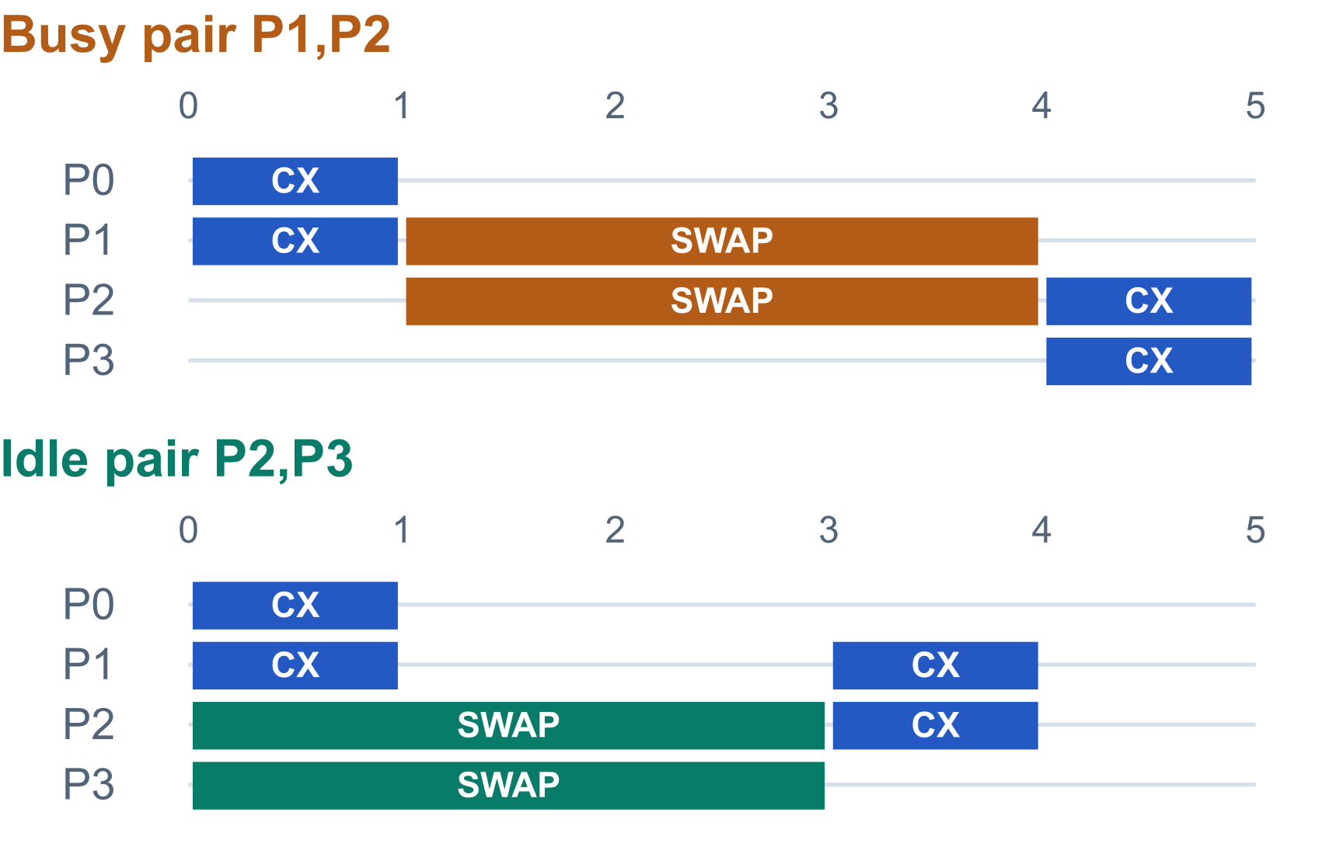
Worked example: readiness favors idle wires
Line P0–P1–P2–P3. After CX(P0,P1), ready = [1,1,0,0]. CX(q1,q3) is pending.
Both shown SWAPs give ΔF = −1 and C = 0
Busy SWAP starts at T = 1
−1 + 0.000022 = −0.999978
Idle SWAP starts at T = 0
−1 + 0 = −1 chosen
Readiness can also outweigh a small
lookahead advantage. It is a score term.
Clocks are approximate. A TwoQ node adds 1, a SWAP adds 3. Trial selection still counts SWAPs.
21
Notes:
This simplified four-wire example has one initial CX, whereas the regression test repeats that initial CX four times. After the routed prefix, ready=[1,1,0,0]. Candidate P1,P2 starts at one and candidate P2,P3 starts at zero. Both improve front distance 2 to 1 and have no eligible block. Scores are -0.999978 and -1. The third candidate P0,P1 worsens distance by one. In this one-CX example c=1, so its total is 1-2/3+0.000022 = 0.333355333…, and it loses. The diagrams show the same two-qubit operation on both occupied wires. Busy: prefix CX [0,1], SWAP [1,4], final CX [4,5]. Idle: prefix CX [0,1], independent SWAP [0,3], final CX [3,4]. The score uses SWAP start time, not final depth. This is a coarse two-qubit schedule: one compressed node counts as one unit, one inserted SWAP always counts as three even after fusion credit, and the model omits physical gate durations and one-qubit timing. There is no guarantee of globally minimal count/depth. Trial selection is unchanged and still minimizes top-level inserted SWAP count, with trial-index tie-breaking. The commit’s readiness/lookahead test shows that a 20-unit wait costs 0.00044 and can overturn a lookahead difference of 0.0001.
Sources: design/sabre_best_swap_codex.md; design/sabre_best_swap_cladue.md. Commit 90ccaac29b2a547592e870797265007a128a02eb. codex note walkthrough B and sections 9, 13–15; route.rs:57–60, 715–760, 1044 and swap_map trial selection.

