Slide 1
CSEFuzz

Slide 2
context
1. what is fuzzing
2. overall architecture
3. symbolic execution
4. program instrumentation
5. test case template select
6. Fuzzing by using efficient init seed

Slide 3
What is fuzzing
Fuzzing is Program testing to find crash or bug about input
So Fuzzing is used by executing at least all of condition

Slide 4
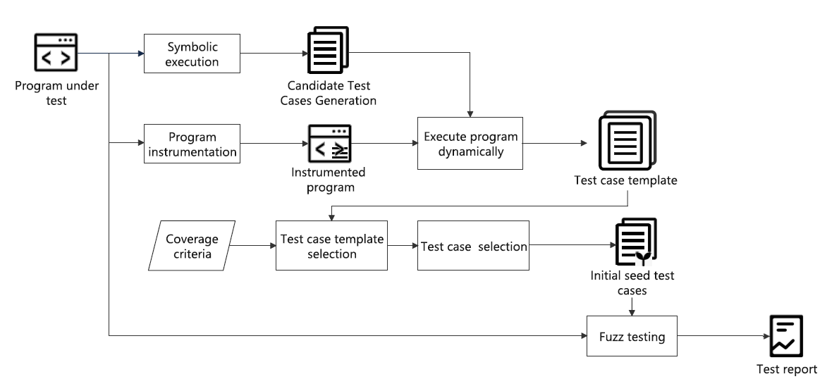
Overall architecture

Slide 5
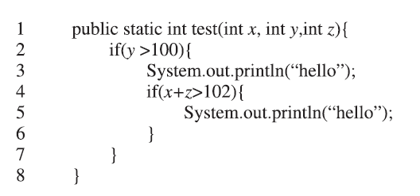
Symbolic execution
Symbolic execution extract condition influenced path of program execution such as input variables, Boolean conditions

Slide 6
program instrumentation
Program instrumentation is to add some debug among program to monitor path like print
int add(int a, int b) {
printf("add() called with %d and %d\n", a, b); // instrumentation
return a + b;
}

Slide 7
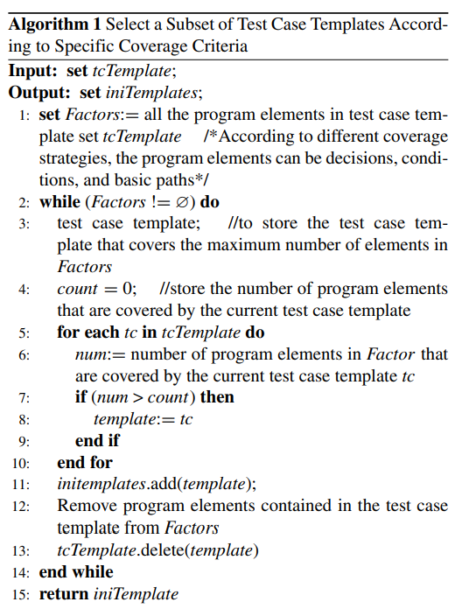
test case template select
Candidate test
selected test
Candidate test branchs
Satisfied conditions
Find Maximum condition test case
Propose to optimize
number of test case

Slide 8
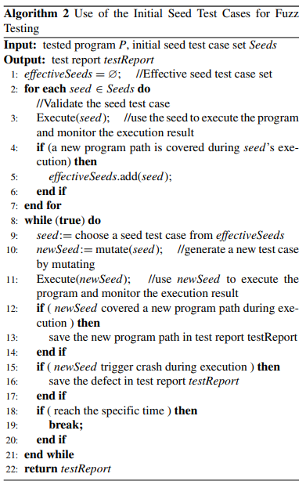
Fuzzing by using efficient init seed
Input values
Get effective seeds that
Have possible of new path
Some mutate due to expect
To find new path
If find New path,
save report
Time over end

