Slide 1
KAN: Kolmogorov-Arnold Networks

Slide 2
context
1. idea
2. comparison between MLP and KAN
3. unique technology
grid extension
Interpretability
4. training
Supervise learning
Unsupervise learning
5. conclusion

Slide 3
Idea of KAN
MLPs have fixed activation function on nodes,
But KAN have learnable and trainable activation functions on edge
So we can make our own activation function by training its parameter,
It is more free and correspond about task and problem than MLP

Slide 4
architecture
KAN is normally using two layer such as above
using varying form of activation function at each of edge

Slide 5
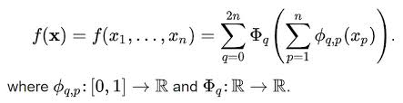
Architecture formula
Input data x is ranging between 0 and 1, output is place real number, also hidden too

Slide 6
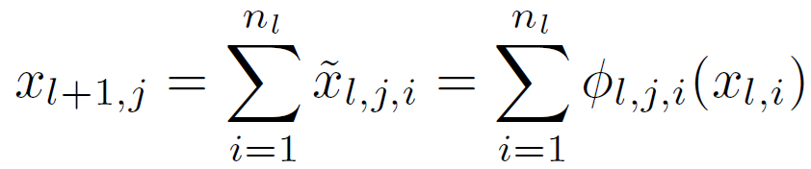
Each node formula
X(1,1)
X(1,2)
X(1,3)
0,2,1
0,2,2
L is index of layer
I is index of data
J is index of activation function
0,1,1
0,3,2
0,3,1
0,1,2
X(0,1)
X(0,2)

Slide 7
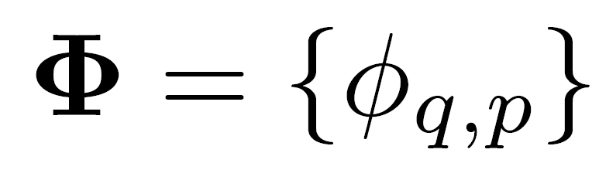
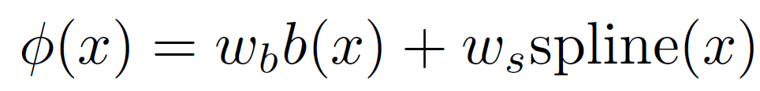
Phi function formula
Q is nber of input node
P is number of output node
Phi is aggregation of phium
Both of Wb and Ws are Linear weights
B function is base function that will introduce next page
spline function is curve function based B-spline, also will introduce later

Slide 8
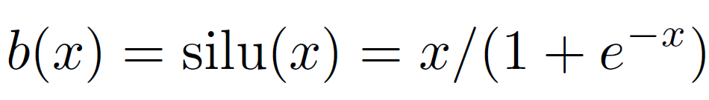
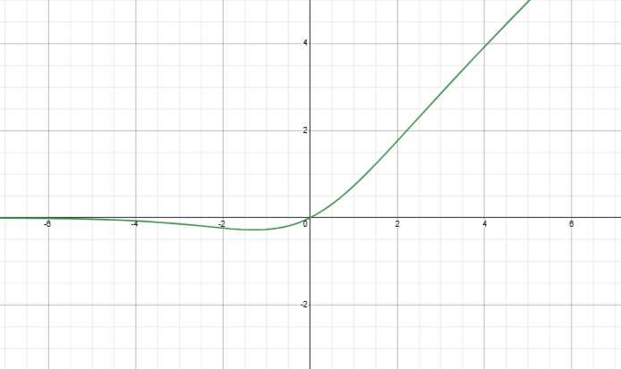
Base function formula

Slide 9
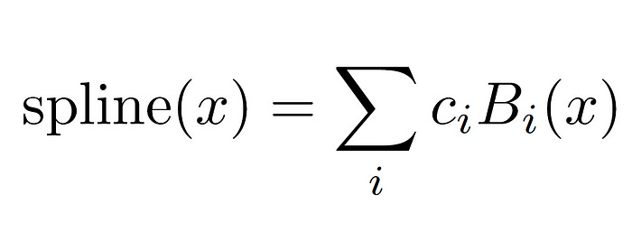
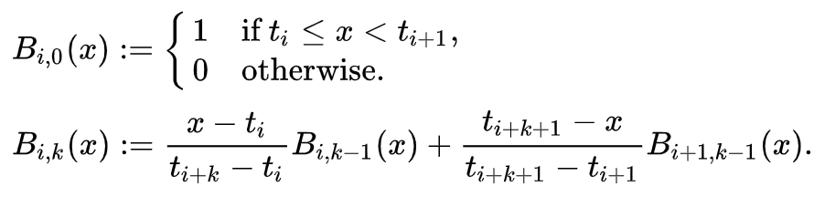
Spline function formula
c is weight
I is index of b-spline base function
K is degree that means curve term
T is Grid represent range of spline
G parameter means number of T

Slide 10
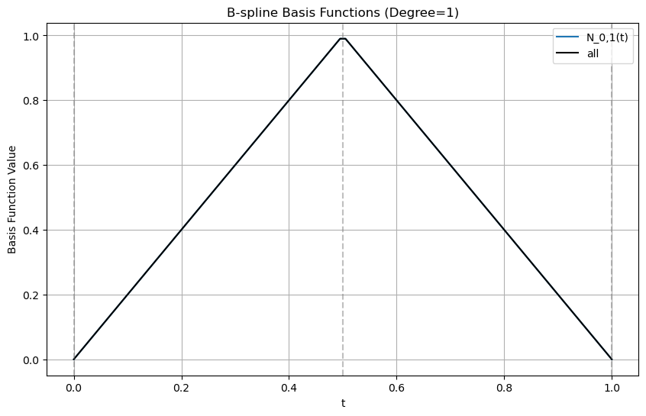
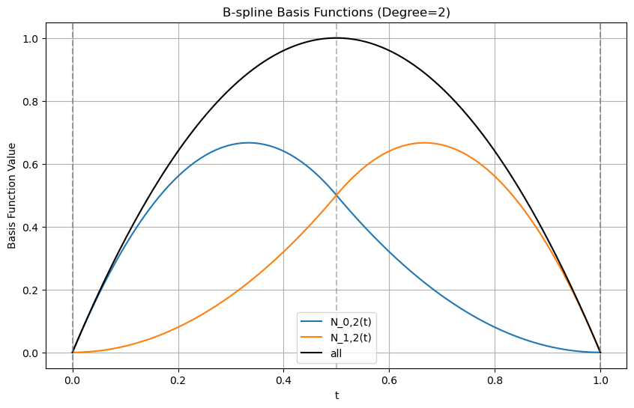
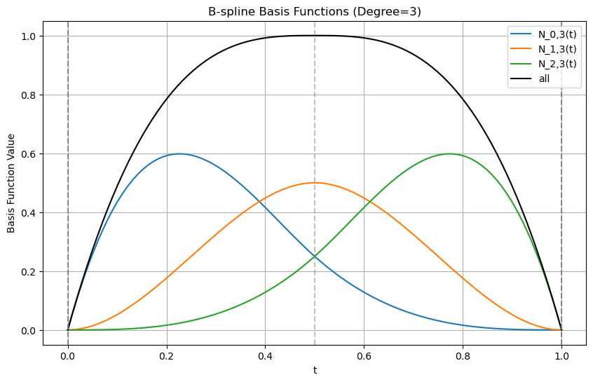
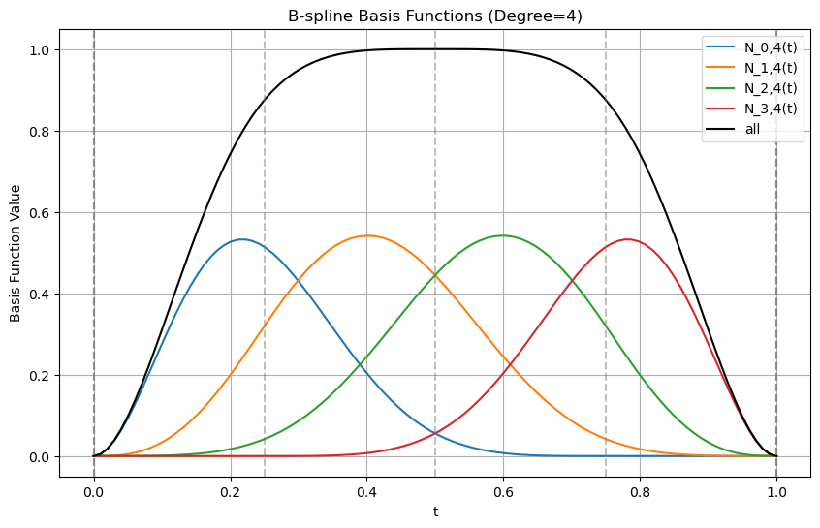
B(x) example
K = 1
G = 3
K = 2
G = 5
K = 3
G = 7
K = 4
G = 10

Slide 11
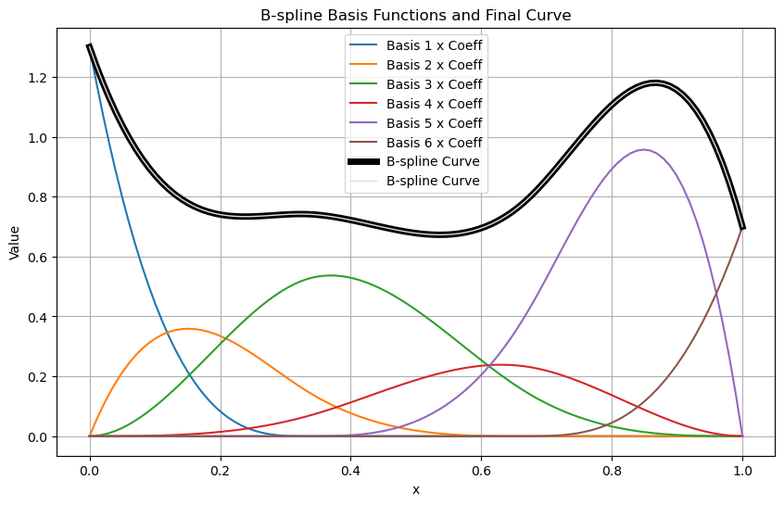
B(x) example
after we calculate basis spline,
We multiply weight c about each of them. And Next, by summing all spline
we can represent any of curve function in range
Note basis function of B-spline
depends constant K and linear vector T.
And there are parameter
when KAN determines during training

Slide 12
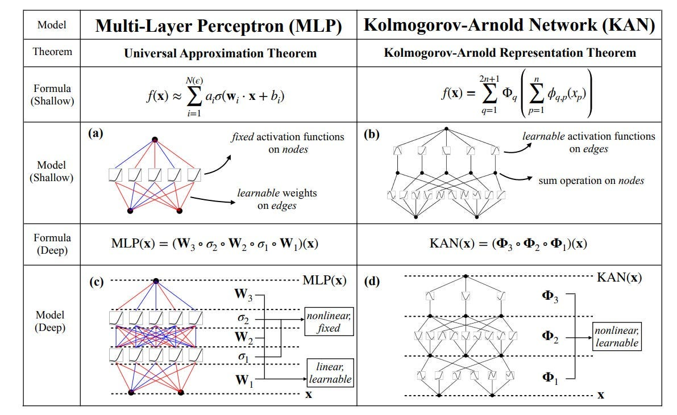
Comparison, MLP versus KAN

Slide 13
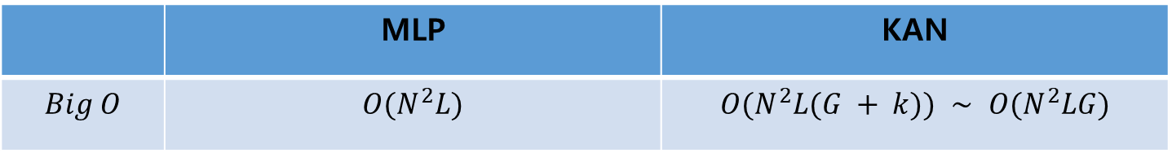
MLP vs KAN at aspect big O
 | MLP | KAN
$$Big O$$ | $$O(N^{2}L)$$ | $$O(N^{2}L(G + k)) ∼ O(N^{2}LG)$$
Only Big O, MLP is effected much better than KAN
But same performance, KAN is used more little parameter than MLP,
So at reality task, KAN is using lower latency and time than MLP

Slide 14
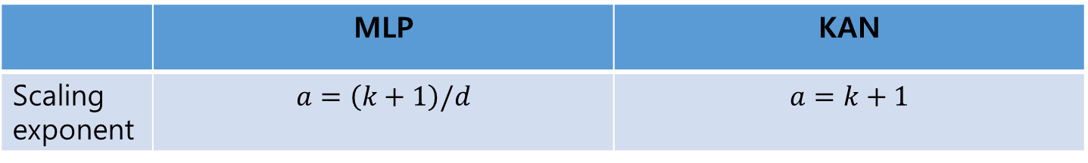
MLP vs KAN at aspect scaling
 | MLP | KAN
Scaling exponent | $$a=\left(k+1\right)/d$$ | $$a=k+1$$
K is polynomials of order
Scaling exponent of MLP depend on dimension parameter d,
So if you extend MLP deeper and wider, you offer curse of dimension(COD),
But KAN is not, because of independent about dimension

Slide 15
MLP vs KAN at aspect DOF
 | MLP | Spline | KAN
External | O | X | O
Internal | X | O | O
DOF is degrees of freedom
MLP only has external DOF, but KAN has both external and internal
So KAN can more represent varying of function forms than MLP

Slide 16
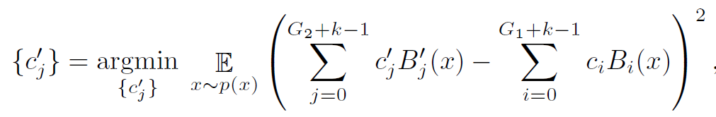
Grid Extension
MLP is expensive to obtain variety of model, because it is trained independently.
But KAN can easily extend using minimizing MSE between low extension and high extension than MLP

Slide 17
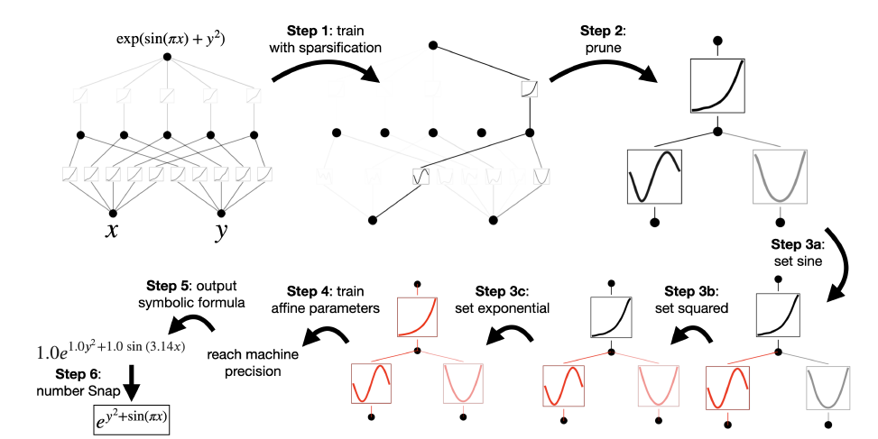
Interpretability technology
KAN is interpreted natural formulas by using above process

Slide 18
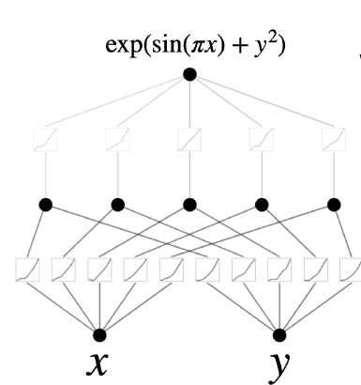
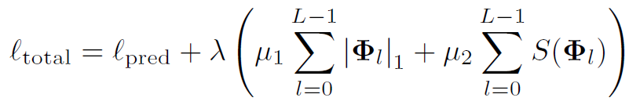
1. Sparsification
Initialized fully KAN, example start [2, 5, 1] KAN
Training with new L1 norm regularization about KAN

Slide 19
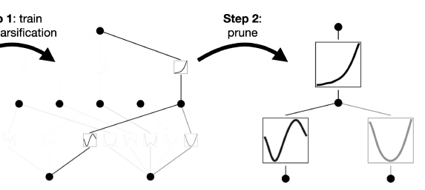

2. pruning
Pruning maximum score edge about each of layer

Slide 20
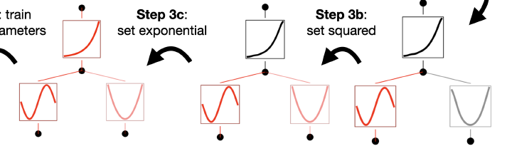
3. Symbolification
Each edge can symbolize for natural formula such as sin, exponent
Indeed, also there are edges that are symbolized impossible
If we change edge to natural formula, its form is fixed but not replaced exactly because of affine transform, so we are also training affine parameter of natural formula

Slide 21
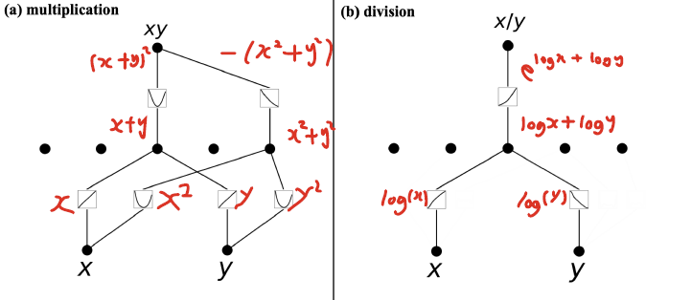
Supervised learning
Data x, y → label xy
Data x, y → label x/y
KAN can find more efficient formula than our intended formula

Slide 22
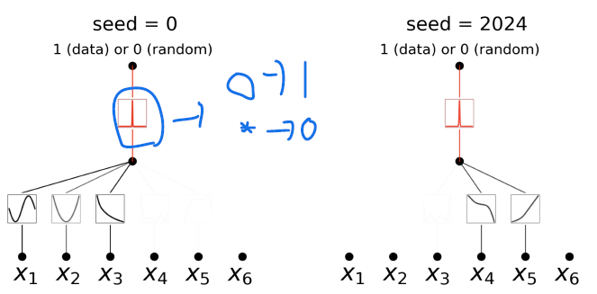

Unsupervised learning
Unsupervised learning learn real data = 1 and fake data = 0,
But we proposes reverse result that real → 0 and fake → 1,
So we choose small width Gaussian function last layer
Data is two type that original positive data and random negative data
Unsupervised learning is sensitive about seed such as above figure selecting different function about seed

Slide 23
Pro and con
Pro
Con
Compositional structure
Complicated function
Continual learning
Learning for Quantitative level
small models training
Weakly High dimension
Learning for Qualitative level
Highly Training time

Slide 24
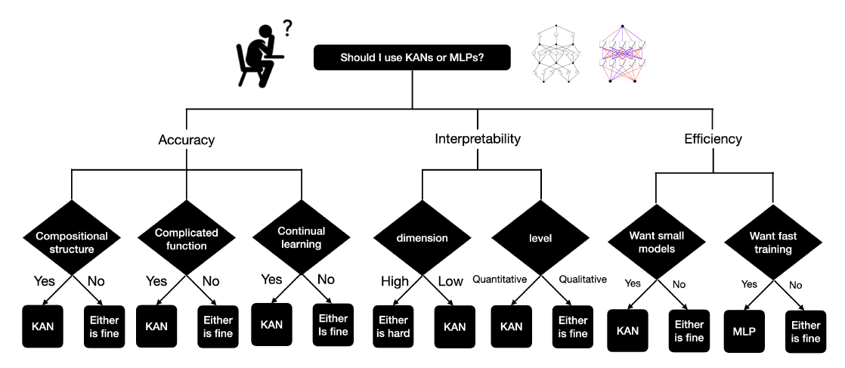
conclusion
KAN is evolution of neuron network that is strongly science, AI problems
But it is not universal, so we should consider the other network depending on the task

