Slide 1
FGSM : fast gradient sign method

Slide 2
Context
1. linear adversarial attack
2. non linear adversarial attack
3. adversarial training of deep learning
4. feature of adversarial example

Slide 3
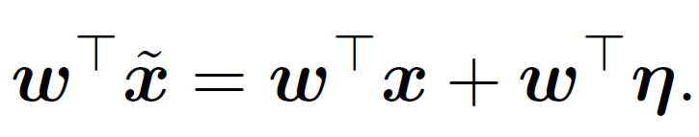
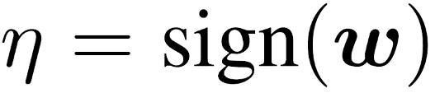
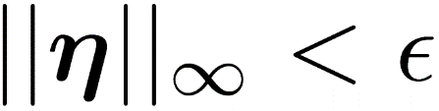
Linear adversarial attack
Linear model
Linear perturbation
Linear perturbation is defined this formula and constraint
formula
constraint

Slide 4
example
6
6
1
2
2
1
1
2
3
-4
X
=
30
1
2
3
-4
X
+
)
40
(
=
8
8
1
1
1
-1
We can make small changes to inputs that add up to one large change to output
This different of activate is defined by weight size multiply epsilon

Slide 5
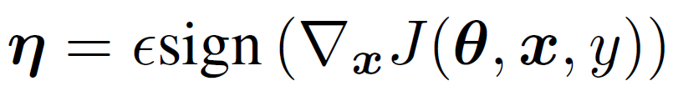
Non Linear adversarial attack
J is cost function also loss function
X is input
Y is label
Theta is parameter
Eta is defined above formula at non linear model
Gradient that Input of sign is calculated while training
and this method is called “fast gradient sign method”

Slide 6
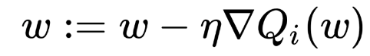
example
Loss function
Adversarial attack
Gradient descent

Slide 7
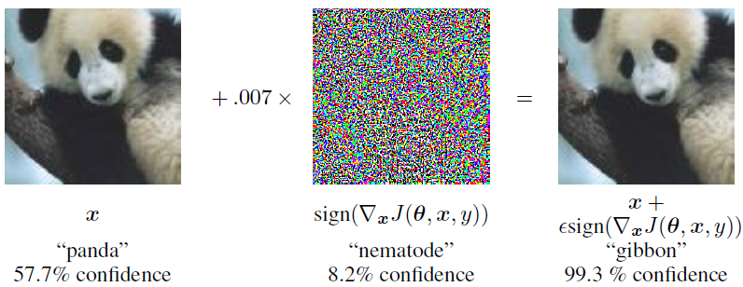
example

Slide 8
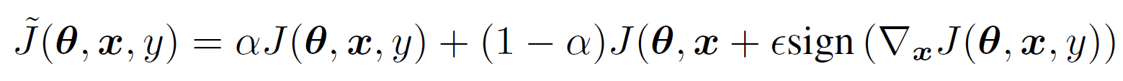
Adversarial training of deep learning
normal input activate
adversarial input activate
Alpha is setting 0.5

Slide 9
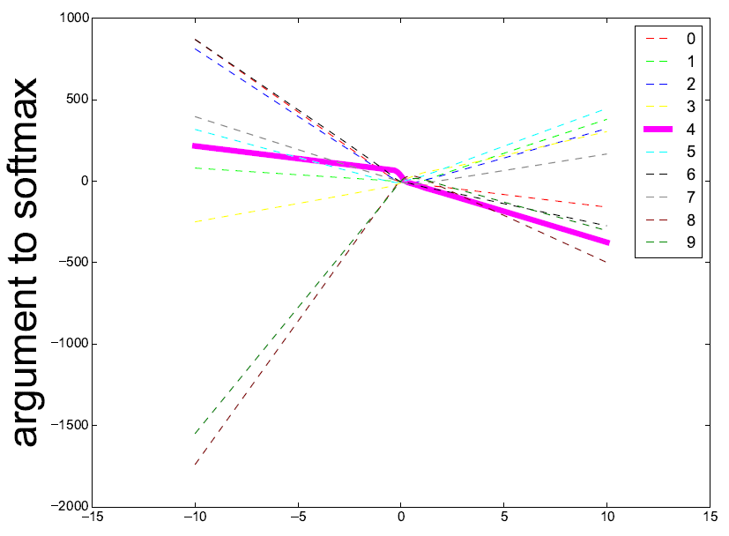
feature of adversarial example
1
Why human do not recognize about adversarial example?
A
Because of highly dimension of weight vector
2
Why do adversarial examples generalize?
A
According to beside figure, simply model such as CNN, Resnet is trained linearilty. so adversarial example occur continuously regions
This means that if adversarial attack jump only one Margin of class, it can attack consistently
Not oscillation

