Slide 1
PGD (projected gradient descent)

Slide 2
content
1. recently adversarial attack
2. define saddle point problem
3. concept projected gradient descent
4. feature of PGD
5. experiment

Slide 3

recently adversarial attack
FGSM is one of represents of adversarial attack

Slide 4
What is saddle point?
It is defined optimization of both max and min problem

Slide 5

define saddle point problem
outer minimization problem
Inner maximization problem
Find adversarial version of data x having high loss
Find model parameter that have

Slide 6

concept projected gradient descent
Previous step x that has some of pertubation
Constrained range of perturbation in (-noise, noise)
adversarial step to find efficient perturbation by using recursively ascent

Slide 7
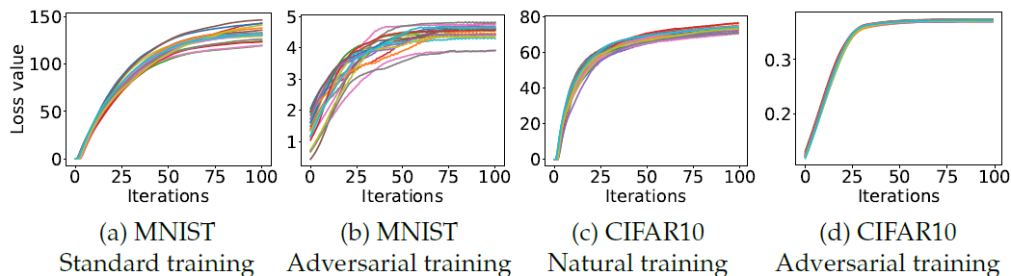
feature of PGD
1. Difficult finding problem in reasonable time
2. It tend to have well concentrated loss value about each steps
low

Slide 8
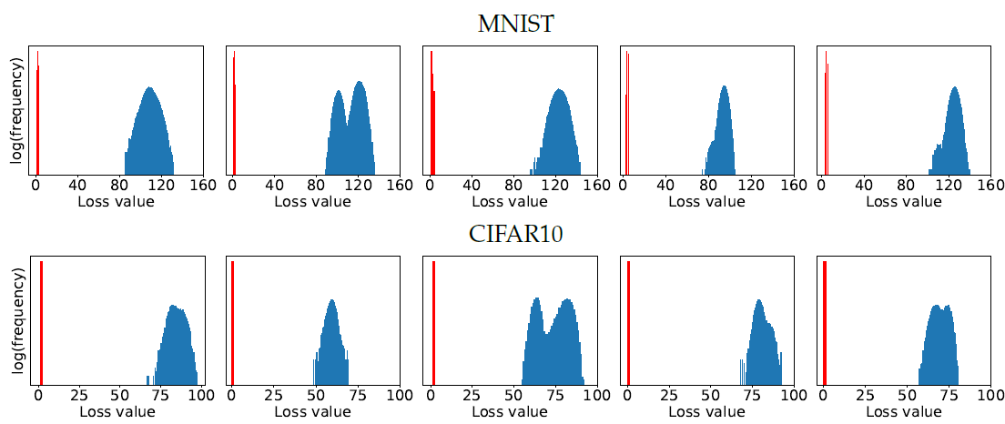
feature of PGD
3. adversarial training is more efficient than standard training indeed without outlier
Red : adversarial, blue : standard

Slide 9
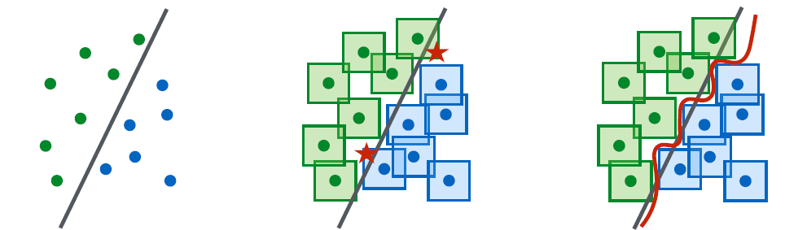
feature of PGD
4. we can find solution of saddle point problem about both outer minimization and inner maximization by using same gradient of inner adversarial version
5. It should have more capacity about model than standard, because of more complicated boundary

Slide 10
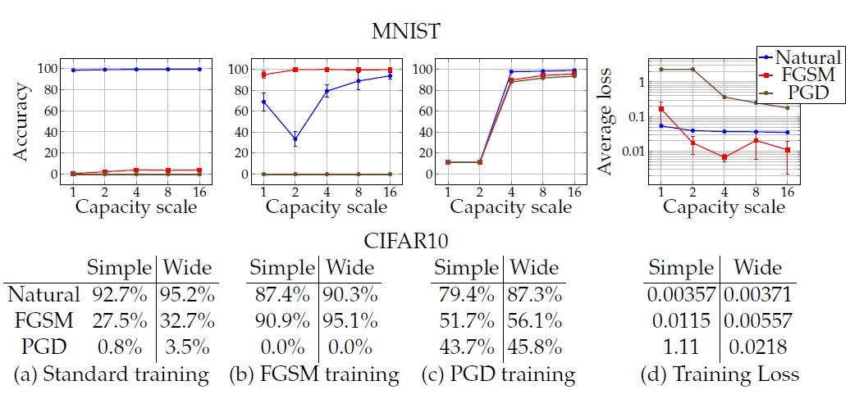
experiment
We can know that standard is not robustness about adversarial example
And PGD is needed further capacity to get high performance

