Slide 1
CW-Attack

Slide 2
Context
1. problem define
2. objective function
3. alternative formulation
4. box constraints
5. L0, L2, L_infty attack

Slide 3
Problem define
D is distance function
C is classification function
But it is too hard to solve directly, because C is non-linear
So we should change it to approximate alternative

Slide 4
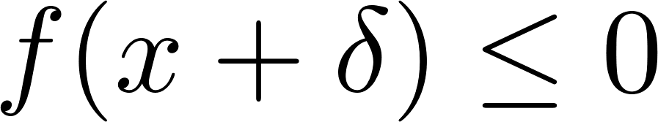
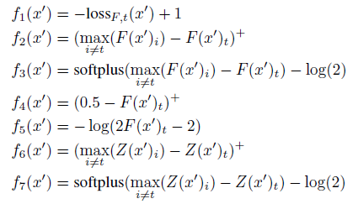
Objective function
We should change C function to approximate alternative
So paper provide seven alternative that should be
in common

Slide 5
Alternative function
Empirically, paper provide best function f_6
So alternative formulation is
That is also represented by using norm

Slide 6
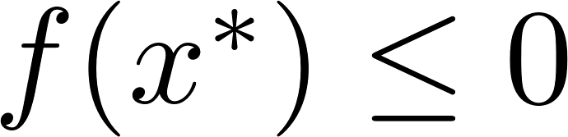
Find c
Best way to choose c is to use the smallest value of c for which the resulting solution
And we can find c using binary search

Slide 7
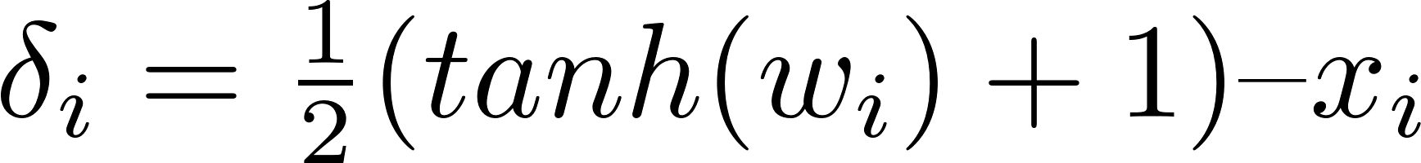
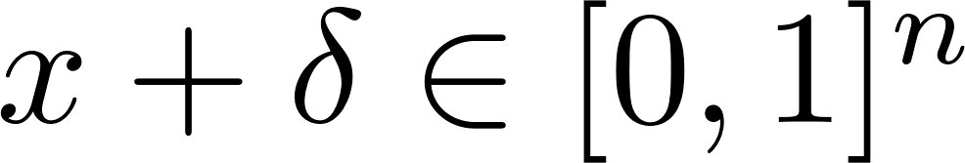
Box constraints
In CW attack, Box constraint using PGD poorly work
So paper provide alternative of box constraint

Slide 8
L2 norm attack
Final optimization problem is
And f is f_6
Starting multiple random points gradient descent

Slide 9
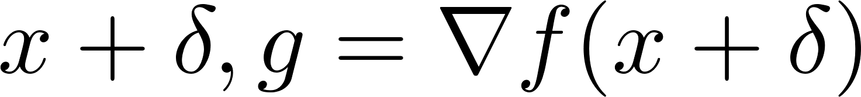
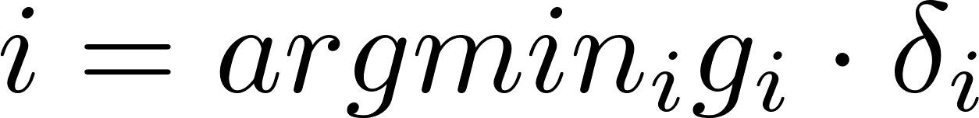
L0 norm attack
Minimal subset of pixels that can be modified to generate an adversarial example.
If we find sample using L2 adversary
And eliminate pixel if it satisfied constraint
this mean that how much reduction in f about each pixel i
This process repeats until the L2 adversary fails to find an adversarial example.
And if it fails, doubling c value, initial c is very low value

Slide 10
L_infty norm attack
Formula is
But L_infty work poorly at gradient descent
Because only largest delta panelize
So that is alternative
If delta < tau for all i, reduce tau factor of 0.9 ( initial 1 )

