Slide 1
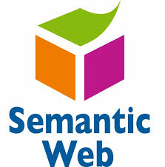
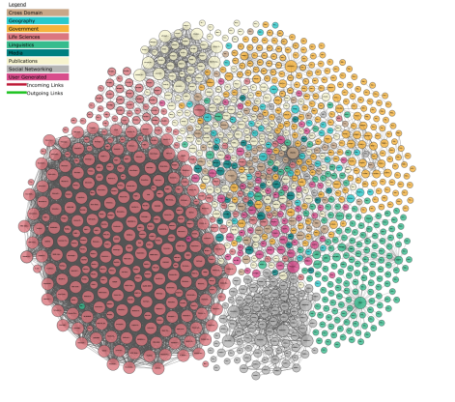
M164-CS2: Knowledge Technologies
L02 – RDF, RDFS
Prof. Manolis Koubarakis
Giorgos Santipantakis

Slide 2
Presentation Outline
RDF
  URI
  RDF Basics
  RDF Graphs
  Literals
  Shorthand notation: Qnames
  URIrefs as vocabularies
  Structured values and blank nodes
  RDF Serialization
RDFS
  Classes
  Properties
  Utility Properties
M164-CS2: Knowledge Technologies
Manolis Koubarakis, G. Santipantakis

Slide 3
The vision
The Web today
The Semantic Web
Universal resource identifiers (URIs) to identify documents.
Hyperlinks to connect one document to the other.
Information is processed by human readers through a browser.
Search Engines to discover information.
Data is controlled by applications, and each application keeps it to itself
Universal resource identifiers (URIs) to identify resources.
Relationships between resources.
Information is processed by software agents. All agents understand the terms/language.
More accurate search Engines using KG.
Integration and combination of data drawn from diverse sources
M164-CS2: Knowledge Technologies
Manolis Koubarakis, G. Santipantakis

Slide 4
Applications
Data integration,
  e.g., see project Optique http://www.optique-project.eu/
E-government,
  e.g., https://data.gov/open-gov/ , https://www.data.gov.uk/
E-commerce,
  see https://www.w3.org/wiki/GoodRelations used by Google, Bing, BestBuy, eBay
Medicine, Biology,
  see BioPortal https://bioportal.bioontology.org/ontologies (1153 ontologies, 15,6 million classes, 100 million links)
  OBO Foundry https://obofoundry.org/ (Open biological and biomedical ontology foundry, 184 active ontologies, total 261 ontologies)
Earth Observation
  see the work of prof. Koubarakis’ group in projects TELEIOS http://www.earthobservatory.eu/ and LEO http://www.linkedeodata.eu/
…
M164-CS2: Knowledge Technologies
Manolis Koubarakis, G. Santipantakis

Slide 5
Presentation Outline
RDF
  URI
  RDF Basics
  RDF Graphs
  Literals
  Shorthand notation: Qnames
  URIrefs as vocabularies
  Structured values and blank nodes
  RDF Serialization
RDFS
  Classes
  Properties
  Utility Properties
M164-CS2: Knowledge Technologies
Manolis Koubarakis, G. Santipantakis

Slide 6
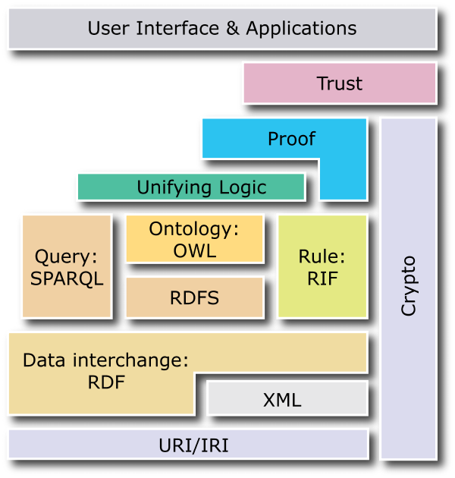
The Semantic Web Layer Cake
M164-CS2: Knowledge Technologies
Manolis Koubarakis, G. Santipantakis

Slide 7
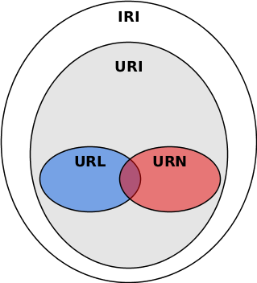
Uniform Resource Identifiers (URI)
Uniform Resource Locator (URL):
  Tells you where is something and how to get it:
    [Scheme]://[Domain]:[Port]/[Path]?[QueryString]#[FragmentId]
Uniform Resource Name (URN):
  A type of URI that uses a name instead of a locator
    urn:[namespace identifier]:[namespace specific string]
URI identifies a resource, which can be abstract or physical
URI can represent various types of resources, including online and offline entities
  A dereferenceable URI uses internet protocols (e.g., HTTP) to obtain a copy or representation of the resource it identifies.
Internationalized Resource Identifier (IRI):
  A generalization of the URI. URI supports only ASCII encoding, IRI fully supports international characters (e.g. UTF-8 encoding). Pay attention on how to use it: e.g. https://ρaypal.com is not the same as https://paypal.com
See also: See http://tools.ietf.org/html/rfc3987 which defines IRIs.
M164-CS2: Knowledge Technologies
Manolis Koubarakis, G. Santipantakis

Slide 8
URI examples
Scheme
Domain
Path
fragment identifier
URI
Scheme
(urn)
Namespace ID
namespace specific string
URI
M164-CS2: Knowledge Technologies
Manolis Koubarakis, G. Santipantakis

Slide 9
URIs in RDF (cont’d)
Consider the following URIs:
  http://www.example.org/index.html
  http://www.example.org/index.html#Section2
In normal HTML usage, these URIs are related (they both refer to the same document, the second one identifying a location within the first one).
RDF assumes no particular relationship between these two URIs. As far as RDF is concerned, they are syntactically different URI references, and hence may refer to unrelated things.
A URI reference (or URIref) is a URI, together with an optional fragment identifier at the end.
  URIref can be absolute (refers to a resource independently of the context in which the URIref appears) or
  relative (a shorthand form of an absolute URIref, where some prefix of the URIref is missing)
M164-CS2: Knowledge Technologies
Manolis Koubarakis, G. Santipantakis

Slide 10
Presentation Outline
RDF
  URI
  RDF Basics
  RDF Graphs
  Literals
  Shorthand notation: Qnames
  URIrefs as vocabularies
  Structured values and blank nodes
  RDF Serialization
RDFS
  Classes
  Properties
  Utility Properties
M164-CS2: Knowledge Technologies
Manolis Koubarakis, G. Santipantakis

Slide 11
The Semantic Web Layer Cake
M164-CS2: Knowledge Technologies
Manolis Koubarakis, G. Santipantakis

Slide 12
Resource Description Framework (RDF)
The Resource Description Framework (RDF) is a data model for representing information (especially metadata) about resources in the Web.
RDF can also be used to represent information about things that can be identified on the Web, even when they cannot be directly retrieved on the Web (e.g., a book or a person).
RDF is intended for situations in which information about Web resources needs to be processed by applications, rather than being only displayed to people.
M164-CS2: Knowledge Technologies
Manolis Koubarakis, G. Santipantakis

Slide 13
RDF Basics
RDF is based on the idea of identifying resources using Web identifiers and describing resources in terms of simple properties and property values.
To identify resources, RDF uses Uniform Resource Identifiers (URIs) and URI references (URIrefs).
Definition: A resource is anything that is identifiable by a URIref.
M164-CS2: Knowledge Technologies
Manolis Koubarakis, G. Santipantakis

Slide 14

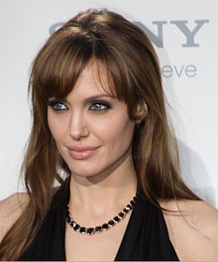
Example
has actor
How do I represent this fact in XML?
M164-CS2: Knowledge Technologies
Manolis Koubarakis, G. Santipantakis

Slide 15
Example
has actor
How do I represent this fact in XML?
<starring>
<film>Changeling</film>
<actor>Angelina Jolie</actor>
</starring>
M164-CS2: Knowledge Technologies
Manolis Koubarakis, G. Santipantakis

Slide 16
Example
has actor
How do I represent this fact in XML?
<starring>
<film>Changeling</film>
<actor>Angelina Jolie</actor>
</starring>
<film name = "Changeling">
<actor>Angelina Jolie</actor>
</film>
M164-CS2: Knowledge Technologies
Manolis Koubarakis, G. Santipantakis

Slide 17
Example
has actor
How do I represent this fact in XML?
<starring>
<film>Changeling</film>
<actor>Angelina Jolie</actor>
</starring>
<film name = "Changeling">
<actor>Angelina Jolie</actor>
</film>
<film name = "Changeling" actor="Angelina Jolie" />
M164-CS2: Knowledge Technologies
Manolis Koubarakis, G. Santipantakis

Slide 18
Discussion
Three well formed XML expressions
It is difficult to compare them and identify that they represent the same fact
M164-CS2: Knowledge Technologies
Manolis Koubarakis, G. Santipantakis

Slide 19
Example
has actor
How do I represent this fact in RDF?
M164-CS2: Knowledge Technologies
Manolis Koubarakis, G. Santipantakis

Slide 20
Example
has actor
How do I represent this fact in RDF?
subject
Changeling_film
predicate
has_actor
object
Angelina Jolie
M164-CS2: Knowledge Technologies
Manolis Koubarakis, G. Santipantakis

Slide 21
Discussion
RDF is based on the idea that the resources being described have properties which have values, and that resources can be described by making statements, similar to the ones above, that specify those properties and values.
Terminology:
  The part that identifies the thing the statement is about is called the subject.
  The part that identifies the property or characteristic of the subject that the statement specifies is called the predicate.
  The part that identifies the value of that property is called the object.
M164-CS2: Knowledge Technologies
Manolis Koubarakis, G. Santipantakis

Slide 22
Example II
Consider the following information:
  “there is a Person identified by
  http://www.w3.org/People/EM/contact#me,
  whose name is Eric Miller, whose email
  address is em@w3.org, and whose title is
  Dr.”
M164-CS2: Knowledge Technologies
Manolis Koubarakis, G. Santipantakis

Slide 23
Example (cont’d)
subject predicate object .
Triple notation:
<http://www.w3.org/People/EM/contact#me>
<http://www.w3c.org/1999/02/22-rdf-syntax-ns#type>
<http://www.w3c.org/2000/10/swap/pim/contact#Person> .
<http://www.w3.org/People/EM/contact#me>
<http://www.w3c.org/2000/10/swap/pim/contact#fullName>
“Eric Miller”.
<http://www.w3.org/People/EM/contact#me>
<http://www.w3c.org/2000/10/swap/pim/contact#mailbox>
<mailto:em@w3.org> .
<http://www.w3.org/People/EM/contact#me>
<http://www.w3c.org/2000/10/swap/pim/contact#personalTitle>
“Dr.”.
Note: In this notation URIs are written out completely, in angle brackets.
M164-CS2: Knowledge Technologies
Manolis Koubarakis, G. Santipantakis

Slide 24
Presentation Outline
RDF
  URI
  RDF Basics
  RDF Graphs
  Literals
  Shorthand notation: Qnames
  URIrefs as vocabularies
  Structured values and blank nodes
  RDF Serialization
RDFS
  Classes
  Properties
  Utility Properties
M164-CS2: Knowledge Technologies
Manolis Koubarakis, G. Santipantakis

Slide 25
RDF Graphs
Graphically, RDF models statements by nodes and arcs in a graph.
In the RDF graph notation, a statement is represented by:
  a node for the subject
  a node for the object
  an arc for the predicate, directed from the subject node to the object node.
A node may be identified by a URIref or it can be a literal (it can also be a blank node; we will explain this later).
An arc is identified by a URIref.
Note: We will draw RDF graphs as directed graphs. But strictly speaking, directed graphs are not sufficient for capturing all of RDF (e.g., directed graphs assume that the sets of nodes and arcs are disjoint but RDF allows a property as a subject of a statement).
M164-CS2: Knowledge Technologies
Manolis Koubarakis, G. Santipantakis

Slide 26
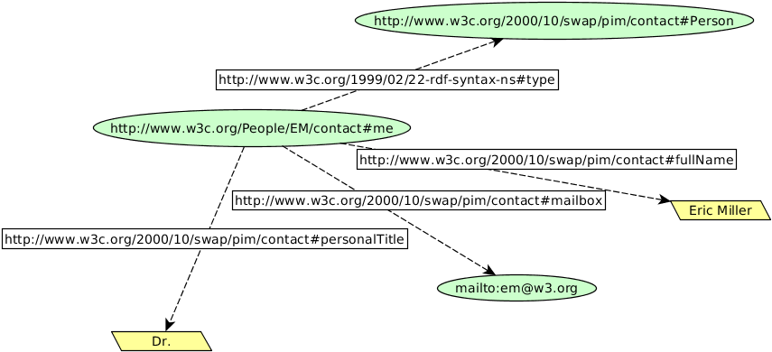
Example II (cont’d)
M164-CS2: Knowledge Technologies
Manolis Koubarakis, G. Santipantakis

Slide 27
Discussion
In terms of the relational model, an RDF statement is similar to a tuple in a relation called Triples or Graph with attributes Subject, Predicate and Object.
In terms of first-order logic, an RDF statement is similar to an atomic formula
triple(subj,pred,obj)
where triple is a first-order logic predicate and subj, pred and obj are constants.
M164-CS2: Knowledge Technologies
Manolis Koubarakis, G. Santipantakis

Slide 28
Presentation Outline
RDF
  URI
  RDF Basics
  RDF Graphs
  Literals
  Shorthand notation: Qnames
  URIrefs as vocabularies
  Structured values and blank nodes
  RDF Serialization
RDFS
  Classes
  Properties
  Utility Properties
M164-CS2: Knowledge Technologies
Manolis Koubarakis, G. Santipantakis

Slide 29
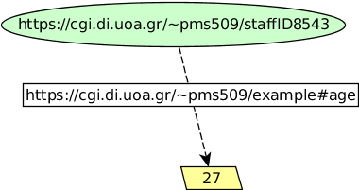
Literals
There are two kinds of literals:
  Plain (untyped).
  Typed.
Example:
What is 27? Number or string?
M164-CS2: Knowledge Technologies
Manolis Koubarakis, G. Santipantakis

Slide 30
Literals (cont’d)
Plain literals have a lexical form (their lexical value) and optionally a language tag.
  Example: “27” , “Hello world”@en
An RDF typed literal is formed by pairing a string with a URIref that identifies a particular datatype.
  Example:
“27”^^http://www.w3.org/2001/XMLSchema#integer
M164-CS2: Knowledge Technologies
Manolis Koubarakis, G. Santipantakis

Slide 31
Typed Literals
RDF has no built-in set of datatypes of its own. RDF typed literals simply provide a way to explicitly indicate, for a given literal, what datatype should be used to interpret it. The datatypes used in typed literals are defined externally to RDF, and identified by their datatype URIs.
Exception: RDF defines a built-in datatype with the URIref rdf:XMLLiteral to represent XML content as a literal value. This is useful when we want to bring into an RDF sentence, content that has already been defined in XML (e.g., in the case of spatial data, a polygon defined in GML).
RDF datatype concepts are based on a conceptual framework from XML Schema datatypes. This framework defines the value space, the lexical space and the lexical-to-value mapping for a datatype (see the RDF specifications for more details).
M164-CS2: Knowledge Technologies
Manolis Koubarakis, G. Santipantakis

Slide 32
XML Schema Datatypes
xsd:integer
xsd:boolean
xsd:string
xsd:date
…
M164-CS2: Knowledge Technologies
Manolis Koubarakis, G. Santipantakis

Slide 33
Presentation Outline
RDF
  URI
  RDF Basics
  RDF Graphs
  Literals
  Shorthand notation: Qnames
  URIrefs as vocabularies
  Structured values and blank nodes
  RDF Serialization
RDFS
  Classes
  Properties
  Utility Properties
M164-CS2: Knowledge Technologies
Manolis Koubarakis, G. Santipantakis

Slide 34
Triple Notation – QNames as Shorthands
The full triple notation results in very long lines.
Shorthand: We can use an XML qualified name (or QName) without angle brackets as an abbreviation for a full URI reference.
A QName consists of a prefix that has been assigned to a namespace URI, followed by a colon, and then a local name. The full URIref is formed from the QName by appending the local name to the namespace URI assigned to the prefix.
The concepts of names and namespaces used in RDF originate in XML.
M164-CS2: Knowledge Technologies
Manolis Koubarakis, G. Santipantakis

Slide 35
XML Namespaces
A namespace is a way of identifying a subset of a set of names (e.g., the set of possible names of resources in the Web) which acts as a qualifier for the names in this subset.
XML namespaces are used for providing uniquely named elements and attributes in an XML document.
XML namespaces help us eliminate ambiguity in an XML document. For example, an XML document can use id to refer to both identifiers of customers and products if id is prefixed by an appropriate name space (e.g., http://customers.org and http://products.com).
A namespace is created by creating a URI for it. By qualifying names with the URIs of their namespaces, anyone can create their own names and properly distinguish them from names with identical spellings created by others.
See the W3C Recommendation “Namespaces in XML 1.0” available at http://www.w3.org/TR/REC-xml-names/.
M164-CS2: Knowledge Technologies
Manolis Koubarakis, G. Santipantakis

Slide 36
Presentation Outline
RDF
  URI
  RDF Basics
  RDF Graphs
  Literals
  Shorthand notation: Qnames
  URIrefs as vocabularies
  Structured values and blank nodes
  RDF Serialization
RDFS
  Classes
  Properties
  Utility Properties
M164-CS2: Knowledge Technologies
Manolis Koubarakis, G. Santipantakis

Slide 37
URIrefs as Vocabulary
Since RDF uses URIrefs instead of words to name things in statements, URIrefs define vocabularies in RDF.
The URIrefs in RDF vocabularies are typically organized so that they can be represented as a set of QNames with a common prefix:
  A common namespace URIref is chosen for all terms in a vocabulary, typically a URIref under the control of whoever is defining the vocabulary.
  URIrefs that are contained in the vocabulary are formed by appending individual local names to the end of the common URIref.
M164-CS2: Knowledge Technologies
Manolis Koubarakis, G. Santipantakis

Slide 38
URIrefs as Vocabulary (cont’d)
RDF uses this same approach to define its own vocabulary of terms:
  The URIrefs in the RDF vocabulary all begin with http://www.w3.org/1999/02/22-rdf-syntax-ns#, conventionally associated with the QName prefix rdf:.
  The RDF Vocabulary Description Language defines an additional set of terms having URIrefs that begin with http://www.w3.org/2000/01/rdf-schema#, conventionally associated with the QName prefix rdfs:.
Where a specific QName prefix is commonly used in connection with a given set of terms in this way, the QName prefix itself is sometimes used as the name of the vocabulary. For example, someone might refer to "the rdfs: vocabulary".
M164-CS2: Knowledge Technologies
Manolis Koubarakis, G. Santipantakis

Slide 39
URIrefs as Vocabulary (cont’d)
Convention: Organizations typically use a vocabulary's namespace URIref as the URL of a Web resource that provides further information about that vocabulary.
Example: the QName prefix dc: with the namespace URIref http://purl.org/dc/elements/1.1 refers to the Dublin Core vocabulary.
  Accessing this namespace URIref in a Web browser will retrieve additional information about the Dublin Core vocabulary (specifically, RDFS definitions of the Dublin core vocabulary).
  Reminder: this is just a useful convention. RDF does not assume that a namespace URI identifies a retrievable Web resource.
M164-CS2: Knowledge Technologies
Manolis Koubarakis, G. Santipantakis

Slide 40
URIrefs as Vocabulary (cont’d)
Using URIrefs as subjects, predicates, and objects in RDF statements supports the development and use of shared vocabularies on the Web.
People can discover and begin using vocabularies already used by others to describe things, reflecting a shared understanding of those concepts.
M164-CS2: Knowledge Technologies
Manolis Koubarakis, G. Santipantakis

Slide 41
Example
Consider the triple ex:index.html dc:creator exstaff:85740 .
  The predicate dc:creator, when fully expanded as a URIref, is an unambiguous reference to the "creator" attribute in the Dublin Core metadata attribute set, a widely-used set of attributes (properties) for describing a wide range of networked resources (see http://dublincore.org/documents/usageguide/).
  The writer of this triple is effectively saying that the relationship between the Web page and the creator of the page is exactly as identified by http://purl.org/dc/elements/1.1/creator.
  Another person familiar with the Dublin Core vocabulary, who finds out what dc:creator means (say by looking up its definition) will know what is meant by this relationship, or write programs to behave in accordance with that meaning when processing triples containing the predicate dc:creator.
M164-CS2: Knowledge Technologies
Manolis Koubarakis, G. Santipantakis

Slide 42
Presentation Outline
RDF
  URI
  RDF Basics
  RDF Graphs
  Literals
  Shorthand notation: Qnames
  URIrefs as vocabularies
  Structured values and blank nodes
  RDF Serialization
RDFS
  Classes
  Properties
  Utility Properties
M164-CS2: Knowledge Technologies
Manolis Koubarakis, G. Santipantakis

Slide 43
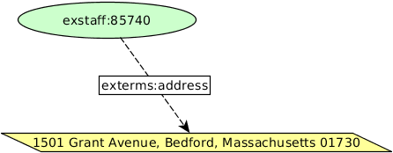
Structured Values in RDF
Consider the triple:
  exstaff:85740 exterms:address "1501 Grant Avenue, Bedford, Massachusetts 01730" .
M164-CS2: Knowledge Technologies
Manolis Koubarakis, G. Santipantakis

Slide 44
Structured Values in RDF
Consider the triple:
  exstaff:85740 exterms:address "1501 Grant Avenue, Bedford, Massachusetts 01730" .
What if the address needs to be represented as a structure consisting of separate street, city, state, and postal code values? How would this be done in RDF?
Structured information is represented in RDF by considering the aggregate thing to be described (like John Smith's address) as a resource, and then making statements about that new resource.
M164-CS2: Knowledge Technologies
Manolis Koubarakis, G. Santipantakis

Slide 45
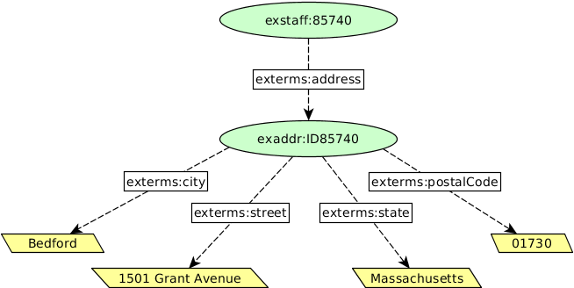
Structured Values in RDF (cont’d)
M164-CS2: Knowledge Technologies
Manolis Koubarakis, G. Santipantakis

Slide 46
Discussion
This way of representing structured information in RDF can involve generating numerous “intermediate” URIrefs such as exaddr:ID85740 to represent aggregate concepts such as the person's address. Such concepts may never need to be referred to directly from outside a particular graph, and hence may not require “universal” identifiers.
RDF allows us to use blank nodes and blank node identifiers to deal with this issue.
M164-CS2: Knowledge Technologies
Manolis Koubarakis, G. Santipantakis

Slide 47
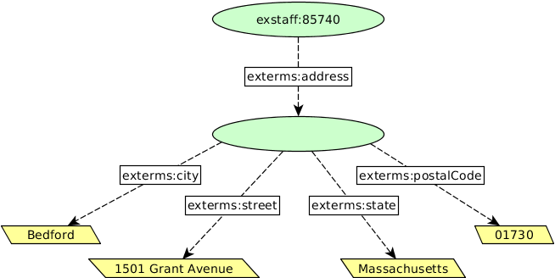
Blank Nodes
M164-CS2: Knowledge Technologies
Manolis Koubarakis, G. Santipantakis

Slide 48
Blank Nodes Using Triples
  exstaff:85740 exterms:address ??? .
  ??? exterms:street "1501 Grant Avenue" .
  ??? exterms:city "Bedford" .
  ??? exterms:state "Massachusetts" .
  ??? exterms:postalCode "01730" .
But what about different blank nodes? Can we handle them using this notation?
M164-CS2: Knowledge Technologies
Manolis Koubarakis, G. Santipantakis

Slide 49
Blank Node Identifiers
  exstaff:85740 exterms:address _:johnaddress .
  _:johnaddress exterms:street "1501 Grant Avenue" .
  _:johnaddress exterms:city "Bedford" .
  _:johnaddress exterms:state "Massachusetts" .
  _:johnaddress exterms:postalCode "01730" .
In a triples representation of a graph, each distinct blank node must be given a different blank node identifier.
Blank node identifiers have significance only within the triples representing a single graph.
Blank node identifiers may only appear as subjects or objects in triples; blank node identifiers may not be used as predicates in triples.
M164-CS2: Knowledge Technologies
Manolis Koubarakis, G. Santipantakis

Slide 50
Semantics of Blank Nodes
In terms of first-order logic, a blank node corresponds to an existentially quantified variable (or a Skolem constant). Thus, a graph with blank nodes is similar to an existentially quantified first order logic statement or a first-order database in the sense of Reiter:
  Raymond Reiter: Towards a Logical Reconstruction of Relational Database Theory. Appears in the collection: Brodie M. L., Mylopoulos J., and Schmidt J. W. (eds.), On Conceptual Modelling: Perspectives from Artificial Intelligence, Database and Programming Languages, pp. 191-233, Springer-Verlag.
In terms of the relational model, a blank node corresponds to a marked null value. Thus, a statement with a blank node identifier is similar to a tuple in a relation in the marked nulls model of Imielinski and Lipski:
  Tomasz Imielinski, Witold Lipski Jr.: Incomplete Information in Relational Databases. J. ACM 31(4): 761-791 (1984).
M164-CS2: Knowledge Technologies
Manolis Koubarakis, G. Santipantakis

Slide 51
Semantics of Blank Nodes (cont’d)
The RDF semantics (http://www.w3.org/TR/rdf-mt/ ) takes this “existential view” of blank nodes and defines appropriate semantics for them.
SPARQL, the standard query language for RDF, considers blank nodes as constants scoped in the graph where they appear.
In practice, it varies how people use blank nodes when they publish linked data.
See the paper
    Alejandro Mallea, Marcelo Arenas, Aidan Hogan, Axel Polleres.
    On Blank Nodes. Proceedings of the International Semantic Web Conference 2011.
    pages 421-437.
  for a nice study of the relevant issues.
M164-CS2: Knowledge Technologies
Manolis Koubarakis, G. Santipantakis

Slide 52
Blank Nodes (cont’d)
Blank nodes are useful to represent n-ary relationships in RDF e.g., the relationship between the person John Smith and the street, city, state, and postal code components of his address.
Blank nodes are also useful to more accurately make statements about resources that may not have URIs, but that are described in terms of relationships with other resources that do have URIs.
M164-CS2: Knowledge Technologies
Manolis Koubarakis, G. Santipantakis

Slide 53
Example
When making statements about a person, say Jane Smith, is it natural to use a URI based on that person's email address as her URI, e.g., mailto:jane@example.org ?
Well, if we do so, how are we going to record information both about Jane's mailbox (e.g., the server it is on) as well as about Jane herself (e.g., her current physical address)? Similarly, if we use her Web page URI etc.
M164-CS2: Knowledge Technologies
Manolis Koubarakis, G. Santipantakis

Slide 54
Example (cont’d)
Blank nodes to the rescue: When Jane herself does not have a URI, a blank node provides a more accurate way of modeling this situation.
  _:jane exterms:mailbox <mailto:jane@example.org> .
  _:jane rdf:type exterms:Person .
  _:jane exterms:name "Jane Smith" .
  _:jane exterms:empID "23748" .
  _:jane exterms:age "26" .
M164-CS2: Knowledge Technologies
Manolis Koubarakis, G. Santipantakis

Slide 55
Presentation Outline
RDF
  URI
  RDF Basics
  RDF Graphs
  Literals
  Shorthand notation: Qnames
  URIrefs as vocabularies
  Structured values and blank nodes
  RDF Serialization
RDFS
  Classes
  Properties
  Utility Properties
M164-CS2: Knowledge Technologies
Manolis Koubarakis, G. Santipantakis

Slide 56
Machine Readable Formats for RDF
RDF has a number of machine readable
formats:
  RDF/XML: represents RDF data as XML (Extensible Markup Language) elements and attributes
  Turtle (Terse RDF Triple Language ): human-readable serialization format that uses abbreviations (prefixes) to shorten URIs
  N-Triples: A line-based serialization format that represents RDF triples as plain text
  …
M164-CS2: Knowledge Technologies
Manolis Koubarakis, G. Santipantakis

Slide 57
RDF/XML
The conceptual model for RDF is a graph.
RDF provides an XML syntax for writing down and exchanging RDF graphs, called RDF/XML.
RDF/XML is the normative syntax for writing RDF.
M164-CS2: Knowledge Technologies
Manolis Koubarakis, G. Santipantakis

Slide 58
Example in RDF/XML
http://www.example.org/index.html has creation-date August 16, 1999.
<?xml version="1.0"?>
<rdf:RDF xmlns:rdf="http://www.w3.org/1999/02/22-rdf-syntax-ns#"
xmlns:exterms="http://www.example.org/terms/">
<rdf:Description rdf:about="http://www.example.org/index.html">
<exterms:creation-date>August 16, 1999</exterms:creation-date>
</rdf:Description>
</rdf:RDF>
M164-CS2: Knowledge Technologies
Manolis Koubarakis, G. Santipantakis

Slide 59
Turtle
Turtle provides another textual syntax for writing down and exchanging RDF graphs.
Turtle is based on the triple notation we used so far, but also includes some additional syntactic means to simplify the specification of RDF graphs.
M164-CS2: Knowledge Technologies
Manolis Koubarakis, G. Santipantakis

Slide 60
Example in Turtle
http://www.w3c.org/People/EM/contact#me is a person and has name Eric Miller.
@prefix rdf: <http://www.w3.org/1999/02/22-rdf-syntax-ns#>.
@prefix exterms: <http://www.example.org/terms/>.
<http://www.w3c.org/People/EM/contact#me>
rdf:type exterms:Person.
<http://www.w3c.org/People/EM/contact#me>
exterms:fullName “Eric Miller“ .
Notation: The @prefix keyword in the first two lines declares namespaces rdf: and exterms:
M164-CS2: Knowledge Technologies
Manolis Koubarakis, G. Santipantakis

Slide 61
Example in Turtle (cont’d)
http://www.w3c.org/People/EM/contact#me is a person and has name Eric Miller.
@prefix rdf: <http://www.w3.org/1999/02/22-rdf-syntax-ns#>.
@prefix exterms: <http://www.example.org/terms/>.
<http://www.w3c.org/People/EM/contact#me>
rdf:type exterms:Person ;
exterms:fullName “Eric Miller“ .
Notation: In this case Turtle allows the semi-colon to separate predicate-object pairs for the same subject. A list of such pairs is terminated with a period.
M164-CS2: Knowledge Technologies
Manolis Koubarakis, G. Santipantakis

Slide 62
Example in Turtle (cont’d)
http://www.w3c.org/People/EM/contact#me attends Knowledge Technologies and Machine Learning.
@prefix rdf: <http://www.w3.org/1999/02/22-rdf-syntax-ns#>.
@prefix exterms: <http://www.example.org/terms/>.
<http://www.w3c.org/People/EM/contact#me>
exterms:attends “Knowledge Technologies”, ”Machine Learning” .
Notation: In this case Turtle allows the comma to separate object values for the same subject-predicate pair. A list of such pairs is terminated with a period.
M164-CS2: Knowledge Technologies
Manolis Koubarakis, G. Santipantakis

Slide 63
Blank Nodes in Turtle
  @prefix exterms: <http://www.example.org/terms/>.
  @prefix exstaff: <http://www.example.org/staff/>.
  exstaff:85740 exterms:address _:abc.
  _:abc exterms:street "1501 Grant Avenue" .
  _:abc exterms:city "Bedford" .
  _:abc exterms:state "Massachusetts" .
  _:abc exterms:postalCode "01730" .
Notation: Blank node identifiers are used.
  @prefix exterms: <http://www.example.org/terms/>.
  @prefix exstaff: <http://www.example.org/staff/>.
  exstaff:85740 exterms:address [
  exterms:street "1501 Grant Avenue“ ;
  exterms:city "Bedford" ;
  exterms:state "Massachusetts" ;
  exterms:postalCode "01730" .
  ].
Notation: anonymous blank node is used
M164-CS2: Knowledge Technologies
Manolis Koubarakis, G. Santipantakis

Slide 64
Summary
In RDF, statements about a domain are encoded by triples.
Triples are of the form
subject predicate object .
The subject of a triple must be a URIref or a blank node.
The predicate of a triple must be a URIref.
The object of a triple must be a URIref, a literal or a blank node.
Literals are not allowed as subjects or predicates. Blank nodes are not allowed as predicates.
Definition: An RDF graph is a set of RDF triples.
M164-CS2: Knowledge Technologies
Manolis Koubarakis, G. Santipantakis

Slide 65
Presentation Outline
RDF
  URI
  RDF Basics
  RDF Graphs
  Literals
  Shorthand notation: Qnames
  URIrefs as vocabularies
  Structured values and blank nodes
  RDF Serialization
RDFS
  Classes
  Properties
  Utility Properties
M164-CS2: Knowledge Technologies
Manolis Koubarakis, G. Santipantakis

Slide 66
The Semantic Web Layer Cake
M164-CS2: Knowledge Technologies
Manolis Koubarakis, G. Santipantakis

Slide 67
RDF Schema (RDFS)
RDFS (RDF Schema) is a W3C standard for describing RDF vocabularies and data models. It provides a set of classes, properties, and utility properties for defining ontologies, enabling richer integration and interoperability of data among descriptive communities.
  Key concepts: class, property, subclass, subproperty
  https://www.w3.org/TR/rdf-schema/
The RDFS is like a schema definition language in the relational or object-oriented data models.
M164-CS2: Knowledge Technologies
Manolis Koubarakis, G. Santipantakis

Slide 68
RDF Schema (cont’d)
The RDF Schema concepts are themselves provided in the form of an RDF vocabulary; that is, as a specialized set of predefined RDF resources with their own special meanings.
The resources in the RDF Schema vocabulary have URIrefs with the prefix http://www.w3.org/2000/01/rdf-schema# (associated with the QName prefix rdfs: ).
Vocabulary descriptions (schemas, ontologies) written in the RDF Schema language are legal RDF graphs. In other words, we use RDF to represent RDFS information.
M164-CS2: Knowledge Technologies
Manolis Koubarakis, G. Santipantakis

Slide 69
Presentation Outline
RDF
  URI
  RDF Basics
  RDF Graphs
  Literals
  Shorthand notation: Qnames
  URIrefs as vocabularies
  Structured values and blank nodes
  RDF Serialization
RDFS
  Classes
  Properties
  Utility Properties
M164-CS2: Knowledge Technologies
Manolis Koubarakis, G. Santipantakis

Slide 70
Classes
A basic step in any kind of description process is identifying the various kinds of things to be described. RDF Schema refers to these “kinds of things” as classes.
A class in RDF Schema corresponds to the generic concept of a type or category, somewhat like the notion of a class in object-oriented programming languages such as Java or object-oriented data models.
M164-CS2: Knowledge Technologies
Manolis Koubarakis, G. Santipantakis

Slide 71
Defining Classes
Suppose an organization example.org wants to use RDF Schema to provide information about motor vehicles, vans and trucks.
To define classes that represent these categories of vehicles, we write the following statements (triples):
  ex:MotorVehicle rdf:type rdfs:Class .
  ex:Van rdf:type rdfs:Class .
  ex:Truck rdf:type rdfs:Class .
In RDFS, a class C is defined by a triple of the form
C rdf:type rdfs:Class .
using the predefined class rdfs:Class and the predefined property rdf:type.
M164-CS2: Knowledge Technologies
Manolis Koubarakis, G. Santipantakis

Slide 72
Defining Instances
Now suppose example.org wants to define an individual car (e.g., the company car) and say that it is a motor vehicle.
This can be done with the following RDF statement:
exthings:companyCar rdf:type ex:MotorVehicle .
M164-CS2: Knowledge Technologies
Manolis Koubarakis, G. Santipantakis

Slide 73
rdf:type
The predefined property rdf:type is used as a predicate in a statement
I rdf:type C
to declare that individual I is an instance of class C.
In statements of the form
C rdf:type rdfs:Class .
rdf:type is used to declare that class C (viewed as an individual object) is an instance of the predefined
class rdfs:Class.
M164-CS2: Knowledge Technologies
Manolis Koubarakis, G. Santipantakis

Slide 74
Defining Classes (cont’d)
Defining a class explicitly is optional; if we write the triple
I rdf:type C
then C is inferred to be a class (an instance of rdfs:Class) in RDFS.
M164-CS2: Knowledge Technologies
Manolis Koubarakis, G. Santipantakis

Slide 75
Notation
Class names will be written with an initial uppercase letter.
Property and instance names are written with an initial lowercase letter (camelCase).
M164-CS2: Knowledge Technologies
Manolis Koubarakis, G. Santipantakis

Slide 76
Subclasses
Now suppose example.org wants to define that vans and trucks are specialized kinds of motor vehicle.
This can be done with the following RDF statements:
  ex:Van rdfs:subClassOf ex:MotorVehicle .
  ex:Truck rdfs:subClassOf ex:MotorVehicle .
The predefined property rdfs:subclassOf is used as a predicate in a statement to declare that a class is a specialization of another more general class.
A class can be a specialization of multiple superclasses (e.g., the graph defined by the rdfs:subclassOf property is a directed graph not a tree).
M164-CS2: Knowledge Technologies
Manolis Koubarakis, G. Santipantakis

Slide 77
Subclasses (cont’d)
The meaning of the predefined property rdfs:subClassOf in a statement of the form
C1 rdfs:subClassOf C2
is that any instance of class C1 is also an
instance of class C2.
Example: If we have the statements
    ex:Van rdfs:subClassOf ex:MotorVehicle .
    exthings:myCar rdf:type ex:Van .
  then RDFS allows us to infer the statement
    exthings:myCar rdf:type ex:MotorVehicle .
M164-CS2: Knowledge Technologies
Manolis Koubarakis, G. Santipantakis

Slide 78
Properties of rdfs:subClassOf
The rdfs:subClassOf property is reflexive and transitive.
Examples:
  If we have a class ex:MotorVehicle then RDFS allows us to infer the statement
  ex:MotorVehicle rdfs:subClassOf ex:MotorVehicle .
  If we have the statements
    ex:Van rdfs:subClassOf ex:MotorVehicle .
    ex:MiniVan rdfs:subClassOf ex:Van .
  then RDFS allows us to infer the statement
    ex:MiniVan rdfs:subClassOf ex:MotorVehicle .
M164-CS2: Knowledge Technologies
Manolis Koubarakis, G. Santipantakis

Slide 79
RDF Schema Predefined Classes
The group of resources that are RDF Schema classes is itself a class called rdfs:Class. All classes are instances of this class.
In the literature, classes such as rdfs:Class that have other classes as instances are called meta-classes.
All things described by RDF are called resources, and are instances of the class rdfs:Resource.
rdfs:Resource is the class of everything. All other classes are subclasses of this class. For example, rdfs:Class is a subclass of rdfs:Resource.
M164-CS2: Knowledge Technologies
Manolis Koubarakis, G. Santipantakis

Slide 80
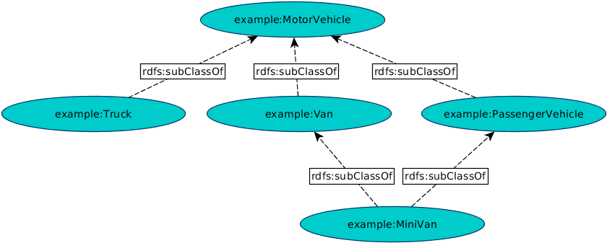
Example
M164-CS2: Knowledge Technologies
Manolis Koubarakis, G. Santipantakis

Slide 81
The Graph in Turtle Notation
@prefix rdf: <http://www.w3.org/1999/02/22-rdf-syntax-ns#>.
@prefix rdfs: <http://www.w3.org/2000/01/rdf-schema#> .
@prefix ex: <http://www.example.org/>.
ex:MotorVehicle rdf:type rdfs:Class .
ex:PassengerVehicle rdf:type rdfs:Class .
ex:Van rdf:type rdfs:Class .
ex:Truck rdf:type rdfs:Class .
ex:MiniVan rdf:type rdfs:Class .
ex:PassengerVehicle rdfs:subClassOf ex:MotorVehicle .
ex:Van rdfs:subClassOf ex:MotorVehicle .
ex:Truck rdfs:subClassOf ex:MotorVehicle .
ex:MiniVan rdfs:subClassOf ex:Van .
ex:MiniVan rdfs:subClassOf ex:PassengerVehicle .
M164-CS2: Knowledge Technologies
Manolis Koubarakis, G. Santipantakis

Slide 82
Presentation Outline
RDF
  URI
  RDF Basics
  RDF Graphs
  Literals
  Shorthand notation: Qnames
  URIrefs as vocabularies
  Structured values and blank nodes
  RDF Serialization
RDFS
  Classes
  Properties
  Utility Properties
M164-CS2: Knowledge Technologies
Manolis Koubarakis, G. Santipantakis

Slide 83
Properties
In addition to defining the specific classes of things they want to describe, user communities also need to be able to define specific properties that characterize those classes of things (such as author to describe a book).
M164-CS2: Knowledge Technologies
Manolis Koubarakis, G. Santipantakis

Slide 84
Defining Properties
A property can be defined by stating that it is an instance of the predefined class rdf:Property.
Example:
ex:author rdf:type rdf:Property .
Then, property ex:author can be used as a predicate in an RDF triple such as the following:
ex:john ex:author ex:book123 .
M164-CS2: Knowledge Technologies
Manolis Koubarakis, G. Santipantakis

Slide 85
Defining Properties (cont’d)
Defining a property explicitly is optional; if we write the RDF triple
S P O .
then P is inferred to be a property by RDFS.
M164-CS2: Knowledge Technologies
Manolis Koubarakis, G. Santipantakis

Slide 86
Properties (cont’d)
Properties are resources too (this makes RDF and RDFS different than many other KR formalisms).
Therefore, properties can appear as subjects or objects of triples.
Example (provenance):
ex:author prov:definedBy ke:john
ke:john prov:defined ex:author
We will see many more examples like the above.
M164-CS2: Knowledge Technologies
Manolis Koubarakis, G. Santipantakis

Slide 87
Properties (cont’d)
In RDFS property definitions are independent of class definitions. In other words, a property definition can be made without any reference to a class.
Optionally, properties can be declared to apply to certain instances of classes by defining their domain and range.
M164-CS2: Knowledge Technologies
Manolis Koubarakis, G. Santipantakis

Slide 88
Domain and Range
RDFS provides vocabulary for describing how properties and classes are intended to be used together in RDF data.
The rdfs:domain predicate can be used to indicate that a particular property applies to instances of a designated class (i.e., it defines the domain of the property).
The rdfs:range predicate is used to indicate that the values of a particular property are instances of a designated class (i.e., it defines the range of the property).
M164-CS2: Knowledge Technologies
Manolis Koubarakis, G. Santipantakis

Slide 89
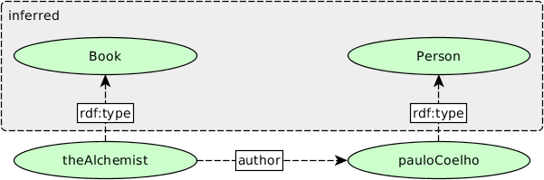
Example
  ex:Book rdf:type rdfs:Class .
  ex:Person rdf:type rdfs:Class .
  ex:author rdf:type rdf:Property .
  ex:author rdfs:domain ex:Book .
  ex:author rdfs:range ex:Person .
M164-CS2: Knowledge Technologies
Manolis Koubarakis, G. Santipantakis

Slide 90
Domain and Range (cont’d)
For a property, we can have zero, one, or more than one domain or range statements.
  If no domain (or range) statement has been made for property P, then nothing has been said about the subjects (or the values) of this property.
M164-CS2: Knowledge Technologies
Manolis Koubarakis, G. Santipantakis

Slide 91
Domain and Range (cont’d)
One domain statement: If we have
P rdfs:domain D .
  then we can infer that when P is applied to some
  resource, this resource is an instance of class D.
One range statement: If we have
P rdfs:range R .
  then we can infer that when P is applied to some
  resource, the value of P is an instance of class R.
Two or more domain statements: If we have
P rdfs:domain D ; rdfs:domain C .
  then we can infer that when P is applied to some
  resource, this resource is both an instance of class D and C .
Similarly for two or more range statements.
M164-CS2: Knowledge Technologies
Manolis Koubarakis, G. Santipantakis

Slide 92
Example
If we have
ex:hasMother rdfs:domain ex:Person .
    exstaff:frank ex:hasMother exstaff:frances .
  then we can infer:
  exstaff:frank rdf:type ex:Person.
If we have
ex:hasMother rdfs:range ex:Person .
    exstaff:frank ex:hasMother exstaff:frances .
  then we can infer
  exstaff:frances rdf:type ex:Person.
M164-CS2: Knowledge Technologies
Manolis Koubarakis, G. Santipantakis

Slide 93
Example II
Example: If we have
    ex:hasMother rdfs:range ex:Female .
    ex:hasMother rdfs:range ex:Person .
    exstaff:frank ex:hasMother exstaff:frances .
  then we can infer that exstaff:frances is an instance
  of both ex:Female and ex:Person.
M164-CS2: Knowledge Technologies
Manolis Koubarakis, G. Santipantakis

Slide 94
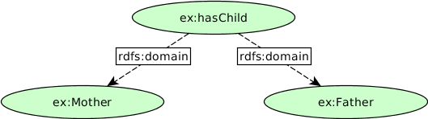
Example III
How can we write that the domain of hasChild is Mother or Father?
What can we infer if we have:
exstaff:frances ex:hasChild exstaff:frank .
M164-CS2: Knowledge Technologies
Manolis Koubarakis, G. Santipantakis

Slide 95
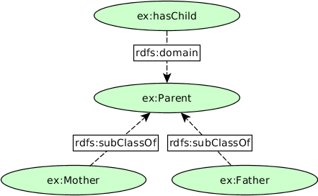
Example III
How can we write that the domain of hasChild is Mother or Father?
M164-CS2: Knowledge Technologies
Manolis Koubarakis, G. Santipantakis

Slide 96
Datatypes for Ranges
The rdfs:range property can also be used to indicate that the value of a property is given by a typed literal.
Example:
  ex:age rdf:type rdf:Property .
  ex:age rdfs:range xsd:integer .
Optionally, we can also assert that xsd:integer is a datatype as follows:
  xsd:integer rdf:type rdfs:Datatype .
M164-CS2: Knowledge Technologies
Manolis Koubarakis, G. Santipantakis

Slide 97
Specializing Properties
RDF Schema provides a way to specialize properties (similarly with classes). This specialization relationship between two properties is described using the predefined property rdfs:subPropertyOf.
Example:
  ex:driver rdf:type rdf:Property .
  ex:primaryDriver rdf:type rdf:Property .
  ex:primaryDriver rdfs:subPropertyOf ex:driver .
M164-CS2: Knowledge Technologies
Manolis Koubarakis, G. Santipantakis

Slide 98
Specializing Properties (cont’d)
If resources S and O are connected by the property P1 and P1 is a subproperty of property P2, then RDFS allows us to infer that S and O are also connected by the property P2.
Example: If we have the statements
ex:john ex:primaryDriver ex:companyCar .
ex:primaryDriver rdfs:subPropertyOf ex:driver .
then we can infer
ex:john ex:driver ex:companyCar .
M164-CS2: Knowledge Technologies
Manolis Koubarakis, G. Santipantakis

Slide 99
Specializing Properties (cont’d)
rdfs:subPropertyOf is reflexive and transitive.
Examples:
  If we have the property ex:driver then RDFS allows to infer the triple
    ex:driver rdfs:subPropertyOf ex:driver .
  If we have the triples
    ex:primaryDriver rdfs:subPropertyOf ex:driver .
    ex:driver rdfs:subPropertyOf ex:isResponsibleFor .
  then RDFS allows us to infer the triple
    ex:primaryDriver rdfs:subPropertyOf ex:isResponsibleFor .
M164-CS2: Knowledge Technologies
Manolis Koubarakis, G. Santipantakis

Slide 100
Summary
RDF Schema provides basic capabilities for describing RDF vocabularies, but additional capabilities are also possible, and can be useful.
These capabilities may be provided through further development of RDF Schema, or in other languages (for example, ontology languages such as OWL).
M164-CS2: Knowledge Technologies
Manolis Koubarakis, G. Santipantakis

Slide 101
Readings
Chapter 2 of the book “Foundations of Semantic Web Technologies” or Chapter 3 of the Semantic Web Primer available from http://www.csd.uoc.gr/~hy566/SWbook.pdf .
The following material from the W3C Semantic Web Activity Web page on RDF http://www.w3.org/RDF/ especially:
  RDF 1.1 Primer.
  RDF 1.1: Concepts and Abstract Syntax
  RDF Schema 1.1
Check out the content published at the RDF and RDFS namespace URIs:
  http://www.w3.org/1999/02/22-rdf-syntax-ns#
  http://www.w3.org/2000/01/rdf-schema#
  where you will find RDFS descriptions of the RDF and RDFS
  vocabularies given in RDF/XML!
The DBpedia project (http://dbpedia.org/About), a nice application of RDF and Linked Data (http://linkeddata.org/).
M164-CS2: Knowledge Technologies
Manolis Koubarakis, G. Santipantakis

