Slide 1

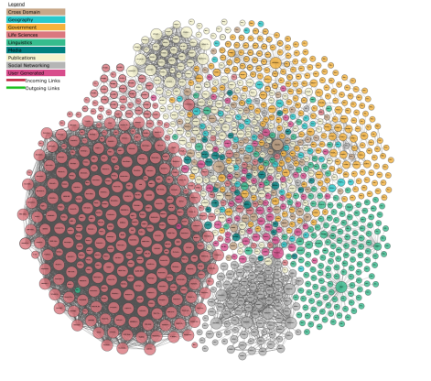
M164-CS2: Knowledge Technologies
L03 – RDF, RDFS, SPARQL
Prof. Manolis Koubarakis
Giorgos Santipantakis

Slide 2
Presentation Outline
Review RDF, RDFS
RDFS set operations
RDF collections
RDF reification
RDFS utility properties
SPARQL
M164-CS2: Knowledge Technologies
Manolis Koubarakis, G. Santipantakis

Slide 3


RDF in a nutshell
subject predicate object
ex:staff1 ex:author ex:document1 .
ex:document1 ex:date “November 11,2024” .
M164-CS2: Knowledge Technologies
Manolis Koubarakis, G. Santipantakis

Slide 4
Resources
Scheme
Domain
Path
fragment identifier
URI
Plain literals (optionally with a language tag). Example: “27” , “Hello world”@en
Literal:
Typed literals formed by pairing a string with a URIref that identifies a particular datatype.
Example:
“27”^^http://www.w3.org/2001/XMLSchema#integer
M164-CS2: Knowledge Technologies
Manolis Koubarakis, G. Santipantakis

Slide 5
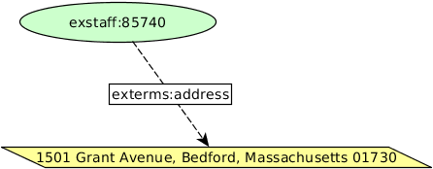
Structured Values in RDF
Consider the triple:
  exstaff:85740 exterms:address "1501 Grant Avenue, Bedford, Massachusetts 01730" .
What if the address needs to be represented as a structure consisting of separate street, city, state, and postal code values? How would this be done in RDF?
M164-CS2: Knowledge Technologies
Manolis Koubarakis, G. Santipantakis

Slide 6
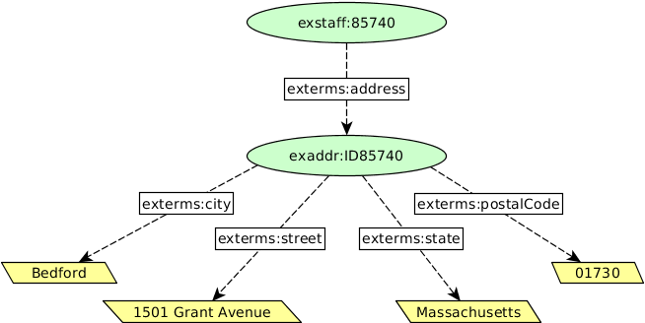
Structured Values in RDF (cont’d)
Structured information is represented in RDF by considering the aggregate thing to be described (like the address in this example) as a resource, and then making statements about that new resource.
M164-CS2: Knowledge Technologies
Manolis Koubarakis, G. Santipantakis

Slide 7
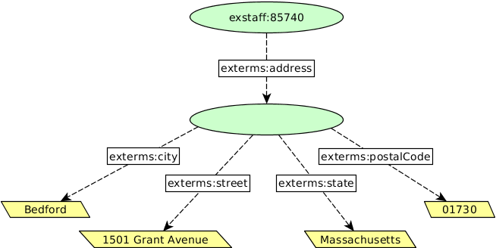
Blank Nodes
  exstaff:85740 exterms:address _:johnaddress .
  _:johnaddress exterms:street "1501 Grant Avenue" .
  _:johnaddress exterms:city "Bedford" .
  _:johnaddress exterms:state "Massachusetts" .
  _:johnaddress exterms:postalCode "01730" .
Blank node identifiers have significance only within the triples representing a single graph.
Blank node identifiers may only appear as subjects or objects in triples; blank node identifiers may not be used as predicates in triples.
M164-CS2: Knowledge Technologies
Manolis Koubarakis, G. Santipantakis

Slide 8
Blank Nodes in Turtle
Anonymous blank node in Turtle:
  @prefix exterms: <http://www.example.org/terms/>.
  @prefix exstaff: <http://www.example.org/staff/>.
  exstaff:85740 exterms:address [
  exterms:street "1501 Grant Avenue“ ;
  exterms:city "Bedford" ;
  exterms:state "Massachusetts" ;
  exterms:postalCode "01730" .
  ].
M164-CS2: Knowledge Technologies
Manolis Koubarakis, G. Santipantakis

Slide 9
Example
  @prefix ex: <http://www.example.org/>.
  [
  ex:hasName "Nikos" ;
  ex:hasSurname "Petrou" ;
  ex:teaches ex:discreteMath ;
  ex:address
  [
  ex:street "Lidias st" ;
  ex:city "Kessariani" ;
  ex:state "Athens" ;
  ex:postalCode "16122" ]
  ] ex:hasStaffID "001" .
M164-CS2: Knowledge Technologies
Manolis Koubarakis, G. Santipantakis

Slide 10
RDF Schema (RDFS)
RDFS (RDF Schema) is a W3C standard for describing RDF vocabularies and data models. It provides a set of classes, properties, and utility properties for defining ontologies, enabling richer integration and interoperability of data among descriptive communities.
  Key concepts: class, property, subclass, subproperty, domain, range
  https://www.w3.org/TR/rdf-schema/
The RDFS is like a schema definition language in the relational or object-oriented data models.
Vocabulary descriptions (schemas, ontologies) written in the RDF Schema language are legal RDF graphs. In other words, we use RDF to represent RDFS information
M164-CS2: Knowledge Technologies
Manolis Koubarakis, G. Santipantakis

Slide 11
Classes
A basic step in any kind of description process is identifying the various kinds of things to be described. RDF Schema refers to these “kinds of things” as classes.
A class in RDF Schema corresponds to the generic concept of a type or category of a resource.
  Is it possible that a resource has more than one types?
  Is it possible that a resource has no type?
M164-CS2: Knowledge Technologies
Manolis Koubarakis, G. Santipantakis

Slide 12
Defining Classes
In RDFS, a class C is defined by a triple of the form
C rdf:type rdfs:Class .
using the predefined class rdfs:Class and the predefined property rdf:type.
Example:
ex:Person rdf:type rdfs:Class .
M164-CS2: Knowledge Technologies
Manolis Koubarakis, G. Santipantakis

Slide 13
Defining Instances
Now suppose we want to specify that ex:staff3402 has type ex:Person .
A triple of the form:
I rdf:type C
Specifies that I is an instance of class C.
Example:
ex:staff3402 rdf:type ex:Person .
Defining a class explicitly is optional; if I rdf:type C, then C is inferred to be a class (an instance of rdfs:Class) in RDFS.
M164-CS2: Knowledge Technologies
Manolis Koubarakis, G. Santipantakis

Slide 14
rdf:type
The predefined property rdf:type is used as a predicate in a statement
I rdf:type C
to declare that individual I is an instance of class C.
In statements of the form
C rdf:type rdfs:Class .
rdf:type is used to declare that class C (viewed as an individual object) is an instance of the predefined
class rdfs:Class.
M164-CS2: Knowledge Technologies
Manolis Koubarakis, G. Santipantakis

Slide 15
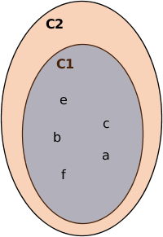
rdfs:subClassOf
The meaning of the predefined property rdfs:subClassOf in a statement of the form
C1 rdfs:subClassOf C2
is that any instance of class C1 is also an instance of class C2.
Example: If we have the statements:
ex:Van rdfs:subClassOf ex:MotorVehicle.
ex:z123ABC rdf:type ex:Van .
then RDFS allows us to infer the statement:
ex:z123ABC rdf:type ex:MotorVehicle .
M164-CS2: Knowledge Technologies
Manolis Koubarakis, G. Santipantakis

Slide 16
Example
Suppose we want to define that vans and trucks are specialized kinds of motor vehicle:
  ex:Van rdfs:subClassOf ex:MotorVehicle .
  ex:Truck rdfs:subClassOf ex:MotorVehicle.
A class can be a specialization of multiple superclasses (e.g., the graph defined by the rdfs:subclassOf property is a directed graph not a tree).
M164-CS2: Knowledge Technologies
Manolis Koubarakis, G. Santipantakis

Slide 17
Properties of rdfs:subClassOf
The rdfs:subClassOf property is reflexive and transitive.
Examples:
  If we have a class ex:MotorVehicle then RDFS allows us to infer the statement
  ex:MotorVehicle rdfs:subClassOf ex:MotorVehicle .
  If we have the statements
    ex:Van rdfs:subClassOf ex:MotorVehicle .
    ex:MiniVan rdfs:subClassOf ex:Van .
  then RDFS allows us to infer the statement
    ex:MiniVan rdfs:subClassOf ex:MotorVehicle .
M164-CS2: Knowledge Technologies
Manolis Koubarakis, G. Santipantakis

Slide 18
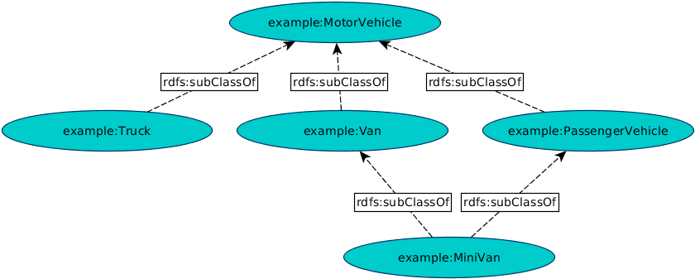
Example
M164-CS2: Knowledge Technologies
Manolis Koubarakis, G. Santipantakis

Slide 19
Defining Properties
In addition to defining the specific classes of things, we need to be able to define specific properties that characterize those classes of things (such as author to describe a book). This can be done with a statement of the form:
P rdf:type rdf:Property .
Example:
ex:author rdf:type rdf:Property .
enables property ex:author to be used as a predicate in an RDF triple such as:
ex:john ex:author ex:book123 .
Defining a property explicitly is optional (RDFS infers that any P used as a predicate is a Property).
M164-CS2: Knowledge Technologies
Manolis Koubarakis, G. Santipantakis

Slide 20
Properties (cont’d)
Properties are resources too
Therefore, properties can appear as subjects or objects of triples.
In RDFS, property definitions are independent of class definitions. In other words, a property definition can be made without any reference to a class.
Optionally, properties can be declared to apply to certain instances of classes by defining their domain and range.
M164-CS2: Knowledge Technologies
Manolis Koubarakis, G. Santipantakis

Slide 21
Domain and Range
The rdfs:domain predicate can be used to indicate that a particular property applies to instances of a designated class (i.e., it defines the domain of the property).
The rdfs:range predicate is used to indicate that the values of a particular property are instances of a designated class (i.e., it defines the range of the property).
A property can have zero, one, or more domain or range statements.
M164-CS2: Knowledge Technologies
Manolis Koubarakis, G. Santipantakis

Slide 22
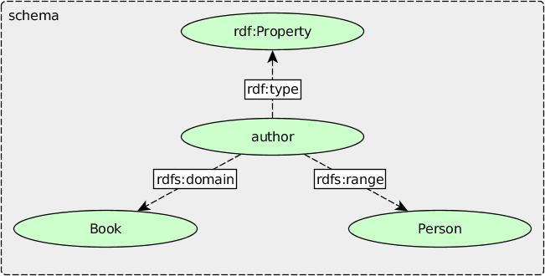
Example
M164-CS2: Knowledge Technologies
Manolis Koubarakis, G. Santipantakis

Slide 23
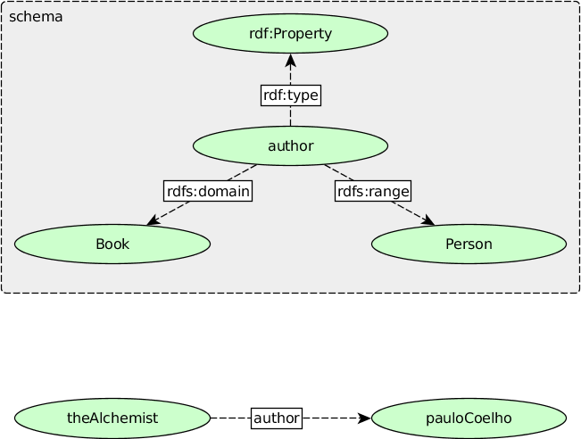
Example (cont’d)
M164-CS2: Knowledge Technologies
Manolis Koubarakis, G. Santipantakis

Slide 24
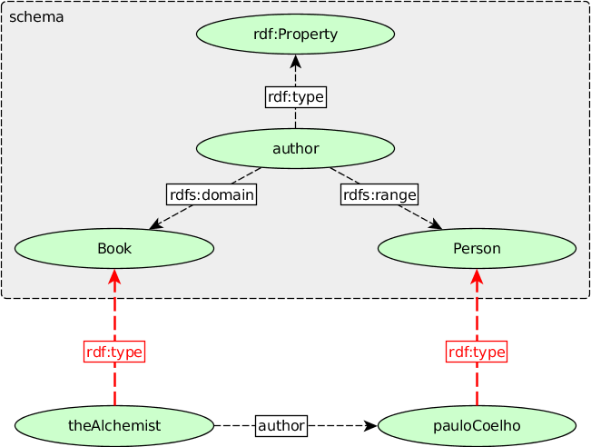
Example (cont’d)
M164-CS2: Knowledge Technologies
Manolis Koubarakis, G. Santipantakis

Slide 25
Domain and Range (cont’d)
One domain statement: If we have
P rdfs:domain D .
  then we can infer that when P is applied to some
  resource, this resource is an instance of class D.
One range statement: If we have
P rdfs:range R .
  then we can infer that when P is applied to some
  resource, the value of P is an instance of class R.
Two or more domain statements: If we have
P rdfs:domain D ; rdfs:domain C .
  then we can infer that when P is applied to some
  resource, this resource is both an instance of class D and C .
Similarly for two or more range statements.
What about zero domain or range?
M164-CS2: Knowledge Technologies
Manolis Koubarakis, G. Santipantakis

Slide 26
Example
If we have
ex:hasMother rdfs:domain ex:Person .
    exstaff:frank ex:hasMother exstaff:frances .
  then we can infer:
  exstaff:frank rdf:type ex:Person.
If we have
ex:hasMother rdfs:range ex:Person .
    exstaff:frank ex:hasMother exstaff:frances .
  then we can infer
  exstaff:frances rdf:type ex:Person.
M164-CS2: Knowledge Technologies
Manolis Koubarakis, G. Santipantakis

Slide 27
Example II
Example: If we have
    ex:hasMother rdfs:range ex:Female .
    ex:hasMother rdfs:range ex:Person .
    exstaff:frank ex:hasMother exstaff:frances .
  then we can infer that exstaff:frances is an instance
  of both ex:Female and ex:Person.
M164-CS2: Knowledge Technologies
Manolis Koubarakis, G. Santipantakis

Slide 28
Datatypes for Ranges
The rdfs:range property can also be used to indicate that the value of a property is given by a typed literal.
Example:
  ex:age rdf:type rdf:Property .
  ex:age rdfs:range xsd:integer .
Optionally, we can also assert that xsd:integer is a datatype as follows:
  xsd:integer rdf:type rdfs:Datatype .
M164-CS2: Knowledge Technologies
Manolis Koubarakis, G. Santipantakis

Slide 29
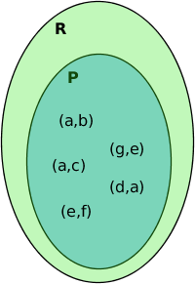
Specializing Properties
RDF Schema provides a way to specialize properties using the predefined property rdfs:subPropertyOf by triples of the form:
P rdfs:subPropertyOf R .
If resources S and O are connected by the property P1 and P1 is a subproperty of property P2, then RDFS allows us to infer that S and O are also connected by the property P2.
Example:
  ex:driver rdf:type rdf:Property .
  ex:primaryDriver rdf:type rdf:Property.
  ex:primaryDriver rdfs:subPropertyOf ex:driver .
  ex:maria ex:primaryDriver ex:z123ABC .
  can infer:
  ex:maria ex:driver ex:z123ABC .
M164-CS2: Knowledge Technologies
Manolis Koubarakis, G. Santipantakis

Slide 30
Example
Consider the following:
ex:freeLancesTo rdfs:subPropertyOf ex:contractsTo.
ex:indirectlyContractsTo rdfs:subPropertyOf ex:contractsTo.
ex:isEmployedBy rdfs:subPropertyOf ex:worksFor.
ex:contractsTo rdfs:subPropertyOf ex:worksFor.
What will be inferred, from the following triples:
ex:Marcus ex:contractsTo ex:UOA.
ex:Spence ex:indirectlyContractsTo ex:UniPi.
ex:Peter ex:isEmployedBy ex:NTUA .

Slide 31
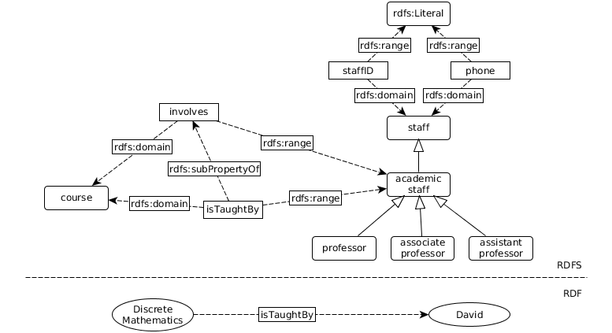
Example II

Slide 32
Presentation Outline
Review RDF, RDFS
RDFS set operations
RDF collections
RDF reification
RDFS utility properties
SPARQL
M164-CS2: Knowledge Technologies
Manolis Koubarakis, G. Santipantakis

Slide 33
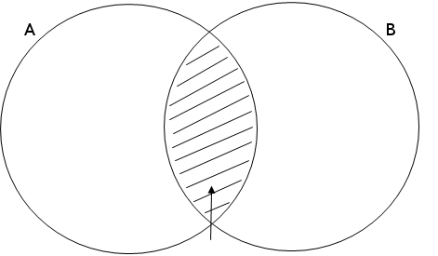
Set intersection
RDFS enables the description of set intersections. If some x has type C, then it also has type A and B.
Example:
ex:Surgeon rdfs:subClassOf ex:Staff.
ex:Surgeon rdfs:subClassOf ex:Physician.
ex:kildare rdf:type ex:Surgeon.
C

Slide 34
Property Intersection
How can we express that a property P is the intersection or properties R, S?
In other words, if x P y, can we infer that:
x R y.
x S y.

Slide 35
Example
Consider the part of an RDF graph describing relations between students and courses. When a student enrolls for a course, she/he also attends the course, and she/he is billed for this course:
ex:enroll rdfs:subPropertyOf ex:attends.
ex:enroll rdfs:subPropertyOf ex:billedFor.
What can be inferred by asserting the triple:
ex:marcus ex:enroll ex:ontologies101.

Slide 36
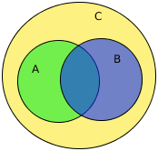
Set Union
How can we express that the union of two classes A, B is a subclass of a class C?
In other words, each resource x that has type Α or Β, we want to also infer that it has type C.

Slide 37
Set Union
How can we express that the union of two classes A, B is a subclass of a class C?
In other words, each resource x that has type Α or Β, we want to also infer that it has type C.
ex:A rdfs:subClassOf ex:C .
ex:B rdfs:subClassOf ex:C .
ex:x rdf:type ex:A .
ex:y rdf:type ex:B .

Slide 38
Presentation Outline
Review RDF, RDFS
RDFS set operations
RDF collections
RDF reification
RDFS utility properties
SPARQL
M164-CS2: Knowledge Technologies
Manolis Koubarakis, G. Santipantakis

Slide 39
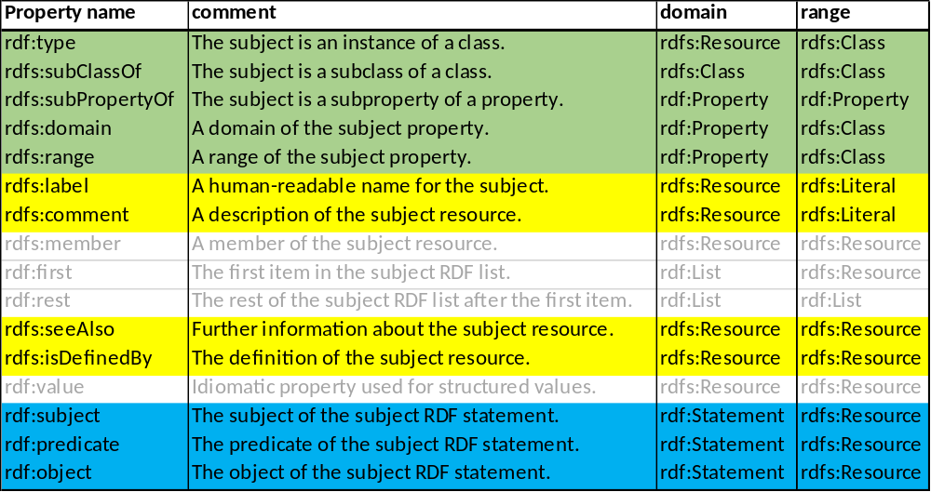
RDF/S Properties
See also RDF Schema 1.1 (https://www.w3.org/TR/rdf-schema/ )
M164-CS2: Knowledge Technologies
Manolis Koubarakis, G. Santipantakis

Slide 40
RDF collections
Often we want to relate a subject to a group of objects, e.g.
  a book to a list of authors,
  A schedule to a list of tasks, etc
RDF provides two kinds of lists for this:
  Containers (open lists)
  Collections (closed lists)
M164-CS2: Knowledge Technologies
Manolis Koubarakis, G. Santipantakis

Slide 41
RDF Containers
A container is a resource that contains members (resources). RDF defines three types of containers:
  bags: unordered group of (possibly duplicate) members
  sequences: ordered group of (possibly duplicate) members
  alternatives: a group of resources that are alternatives
M164-CS2: Knowledge Technologies
Manolis Koubarakis, G. Santipantakis

Slide 42
RDF Containers (cont’d)
There are built-in container membership properties with names of the form rdf:_n, where n is a decimal integer greater than zero, with no leading zeros, e.g., rdf:_1, rdf:_2, rdf:_3, and so on, and are used specifically for describing the members of containers.
rdfs:member is a super-property of all the container membership properties
M164-CS2: Knowledge Technologies
Manolis Koubarakis, G. Santipantakis

Slide 43
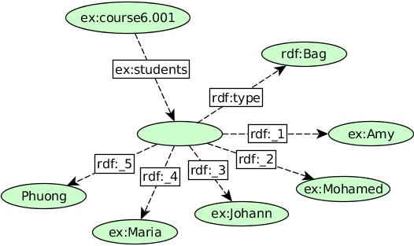
Example (Bag)
Consider the sentence "Course 6.001 has the students Amy, Mohamed, Johann, Maria, and Phuong" .
M164-CS2: Knowledge Technologies
Manolis Koubarakis, G. Santipantakis

Slide 44
Discussion
There are cases where using a container is the most prominent modeling option.
Consider the statement:
  The resolution was approved by the Rules Committee, having members Fred, Wilma, and Dino.
The statement says that the committee as a whole approved the resolution; it does not necessarily state that each committee member individually voted in favor of the resolution.
M164-CS2: Knowledge Technologies
Manolis Koubarakis, G. Santipantakis

Slide 45
RDF Collection
A limitation of the containers is that there is no way to close them, i.e., to say "these are all the members of the container".
RDF provides support for describing groups containing only the specified members, in the form of RDF collection
An RDF collection is a group of things represented as a list structure in the RDF graph. This list structure is constructed using the predefined terms:
  rdf:List,
  rdf:first,
  rdf:rest,
  rdf:nil.
RDF does not enforce well-formedness constraints for collections too; this is left to applications.
M164-CS2: Knowledge Technologies
Manolis Koubarakis, G. Santipantakis

Slide 46
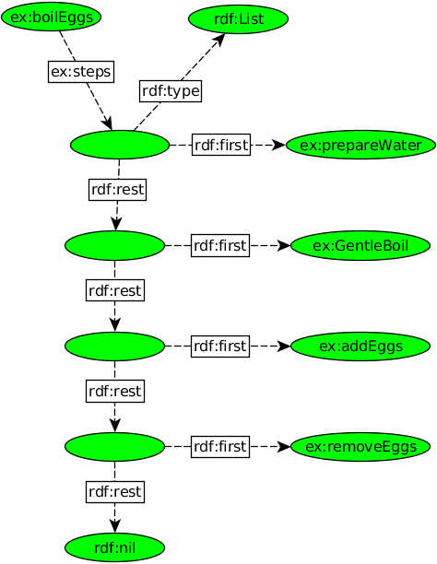
Example (rdf:List)
M164-CS2: Knowledge Technologies
Manolis Koubarakis, G. Santipantakis

Slide 47
Presentation Outline
Review RDF, RDFS
RDFS set operations
RDF collections
RDF reification
RDFS utility properties
SPARQL
M164-CS2: Knowledge Technologies
Manolis Koubarakis, G. Santipantakis

Slide 48
RDF/S Properties
See also RDF Schema 1.1 (https://www.w3.org/TR/rdf-schema/ )
M164-CS2: Knowledge Technologies
Manolis Koubarakis, G. Santipantakis

Slide 49
RDF Reification
RDF applications sometimes need to describe other RDF statements using RDF, for instance, to record information about when statements were made, who made them, or other similar information (this is sometimes referred to as “provenance” information).
M164-CS2: Knowledge Technologies
Manolis Koubarakis, G. Santipantakis

Slide 50
RDF Reification (cont’d)
RDF provides a built-in vocabulary intended for describing RDF statements. A description of a statement using this vocabulary is called a reification of the statement.
The RDF reification vocabulary consists of the class rdf:Statement, and the properties rdf:subject, rdf:predicate, and rdf:object.
M164-CS2: Knowledge Technologies
Manolis Koubarakis, G. Santipantakis

Slide 51
Example
We want to record who made the statement:
ex:item10245 ex:weight "2.4"^^xsd:decimal.
M164-CS2: Knowledge Technologies
Manolis Koubarakis, G. Santipantakis

Slide 52
Example
We want to record who made the statement:
ex:item10245 ex:weight "2.4"^^xsd:decimal.
We assign the above statement with a URIref:
ex:triple123 rdf:type rdf:Statement .
ex:triple123 rdf:subject ex:item10245 .
ex:triple123 rdf:predicate ex:weight .
ex:triple123 rdf:object "2.4"^^xsd:decimal .
M164-CS2: Knowledge Technologies
Manolis Koubarakis, G. Santipantakis

Slide 53
Example
We want to record who made the statement:
ex:item10245 ex:weight "2.4"^^xsd:decimal.
We assign the above statement with a URIref:
ex:triple123 rdf:type rdf:Statement .
ex:triple123 rdf:subject ex:item10245 .
ex:triple123 rdf:predicate ex:weight .
ex:triple123 rdf:object "2.4"^^xsd:decimal .
We add the information about who made the statement:
ex:triple123 dc:creator ex:marcus .
M164-CS2: Knowledge Technologies
Manolis Koubarakis, G. Santipantakis

Slide 54
Presentation Outline
Review RDF, RDFS
RDFS set operations
RDF collections
RDF reification
RDFS utility properties
SPARQL
M164-CS2: Knowledge Technologies
Manolis Koubarakis, G. Santipantakis

Slide 55
RDF/S Properties
See also RDF Schema 1.1 (https://www.w3.org/TR/rdf-schema/ )
M164-CS2: Knowledge Technologies
Manolis Koubarakis, G. Santipantakis

Slide 56
The Property rdfs:label
rdfs:label is an instance of rdf:Property that may be used to provide a human-readable version of a resource's name.
The rdfs:domain of rdfs:label is rdfs:Resource. The rdfs:range of rdfs:label is rdfs:Literal.
Multilingual labels are supported using the language tagging facility of RDF literals.
M164-CS2: Knowledge Technologies
Manolis Koubarakis, G. Santipantakis

Slide 57
The Property rdfs:comment
rdfs:comment is an instance of rdf:Property that may be used to provide a human-readable description of a resource.
The rdfs:domain of rdfs:comment is rdfs:Resource. The rdfs:range of rdfs:comment is rdfs:Literal.
Multilingual documentation is supported through use of the language tagging facility of RDF literals.
M164-CS2: Knowledge Technologies
Manolis Koubarakis, G. Santipantakis

Slide 58
The Property rdfs:seeAlso
rdfs:seeAlso is an instance of rdf:Property that is used to indicate a resource that might provide additional information about the subject resource.
A triple of the form S rdfs:seeAlso O states that the resource O may provide additional information about S. It may be possible to retrieve representations of O from the Web, but this is not required. When such representations may be retrieved, no constraints are placed on the format of those representations.
The rdfs:domain of rdfs:seeAlso is rdfs:Resource. The rdfs:range of rdfs:seeAlso is rdfs:Resource.
M164-CS2: Knowledge Technologies
Manolis Koubarakis, G. Santipantakis

Slide 59
The Property rdfs:isDefinedBy
rdfs:isDefinedBy is an instance of rdf:Property that is used to indicate a resource defining the subject resource. This property may be used to indicate an RDF vocabulary in which a resource is described.
A triple of the form S rdfs:isDefinedBy O states that the resource O defines S. It may be possible to retrieve representations of O from the Web, but this is not required. When such representations may be retrieved, no constraints are placed on the format of those representations. rdfs:isDefinedBy is a subproperty of rdfs:seeAlso.
The rdfs:domain of rdfs:isDefinedBy is rdfs:Resource. The rdfs:range of rdfs:isDefinedBy is rdfs:Resource.
M164-CS2: Knowledge Technologies
Manolis Koubarakis, G. Santipantakis

Slide 60
Presentation Outline
Review RDF, RDFS
RDFS set operations
RDF collections
RDF reification
RDFS utility properties
SPARQL
M164-CS2: Knowledge Technologies
Manolis Koubarakis, G. Santipantakis

Slide 61
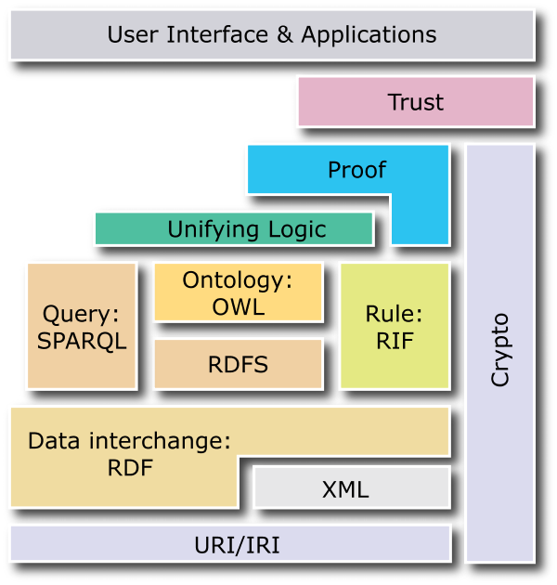
The Semantic Web Layer Cake
M164-CS2: Knowledge Technologies
Manolis Koubarakis, G. Santipantakis

Slide 62
SPARQL
SPARQL stands for “SPARQL Protocol and RDF Query Language”.
In addition to the language, W3C has also defined:
  The SPARQL Protocol for RDF specification: it defines the remote protocol for issuing SPARQL queries and receiving the results.
  The SPARQL Query Results XML Format specification: it defines an XML document format for representing the results of SPARQL queries.
M164-CS2: Knowledge Technologies
Manolis Koubarakis, G. Santipantakis

Slide 63
SPARQL Basics
SPARQL is based on matching graph patterns against RDF graphs.
What is a graph pattern?
To define graph patterns, we must first define triple patterns:
  A triple pattern is like an RDF triple, but with the option of a variable in place of RDF terms (i.e., URIs, literals or blank nodes) in the subject, predicate or object positions.
  Example:
  ex:book1 dc:title ?title .
  ?title is a variable.
M164-CS2: Knowledge Technologies
Manolis Koubarakis, G. Santipantakis

Slide 64
Example
Matching triple patterns against RDF data:
Data:
:TheBeatles a :Band .
:TheBeatles :member :JohnLennon .
:JohnLennon a :Person .
:JohnLennon :born "1940-10-09"^^xsd:gYear .
Patterns:
?bandName a :Band .
:TheBeatles ?r :JohnLennon .
?res a ?type .
?s ?p ?o
M164-CS2: Knowledge Technologies
Manolis Koubarakis, G. Santipantakis

Slide 65
Basic Graph Pattern
A basic graph pattern (BGP) is a set of triple patterns written as a sequence of triple patterns (separated by a period if necessary).
A BGP should be understood as the conjunction of its triple patterns.
Example:
  { ?x foaf:name ?name . ?x foaf:mbox ?mbox }
M164-CS2: Knowledge Technologies
Manolis Koubarakis, G. Santipantakis

Slide 66
Example
Matching Graph patterns against RDF data:
Data:
ex:user1 foaf:name "John Doe" .
ex:user1 foaf:mbox "johndoe@example.com" .
ex:user2 foaf:name "Jane Smith" .
ex:user2 foaf:mbox "janesmith@example.com" .
ex:user3 foaf:name "David Lee" .
ex:user3 foaf:mbox "davidlee@example.com" .
ex:user4 foaf:name "Sarah Jones" .
ex:user4 foaf:mbox "sarahjones@example.com" .
ex:user5 foaf:name "Michael Brown" .
ex:user5 foaf:mbox "michaelbrown@example.com" .
Pattern:
?x foaf:name ?name . ?x foaf:mbox ?mbox
M164-CS2: Knowledge Technologies
Manolis Koubarakis, G. Santipantakis

Slide 67
SPARQL Query Types
SELECT: Retrieves data from a RDF dataset and returns it in a tabular form.
CONSTRUCT: Generates a new RDF graph by substituting variables in a set of triple templates with matches found in the query.
ASK: Evaluates a query pattern against a RDF dataset and returns a boolean value indicating whether there is at least one match.
DESCRIBE: Retrieves the RDF graph that describes a particular resource, providing information about its properties and relationships.
Additionally, SPARQL UPDATE includes queries for:
  DELETE: Deletes data from a RDF dataset.
  INSERT: Inserts new data into a RDF dataset.
  MANIPULATE: Modifies existing data in a RDF dataset.
M164-CS2: Knowledge Technologies
Manolis Koubarakis, G. Santipantakis

Slide 68





Anatomy of a SPARQL query
PREFIX rdf: <http://www.w3.org/1999/02/22-rdf-syntax-ns#>
PREFIX rdfs: <http://www.w3.org/2000/01/rdf-schema#>
PREFIX msc: <http://www.myExample.gr/dataset#>
SELECT ?title
WHERE
{
?x rdf:type msc:SomeClass .
?dataset rdf:title ?title .
FILTER(…)
}
Group By …
Having …
Order By …
Limit …
Offset …
Bindings …
Prefixes
Query type
Select the variables to project
Graph Pattern and Filter
Optional query modifiers
More prefixes at http://prefix.cc
M164-CS2: Knowledge Technologies
Manolis Koubarakis, G. Santipantakis

Slide 69
SPARQL SELECT DISTINCT
Data:
ex:uni1 ex:locatedIn ex:Athens .
ex:uni2 ex:locatedIn ex:Athens .
ex:uni3 ex:locatedIn ex:Athens .
…
SELECT ?city WHERE {
?university ex:locatedIn ?city
}
versus:
SELECT DISTINCT ?city
WHERE {
?university ex:locatedIn ?city
}
Results:
?city
ex:Athens
ex:Athens
ex:Athens
…
Results:
?city
ex:Athens
M164-CS2: Knowledge Technologies
Manolis Koubarakis, G. Santipantakis

Slide 70
UNION
Data:
ex:uni1 ex:locatedIn ex:Athens .
ex:uni2 ex:locatedIn ex:Athens .
ex:uni3 ex:locatedIn ex:Athens .
ex:uni4 ex:locatedIn ex:Piraeus .
ex:uni5 ex:locatedIn ex:Patras .
…
Get the universities located in Athens or Piraeus:
SELECT ?u WHERE {
{?u ex:locatedIn ex:Athens .}
UNION
{?u ex:locatedIn ex:Piraeus .}
}
Results:
?city
ex:uni1
ex:uni2
ex:uni3
ex:uni4
M164-CS2: Knowledge Technologies
Manolis Koubarakis, G. Santipantakis

Slide 71
MINUS
Data:
ex:st1 ex:studies ex:Phys1 .
ex:st1 ex:studies ex:Math1 .
ex:st2 ex:studies ex:CS901 .
ex:st2 ex:studies ex:MED101 .
ex:st3 ex:studies ex:CS901 .
SELECT ?student WHERE {
{?student ex:studies ex:CS901 }
MINUS
{?student ex:studies ex:MED101}
}
A MINUS B: Match Α, match Β, return all results in A minus results of B.
Results:
?student
ex:st3
M164-CS2: Knowledge Technologies
Manolis Koubarakis, G. Santipantakis

Slide 72
OPTIONAL
SELECT ?student ?book WHERE {
?student ex:studies ex:CS901 .
OPTIONAL
{?student ex:checkedOut ?book}
}
A OPTIONAL {B}: Returns all matches in Α and any matches in Β
M164-CS2: Knowledge Technologies
Manolis Koubarakis, G. Santipantakis

Slide 73
Example
Data:
ex:st1 ex:studies ex:Phys1 .
ex:st2 ex:checkedOut ex:book1 .
ex:st2 ex:studies ex:CS901 .
ex:st2 ex:studies ex:MED101 .
ex:st3 ex:studies ex:CS901 .
…
SELECT ?student ?book WHERE {
?student ex:studies ex:CS901 .
OPTIONAL
{?student ex:checkedOut ?book}
}
Results:
?student ?book
ex:st2 ex:book1
ex:st3
SELECT ?student ?book WHERE {
?student ex:studies ex:CS901 .
?student ex:checkedOut ?book
}
Results:
?student ?book
ex:st2 ex:book1
M164-CS2: Knowledge Technologies
Manolis Koubarakis, G. Santipantakis

Slide 74
FILTER
A SPARQL filter is a clause used to restrict the results of a query based on a boolean expression.
The Filter is placed within the Graph Pattern:
SELECT * WHERE {
A . B .
FILTER ( ...expr... )
}
M164-CS2: Knowledge Technologies
Manolis Koubarakis, G. Santipantakis

Slide 75
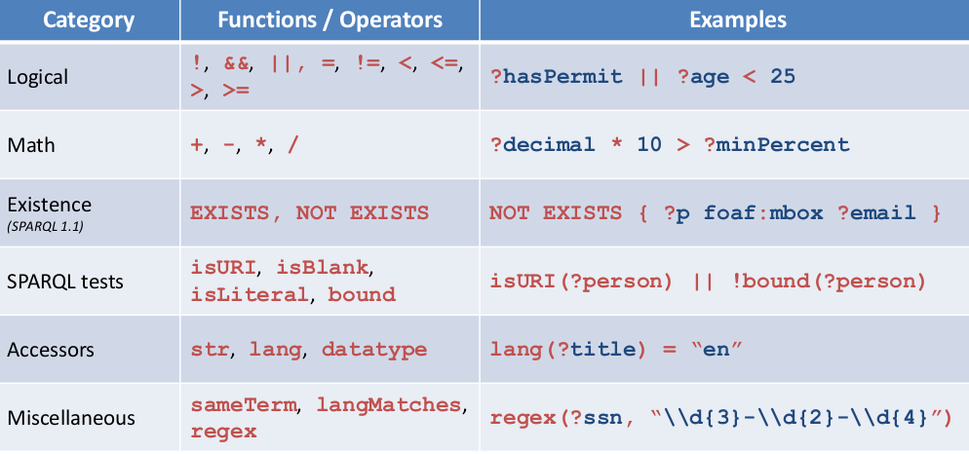
Filter Functions and Operators
M164-CS2: Knowledge Technologies
Manolis Koubarakis, G. Santipantakis

Slide 76
CONSTRUCT
A SPARQL CONSTRUCT query is a type of query that generates new RDF triples based on a template and the data matched by the query.
Example:
CONSTRUCT { ?student ex:classmate ?friend }
WHERE {
?student ex:studies ?course .
?student foaf:knows ?friend .
?friend ex:studies ?course }
}
M164-CS2: Knowledge Technologies
Manolis Koubarakis, G. Santipantakis

Slide 77
ASK
The SPARQL ASK query type is used to determine whether a particular triple pattern exists in a specified dataset.
Examples:
Does ex:029389 study ex:MED101?
ASK { ex:029389 ex:studies ex:MED101 }
Does ex:029389 know someone who attends ex:MED101?
ASK {ex:029389 foaf:knows ?x .
?x ex:studies ex:MED101 }
Is there a student over 30 years old, who attends CS901;
ASK { ?s ex:studies ex:CS901 .
?s ex:hasAge ?age .
FILTER (?age > 30) }
M164-CS2: Knowledge Technologies
Manolis Koubarakis, G. Santipantakis

Slide 78
DESCRIBE
The DESCRIBE query returns an RDF graph that describes the resources matched by a query pattern.
Example:
DESCRIBE ?city
WHERE {
?city a dbpedia:City .
?city dbpedia:population ?pop .
?city dbpedia:country dbpedia:United_Kingdom.
FILTER (?pop > 1000000)
}
M164-CS2: Knowledge Technologies
Manolis Koubarakis, G. Santipantakis

Slide 79
ORDER BY
SELECT ?name ?course
WHERE {
?student ex:studies ?course .
?student foaf:name ?name .
}
ORDER BY ?name
SELECT ?name ?age
WHERE {
?student ex:hasAge ?age .
?student foaf:name ?name .
}
ORDER BY DESC (?age) ASC (?name)
M164-CS2: Knowledge Technologies
Manolis Koubarakis, G. Santipantakis

Slide 80
LIMIT
SELECT ?name ?course
WHERE {
?student ex:studies ?course .
?student foaf:name ?name .
}
LIMIT 15
M164-CS2: Knowledge Technologies
Manolis Koubarakis, G. Santipantakis

Slide 81
OFFSET
SELECT ?name ?course
WHERE {
?student msc:studies ?course .
?student foaf:name ?name .
}
ORDER BY ?name
OFFSET 5
LIMIT 3
M164-CS2: Knowledge Technologies
Manolis Koubarakis, G. Santipantakis

Slide 82
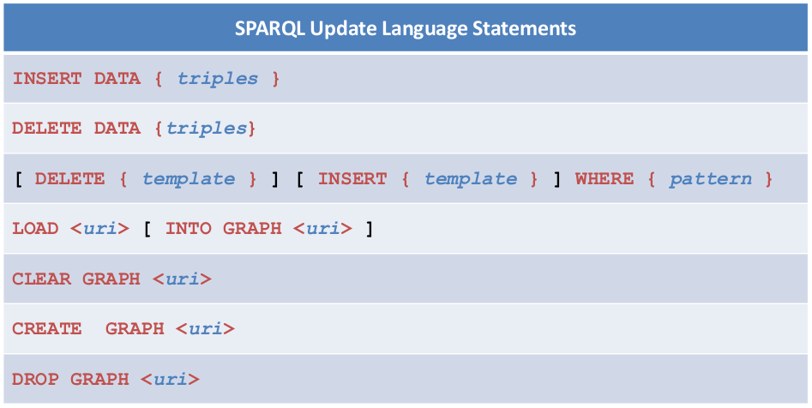
SPARQL
(UPDATE)

Slide 83
Readings
Test SPARQL queries
  http://data.europa.eu/euodp/en/linked-data
  http://dbpedia.org/sparql
  https://sophox.org/
  http://sparql.bioontology.org/
List of online SPARQL endpoints:
  https://www.w3.org/wiki/SparqlEndpoints
M164-CS2: Knowledge Technologies
Manolis Koubarakis, G. Santipantakis

Slide 84
Readings
Chapter 7 of the book “Foundations of Semantic Web Technologies”.
The original 2008 SPARQL standard “SPARQL Query Language for RDF” from http://www.w3.org/TR/rdf-sparql-query/ .
The SPARQL tutorial given at ESWC 2007 available from https://aic.ai.wu.ac.at/~polleres/sparqltutorial/ especially Unit 2 (SPARQL formalization)
The formal semantics of SPARQL can be found in the W3C specification (http://www.w3.org/TR/rdf-sparql-query/#sparqlDefinition).
The semantics and expressive power of SPARQL following the papers
  Jorge Pérez, Marcelo Arenas, and Claudio Gutierrez. Semantics and Complexity
  of SPARQL. Proc. of ISWC 2006. Long version in ACM Transactions on Database
  Systems, 34(3), 2009. https://users.dcc.uchile.cl/~cgutierr/papers/sparql.pdf
  Renzo Angles, Claudio Gutierrez. The Expressive Power of SPARQL. Proc. of
  ISWC 2008. https://users.dcc.uchile.cl/~cgutierr/papers/expPowSPARQL.pdf
M164-CS2: Knowledge Technologies
Manolis Koubarakis, G. Santipantakis

