Slide 1
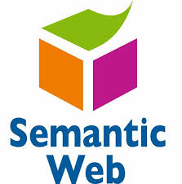
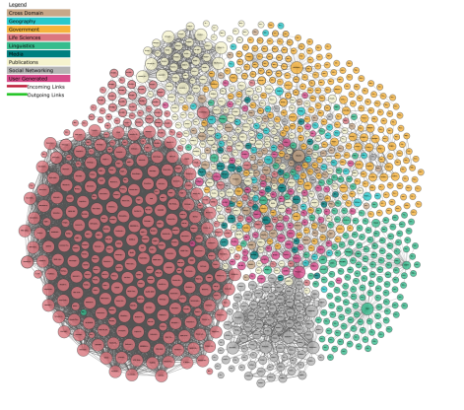
M164-CS2: Knowledge Technologies
L05 – Retrieval Augmented Generation, SPARQL formalism
Prof. Manolis Koubarakis
Giorgos Santipantakis

Slide 2
Presentation Outline
Retrieval Augmented Generation (RAG)
SPARQL Formalization
M164-CS2: Knowledge Technologies
Manolis Koubarakis, G. Santipantakis

Slide 3
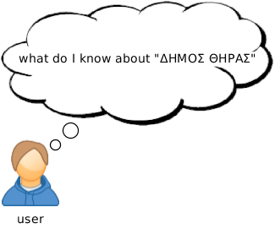
Example
M164-CS2: Knowledge Technologies
Manolis Koubarakis, G. Santipantakis

Slide 4
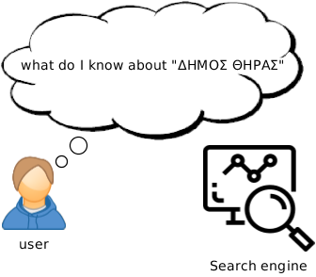
Example
M164-CS2: Knowledge Technologies
Manolis Koubarakis, G. Santipantakis

Slide 5
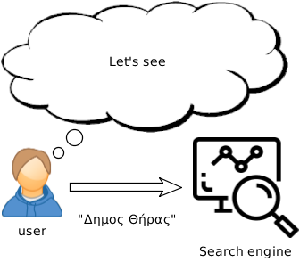
Example
M164-CS2: Knowledge Technologies
Manolis Koubarakis, G. Santipantakis

Slide 6
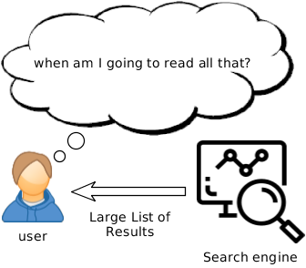
Example
M164-CS2: Knowledge Technologies
Manolis Koubarakis, G. Santipantakis

Slide 7
Example
M164-CS2: Knowledge Technologies
Manolis Koubarakis, G. Santipantakis

Slide 8
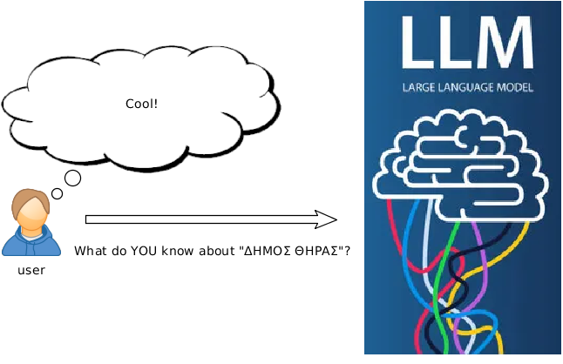
Example
M164-CS2: Knowledge Technologies
Manolis Koubarakis, G. Santipantakis

Slide 9
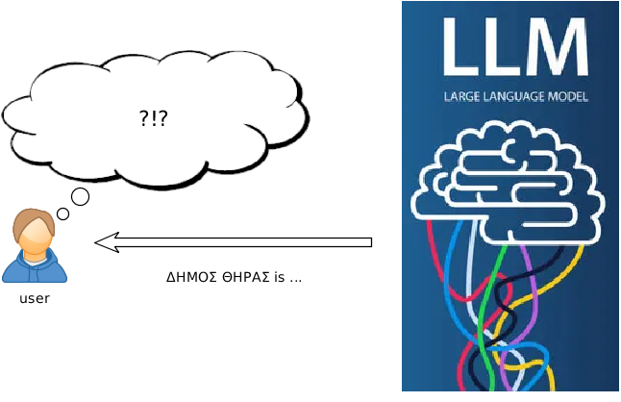
Example
M164-CS2: Knowledge Technologies
Manolis Koubarakis, G. Santipantakis

Slide 10
Discussion
Two key limitations of traditional LLMs:
Outdated training data: LLMs are trained on static data, which can lead to inaccurate or outdated responses.
Hallucinations: LLMs may extrapolate or make false statements when facts are unavailable.
M164-CS2: Knowledge Technologies
Manolis Koubarakis, G. Santipantakis

Slide 11
Retrieval-Augmented Generation
Retrieval Augmented Generation (RAG) combines the strengths of traditional information retrieval systems with the capabilities of generative large language models (LLMs).
It enables LLMs to access and reference information outside their own training data, such as an organization’s specific knowledge base, before generating a response.
This integration enhances the LLM’s context, providing it with a more comprehensive understanding of the topic.
M164-CS2: Knowledge Technologies
Manolis Koubarakis, G. Santipantakis

Slide 12
RAG and Knowledge Graphs
Can I use an LLM to query my Knowledge Graph (KG)?
Is it safe to enrich the context of an LLM with parts of a KG?
M164-CS2: Knowledge Technologies
Manolis Koubarakis, G. Santipantakis

Slide 13
RAG and Knowledge Graphs
Can I use an LLM to query my Knowledge Graph (KG)?
Is it safe to enrich the context of an LLM with parts of a KG?
M164-CS2: Knowledge Technologies
Manolis Koubarakis, G. Santipantakis

Slide 14
Building a simple RAG using KG
What we need:
  A Knowledge Graph for the context
  An LLM
  A document indexing process
  Patience (depending on the size of the KG)
M164-CS2: Knowledge Technologies
Manolis Koubarakis, G. Santipantakis

Slide 15
Building a simple RAG using KG
The workflow:
  Index parts of the KG using the Document indexing library – as a “document” here we use a set of triples (i.e. parts of the KG).
  When a user query arrives, instead of pushing it directly to the LLM, search for relevant documents (indexed parts of the KG) – these are the context of the query.
  Add any instructions necessary, on how the answer should be provided (e.g. “answer in Shakespearean style of writing”).
M164-CS2: Knowledge Technologies
Manolis Koubarakis, G. Santipantakis

Slide 16
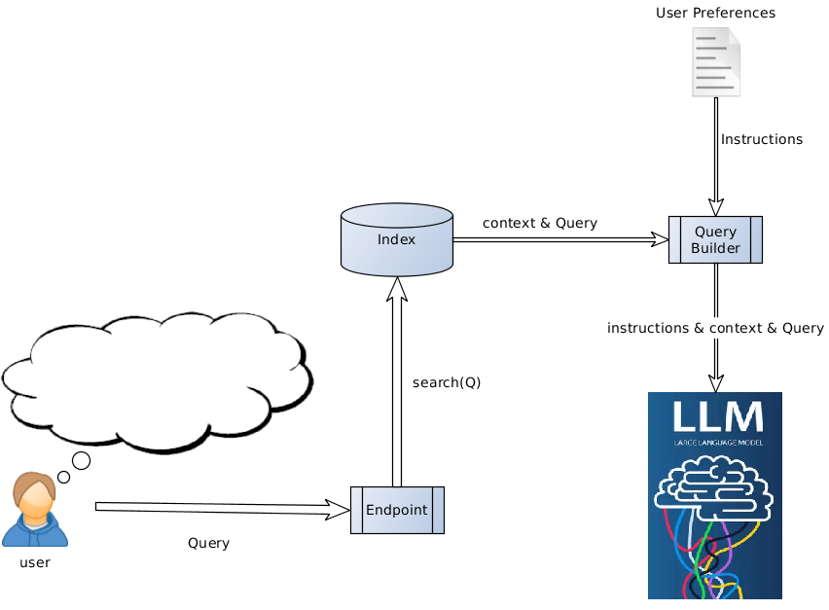
Example
M164-CS2: Knowledge Technologies
Manolis Koubarakis, G. Santipantakis

Slide 17
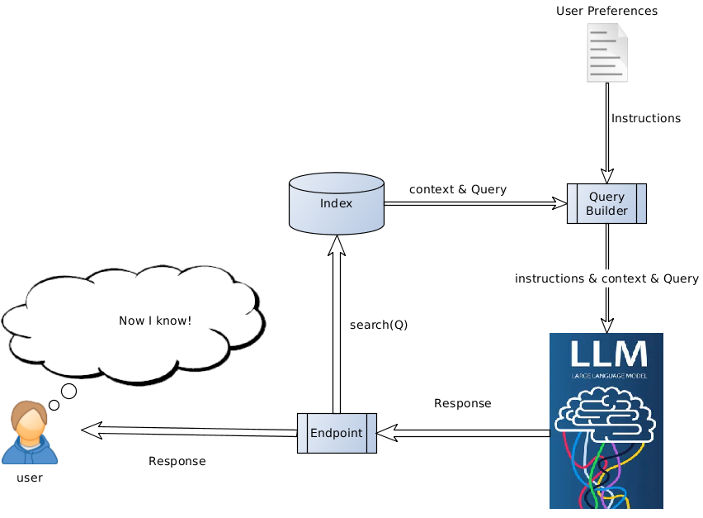
Example
M164-CS2: Knowledge Technologies
Manolis Koubarakis, G. Santipantakis

Slide 18
Discussion
If I can “talk” to my KG using LLM, are we done with SPARQL?
M164-CS2: Knowledge Technologies
Manolis Koubarakis, G. Santipantakis

Slide 19
Discussion
If I can “talk” to my KG using LLM, are we done with SPARQL?
Searching the index is straightforward, but how about building it?
How can I SELECT or DESCRIBE resources of a KG to build the index?
Is it possible that sometimes I need to FILTER the set of triples that will be indexed?
Can we include FEDERATED data sources?
M164-CS2: Knowledge Technologies
Manolis Koubarakis, G. Santipantakis

Slide 20
Discussion
If I can “talk” to my KG using LLM, are we done with SPARQL? – No, SPARQL will be always an option for (at least) some of the following tasks ☺
Searching the index is straightforward, but how about building it?
How can I SELECT or DESCRIBE resources of a KG to build the index?
Is it possible that sometimes I need to FILTER the set of triples that will be indexed?
Can we include FEDERATED data sources?
M164-CS2: Knowledge Technologies
Manolis Koubarakis, G. Santipantakis

Slide 21
Reading
Juan Sequeda, Dean Allemang, Bryon Jacob, A Benchmark to Understand the Role of Knowledge Graphs on Large Language Model's Accuracy for Question Answering on Enterprise SQL Databases, SIGMOD/PODS '24, 2024
https://www.deepset.ai/blog/graph-rag
Unveiling the Synergy: Retrieval Augmented Generation (RAG) Meets Knowledge Graphs
https://www.microsoft.com/en-us/research/blog/graphrag-unlocking-llm-discovery-on-narrative-private-data/
M164-CS2: Knowledge Technologies
Manolis Koubarakis, G. Santipantakis

Slide 22
Presentation Outline
Retrieval Augmented Generation (RAG)
SPARQL Formalization
M164-CS2: Knowledge Technologies
Manolis Koubarakis, G. Santipantakis

