Slide 1
Open Source project for NLP research collaboration: NLP meets VR/AR
Dr Alexander Mikhalev

Slide 2
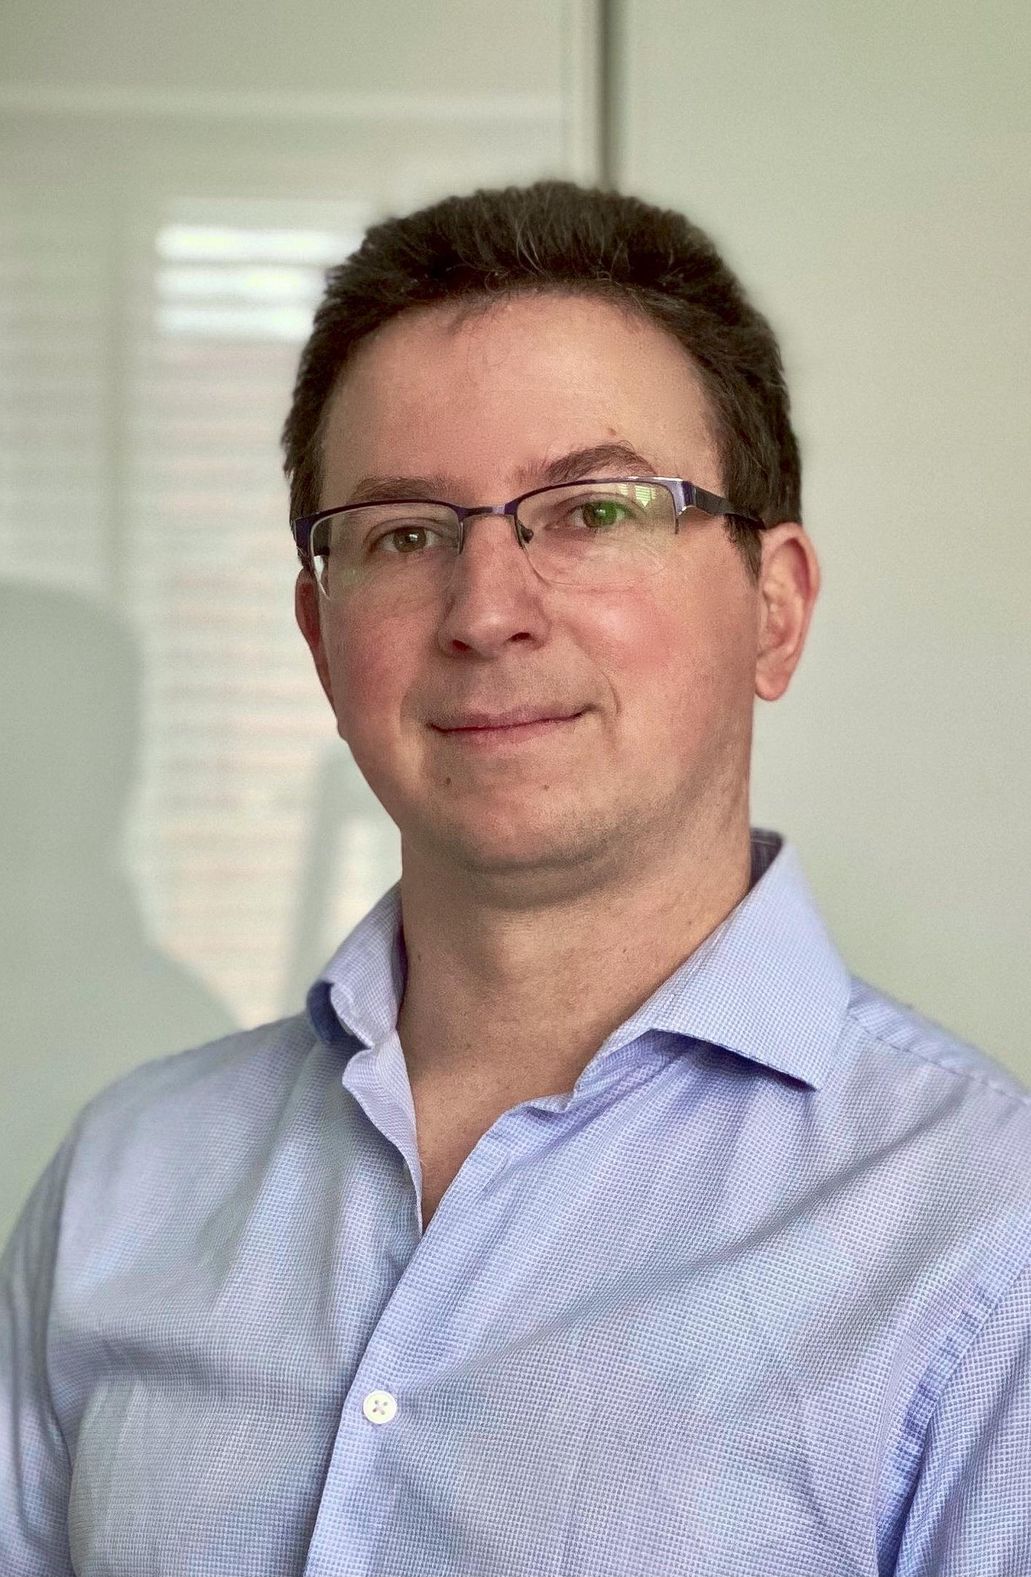
Dr Alexander Mikhalev
Geek in Data Architecture team in Nationwide Building Society
MSc (Engineer) in Computer Science and Computer Engineering focused on Natural Language Processing and Autonomous Decision Making
PhD Applied Mathematics - Multi Agent data fusion for UAV geolocation (Cranfield University/Defence Academy UK)

Slide 3
Thesis
The amount of information and ever increasing complexity of the world (and decisions) requires conceptually new tools
The Pattern
"Engelbart’s demo": augmenting human intelligence using modern AI and VR tools, demonstrating new concepts to assist knowledge exploration, presentation and re-use.
Language is at the core of our communication, we control language as part of leadership role or as part of architectural/engineering work: domain driven design or Business Objects Reference Ontology. But modern tools don't support re-use of the knowledge captured.
We regularly perform different roles: researcher, father, architect (analysts, surgeon and radiologist), each of them needs a different "viewmodel" - several type of interfaces "views", driven by the same knowledge base.

Slide 4
Deploying AI/ML and making useful
- Building useful NLP products requires data science and engineering effort
- Requires synergy of "old school" ML and trendy "deep learning"
- And not trivial engineering - including systems engineering and software engineering
- Knowledge graph ("it's about things, not strings") is at the core of the intelligent systems
- Once we build knowledge graph, building interfaces (views) are straightforward:
VR/AR
BERT Question Answering

Slide 5
OODA loop
Observe | Orient | Decide | Act
Machine Learning boom | Pytorch/Tensorflow
NLP technologies | Huggingface/Transformers | Select practices and apply to the problem of complex navigation through medical literature | The Pattern (community level)
Graph technologies | Neo4j, Memgraph, DiGraph, RedisGraph, |  | Terraphim (personal level)
Enterprise metadata management | Data.world, Collbra
Exponential growth of information | PoolParty (Semantic Web Company)

Slide 6
Systems Engineering Aspects
Knowledge graphs (Paper) | Graph Databases (brick) | GraphQL/RDF/REST (Orange)
What to write (things not strings) | Where to write and read from | How to query

Slide 7
The problem
The medical profession put a lot of effort into collaboration, starting from Latin as a common language to industry-wide thesauruses like UMLS. Yet if full of scandals where publication in the prestigious journal would be retracted and the World Health Organisation would change its policy advice based on the article. It's not uncommon to see conversations like this where bits of randomness were presented as major findings. I think "paper claiming that eating a bat-like Pokémon sparked the spread of COVID-19" takes a prize. One would say that editors in those journals don't do their job, and while it may seem true, I would say they had no chance: with a number of publications about COVID (SARS-V) passing 300+ per day, we need better tools to navigate via such flow of information.

Slide 8
Vision
When I am exploring topics on science or engineering, I look at the diversity of the opinion, not the variety of the same cluster of words, same thought. I want to avoid confirmation bias. I want to find articles relevant to the same concept, not necessarily the ones which have similar words. My focus is to build a natural language processing pipeline, capable of handling a large number of documents and concepts, incorporating System 1 AI (fast, intuitive reasoning) and System 2 (high-level reasoning) and then present knowledge in a modern VR/AR visualisation. Search or rather information exploration should be spatial preferably in VR (memory palace, see Theatre of Giulio Camillo). A force-directed graph is a path towards it, where visuals are assisted by text — relevant text pops up on the connection and where people explore the concepts and then dig deeper into text. The purpose of the pipeline that knowledge should be re-usable and shareable.

Slide 9
The UMLS, or Unified Medical Language System, is a set of files and software that brings together many health and biomedical vocabularies and standards to enable interoperability between computer systems.
What is the UMLS?
The Three UMLS Knowledge Sources
Metathesaurus: Terms and codes from many vocabularies, including CPT, ICD-10-CM, LOINC, MeSH, RxNorm, and SNOMED CT. Hierarchies, definitions, and other relationships and attributes.
What is the UMLS? Broad categories (semantic types) and their relationships (semantic relations).
What is the UMLS? Lexicon and Lexical Tools: A large syntactic lexicon of biomedical and general English and tools for normalizing strings, generating lexical variants, and creating indexes.
Unified Medical Language System (UMLS)
The UMLS integrates and distributes key terminology, classification and coding standards, and associated resources to promote creation of more effective and interoperable biomedical information systems and services, including electronic health records.
UMLS in Use
You can use the UMLS to:
Link terms and codes between your doctor, your pharmacy, and your insurance company
Coordinate patient care among several departments within a hospital
Process texts to extract concepts, relationships, or knowledge
Facilitate mapping between terminologies
Develop an information retrieval system
Extract specific terminologies from the Metathesaurus
Create and maintain a local terminology
Develop a terminology service
Research terminologies or ontologies

Slide 10


General principle to build knowledge graph

Slide 11
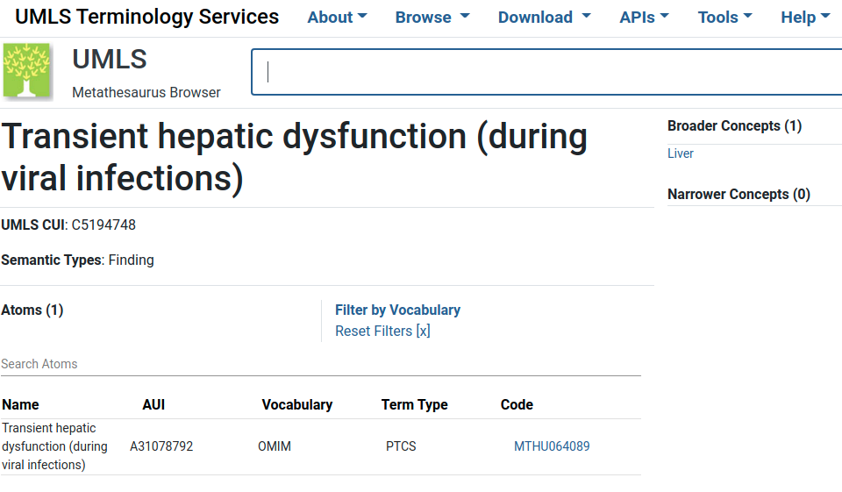
Unified Medical Language System (UMLS)

Slide 12
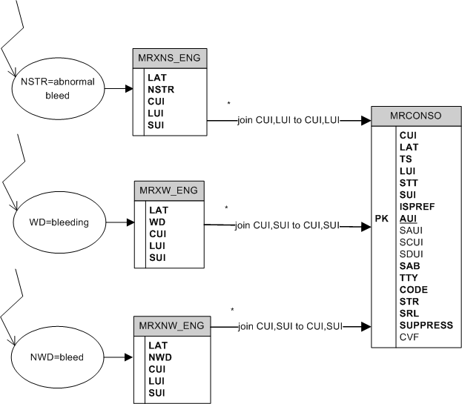
UMLS Database Query Diagrams
How to perform searches for normalized strings, normalized words, or regular words

Slide 13
But “bleeding” matches to 11000 concepts (CUI)!
UMLS subset relevant to GP or Nurse
- anst|T017|Anatomical Structure
- dsyn|T047|Disease or Syndrome
- bpoc|T023|Body Part, Organ, or Organ Component
- diap|T060|Diagnostic Procedure

Slide 14
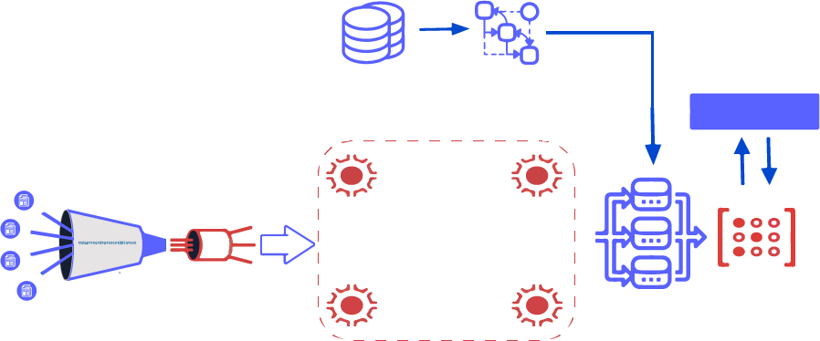
NLP Pipeline build in 2020 (medium complexity project)
Read UMLS table
Build automata
Flask API
Extract & parse cord-19 documents
Create streams
Language
detector
Spell
checker
Split
paragraphs
Redis Graph
Redis Gears
Matcher
More Traditional View
Notes:
Why do you need RedisGears based pipeline? While 50 thousands articles is a small dataset by modern standard, it’s more than single laptop can handle. Redis Gears provides a very easy way to create a distributed data processing. We will be re-using half of the pipeline - until matcher step, but then we fork and adjust pipeline to use Redis AI

Slide 15
NLP Pipeline build in 2020 (medium complexity project) 2
Read UMLS table
Build automata
Flask API
Extract & parse cord-19 documents
Create streams
JSON documents with: Title, Year and body (paragraphs)
Property Graph with:
Node( concept_id, name, rank)
Edge(source_concept_id, destination_concept_id, rank)
Language
detector
Spell
checker
Split
paragraphs
Redis Graph
Redis Gears
Matcher
More Traditional View
Notes:
Why do you need RedisGears based pipeline? While 50 thousands articles is a small dataset by modern standard, it’s more than single laptop can handle. Redis Gears provides a very easy way to create a distributed data processing. We will be re-using half of the pipeline - until matcher step, but then we fork and adjust pipeline to use Redis AI

Slide 16
Demo
http://thepattern.digital

Slide 17
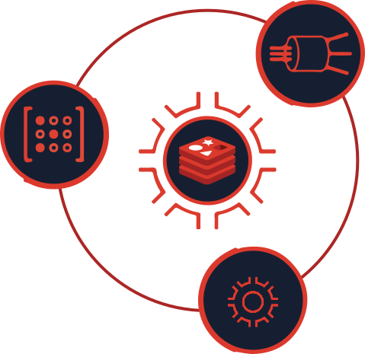
Solution Overview: NLP pipeline
0. Intake step - is very simple and nothing to write about: pump all JSON records into RedisCluster, then NLP pipeline starts processing all records, code is here .
How are the steps of the NLP pipeline fit into RedisGears?
For each record — detect language (discard non English), it’s “filter”
Map paragraphs into a sentence — flatmap
Sentences spellchecker — it’s “map”
Save sentences into hash — processor
Now we will add API for Extractive Question Answering using BERT model running inside Redis AI

Slide 18
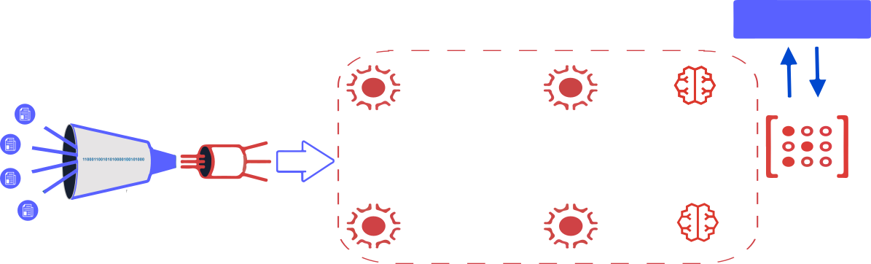
NLP Pipeline with Redis AI
Flask API
Extract & parse cord-19 documents
Language
detector
Spell
checker
Split
paragraphs
RedisAI
RedisGears
RedisAI

Slide 19
Solution Overview
I would like to incorporate modern machine learning models into NLP pipeline for Question Answering (like chatbot)
Creating a BERT based Question Answering services is quite straightforward, except even on such “small” dataset as cord19, API response time will 10-15 seconds which isn’t good users experience.
This is where Redis and Redis Modules come into picture.
Pre-Process articles using Redis Gears
Pre-load models for QA into Redis AI and RedisGears
Create API to run inference for QA using Redis AI distributing compute by RedisGears
Notes:
vision which I have been thinking about for a while: work with information should not be limited to 2D and we are looking for “things not strings”. Using Redis technologies whenever possible.

Slide 20
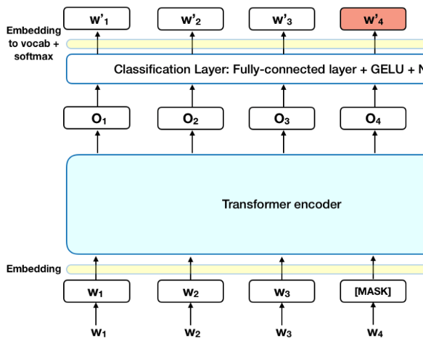
BERT models introduction
BERT (Bidirectional Encoder Representations from Transformers)
Created by researchers at Google AI Language
State-of-the-art results in a wide variety of NLP tasks, including Question Answering (SQuAD v1.1), Natural Language Inference (MNLI), and others.
Read more about BERT at Towards Data Science blog

Slide 21
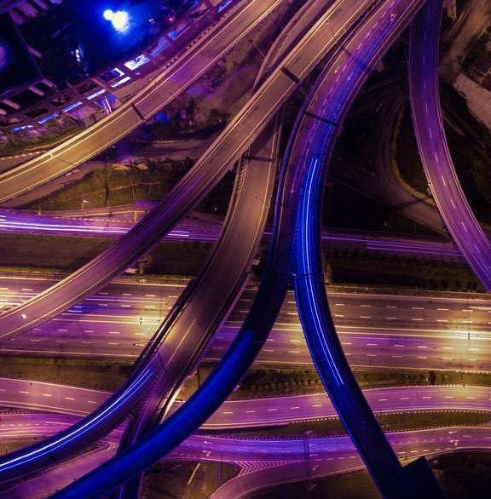
BERT models Use Cases
Next Sentence Prediction
Text Summarization
Question Answering
Text classification and many more

Slide 22
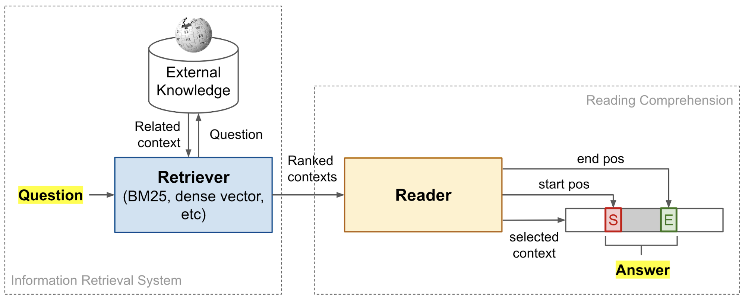
Open Domain Question Answering
Open Domain Question/Answering

Slide 23
Demo 2
http://thepattern.digital

Slide 24

Next Steps
NLP is of the utmost importance in the modern world
Let’s build and open source tools to help different communities manage their knowledge

Slide 25
More Resources
Project documentation https://alexmikhalev.github.io/cord19redisknowledgegraph
Overall Github repo https://github.com/applied-knowledge-systems/the-pattern
Live demo http://thepattern.digital
Join our team on Discord

Slide 26
References
Measuring Discourse Bias Using Text Network Analysis
Open Domain Question/Answering
The Knowledge Graph Cookbook
Entity Co-occurrence graphs as Mind Maps
The Pattern project

Slide 27
Join Hackathon on RedisConf 2021
Idea for hackathon: when you find a relevant article on topic (the pattern), then you click on summarization and take it to my knowledge graph (via obsidian) and then we build a local knowledge graph (terraphim project) with skeleton in VR mapping locally taken concepts onto skeleton (like this). It doesn't have to be skeleton, but something which can represents local view (viewmodel) for specific role. Like for myself roles: scientists, engineer, architect, gamer, father. Each role have a different concepts associated with - role of gamer is interested in new games (and news and tutorials) while role architect find those annoying and distracting. Register here for RedisConf 2021 and tick box "join hackathon"

