Slide 1
Requirements for RDF Validation
Harold Solbrig
Mayo Clinic

Slide 2
Background
The LDS Hospital HELP system:
Early equivalent of “RDF” store
Data consisted of “strings”
Subject was (usually) a patient
Grouping by event time / specimen
String consisted of collection of 8 byte codes
Data Class
Field Code
[noun, [adjective, [adverb]]]
Type and (data or len/text)

Slide 3
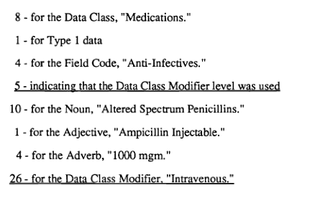
PTXT Sample
8.1.4.5.10.1.4.26

Slide 4
HELP System
Advantages
One data structure – PTXT identifiers determined the specific assertion
Real time and batch data analysis required an understanding of the PTXT 8 byte structure
Assertions were atomic (patient → {event → {code/value}})

Slide 5
HELP System
Disadvantages included
Single parent hierarchy:
The code for allergin (e.g. penicillin) was different than the code for orderable drug
Semantics and syntax intermingled (vs. URI’s)
‘String’ structure was amorphous
Entry screens and software determined what was and wasn’t in a ‘string’
Just because you had a red cell count in a string didn’t necessarily mean you had a white cell count

Slide 6
Lack of ‘string’ structure
Inordinate amount of software development time was consumed with detecting possible missing data – even if RBC and WBC co-occurred today, you had to think about what you did if you had one without the other…
… did you search for another string?
… ignore the result?
… just work with the present element?
This becomes a NP problem (in development time…) as the number of combinations increase

Slide 7
Solution to HELP problem
ASN.1 Models (!)
Described possible system states
Used to validate input (fine grained)
Used to query output (coarse grained)
Became the basis for constructing forms, advanced queries, etc.

Slide 8
On to RDF
RDF
Actually possible that some of the roots are traceable to the HELP / PTXT system
Same strengths…
… although PTXT dictionary is distributed across the net
Same weaknesses…
… what guarantees do I have?

Slide 9
RDF Store Guarantees
Store is represented as triples
Subject (IRI or BNODE)
Predicate (IRI)
Object (IRI or BNODE or Literal)
Literals have formal structure (!)
The only guarantees are (1) and (2)
#HaroldSolbrig foaf:givenName “Harold”.
- can I count of familyName?
- how does this relate to foaf:name?
:stmt_1 rdf:subject #HaroldSolbrig;
rdf:predicate foaf:name.
- no rdf:object? What does this mean?

Slide 10
Same issues
Either you assume…
… that you know where the data came from and what constraints applied
… or that the data sources are sensible, consistent and error free
… or you have to start coding defensively

Slide 11
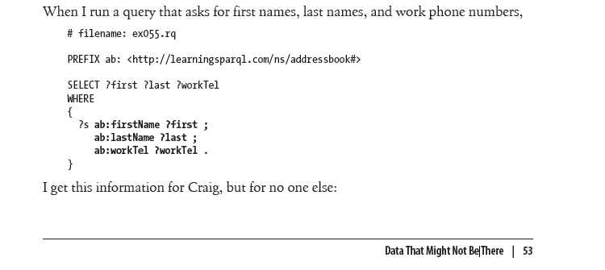
Learning SPARQL
2011 Bob DuCharme – Oreilly Books

Slide 12
Learning SPARQL (continued)
Explanation goes on to descripte the use of OPTIONAL, the fact that the order of OPTIONAL matters, the fact that OPTIONAL can be used to find something out about new data sets, etc…

Slide 13
Issue
OPTIONAL doesn’t scale and yet…
… unless the particular store can offer some guarantees…
… you should code everything as optional (!)

Slide 14
Side Note
RDF Graph – set of triples
Identity of the graph is its content
RDF Dataset – a collection of RDF Graphs
Identity pf dataset is its content (?)
Triple Store – set of triples that change over time
Identity independent of content

Slide 15
RDF “Store”
A triple store with
Identity
State (RDF Graph)
Update function
F(S₁, G_{A}, G_{D}) → S₂
Invariants
Always true about State
Transition Rules
Allowed State → State transitions

Slide 16
RDF Validation Requirements (MUST)
Provide a standard syntax and semantics for describing RDF Invariants (and Transition Rules?)
Allow publication and discovery
Describe invariant enforcement rules (preconditions / postconditions)
Handle invariant evolution (future)

Slide 17
RDF Validation Requirements (SHOULD)
Invariants:
Representatable in RDF
Easy to use might also imply DSL(s)
Be formally verifable
Consistency
Completeness (?)
Be self defining
Be able to express subset of UML 2.x class and attribute assertions (and some OCL?)
Subset of Invarients → UML 2.x
Be able to express XML Schema invariants
Subset of Invariants → XML Schema
Be implementable in existing tooling and infrastructure
(RDF / SPARQL / REST / …)

Slide 18
Need to Address
Cardinality
Types
Open World / Unique Identifier Issues
Allowed Transitions (ala. Skjaeveland/Stolpe)
Known subjects/predicates/data types
Preconditions
:X a s:type1. → rules
Postconditions
:X a s:type1. → :x s:r s:y.
Data types
Hidden parsable structure
Allows hiding of complexity
Allowable values (S → P, SP → T, etc.)

Slide 19
Summary
Linked Open Data today (mainly) represents secondary data
Ok for research, but not for production systems
Ok for relatively static stores but not for federation and evolution
The ability to create, share and execute invariants is (a) key to RDF becoming the de-facto language of many domains

