Slide 1



Automatic Speech Recognition system for Indian Languages “IndicWav2Vec”
AI4Bharat Speech Team

Slide 2




What is ASR
सारे जहाँ से अच्छा

Slide 3

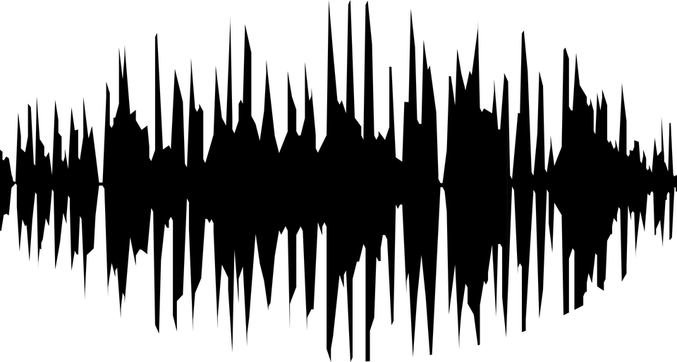



Challenges for Indian ASR Systems
नमस्ते
धन्यवाद
प्रभात
Manual Transcription is a time-consuming process causing delays
Modern ASR models rely on large amounts of labeled data for each language.
It is -
Expensive
Not scalable
Accurate, free, open-source ASR systems are not available for all the Indic languages of interest
Complex inflectional systems leads to larger vocabulary sizes posing challenges to incorporate language models

Slide 4
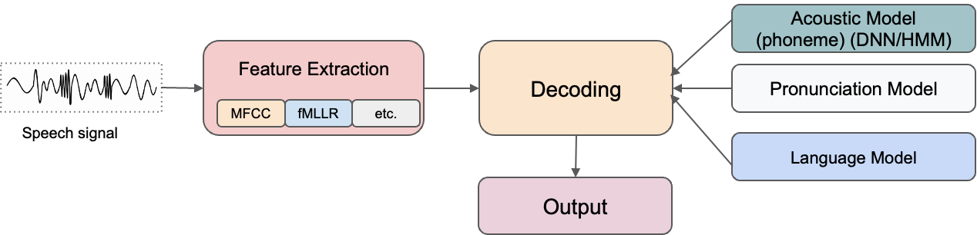
Traditional ASR Modelling Systems
Limitations:
Complexity
Chained Inefficiencies
Reliance on labelled datasets
Deployment
Can we do better?
Notes:
Can we do better,
It turns out that we can by achieveing end-to-end nature of the models and leverage unlabelled dataset

Slide 5
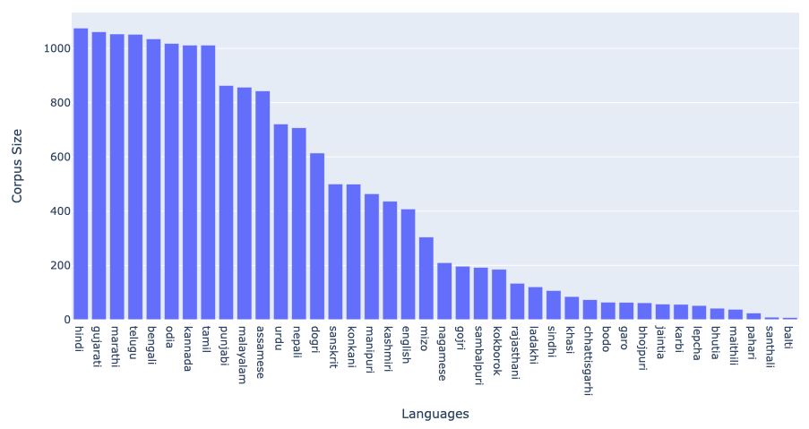

How can we do better?
नमस्ते
धन्यवाद
प्रभात
Utilize large amounts of freely available unlabeled data on Youtube, NewsOnAir to perform Self-Supervised Pretraining
Reduce the requirement for labeled fine-tuning data.
Build robust ASR systems by pretraining a multilingual model across Indian languages

Slide 6
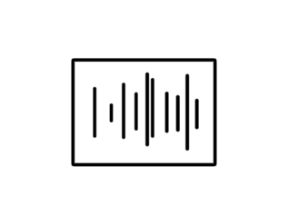
Technical Description of Proposed Methodology
Data Curation Pipeline
Pre-training
Finetuning
Language Modelling
Video Data Extraction
हिंदी….
Self Supervised Pretraining
हिंदी…..
URL Identification
Quality Check
Download Video
Audio Extraction
CTC Loss
अच्छा…
External LM
Contrastive Loss
Lexicon
Rescoring
Manual
Manual
youtube-dl
ffmpeg
Corpora
Noisy Content Filtering
Voiced Activity Detection
Sampling freq. adjustments (16Khz)
Linear Projection
Encoder Network
Top K predictions
wada-SNR
py-webrtcvad
ffmpeg
Pretrained Model
Audio Data Processing Pipeline
wav2vec2
Finetuned Model
Unlabelled Data
wav2vec2_ctc
हिंदी…..
अच्छा……
Unlabelled Data
Labelled Data

Slide 7
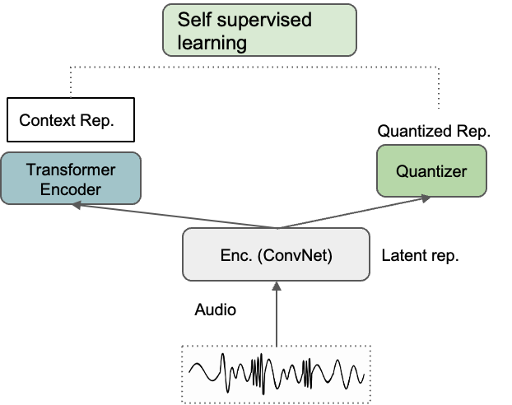
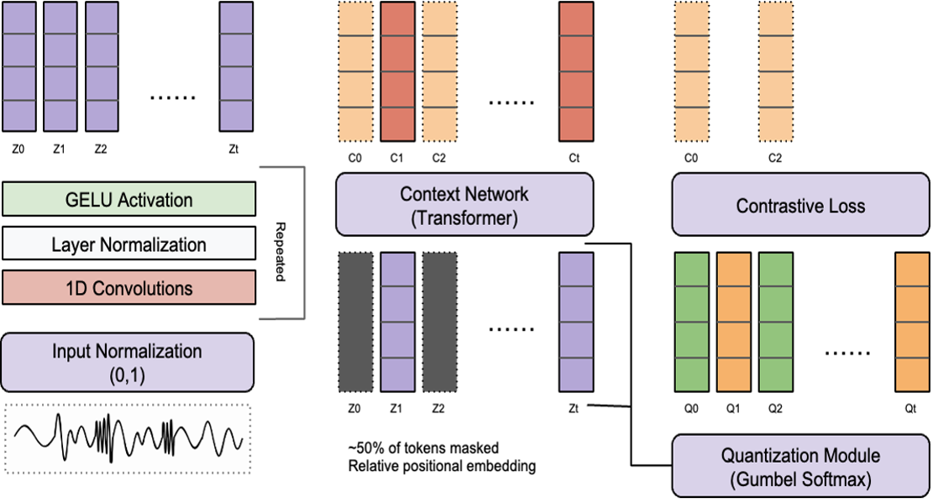
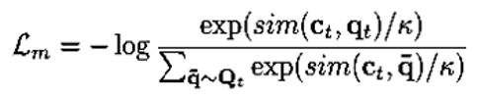
Self-Supervised Pretraining
Codebook
Self-supervision
Notes:
Limitations:
Language specific finetunining results in a new model for each new language
Deployment is difficult because model for each language has to be deployed separately
Due to their enormous sizes of these models (~300M parameters), latency becomes an issue
Future Direction:
Move to completely multilingual setup where you have a single model for all Languages
Integrating LM reliably within the ASR system for better performance.
Pretraining helps so more and more data can be curated to improve on the performance of models
Standardization of the output by using Inverse Text Normalization (1 and एक causes confusion even if model is correct in both cases)
Build benchmark datasets for resource constrained languages.

Slide 8
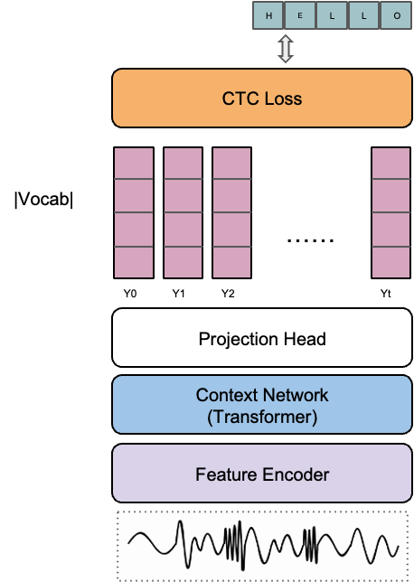
Finetuning
Fine-tuning:
Add a projection layer
CTC loss

Slide 9
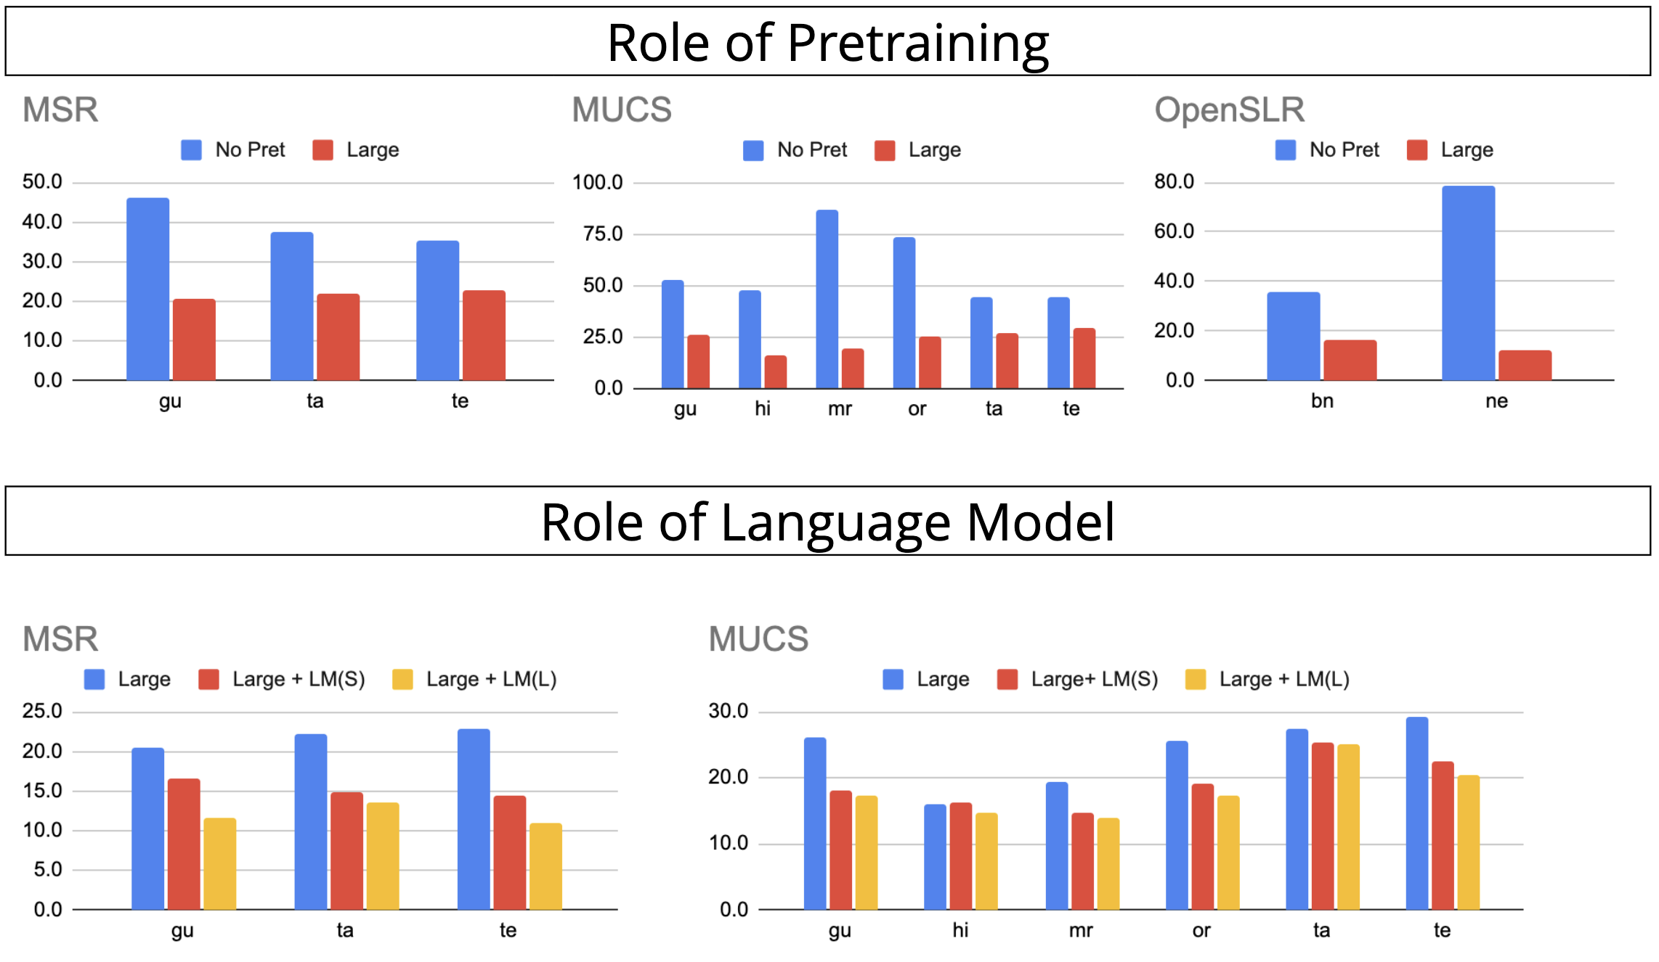
Results
Pretraining Data source: Dhwani
Finetuning Data source: MUCS, MSR, OpenSLR
Notes:
Societal Impact: It can serve as a tool for Converting High Quality Education material into Native Language which will help the students to learn thing much better (Things are always easier to understand in your mother tongue).
It can further help differently-abled persons.
First Stepping stone in building Speech to Speech systems (Realtime translators)
Personalized Smart Assistants like google in your own Native language (Siri, mere phone mai alarm lagado!)

Slide 10
MODELS
Siri, phone mai 12 baje ki alarm lagado!
Personal Smart Assistants
Differently abled persons can hear through text
Stepping stone for building S2S Translation systems
ASR Systems
IndicWav2Vec
अच्छा……
ASR
MT
TTS
Dhwani Dataset
17000 hours of Pretraining Data across 40 Languages
SOTA ASR models for 9 languages** across 3 datasets*.
High quality education content in native language
Extensive ablations and insights about building ASR Systems, informing LM Choice, Lexicon Choice, Size of Pretraining data.
Realtime Translations
Open sourced Pretrained model which can be used in building speech applications
Pretraining Significantly helps
Choice of Lexicon is crucial
Moving to bigger LM Helps
**hi, ta, te, gu, mr, or, ne, bn, si *MUCS, MSR, OpenSLR
Results on pretraining effects and comparison to SOTA approaches on benchmark datasets are provided in Appendix
Notes:
Societal Impact: It can serve as a tool for Converting High Quality Education material into Native Language which will help the students to learn thing much better (Things are always easier to understand in your mother tongue).
It can further help differently-abled persons.
First Stepping stone in building Speech to Speech systems (Realtime translators)
Personalized Smart Assistants like google in your own Native language (Siri, mere phone mai alarm lagado!)

Slide 11
Future Directions
Finetuned ASR Model
New Benchmarks
hi+ur+ta...+20
Pretrained Model
..1..
Pretrained Model
Adapters
Evaluate
..एक..
ASR Models
Completely Multilingual setup
Using domain specific adapters
Standardization of the output by using ITN (1 and एक causes confusion even if model is correct in both cases)
Building Benchmark to better assess model Performance
Notes:
Limitations:
Language specific finetunining results in a new model for each new language
Deployment is difficult because model for each language has to be deployed separately
Due to their enormous sizes of these models (~300M parameters), latency becomes an issue
Future Direction:
Move to completely multilingual setup where you have a single model for all Languages
Integrating LM reliably within the ASR system for better performance.
Pretraining helps so more and more data can be curated to improve on the performance of models
Standardization of the output by using Inverse Text Normalization (1 and एक causes confusion even if model is correct in both cases)
Build benchmark datasets for resource constrained languages.

Slide 12
Questions?

