Slide 1
4 Batches of samples
DOB of 20200612
DOB of 20200806
DOB of 20200917
DOB of 20201105
Metabolites were extracted from lysed cells. Lysed cell suspensions were centrifuged at 12,000x g for 30min at 4oC. The supernatant were collected for NMR measurement. All 1H NMR spectra were acquired on Agilent/Varian 600 MHz spectrometer at 298K. 1H metabolic profiles were recorded using a conventional NOESY experiment with water suppression (1D NOESY).
BMMC date of birth | 20200612
# of week | sample ID | NMR solvent | supernatant after ultracentrifuge | Cell density in NMR solvent (million/ml)
week 0-4, 7,8 | NA
week 5 | ZY-4-134 | D2O/TMSP | clear without gel | 11.3
week 6 | ZY-4-135 | D2O/TMSP | clear without gel | 36.5
week 9 | ZY-4-139 | D2O/TMSP | clear without gel | 12.1
week 10 | ZY-4-141 | D2O/TMSP | clear without gel | 19.8
BMMC date of birth | 20200806
# of weeks | sample ID | NMR solvent | supernatant after ultracentrifuge | Cell density in NMR solvent (million/ml)
week 0 | ZY-4-137 | D2O/TMSP | clear without gel | 4.6
week 1 | ZY-4-138 | D2O/TMSP | clear without gel | 44.8
week 2 | ZY-4-140 | D2O/TMSP | clear without gel | 38.8
week 3 | ZY-4-144 | D2O/TMSP | not very clear due to too many lysed cells | 148
week 4 | ZY-4-146 | D2O/TMSP/PBS | sticky gel like solution | 87
week 5 | ZY-4-148 | D2O/TMSP/PBS | sticky gel like solution | 75.8
week 6 | ZY-4-151 | D2O/TMSP/PBS | sticky gel like solution | 45.5
week 7 | ZY-4-155 | D2O/TMSP/PBS | sticky gel like solution | 19.7
week 8 | zy-4-161 | D2O/TMSP/PBS | sticky gel like solution | 9.6

Slide 2
4 Batches of samples
DOB of 20200612
DOB of 20200806
DOB of 20200917
DOB of 20201105
BMMC date of birth | 20200917
# of weeks | sample ID | NMR solvent | supernatant after ultracentrifuge | Cell density in NMR solvent (million/ml)
week 0 | ZY-4-153 | D2O/TMSP/PBS | sticky gel like solution | 16.8
week 1 | ZY-4-157 | D2O/TMSP/PBS | sticky gel like solution | 58.7
week 2 | ZY-4-159 | D2O/TMSP/PBS | sticky gel like solution | 15.5
week 3 | ZY-4-166 | D2O/TMSP/PBS | sticky gel like solution, lost most of the solution, add 500ul NMR solution, diluted solution! | 20
week 4 | ZY-4-167 | D2O/TMSP/PBS | sticky gel like solution | 112
week 5 | ZY-4-169B | D2O/TMSP/PBS | sticky gel like solution | 135
week 6 | ZY-4-177 | D2O/TMSP/PBS | sticky gel like solution | 44.2
week 7 | ZY-4-178 | D2O/TMSP/PBS | sticky gel like solution, filtered with 0.2um PES Nalgene Syringe filter | 35
week 8 | ZY-4-179 | D2O/TMSP/PBS | sticky gel like solution, filtered with 0.2um PES Nalgene Syringe filter | 19
week 9 | ZY-4-180 | D2O/TMSP/PBS | sticky gel like solution, filtered with 0.2um PES Nalgene Syringe filter | 46.2
BMMC date of birth | 20201105
# of weeks | sample ID | NMR solvent | supernatant after ultracentrifuge | Cell density in NMR solvent (million/ml)
week 0,1,3,8 | NA
week 2 | ZY-4-181 | D2O/TMSP/PBS | sticky gel like solution, filtered with 0.45um PTFE Syringe filter | 25.7
week 4 | ZY-4-182 | D2O/TMSP/PBS | sticky gel like solution, filtered with 0.45um PTFE Syringe filter, sample may be contaminated! | 68
week 5 | ZY-4-183 | D2O/TMSP/PBS | sticky gel like solution, filtered with 0.45um PTFE Syringe filter | 84
week 6 | ZY-4-184 | D2O/TMSP/PBS | sticky gel like solution, filtered with 0.45um PTFE Syringe filter | 46
week 7 | ZY-4-187 | D2O/TMSP/PBS | sticky gel like solution, filtered with 0.45um PTFE Syringe filter | 72.7
week 9 | ZY-4-191 | D2O/TMSP/PBS | sticky gel like solution, filtered with 0.45um PTFE Syringe filter | 35.4
week 10 | ZY-4-192 | D2O/TMSP/PBS | sticky gel like solution, filtered with 0.45um PTFE Syringe filter | 9.5

Slide 3
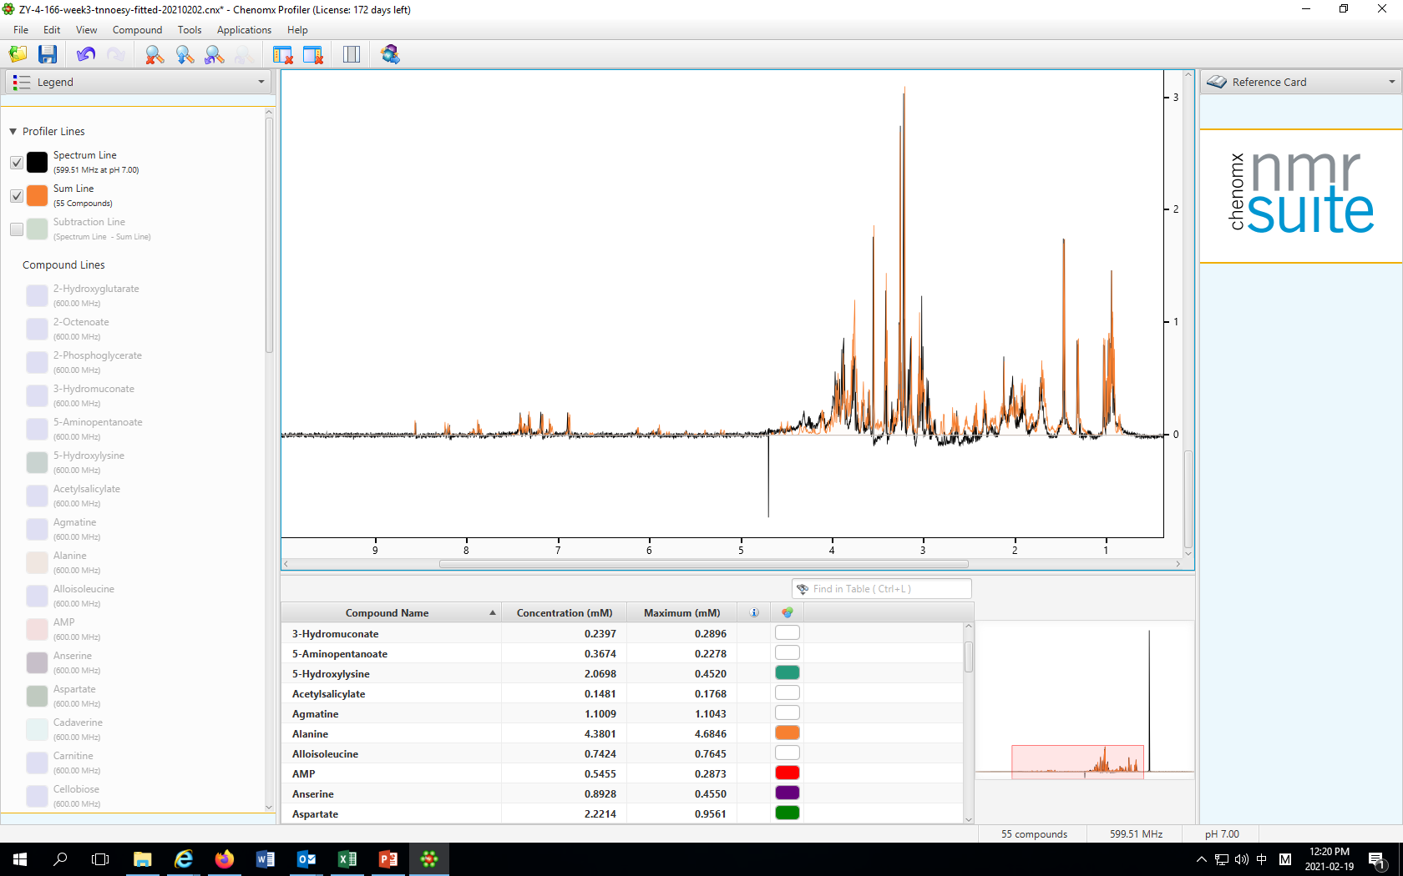

Slide 4
# | Compound Name | Concentration (mM)
1 | 2-Hydroxyglutarate | 1.4902
2 | 2-Octenoate | 1.0467
3 | 2-Phosphoglycerate | 2.7642
4 | 3-Hydromuconate | 0.2397
5 | 5-Aminopentanoate | 0.3674
6 | 5-Hydroxylysine | 2.0698
7 | Acetylsalicylate | 0.1481
8 | Agmatine | 1.1009
9 | Alanine | 4.3801
10 | Alloisoleucine | 0.7424
11 | AMP | 0.5455
12 | Anserine | 0.8928
13 | Aspartate | 2.2214
14 | Cadaverine | 1.0809
15 | Carnitine | 1.0389
16 | Cellobiose | 1.0315
17 | Dimethyl sulfone | 0.5605
18 | Ethylmalonate | 0.3385
19 | Glutamate | 2.6689
20 | Glutamine | 1.5885
21 | Glutathione | 0.7008
22 | Glycine | 3.853
23 | Glycylproline | 1.1684
24 | Histamine | 1.0804
25 | Histidine | 0.5845
26 | Isocitrate | 2.1309
27 | Isoleucine | 1.3795
28 | Lactate | 1.9508
29 | Leucine | 2.5134
30 | Lysine | 1.3967
31 | Malonate | 0.3331
32 | Mannitol | 1.2634
33 | Melatonin | 0.5088
34 | Methionine | 0.6246
35 | N-Acetylglutamate | 0.3305
36 | N-Acetylglutamine | 0.2828
37 | N-Isovaleroylglycine | 0.5775
38 | N-Nitrosodimethylamine | 0.6482
39 | Ornithine | 4.4214
40 | Oxypurinol | 5.5481
41 | Phenylalanine | 1.041
42 | Proline | 2.7298
43 | Serine | 3.8153
44 | sn-Glycero-3-phosphocholine | 0.8751
45 | Suberate | 0.3253
46 | Sucrose | 0.3651
47 | Taurine | 5.5993
48 | Trimethylamine N-oxide | 0.7531
49 | Tropate | 0.3596
50 | Tyrosine | 1.1944
51 | UDP-glucose | 0.2016
52 | UDP-N-Acetylglucosamine | 0.1594
53 | Uridine | 0.3914
54 | Valine | 2.4576
55 | Xylose | 1.0125

