Slide 1
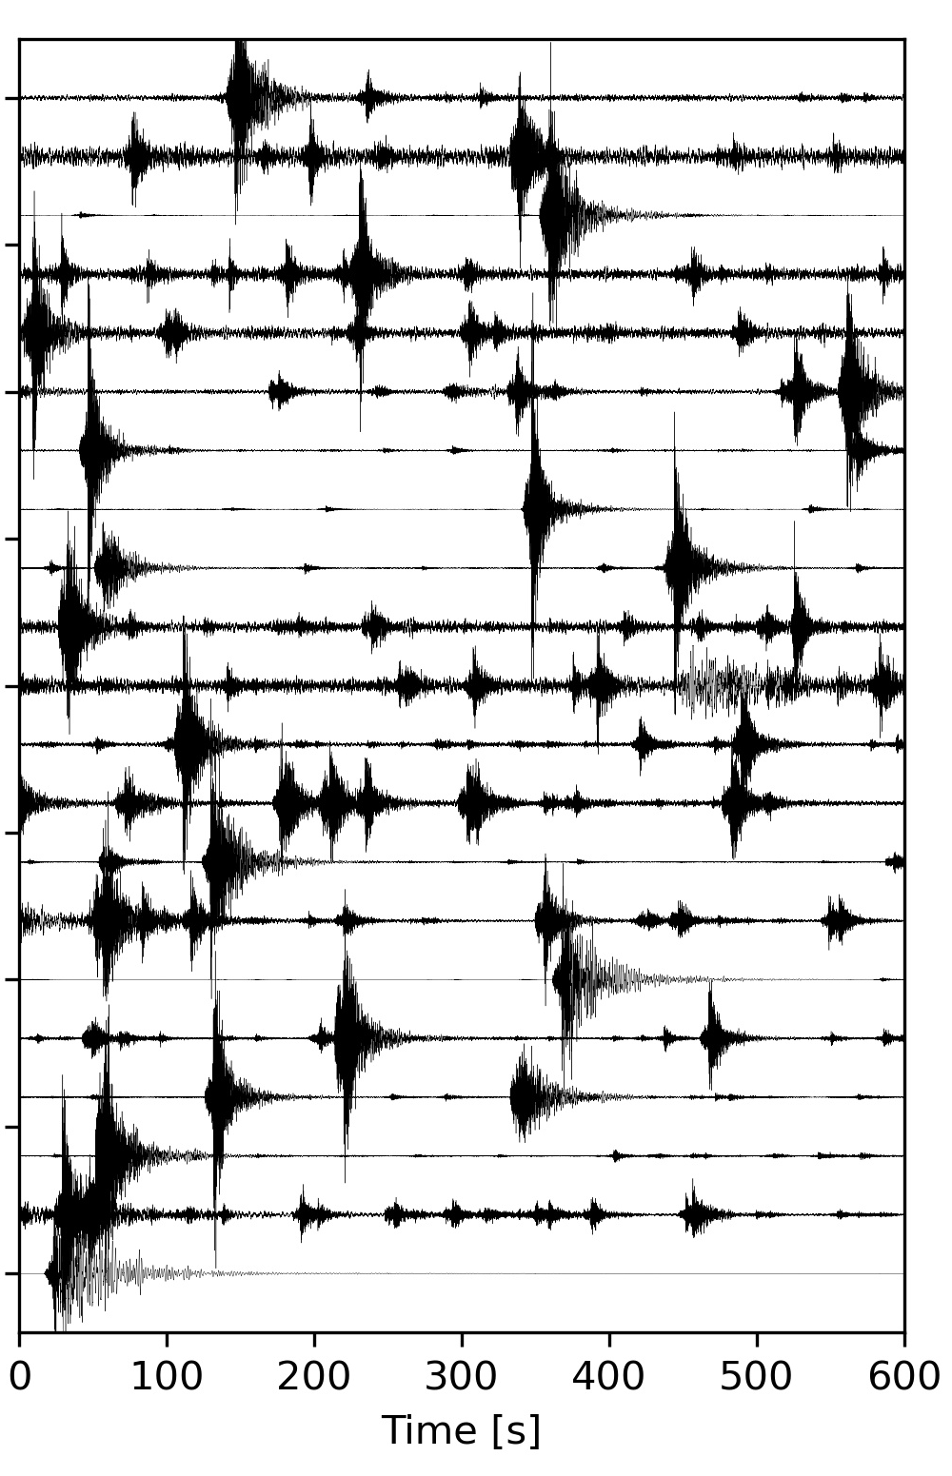
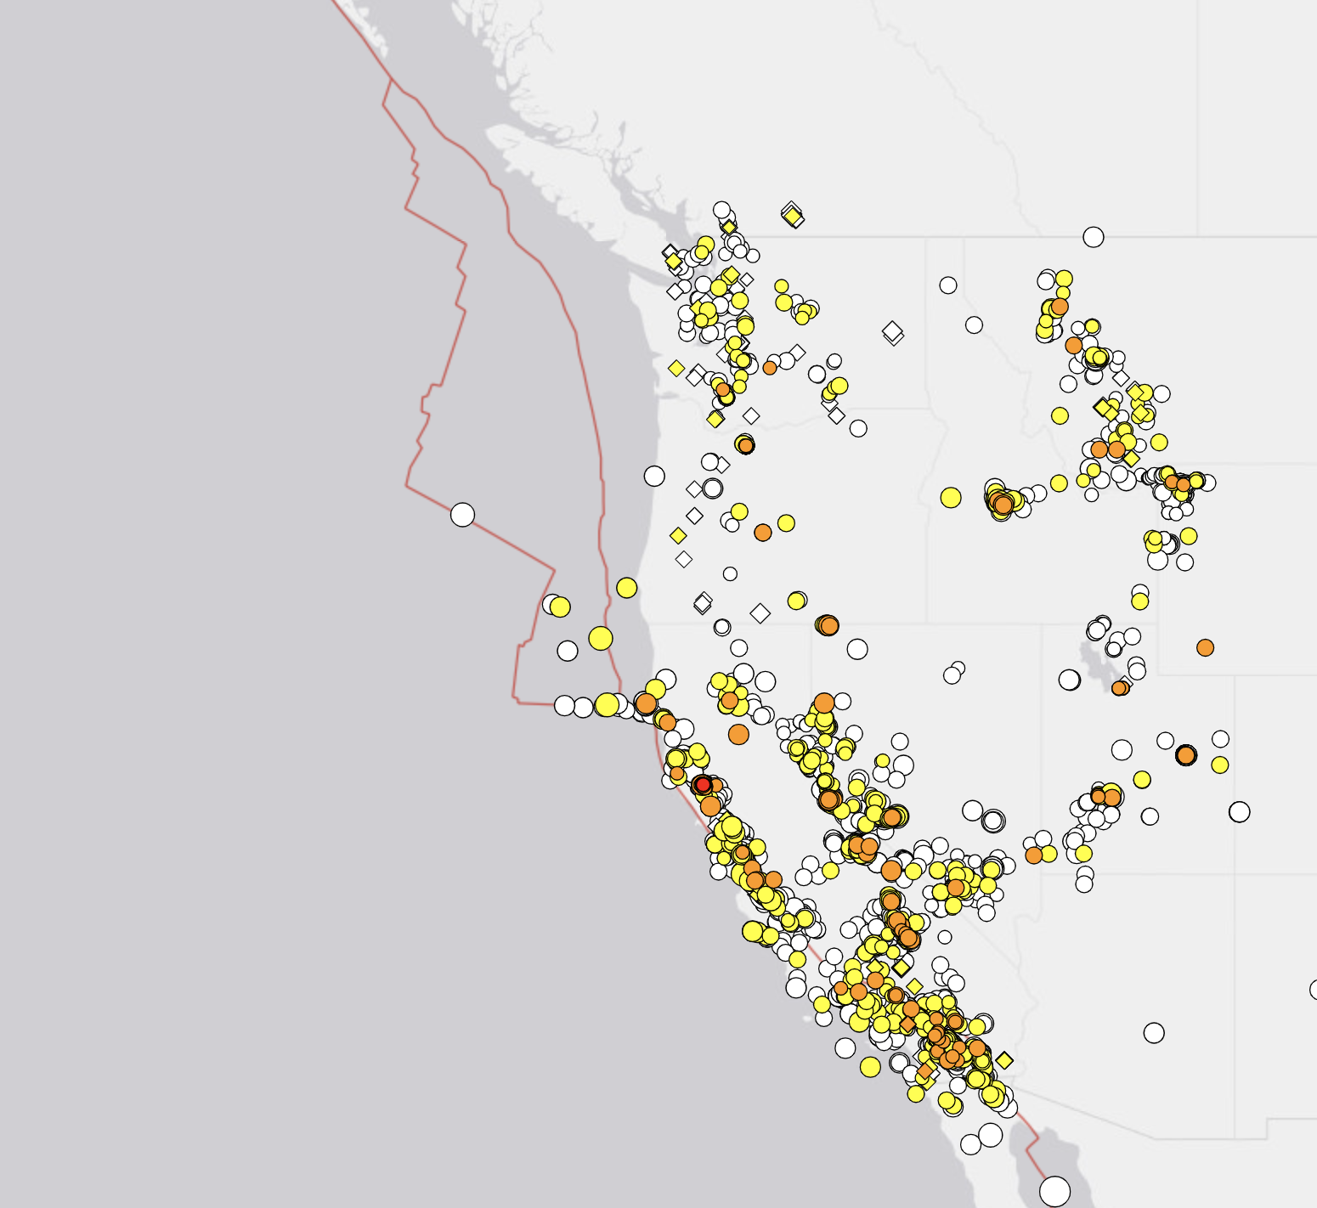
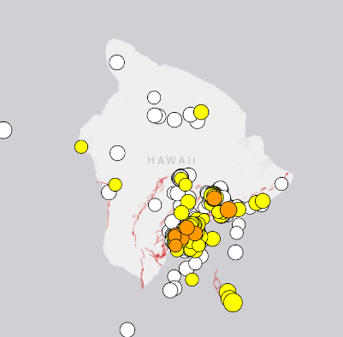
Deep Learning for Earthquake Monitoring
Pre-processing
DeepDenoiser
(Zhu et al. 2019)
Phase Picking
PhaseNet
(Zhu et al. 2018)
Phase Association
GaMMA
(Zhu et al. 2021)
Earthquake
Location&Relocation
ADLoc
(Zhu et al. in prep)

