Slide 1
Expert Agent
Task 2.1 – Knowledge-assisted AI
IRT SystemX

Slide 2
Outline
Context
Methodology
Original Contribution
Overview of code structure
Algorithm #1
Algorithm #2

Slide 3
Context
Definition
Expert Agent is an RL agent where the exploration capability may be guided by expert knowledge.
Motivation
The huge action space size in some critical infrastructure may cause some problems such as generalization, overfitting, instable and delayed convergence and exporation becoming intractable. The expert knowledge help the agent to be trained on effective and reduced action space while not avoiding the whole actions space exploration.
Use cases
This implementation is specific to Power Grid domain and power grid assistant use case. In this use case, AI assistant supports human operators in decision-making and managing power grid congestion by suggesting remedial actions.

Slide 4
Methodology
Main idea = Exploit the Expert Knowledge using ExpertOp4Grid package ¹ to
(1) focus the exploration phase of an RL agent on specific zones of a power grid
(2) reduce the action space to most relevant ones and improve the scalability or RL agents
Use a gymenv enabling the access to original action space and states
Focus the exploration phase of the agent on a specific zone or reduce the action space based on expert knowledge
The extended RL agent could explore and learn from expert knowledge for stability and traceability
An RL agent explores the whole or reduced action space based on expert knowledge
Knowledge-assisted RL
Preliminary experiments on Power Grids, but could easily be extended to other doamins if the expert knowledge is available

Slide 5
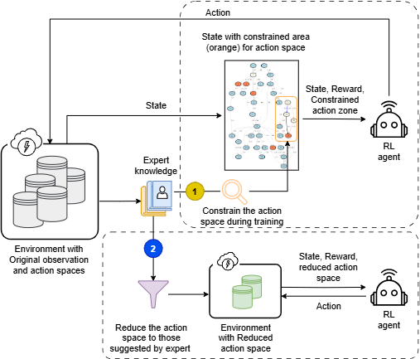
Schematic representation of the methods
Main idea = Exploit the Expert Knowledge to
focus the exploration phase of an RL agent on specific zones of a power grid
reduce the action space to most relevant ones and improve the scalability or RL agents
1
2

Slide 6
Original contribution
Algorithm #1 | DeepQExpert
Short description: Focus the learning to the zones suggested by expert knowledge
State-of-the-art: Classical deep reinforcement learning algorithms ¹ or expert system ²
Contribution: Exploitation of expert knowledge during the training of an RL agent
Implemented WP2 features: Knowledge-assisted RL
Algorithm #2 | ExpertAgent (better scalability)
Short description: Exploiting the reduced action-space obtained using expert knowledge as preprocessing
State-of-the-art: Classical deep reinforcement learning algorithms ¹ or expert system ²
Contribution: Train the classical RL algorithms on reduced action space obtained using expert knowledge
Implemented WP2 features: Knowledge-assisted RL
¹Rocchetta, Roberto, et al., A reinforcement learning framework for optimal operation and maintenance of power grids (2019)
²Marot, Antoine, et al., Expert system for topological remedial action discovery in smart grids (2018)

Slide 7

Overview of repository structure
The provided repository includes a python package implementing two main expert agents
ExpertAgent
Python package
Method #1, focus the exploration based on expert suggested zones
DeepQExpert
…
Method #2, use an RL agent on reduced action space obtained using expert knowledge
ExpertAgent
ExpertAgentHeuristic
Heuristic based approach
…
ExpertAgentRL
Learning-based approach
…
utils
Utilities to extract action spaces using expert knowledge
…

Slide 8
Authors
Authors | Institution
Milad Leyli-abadi | IRTSX (IRT SystemX)

Slide 9
Algorithm #1

Slide 10
Schematic representation of Algorithm #1
Main idea = Exploit the Expert Knowledge to
focus the exploration phase of an RL agent on specific zones of a power grid
reduce the action space to most relevant ones and improve the scalability or RL agents
Heuristic-based
RL-based
1
2

Slide 11
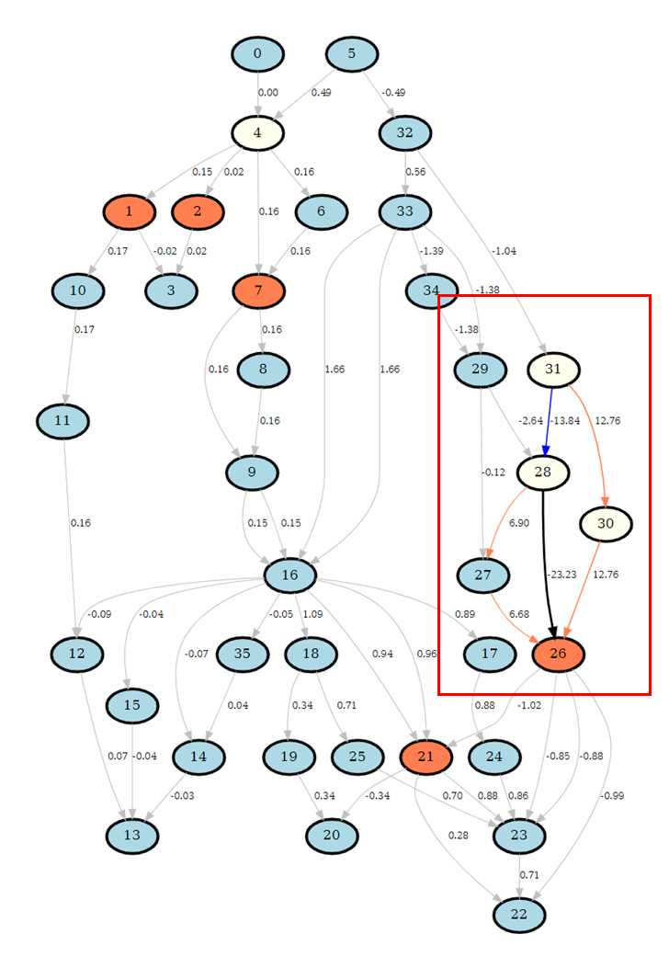


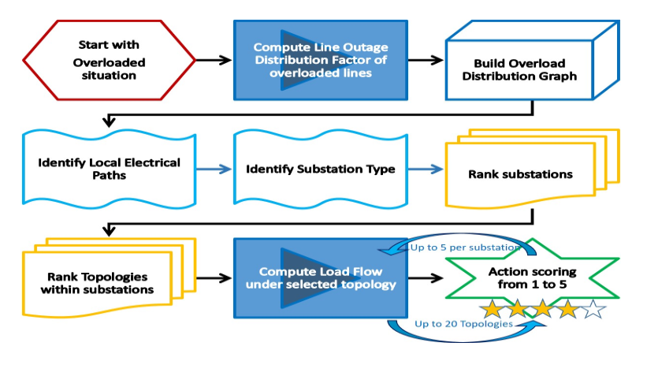
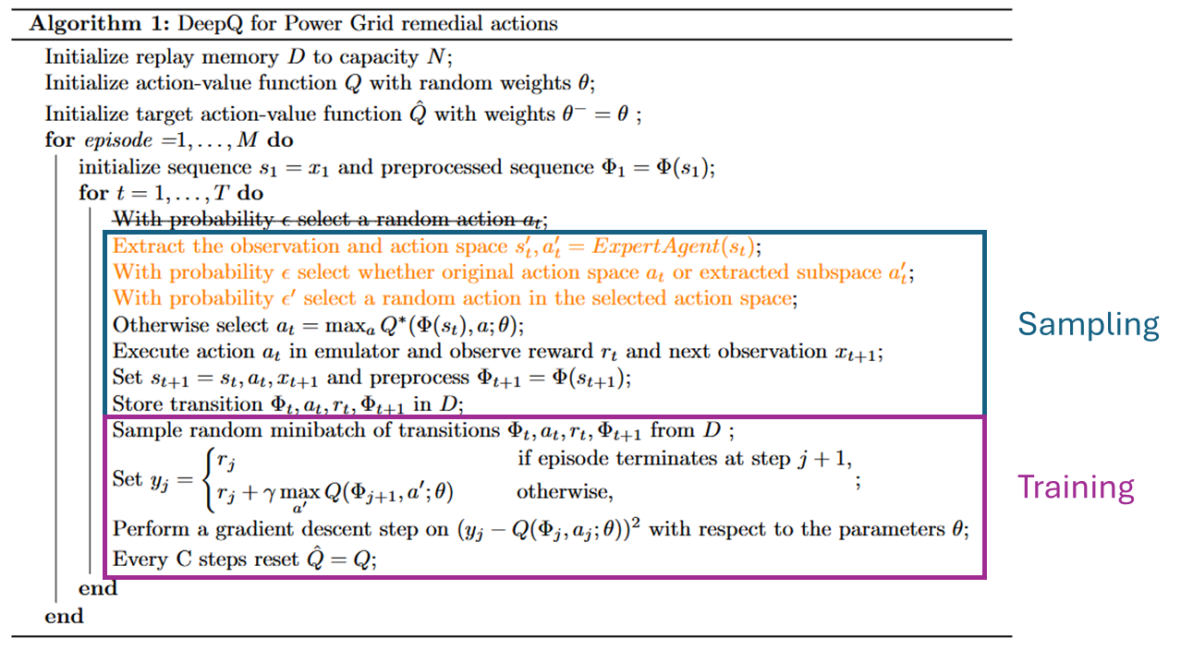
Procedure
Harness Expert knowledge for an RL agent
ExpertOp4Grid framework
Extract expert knowledge
Implementation of the adapted DeepQ to exploit the expert knowledge in power grid use case
Experimentation and benchmark
Analysis of the impact of the expert knowledge (transparency + Explainability)
Use an existing work to exploit expert knowledge
Allows to identify the high impact zones for exploration
Extended DeepQ algrithm harnessing expert-suggested zones
Explanation
See presentation
T2.3 - explainability

Slide 12
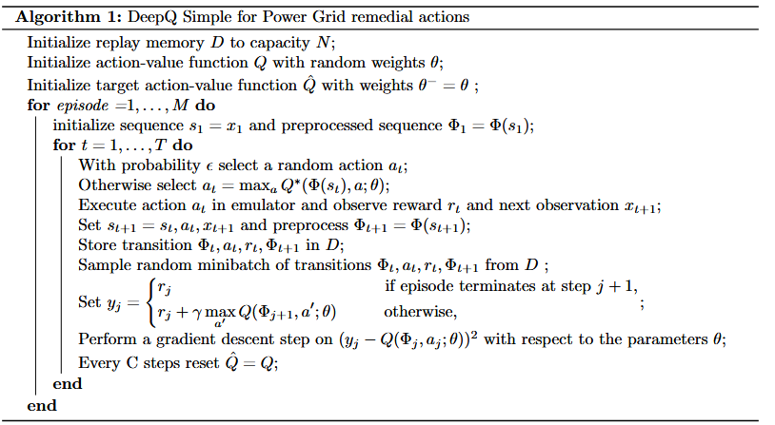
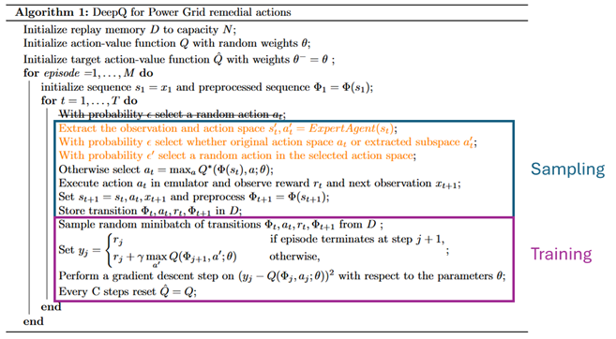
Algorithm
DeepQ Simple
DeepQ Expert

Slide 13

Overview of code structure
DeepQ harnessing the expert knowledge
DeepQExpert
Python package
L2rpn_case14_sandbox
Trained DeepQ weights for 14 nodes environment
…
DeepQAgent.py
Base class including main functionalities
DeepQNN.py
Neural Network (NN) implementation (tensorflow)
deepQExpert.py
Expert Agent class including training loop
config.ini
Configuration file used for expert knowledge (ExpertOp4Grid)
train.py
Script provided to train the agent
evaluate.py
Script provided to evaluate the agent

Slide 14
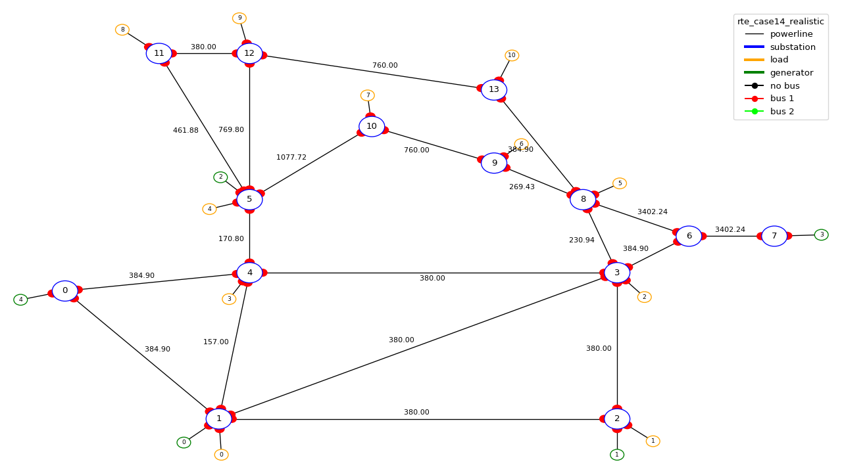
Grid representation
Environment = ai4realnet_small
# Lines = 20
# Substations = 14
# Generations = 6
# Loads = 11

Slide 15
Inputs
Observation space include the following variables with a total of 197 values
Variable | Length | Variables | Length
day_of_week | 1 | actual_dispatch | 6
hour_of_day | 1 | target_dispatch | 6
minute_of_hour | 1 | topo_vect | 57
prod_p | 6 | line_status | 20
prod_v | 6 | time_before_cooldown_line | 20
load_p | 11 | time_before_cooldown_sub | 14
load_q | 11 | rho | 20
 |  | timestep_overflow | 20

Slide 16
Inputs (for 36 nodes)
Observation space include the following variables with a total of 614 values
Variable | Length | Variables | Length
day_of_week | 1 | actual_dispatch | 22
hour_of_day | 1 | target_dispatch | 22
minute_of_hour | 1 | topo_vect | 177
prod_p | 22 | line_status | 59
prod_v | 22 | time_before_cooldown_line | 59
load_p | 37 | time_before_cooldown_sub | 36
load_q | 37 | rho | 59
 |  | timestep_overflow | 59

Slide 17
Output data
A folder with saved models, hyperparameters, cumulative rewards and alive times steps, and action space used during the training of the model
A folder including the evaluation logs for each chronic selected during the evaluation and includes the following information
Execution_time
Rewards
Other rewards (if there are any other optional rewards are computed in parallel)
Actions
Env_modifications
Observations
Oponnent attack

Slide 18
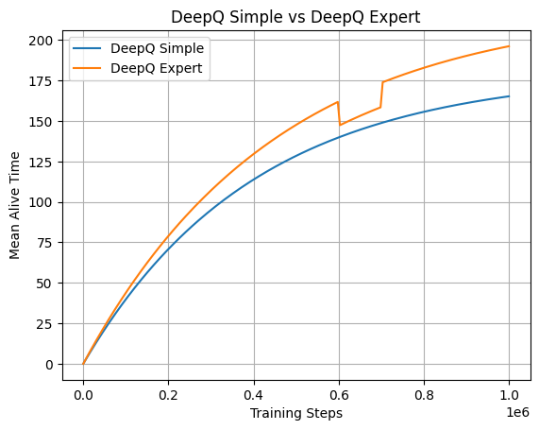
Experiments
DeepQ Simple
Training loss
0.01
Mean Alive
178
DeepQ Expert
Training loss
0.008
Mean Alive
230

Slide 19
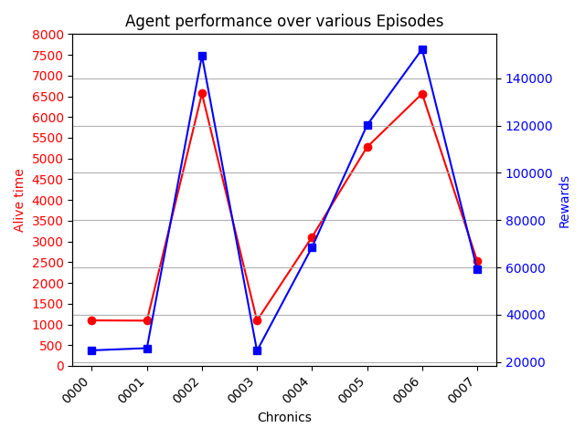
Performance on test scenario
DeepQExpert
Number of episodes : 8
Max duration : 8000
Performance measured based on
Agent’s alive time
Reward

Slide 20
Perspectives
Improve the agent hyperparameters using a fine-tuning algorithm

Slide 21
Algorithm #2

Slide 22
Schematic representation of the methods
Main idea = Exploit the Expert Knowledge to
focus the exploration phase of an RL agent on specific zones of a power grid
reduce the action space to most relevant ones and improve the scalability or RL agents
Heuristic-based
RL-based
1
2

Slide 23


General Procedure
Harness Expert knowledge for an RL agent
Use ExpertOp4Grid framework
Extract expert knowledge
Using an approach to harness the expert knowledge
Experimentation and benchmark
Analysis of the impact of the expert knowledge (transparency + Explainability)
Heuristic-based
Option 2.A
RL-based
Option 2.B
STEP 1
Reduce the action space
Extracting effective actions using expert
STEP 2
Selecting an action
Explanation
See presentation
T2.3 - explainability

Slide 24
Step 1. Reduce action space
ExpertOp4Grid package
Action extraction pseudocode
# list to keep reduced action space
ExpertActions = []
# iterate over all the episodes
for episode in all_episodes:
# iterate over all the time stamps
for timestamp in len(episode):
# call ExpertOp4grid Package
topoActions, scores = call ExpertOp4Grid
# filter actions with high scores (3 & 4)
candidateActions = topoActions[scores>=3.]
# verify to not implicate new overloads
for action in candidateActions:
obs, reward, done = env.simulate(action)
# check no overload
if obs.rho.max() < 1.:
# append the action to the list
topoActions.append(action)
# store all the extracted actions
store(ExpertActions)
Simulate and assess the remedial actions and attribute a score as:
4 - it solves all overloads,
3 - it solves only the overload of interest
2 - it partially solves the overload of interest
1 - it solves the overload of interest but worsen other overloads
0 - it fails to relieve even partially the overload
https://github.com/marota/ExpertOp4Grid

Slide 25
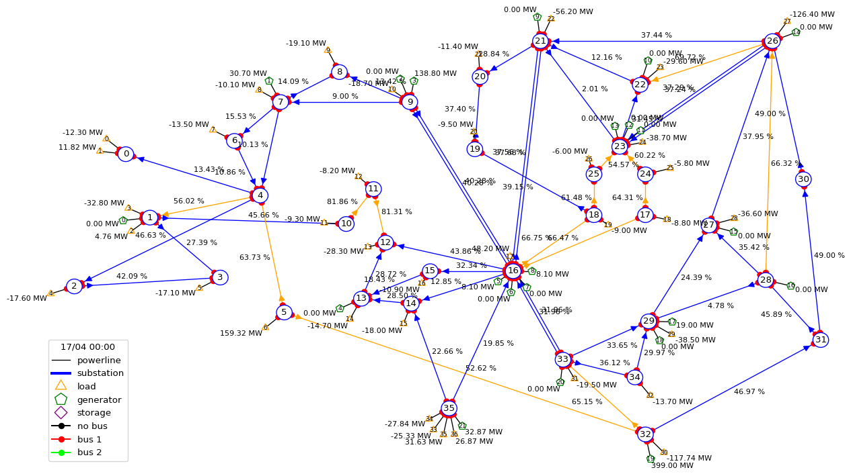
Grid representation
Environment = ai4realnet_small
# Lines = 59
# Substations = 36
# Generations = 22
# Loads = 37

Slide 26
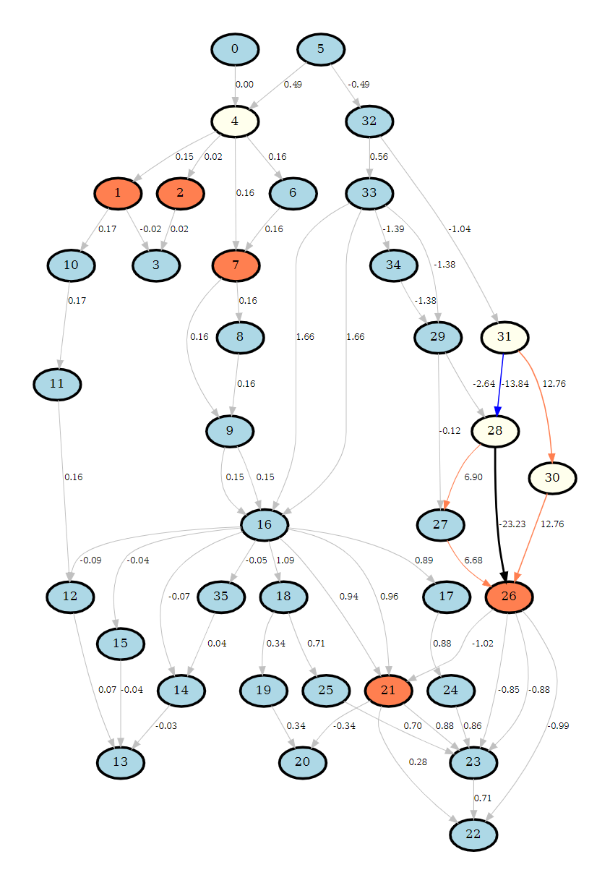
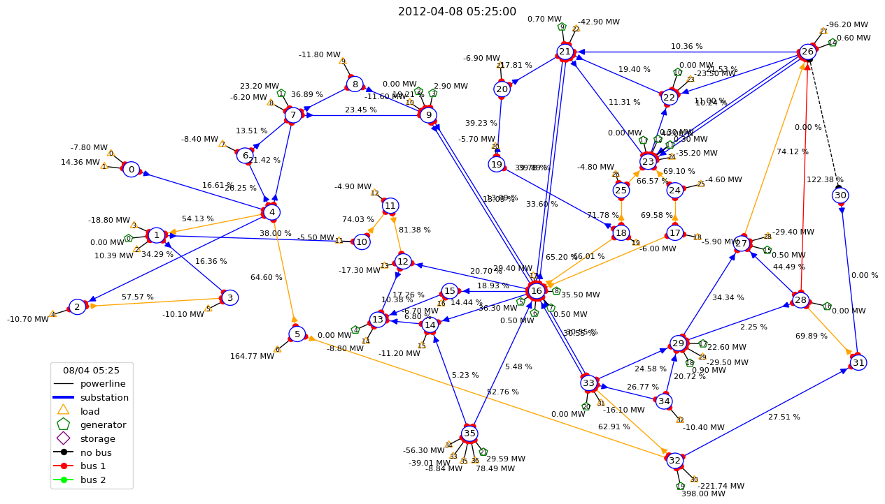
Reduced action space
Extracting most effective actions using ExpertOp4Grid running on various scenarios
Reducing the original action space including only topological action set actions from ~ 30 000 to only 224 effective actions
Overload Graph
Identifying most effective actions

Slide 27
Step 2. Option a) Use heuristic-based agent
Inspired by and extending the winning solution of L2RPN 2023 IDF challenge
Greedy search over reduced action space obtained using the expert knowledge
Use a set of well-known heuristics for power grid control
Reconnecting the disconnected lines
Return to the reference topology
Apply an existing convex optimization for continuous control (credit to LJN agent)
env, obs, reward # # Inputs : Get the environment, current observation and reward
action = env.action_space({}) # Initialize the action by doing nothing
reco_action = try_to_reconnect(obs, action, reward) # Try to reconnect
if reco_action is not None: # verify if there exists a potential reconenction action
_obs, _reward, _done = obs.simulate(action, time_step=1) # simulate the act
if not(done) & obs.rho.max() < 2.:
action += reco_action # add the reconnection to initial action if the overload less than 2
if obs.rho.max() > 0.99: # if an overload is observed
# try to recover the reference topology if possible
recover_act = try_to_recover_topo(obs, action, reward)
if recover_act is not None:
action += recover_act
else:
# retrieve the reduced action space obtained by the expert from step 1 (previous slide)
topo_act = search_expert_actions(reduced_action_space)
action += topo_act if topo_act is not None
_obs, _reward, _done = obs.simulate(topo_act, time_step=1)
if_obs.rho.max() > 0.9:
# Peform a convex optimization for continuous actions if no effective actions suggested yet
action = get_continuous_action_by_optimization(obs, action, reward)
elif obs.rho.max() < 0.9:
# try to recover the reference topology if possible whenever possible, even if no overload observed
recover_act = try_to_recover_topo(obs, action, reward)
if recover_act is not None:
action += recover_act

Slide 28
Input data
Heuristic-based agent
Grid2op Environment (ai4realnet_small)
The path to reduced action space (obtained using expert knowledge)
The definition of overload thresholds
Danger >= 0.99
Safe = 0.9
Evaluation
Number of episodes for evaluation
Max iterations (time stamps) to evaluate per episode

Slide 29
Output data
Evaluation logs
Proposed actions based on heuristic and expert knowledge
Diagram showing the performance of the agent

Slide 30
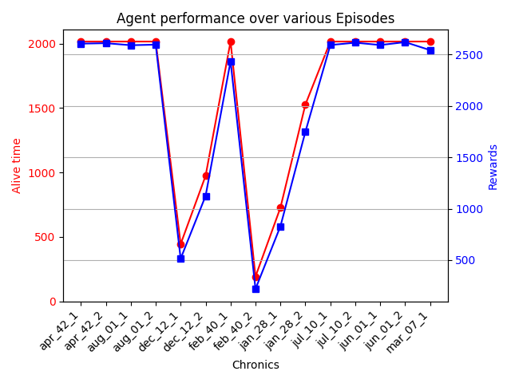
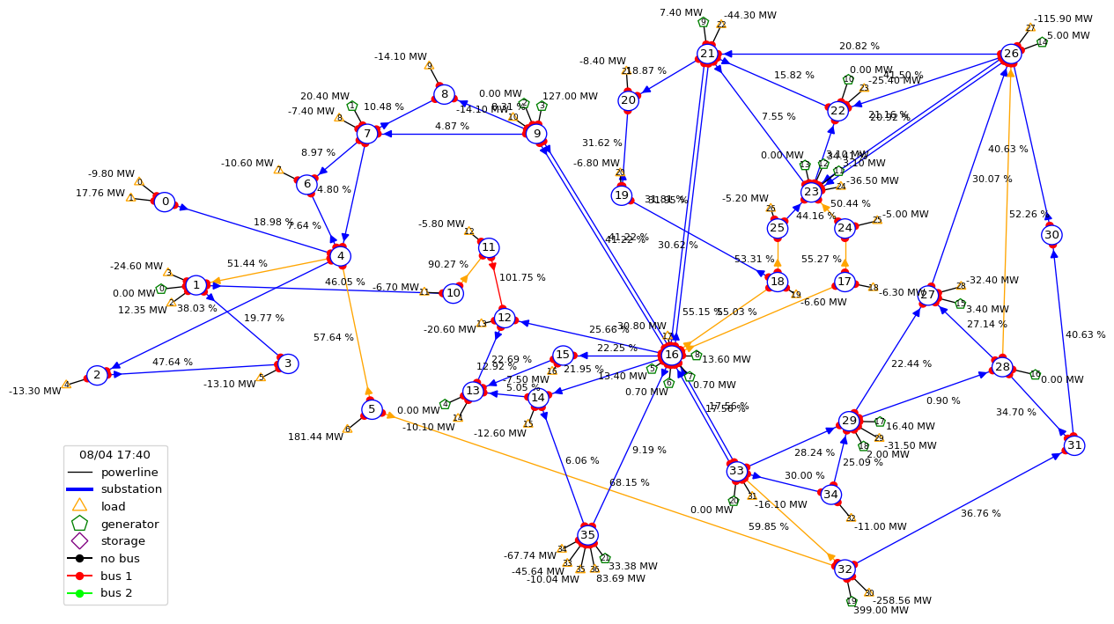
Experiment
Tested on 15 episodes of environment
ai4realnet_small

Slide 31
Step 2. Option b) Use RL-based agent
Train a Proximal Policy Optimization (PPO) algorithm on reduced action space obtained in step 1
Use a set of well-known heuristics for power grid control at inference time
Reconnecting disconnected lines
Return to the reference topology
Apply an existing convex optimization for continuous control (credit to LJN agent)
env, obs, reward # # Inputs : Get the environment, current observation and reward
action = env.action_space({}) # Initialize the action by doing nothing
reco_action = try_to_reconnect(obs, action, reward) # Try to reconnect
if reco_action is not None: # verify if there exists a potential reconenction action
_obs, _reward, _done = obs.simulate(action, time_step=1) # simulate the act
if not(done) & obs.rho.max() < 2.:
action += reco_action # add the reconnection to initial action if the overload less than 2
if obs.rho.max() > 0.99: # if an overload is observed
# try to recover the reference topology if possible
recover_act = try_to_recover_topo(obs, action, reward)
if recover_act is not None:
action += recover_act
else:
# search the best action over top_k prediction of ExpertAgent RL
topo_act = search(ExpertAgent_RL.top_k_predictions)
action += topo_act if topo_act is not None
_obs, _reward, _done = obs.simulate(topo_act, time_step=1)
if_obs.rho.max() > 0.9:
# Peform a convex optimization for continuous actions if no effective actions suggested yet
action = get_continuous_action_by_optimization(obs, action, reward)
elif obs.rho.max() < 0.9:
# try to recover the reference topology if possible whenever possible, even if no overload observed
recover_act = try_to_recover_topo(obs, action, reward)
if recover_act is not None:
action += recover_act

Slide 32
Input data
RL-based agent
Grid2op Environment (ai4realnet_small) and its Gym counterpart
The path to the trained PPO model
The hyper-parameters of the PPO policy (MLP Policy)
Evaluation
Number of episodes for evaluation
Max iterations (time stamps) to evaluate per episode
Agent
Environment
Seed

Slide 33
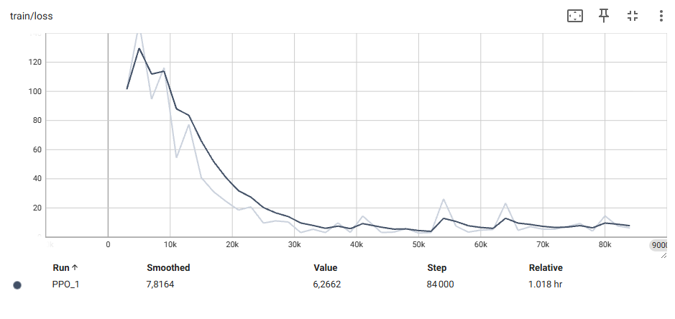
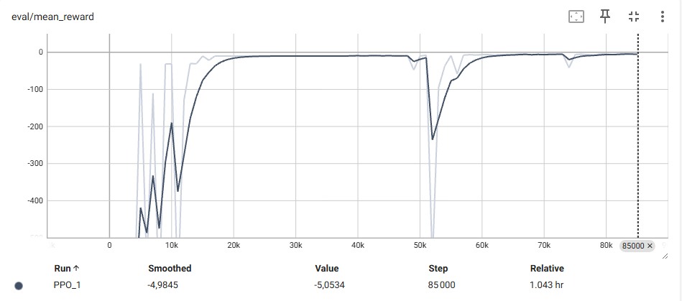
Output data
Evaluation logs
Proposed actions based on heuristic and expert knowledge
Diagram showing the performance of the agent
Tensorboard logs showing convergence informaiton and training losses

Slide 34
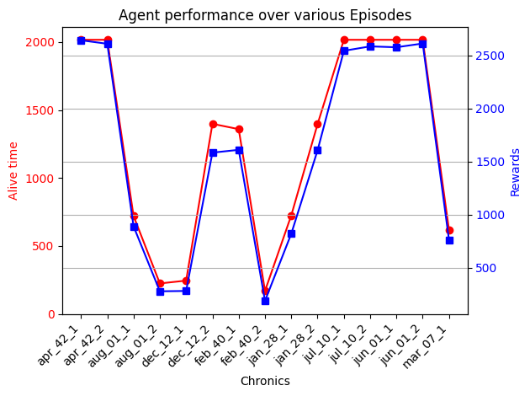
Experiment
Tested on 15 episodes of environment
ai4realnet_small

Slide 35
Perspectives
Extensive hyperparameter tuning of the RL model (PPO)
Integrate various variations of the environment (scenarios) during the training

Slide 36
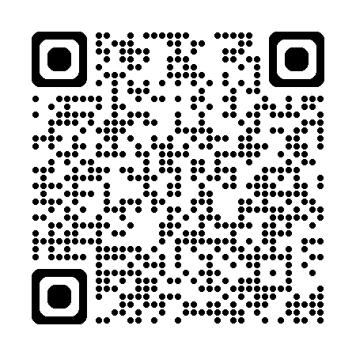
Link to the repository
AI4REALNET/T2.1_deep_expert: Expert Agent exploiting the expert knowledge during the training

