Slide 1
Graph Neural Solver: Power Grid
Power Grid domain
Milad Leyli-abadi, IRT SystemX

Slide 2
Outline
Context
Methodology
Original Contribution
Overview of code structure
Experiments

Slide 3
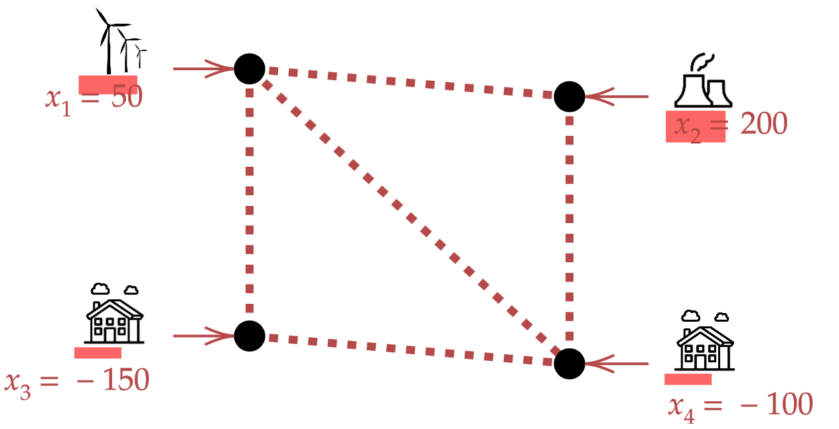
Context
Currently used physical simulators
Inputs / outputs
X = injections
(productions + loads)
T = topology
Numeric Solver
(physics model)
Y = power flows

Slide 4
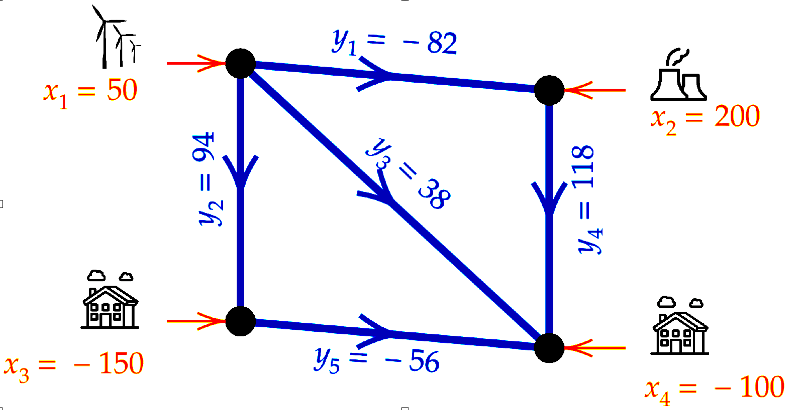
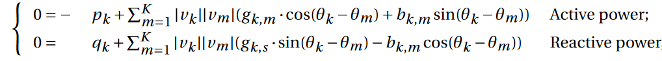
Context
Currently used physical simulators
Inputs / outputs
Characteristics
Relies on physics equations (Kirchhoff law), resolved by iterative optimization (Newton-Raphson)
Able to predict in a normal condition or different grid conditions
X = injections
(productions + loads)
T = topology
Numeric Solver
(physics model)
Y = power flows
Power Grid equations

Slide 5
Context
Need → Simulations allowing to predict the grid state in real time with respect to
Action (topological changes)
Exogenous factors (wind, temperature, anomalies, etc.)
Problem → Physics simulation are computationally intensive
Need to accelerate the simulation [x100 à x1000]
Solutions → Approximation of physical simulations using machine learning
The use of Physics Informed Neural Networks to ensure physics compliance
Objective → Trade-off between computation time and model’s quality
Accuracy
Acceleration

Slide 6
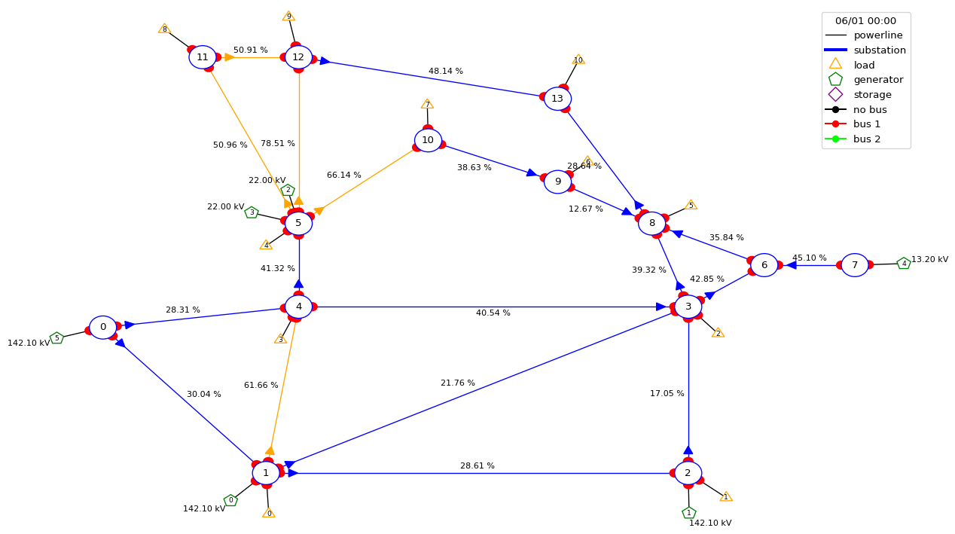
Problem setup
Physical simulator → DC approximation
Scenario → Risk identification (allowing the disconnection of power lines and topology reconfiguration)
Contribution → Predict the active powers at power lines using a Hybrid Machine-learning based model exploiting physical constraints (local conservation law)
Evaluation pipeline → Learning Industrial Physical Simulation (LIPS) framework with four categories of evaluation criteria
IEEE14 Power Grid

Slide 7

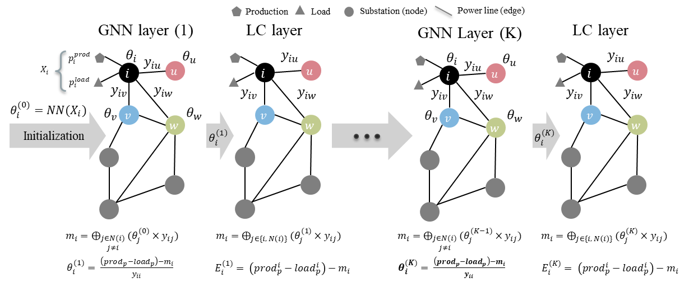
Methodology
Hybrid models : Physics Informed Graph Neural Networks (PIGNNs)

Slide 8
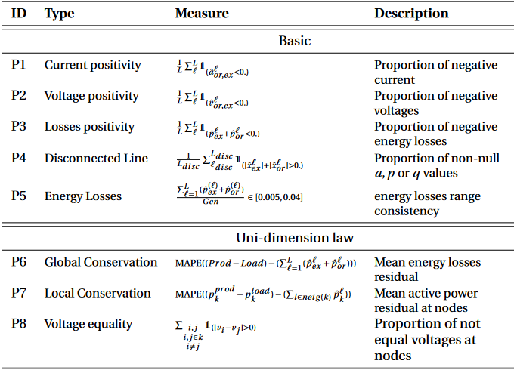
Original contribution
Compliance to physics criteria / laws by integrating the local conservation as the optimization criteria (non-supervised learning)

Slide 9
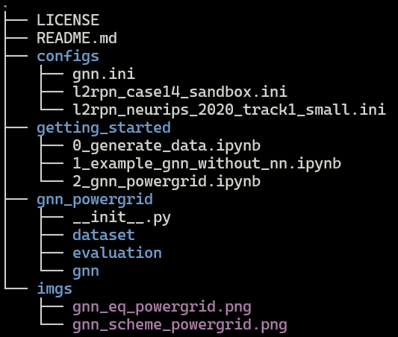
Overview of code structure
License (Mozilla Public License) that is used currently
General overview and instructions to install dependencies
Configurations files used for initializing scenarios (two different l2rpn environments) and also the models (gnn.ini)
Getting started jupyter notebooks providing examples to generate data and reproduce the results
The Physics Informed GNN package, including dataset, evaluation and gnn modules

Slide 10
Experiments
Results (The values are the violation percentage of the corresponding metric)
Test dataset | Loss target | Output | Disc lines | Loss pos | Energy loss consistency | Global conservation | Local conservation
FC | P | P | 0.0 | 43 | 0.0 | 88 | 91
GNN | Ө | P | 0.0 | 0.0 | 0.0 | 0.0 | 0.0
Test OOD dataset | Loss target | Output | Disc lines | Loss pos | Energy loss consistency | Global conservation | Local conservation
FC | P | P | 0.0 | 43 | 0.0 | 95 | 93
GNN | Ө | P | 0.0 | 0.0 | 0.0 | 0.0 | 3.08

Slide 11
Perspectives
Generalize the proposed approach for AC power flow simulation
The physics compliance integration could inspire the algorithm design for batch 2 focusing on a control problem using Deep Reinforcement Learning algorithms
Integrating the simplified physical equation and expert knowledge into RL agents which should suggest remedial actions with respect to observed context (environment)

