Slide 1
Graph Neural Solver: Power Grid
Task 2.1 – Knowledge-assisted AI
IRT SystemX

Slide 2
Outline
Context
Methodology
Original Contribution
Overview of code structure
Experiments

Slide 3
Context
Definition
Graph Neural Solver is a machine learning algorithm assisted (informed) by physics knowledge for compliance to physical constraints imposed in a Power Grid
Motivation
Each industrial domain has its set of constraints that should be respected in addition to classical machine learning evaluation criteria, and this implementation allows to integrate these constraints in the loss function of the Neural Networks
Use cases
This implementation is specific to Power Grid domain and enables the prediction of active powers from the injections in the substations (nodes of the graph). It could motivate the future implementations for decision-making in the context of RL and specifically the following power grid usecase: “Power Grid Assistant”

Slide 4
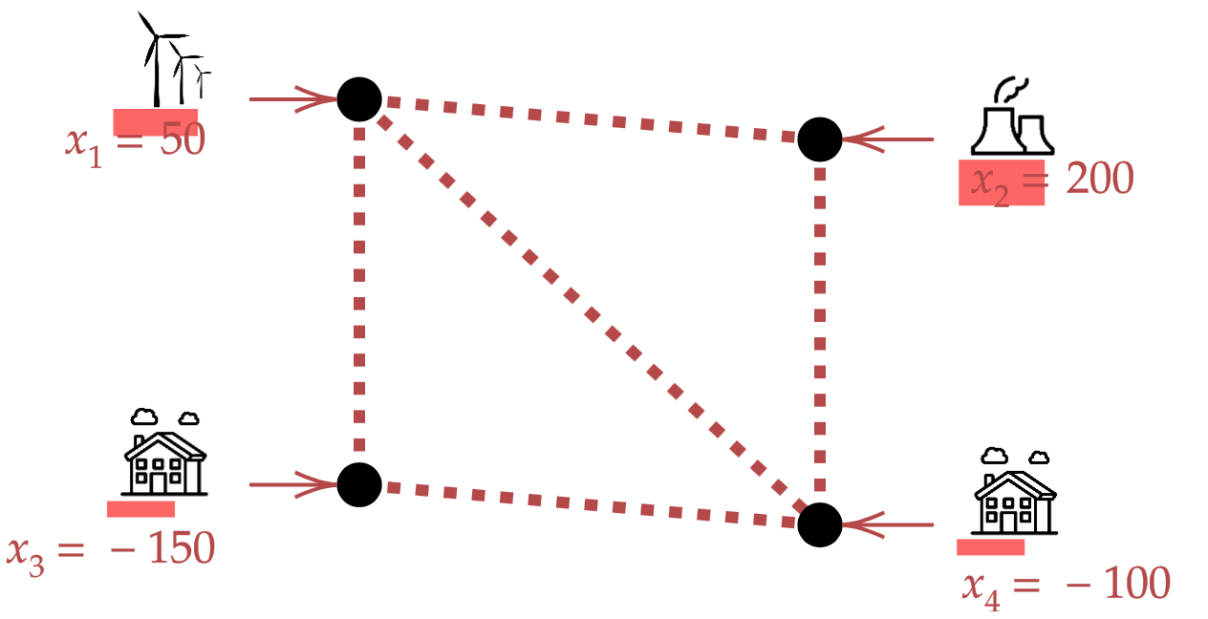
Context
Currently used physical simulators
Inputs / outputs
X = injections
(productions + loads)
T = topology
Numeric Solver
(physics model)
Y = power flows

Slide 5
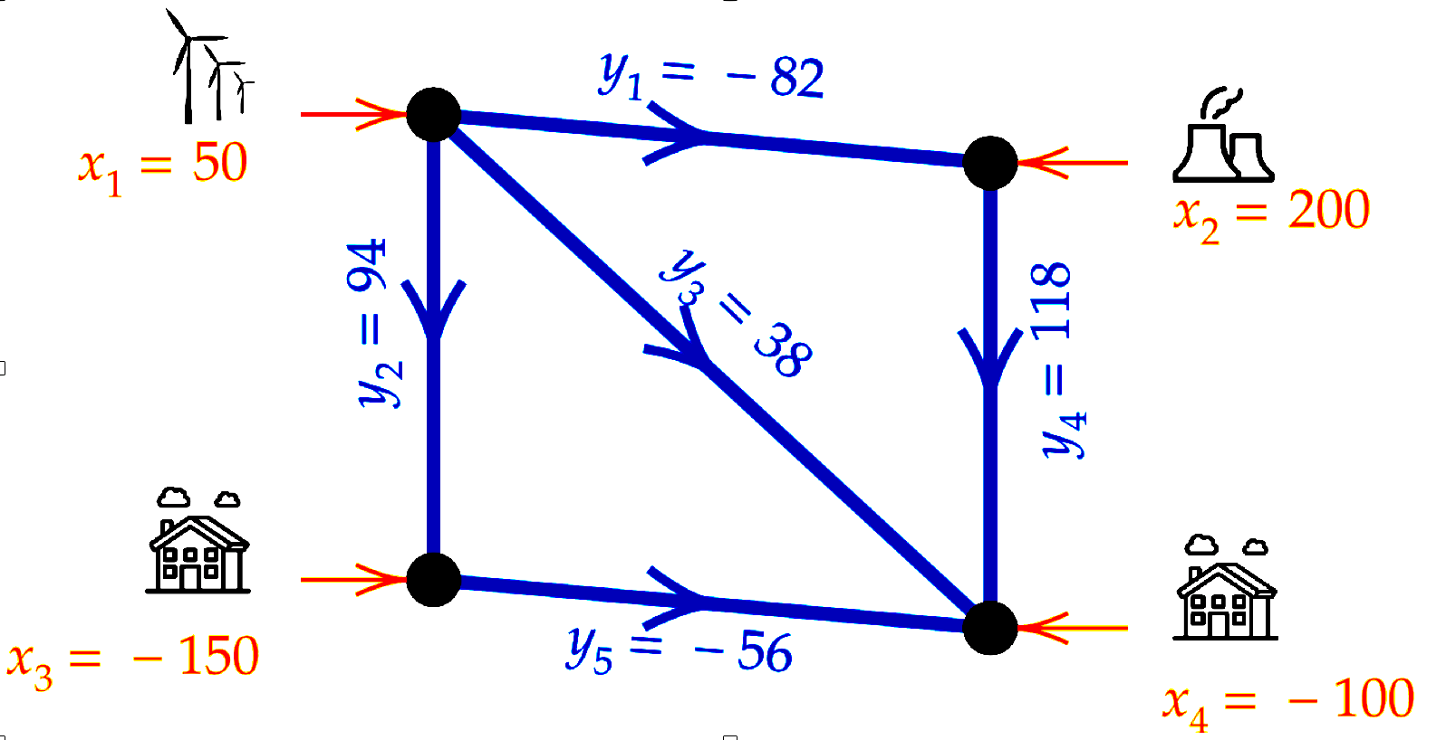
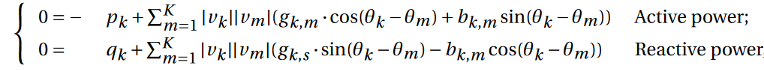
Context
Currently used physical simulators
Inputs / outputs
Characteristics
Relies on physics equations (Kirchhoff law), resolved by iterative optimization (Newton-Raphson)
Able to predict in a normal condition or different grid conditions
X = injections
(productions + loads)
T = topology
Numeric Solver
(physics model)
Y = power flows
Power Grid equations

Slide 6
Context
Need → Simulations allowing to predict the grid state in real time with respect to
Action (topological changes)
Exogenous factors (wind, temperature, anomalies, etc.)
Problem → Physics simulation are computationally intensive
Need to accelerate the simulation [x100 à x1000]
Solutions → Approximation of physical simulations using machine learning
The use of Physics Informed Neural Networks to ensure physics compliance
Objective → Trade-off between computation time and model’s quality
Accuracy
Acceleration

Slide 7
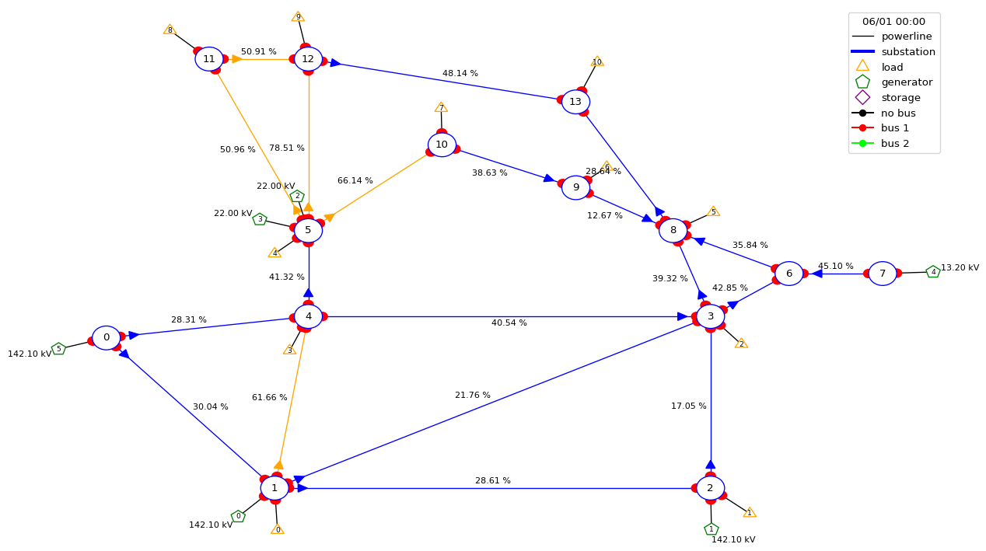
Problem setup
Physical simulator → DC approximation
Scenario → Risk identification (allowing the disconnection of power lines and topology reconfiguration)
Contribution → Predict the active powers at power lines using a Hybrid Machine-learning based model exploiting physical constraints (local conservation law)
Evaluation pipeline → Learning Industrial Physical Simulation (LIPS) framework with four categories of evaluation criteria
IEEE14 Power Grid

Slide 8
Methodology
Main idea = Consider a physical constraint as the objective function of Neural Networks (GNN) that should be optimized during the training and used for the estimation of the parameters
Generate a set of synthetic data using the Data Module
Use the Graph Neural Solver to learn from the data (injections, voltage angles)
Evaluate the performance using a set of 4 categories of evaluation criteria
A physics informed neural network to optimize on local conservation law
Benchmarking enabled using LIPS framework
Preliminary experiments on a toy usecase which could inspire the future works for AI4REALNET usecases on how include the physics knowledge in the learning algorithms

Slide 9

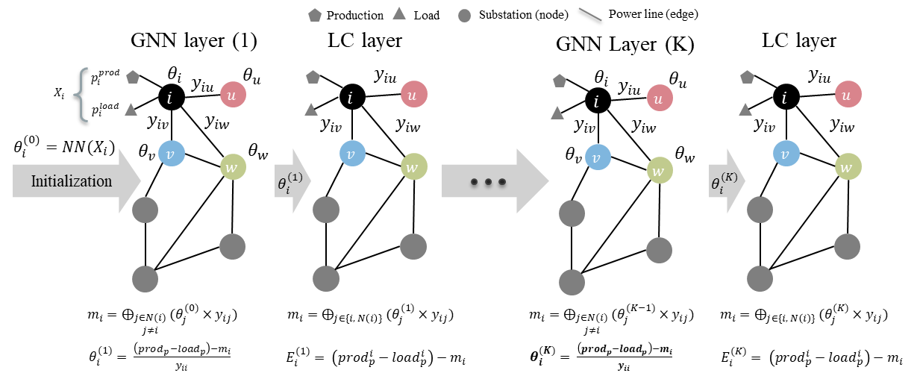
Methodology
Hybrid models : Physics Informed Graph Neural Networks (PIGNNs)

Slide 10
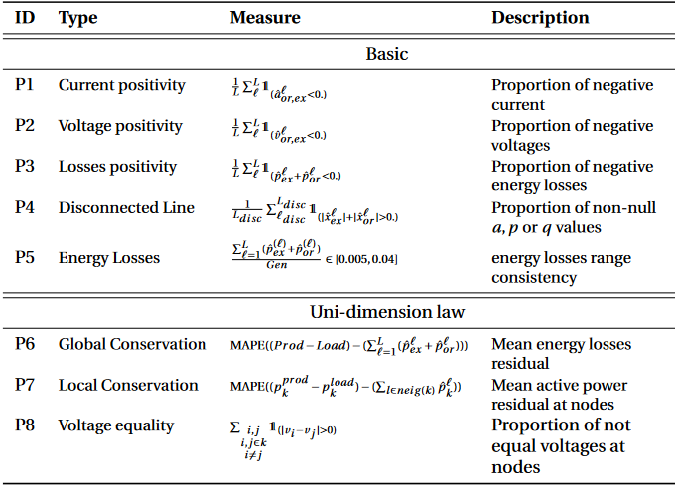
Original contribution
Compliance to physics criteria / laws by integrating the local conservation as the optimization criteria (non-supervised learning)

Slide 11
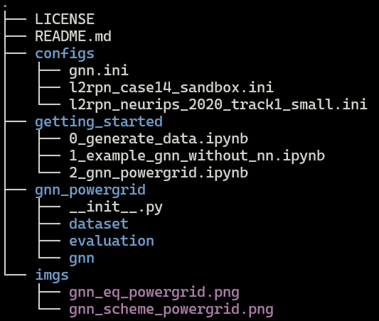
Overview of code structure
License (Mozilla Public License) that is used currently
General overview and instructions to install dependencies
Configurations files used for initializing scenarios (two different l2rpn environments) and also the models (gnn.ini)
Getting started jupyter notebooks providing examples to generate data and reproduce the results
The Physics Informed GNN package, including dataset, evaluation and gnn modules

Slide 12
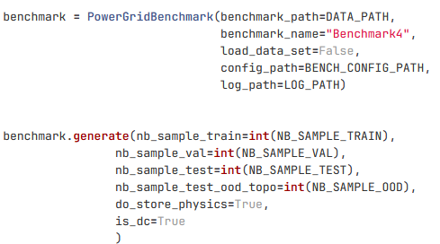
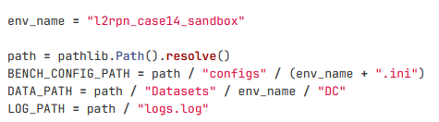
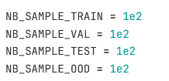
Input data
The data generated using a configuration file associated with a specific environment (2 envs):
L2RPN_case14_sandbox: A toy environment including 14 nodes and 20 power lines
l2rpn_neurips_2020_track1_small: A more complex environment including 38 nodes
The environment to use and paths to the cofiguration and dataset directory
The script to generate the dataset
Specify the number of required data

Slide 13
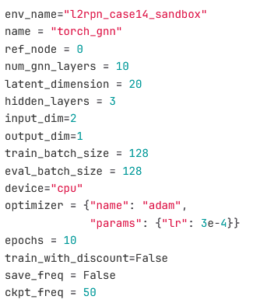
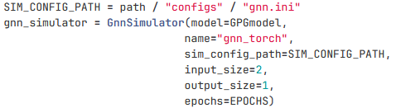
Input data
The hyperparameters of the graph neural solver to be adjusted using two methods:
Using an existing configuration file
Set them directly as arguments at the instantiation step which will override the ones imported by configuration file
All these configs could be set as arguments in class constructor

Slide 14
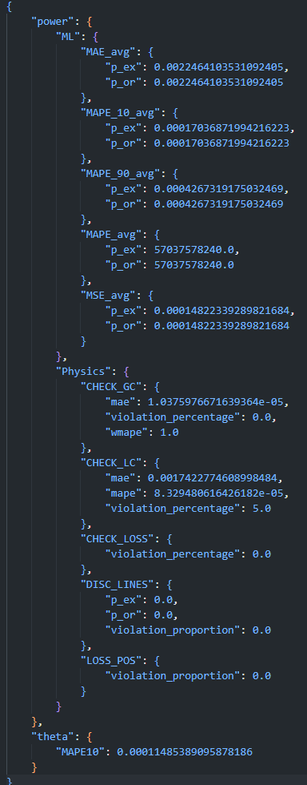
Output data
Obtained using main_wo_nn.py
The outputs are evaluated criteria (ML & Physics) on the considered datasets
Validation dataset: dataset used for validation with the same distribution as training
Test dataset: dataset used for test presenting the same distribution as training data
Test OOD dataset: dataset used for test the out-of-distribution generalization capacity of the model
Machine Learning related criteria
(accuracy measures)
Physics compliance criteria
(physics constraints)
Quality of voltage angle estimation

Slide 15
Authors
Authors | Institution
Milad Leyli-abadi | IRTSX (IRT SystemX)

Slide 16
Experiments
Results (The values are the violation percentage of the corresponding metric)
Test dataset | Loss target | Output | Disc lines | Loss pos | Energy loss consistency | Global conservation | Local conservation
FC | P | P | 0.0 | 43 | 0.0 | 88 | 91
GNN | Ө | P | 0.0 | 0.0 | 0.0 | 0.0 | 0.0
Test OOD dataset | Loss target | Output | Disc lines | Loss pos | Energy loss consistency | Global conservation | Local conservation
FC | P | P | 0.0 | 43 | 0.0 | 95 | 93
GNN | Ө | P | 0.0 | 0.0 | 0.0 | 0.0 | 3.08

Slide 17
Perspectives
Improve the implementation of neural network based GNN which requires more training and layers to achieve the same performance as the GNN without NN
Generalize the proposed approach for AC power flow simulation
The physics compliance integration could inspire the algorithm design for batch 2 focusing on a control problem using Deep Reinforcement Learning algorithms
Integrating the simplified physical equation and expert knowledge into RL agents which should suggest remedial actions with respect to observed context (environment)

