Slide 1
Graph Neural Solver: Power Grid
Power Grid domain
Milad Leyli-abadi, IRT SystemX

Slide 2
Outline
Context
Methodology
Original Contribution
Overview of code structure
Experiments

Slide 3
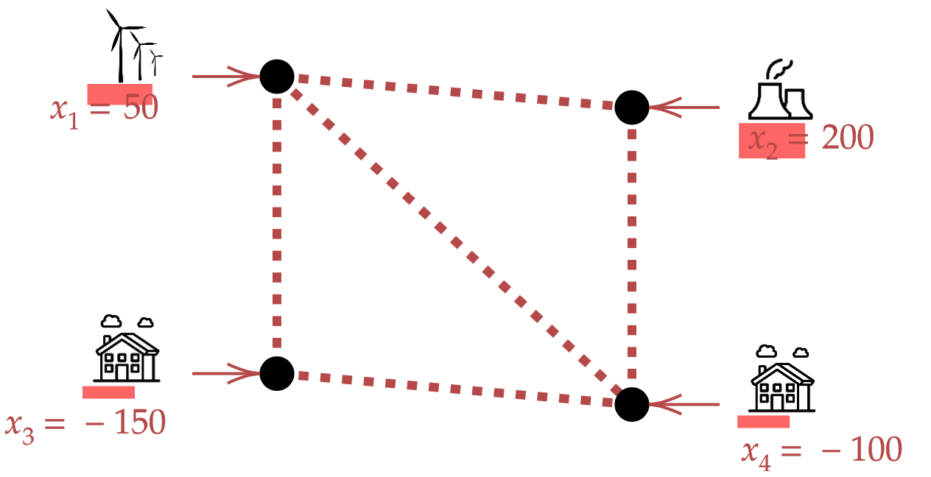
Context
Currently used physical simulators
Inputs / outputs
X = injections
(productions + loads)
T = topology
Numeric Solver
(physics model)
Y = power flows

Slide 4
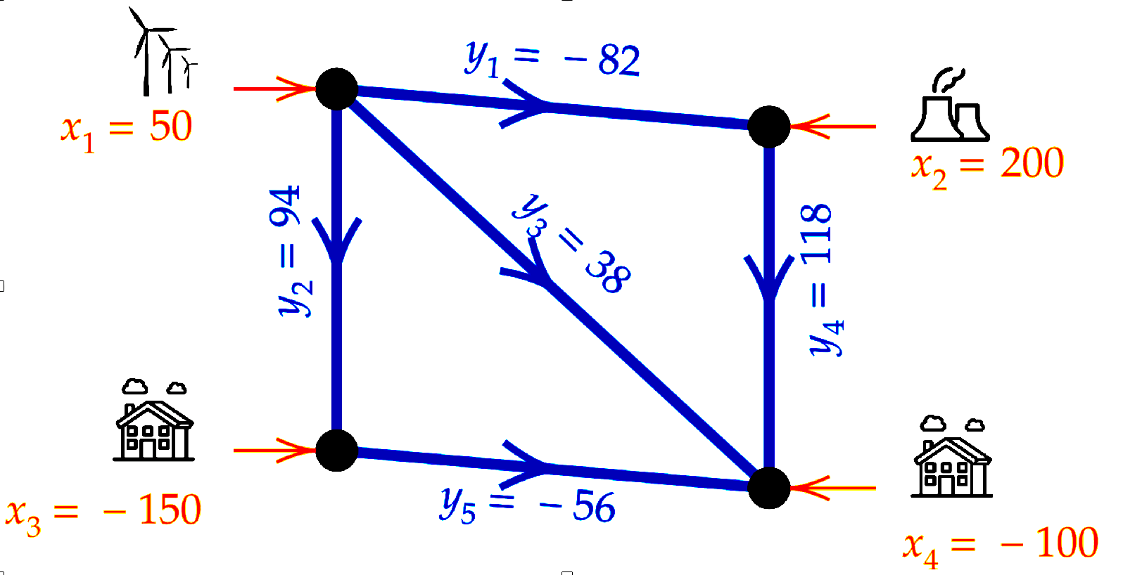
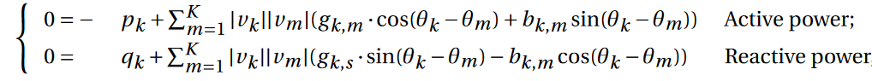
Context
Currently used physical simulators
Inputs / Outpus
Characteristics
Relies on physics equations (Kirchhoff law), resolved by iterative optimization (Newton-Raphson)
Able to predict in a normal condition or different grid conditions
X = injections
(productions + loads)
T = topology
Numeric Solver
(physics model)
Y = power flows
Power Grid equations

Slide 5

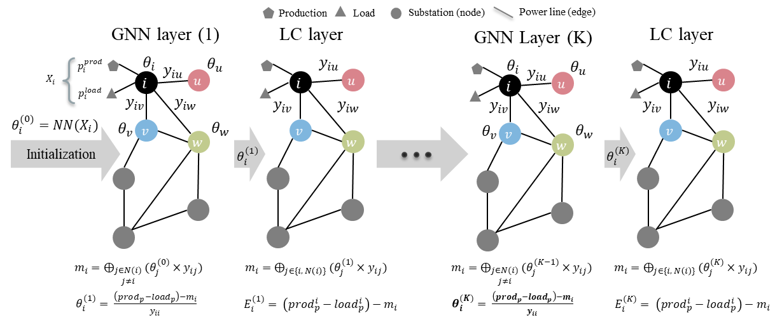
Methodology
Hybrid models : Physics Informed Graph Neural Networks (PIGNNs)

Slide 6
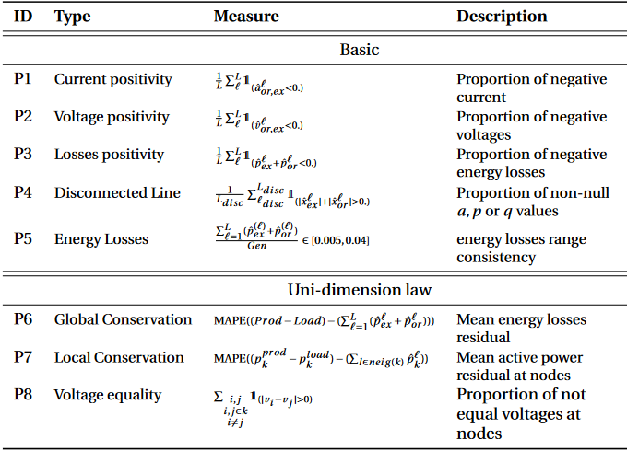
Original contribution
Physics criteria/law to respect

Slide 7
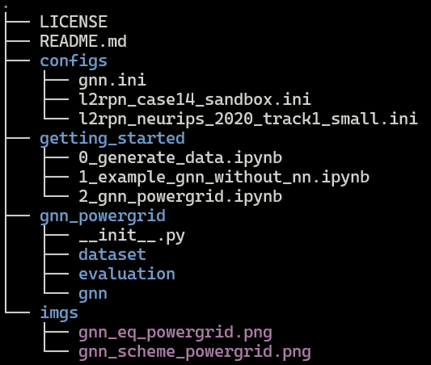
Overview of code structure
Configurations files used for initializing scenarios (two different l2rpn environments) and also the models (gnn.ini)
Getting started jupyter notebooks providing examples to generate data and reproduce the results
The Physics Informed GNN package, including dataset, evaluation and gnn modules

Slide 8
Experiments
Results (The values are the violation percentage of the corresponding metric)
Test dataset | Loss target | Output | Disc lines | Loss pos | Energy loss consistency | Global conservation | Local conservation
FC | P | P | 0.0 | 43 | 0.0 | 88 | 91
GNN | Ө | P | 0.0 | 0.0 | 0.0 | 0.0 | 0.0
Test OOD dataset | Loss target | Output | Disc lines | Loss pos | Energy loss consistency | Global conservation | Local conservation
FC | P | P | 0.0 | 43 | 0.0 | 95 | 93
GNN | Ө | P | 0.0 | 0.0 | 0.0 | 0.0 | 3.08

Slide 9
at least 1 algorithm per Task to be published in the repo
validation on project use-cases is recommended

