Slide 1
Explainability Dashboard
Task 2.3.1 – Explainable and safe AI
IRT SystemX

Slide 2
Outline
Context
Methodology
Original Contribution
Overview of code structure
Experiments

Slide 3
Context
Definition
Explainability dashboard provides a set of statistical measures and visualizations to make the AI agent decisions explainable, while providing guidance to user to ensure the safety.
Motivation
This dashboard supports understanding by connecting the recommendations to expert knowledge and complementing them with statistical analysis, visualizations, and brief explanations.
Use cases
This implementation is specific to Power Grid domain and power grid assistant use case. It serves as a companion tool for the AI agents developed in Task 2.1 (knowledge-assisted AI). In this use case, AI assistant supports human operators in decision-making and managing power grid congestion by suggesting remedial actions.

Slide 4
Methodology
Main idea = leverage expert knowledge (using the ExpertOp4Grid package [1]) to explain and monitor the decisions made by AI agents and measure their relevance.
AI agents providing recommendaitons and a scenario
Explainability panel provides guidance towards the relevance of the actions
Human operators can build trust in the AI agents by monitoring their performance in operation
An AI agent recommends the actions to reduce the overload and maintain stability
Preliminary experiments on Power Grids, but could easily be extended to other doamins if the expert knowledge is available
[1]

Slide 5
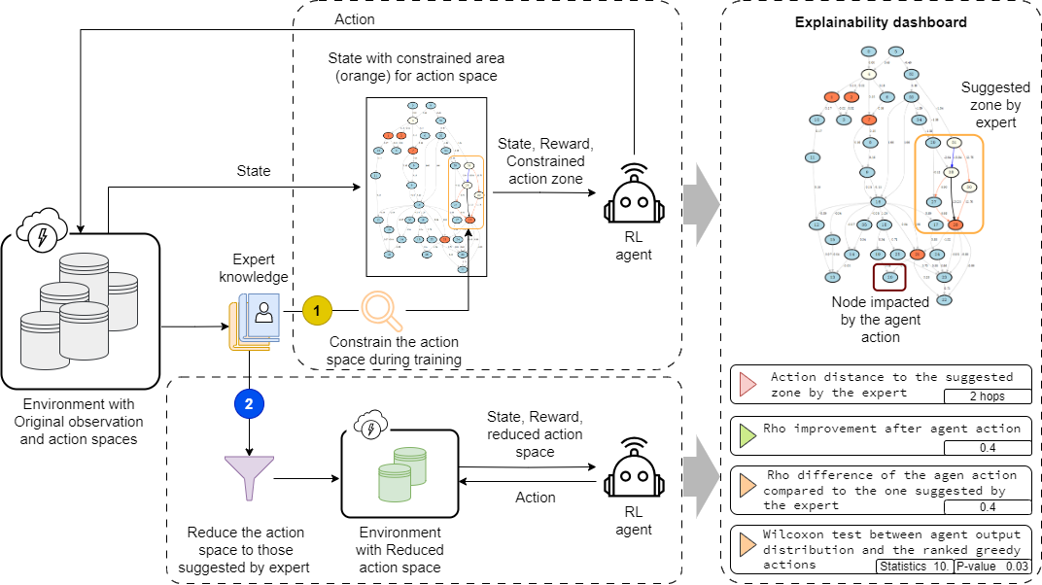
Schematic representation of the panel
Task 2.1
(See T2.1_KAI_ExpertAgent.pptx)
Task 2.3
(current)
Main idea = Monitor the AI recommendation
  AI Agent: focus the exploration phase of an RL agent on specific zones of a power grid
  AI Agent: reduce the action space to most relevant ones and improve the scalability or RL agents
  Explainability Dashboard to analyze the AI agents ( , ) recommendations
3
1
Task 2.1
2
Task 2.3
(current)
3
1
2

Slide 6
Original contribution
Dashboard | Explainability
Short description: Explaining the AI agent recommendation by harnessing expert knowledge
State-of-the-art: Most of the explainability tools are generic and could not be used for specific use cases such as power grids
Contribution: Exploitation of expert knowledge to enhance the trust towards the AI agent recommendations and develop domain-specific (Power Grids) explainability tool
Implemented WP2 features: Knowledge-assisted RL, Explainability through the analysis of expert knowledge

Slide 7


Overview of code structure
The provided repository includes a python package implementing the interface using Dash library
T2.3_explainability_panel
Dash interface
ressources
ai4realnet_small
Gym environment for power grids
explainability_panel
The dashboard source files and scripts
Callbacks
Set of callbacks for buttons and actions
…
explainability.py
The app file to be executed using python command
Services including the import of AI agent and environment and some utility functions
services.py
LICENSE
Mozilla Public License 2.0
README.md
README file including instruction for installation

Slide 8



Inputs and requirements
RL agent → For the moment the explainability tool is adapted for the agents developed in Taks 2.1 of the project (knoweldge-assisted AI)
  These agents could be installed as a package by cloning the corresponding Github repository
RL environment → Using the Power Grid scenario designed for AI4REALNET project (ai4realnet_small)
  This scenario could be obtained using the corresponding Github repository
Dependecies → Installing the dependencies for this package using the requirements file provided in the Github repository

Slide 9
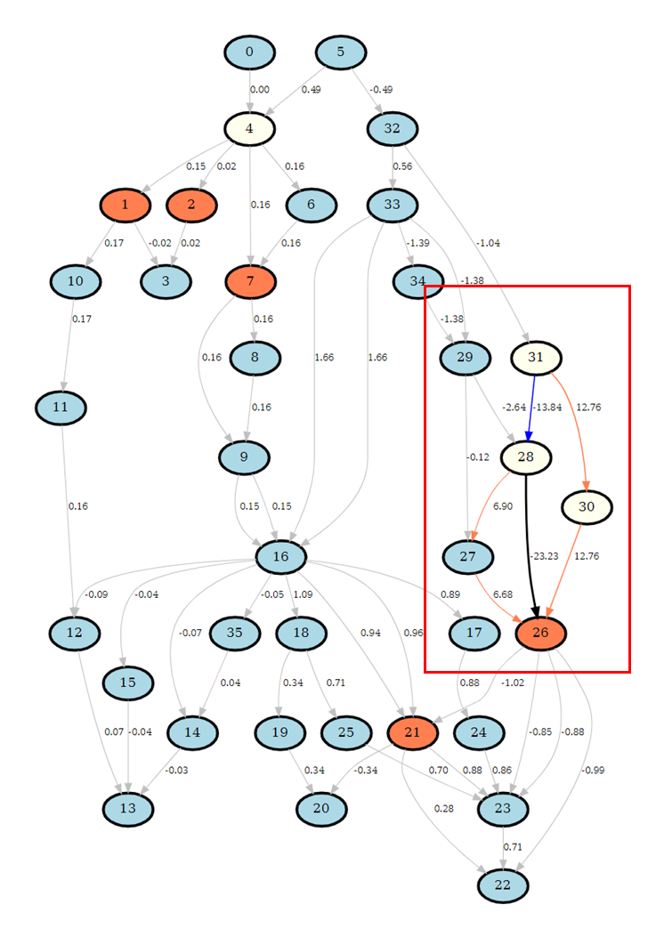
Dashboard presentation
Suggesting a panel to follow up the agent decision with some statistics and visualizations
Statistics
Visualization
Multiple sources of information
Agent action distance to the expert knowledge :
→ This information shows that the agent takes an action which is outside the zone that may be suggested by an expert method
2 hops
Rho improvement:
0.4
Expert Interest Zone
Rho difference wrt. the expert action:
→ The agent’s action improves the Rho value (overload) by 0.4 points but is sub-optimal wrt. Expert action.
0.2
Wilcoxon test between the agent output distribution and the ranked greedy actions:
→ Wilcoxon test shows that agent’s output distribution is significantly (95% confidence) different from optimal greedy action.
Statistic
10.
P-value
0.03
Node impacted by the agent action

Slide 10
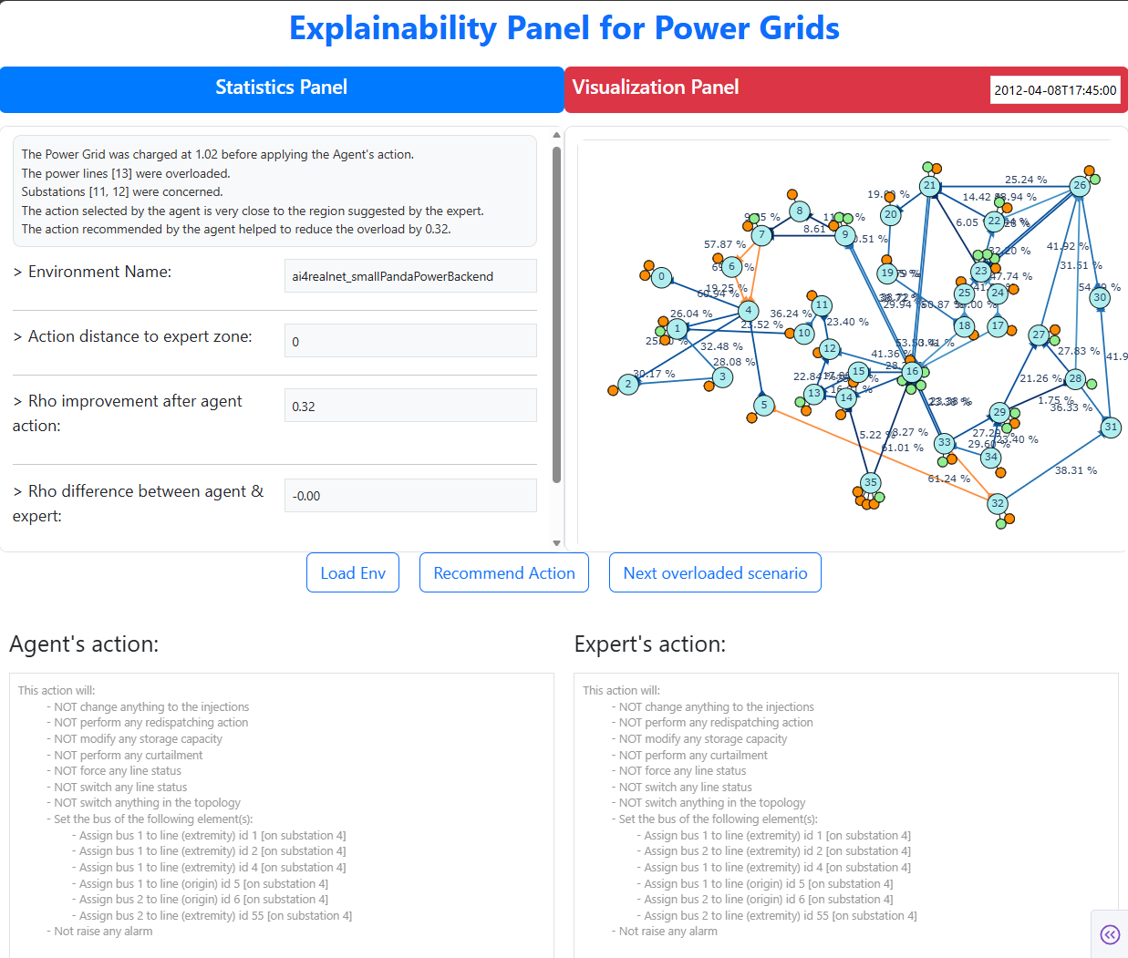
Explainability dashboard – how to use
Textual explanation provided to user based on statistics or power grid current state and the state after the application of AI recommendation
Fast forward to the next overload scenario on the power grid
Two functionalities
Load the environment for the first time
Return to the first time-stamp
Two functionalities
Progress in scenario (next time stamp)
Take a recommendation from AI agent
Expert action obtained using ExpertOp4Grid package
AI Agent’s
action

Slide 11
Perspectives
Generate explanation using LLM
Extend to other AI agents and ability to import AI agents via API
Enabling the change of environment and scenarios during the analysis

Slide 12
Authors
Authors | Institution
Milad Leyli-abadi | IRTSX (IRT SystemX)

Slide 13
Link to the repository
AI4REALNET/T2.3_explainability_dashboard: The explainability panel for RL agents and Power Grid use case

