Slide 1
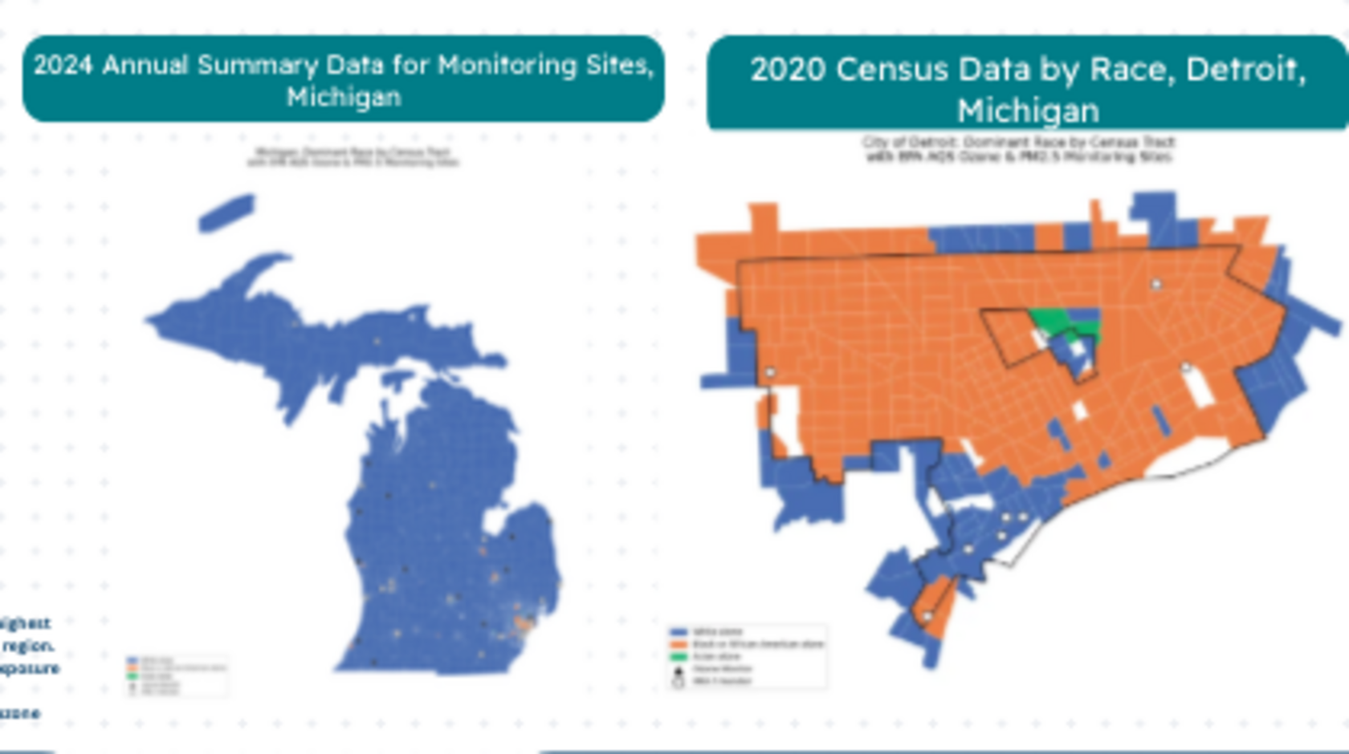
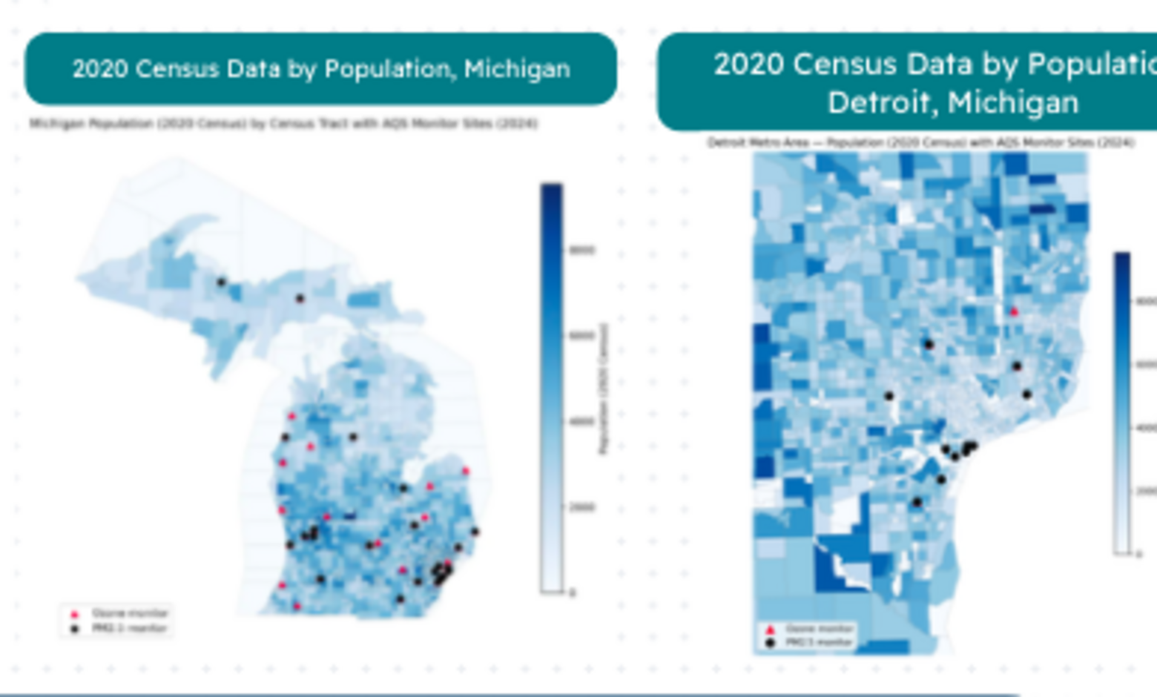
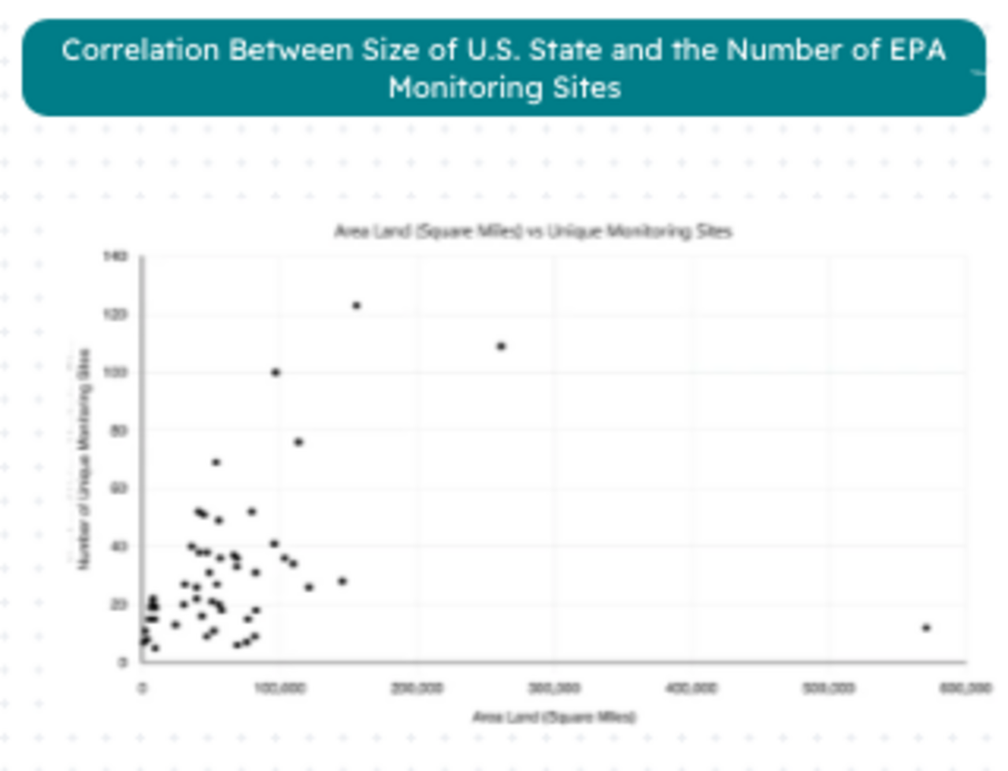
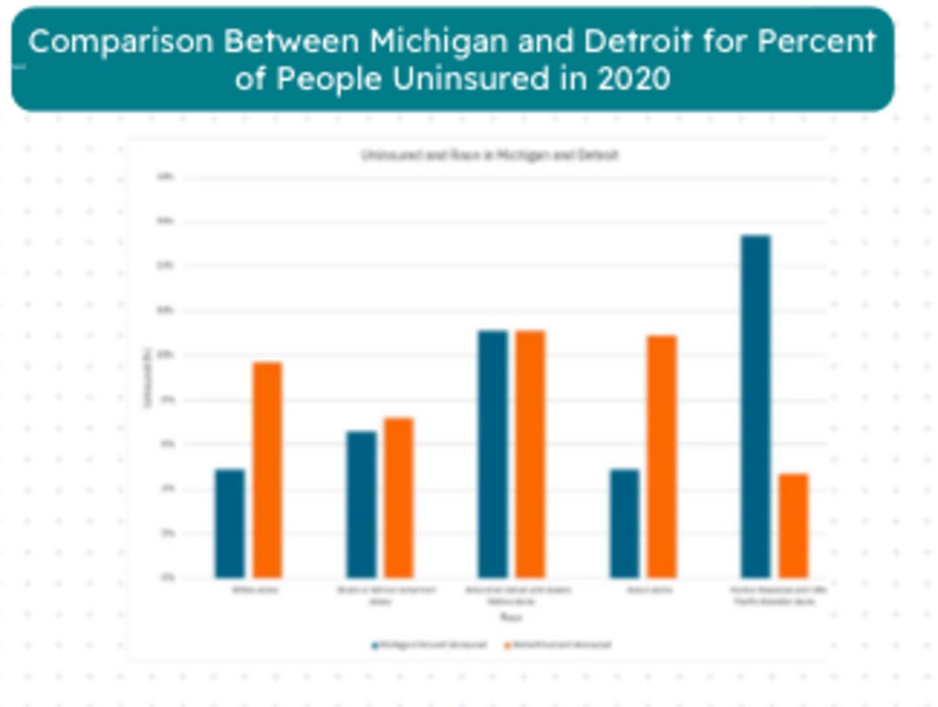
Detroit Monitoring Coverage Misses Community Patterns
Demographics, population distribution, and environmental-justice implications
Who lives near the monitoring network?
Race and monitoring locations
Population and monitoring locations
What disparities emerge?
More land area does not mean more monitors
Race, insurance, and vulnerability
IMPLICATION
The weak relationship suggests that monitoring coverage is uneven and cannot be explained by state size alone.
Reduced healthcare access may intensify the consequences of air-pollution exposure for some Detroit residents.
Monitoring should better represent where people live and where exposure burdens are greatest.
Detroit Air Quality Analysis • Group 1
POSTER 2 OF 2

