Slide 1
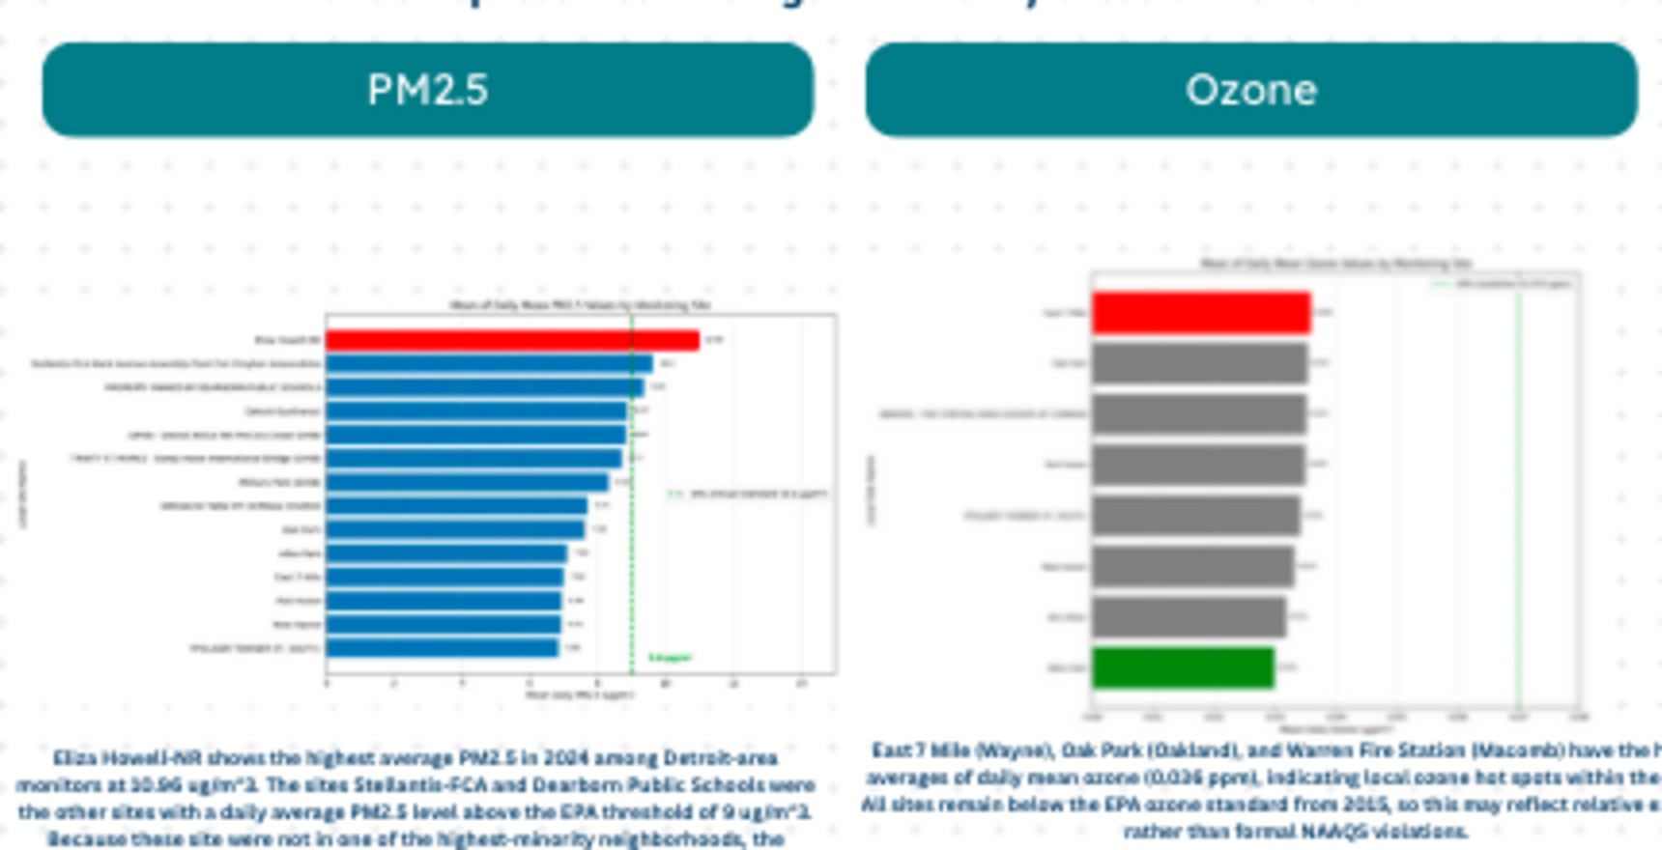
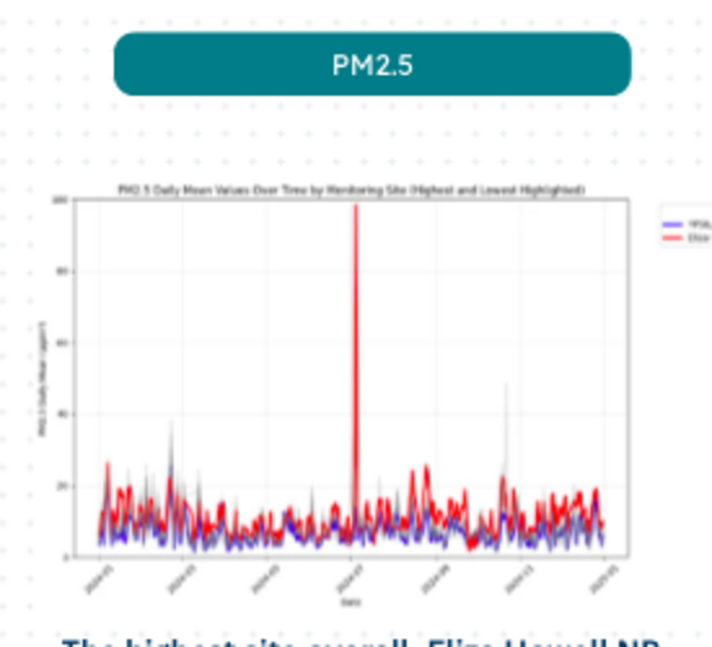
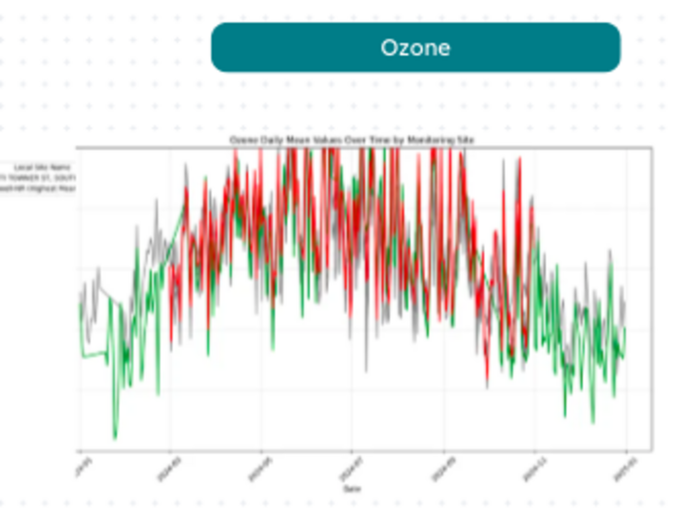
Detroit’s Air Quality Varies Sharply by Site and Season
PM2.5 and ozone monitoring patterns across Detroit-area locations
Where are the highest measurements?
KEY FINDING
A small number of sites drive the highest observed readings.
Eliza Howell shows the highest average PM2.5 among the sites analyzed. East 7 Mile and Oak Park rank among the highest for ozone.
How do concentrations change over time?
PM2.5: highest vs. lowest site
Ozone: highest vs. lowest site
The highest site shows a pronounced July spike; otherwise, the two series are generally comparable.
Ozone follows a seasonal pattern at both sites, with the clearest separation occurring when the lower site declines in winter.
Detroit Air Quality Analysis • Group 1
POSTER 1 OF 2

