Slide 1
Back Propagation
Back propagation (backward propagation of errors) uses gradient descent to update the weights, in an attempt to minimize the loss function. Backpropagation tries to optimize the inter-neuron weights
The combination of weights which minimizes the error function is considered to be a solution of the learning problem.
Notes:
1000 images to be classified. If we pass 10 images once, the batch size is 10 and 1 epoch will be when all the images have been passed through i.e. 100 batches have passed through.The number of epochs is the number of complete passes through the training dataset.

Slide 2
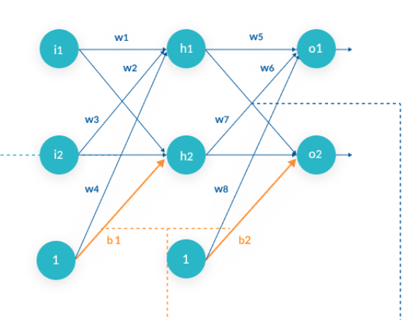
Back Propagation
The backpropagation algorithm calculates how much the final output values, o1 and o2, are affected by each of the weights. To do this, it calculates partial derivatives, going back from the error function to the neuron that carried a specific weight.
Backpropagation goes in the opposite direction:
total errors → affected by output o2 → affected by total input of neuron o2 → affected by neuron h1 with weight w6
Notes:
1000 images to be classified. If we pass 10 images once, the batch size is 10 and 1 epoch will be when all the images have been passed through i.e. 100 batches have passed through.The number of epochs is the number of complete passes through the training dataset.

Slide 3
Back Propagation
The algorithm calculates three derivatives:
The derivative of total errors with respect to output o2
The derivative of output o2 with respect to total input of neuron o2
Total input of neuron o2 with respect to neuron h1 with weight w6
This gives us complete traceability from the total errors, all the way back to the weight w6.
Using the Leibniz Chain Rule, it is possible to calculate, based on the above three derivatives, what is the optimal value of w6 that minimizes the error function.
Notes:
1000 images to be classified. If we pass 10 images once, the batch size is 10 and 1 epoch will be when all the images have been passed through i.e. 100 batches have passed through.The number of epochs is the number of complete passes through the training dataset.

Slide 4
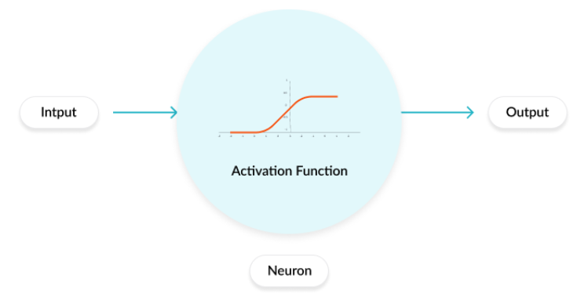
Activation Functions
In a neural network, numeric data points, called inputs, are fed into the neurons in the input layer. Each neuron has a weight, and multiplying the input number with the weight gives the output of the neuron, which is transferred to the next layer.
The activation function is a mathematical “gate” in between the input feeding the current neuron and its output going to the next layer.
Activation functions can be linear or nonlinear.

Slide 5
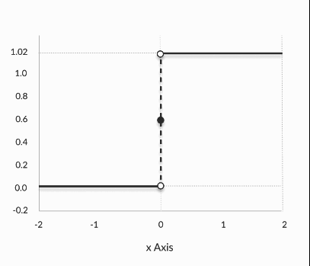
Binary Activation Functions
A binary step function is a threshold-based activation function. If the input value is above or below a certain threshold, the neuron is activated and sends exactly the same signal to the next layer.

Slide 6

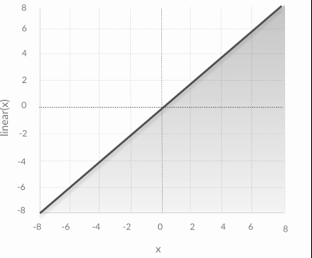
Linear Activation Functions
A linear activation function takes the form: It takes the inputs, multiplied by the weights for each neuron, and creates an output signal proportional to the input. A linear function is recommended over a step function as it allows multiple outputs.
Equation : f(x) = x
Range : (-infinity to infinity)
It doesn’t help with the complexity or various parameters of usual data that is fed to the neural networks.
Notes:
However, a linear activation function has two major problems:
1. Not possible to use backpropagation (gradient descent) to train the model—the derivative of the function is a constant, and has no relation to the input, X. So it’s not possible to go back and understand which weights in the input neurons can provide a better prediction.
All layers of the neural network collapse into one—with linear activation functions, no matter how many layers in the neural network, the last layer will be a linear function of the first layer (because a linear combination of linear functions is still a linear function). So a linear activation function turns the neural network into just one layer.
A neural network with a linear activation function is simply a linear regression model. It has limited power and ability to handle complexity varying parameters of input data.

Slide 7
Nonlinear Activation Functions
The Nonlinear Activation Functions are the most used activation functions.
It makes it easy for the model to generalize or adapt with variety of data and to differentiate between the output.
The main terminologies needed to understand for nonlinear functions are:
Derivative or Differential: Change in y-axis w.r.t. change in x-axis.It is also known as slope.
Monotonic function: A function which is either entirely non-increasing or non-decreasing.
The Nonlinear Activation Functions are mainly divided on the basis of their range or curves
Notes:
They allow backpropagation because they have a derivative function which is related to the inputs.
They allow “stacking” of multiple layers of neurons to create a deep neural network. Multiple hidden layers of neurons are needed to learn complex data sets with high levels of accuracy.

Slide 8
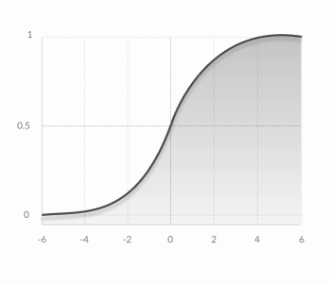

Nonlinear Activation Functions
Sigmoid/Logistic
The main reason why we use sigmoid function is because it exists between (0 to 1). Therefore, it is especially used for models where we have to predict the probability as an output.Since probability of anything exists only between the range of 0 and 1, sigmoid is the right choice.
The function is differentiable.That means, we can find the slope of the sigmoid curve at any two points.
The function is monotonic but function’s derivative is not.
The logistic sigmoid function can cause a neural network to get stuck at the training time.
The softmax function is a more generalized logistic activation function which is used for multiclass classification
Notes:
They allow backpropagation because they have a derivative function which is related to the inputs.
They allow “stacking” of multiple layers of neurons to create a deep neural network. Multiple hidden layers of neurons are needed to learn complex data sets with high levels of accuracy.

Slide 9
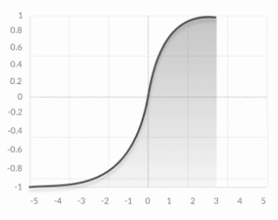

Nonlinear Activation Functions
tanh
tanh is also like logistic sigmoid but better. The range of the tanh function is from (-1 to 1). tanh is also sigmoidal (s - shaped).
The advantage is that the negative inputs will be mapped strongly negative and the zero inputs will be mapped near zero in the tanh graph.
The function is differentiable.
The function is monotonic while its derivative is not monotonic.
The tanh function is mainly used classification between two classes.
Notes:
They allow backpropagation because they have a derivative function which is related to the inputs.
They allow “stacking” of multiple layers of neurons to create a deep neural network. Multiple hidden layers of neurons are needed to learn complex data sets with high levels of accuracy.

Slide 10
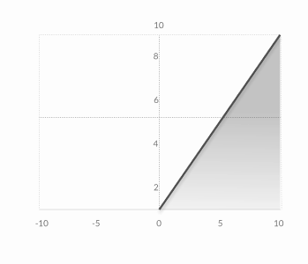
Nonlinear Activation Functions
ReLU (Rectified Linear Unit)
The ReLU is the most used activation function in the world right now.Since, it is used in almost all the convolutional neural networks or deep learning.
As you can see, the ReLU is half rectified (from bottom). f(z) is zero when z is less than zero and f(z) is equal to z when z is above or equal to zero.
Range: [ 0 to infinity)
The function and its derivative both are monotonic.
But the issue is that all the negative values become zero immediately which decreases the ability of the model to fit or train from the data properly. That means any negative input given to the ReLU activation function turns the value into zero immediately in the graph, which in turns affects the resulting graph by not mapping the negative values appropriately.
Notes:
They allow backpropagation because they have a derivative function which is related to the inputs.
They allow “stacking” of multiple layers of neurons to create a deep neural network. Multiple hidden layers of neurons are needed to learn complex data sets with high levels of accuracy.

Slide 11
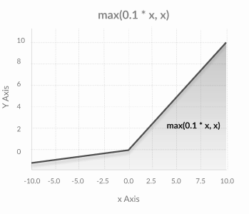
Nonlinear Activation Functions
Leaky ReLU
This variation of ReLU has a small positive slope in the negative area, so it does enable backpropagation, even for negative input values
Therefore the range of the Leaky ReLU is (-infinity to infinity).
Notes:
They allow backpropagation because they have a derivative function which is related to the inputs.
They allow “stacking” of multiple layers of neurons to create a deep neural network. Multiple hidden layers of neurons are needed to learn complex data sets with high levels of accuracy.

Slide 12
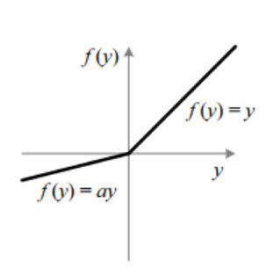
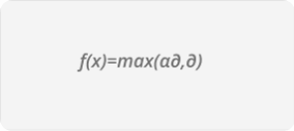
Nonlinear Activation Functions
Parametric ReLU
unlike leaky ReLU, PReLU provides the slope of the negative part of the function as an argument. It is, therefore, possible to perform backpropagation and learn the most appropriate value of α.
Notes:
They allow backpropagation because they have a derivative function which is related to the inputs.
They allow “stacking” of multiple layers of neurons to create a deep neural network. Multiple hidden layers of neurons are needed to learn complex data sets with high levels of accuracy.

Slide 13
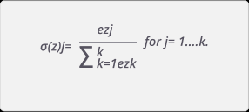
Nonlinear Activation Functions
Softmax
Able to handle multiple classes. normalizes the outputs for each class between 0 and 1, and divides by their sum, giving the probability of the input value being in a specific class. Softmax is used only for the output layer, for neural networks that need to classify inputs into multiple categories
Notes:
They allow backpropagation because they have a derivative function which is related to the inputs.
They allow “stacking” of multiple layers of neurons to create a deep neural network. Multiple hidden layers of neurons are needed to learn complex data sets with high levels of accuracy.

