Slide 1
Sequence Form
Non-technical theory (thanks to Weiran Shi)

Slide 2
Outline
Overview
Sequence form
Computing equilibria
Summary

Slide 3


Overview | Sequence form | Computing equilibria | Summary
History
Prof. Bernhard von Stengel
Introduce sequence form and its application to computing equilibria (1996)
Prof. Daphne Koller
Similar idea (1992)
Computing equilibria for two-player general sum games (1996)

Slide 4
Overview | Sequence form | Computing equilibria | Summary
Significance
 | Standard way | Sequence form
Representing size | Exponential | Linear
Computing complexity | Exponential | Polynomial
Conclusion | Inefficient | Efficient

Slide 5
Outline
Overview
Sequence form
Computing equilibria
Summary

Slide 6
Overview | Sequence form | Computing equilibria | Summary
1
a
L
R
2
b
c
A
B
(1,1)
1
1
d
e
l
r
l
r
f
g
h
i
(0,1)
(2,4)
(2,4)
(1,0)

Slide 7
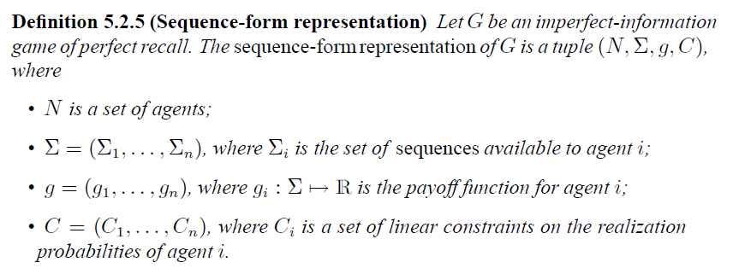
Overview | Sequence form | Computing equilibria | Summary
Definition of sequence form

Slide 8
Overview | Sequence form | Computing equilibria | Summary
Sequence
1
Defined by a node of the game tree
The ordered set of player i’s actions lying on the path
Build player’s strategy around paths in the tree (there is only a small number of nodes)
a
L
R
2
b
c
A
B
(1,1)
1
1
d
e
l
r
l
r
f
g
h
i
(0,1)
(2,4)
(2,4)
(1,0)

Slide 9
Overview | Sequence form | Computing equilibria | Summary
Payoff function
1
Payoff g(σ)=u(z) if leaf node z would be reached when each player played his sequence on σ.
Each payoff that is defined at a leaf in the game tree occurs exactly once.
a
L
R
2
b
c
A
B
(1,1)
1
1
d
e
l
r
l
r
f
g
h
i
(0,1)
(2,4)
(2,4)
(1,0)

Slide 10
Overview | Sequence form | Computing equilibria | Summary
Payoff function
 | Ф | A | B
Ф | 0,0 | 0,0 | 0,0
L | 0,0 | 0,0 | 0,0
R | 1,1 | 0,0 | 0,0
Ll | 0,0 | 0,1 | 2,4
Lr | 0,0 | 2,4 | 1,0
1
a
L
R
2
b
c
A
B
(1,1)
1
1
d
e
l
r
l
r
f
g
h
i
(0,1)
(2,4)
(2,4)
(1,0)
Sparse encoding

Slide 11
Overview | Sequence form | Computing equilibria | Summary
Linear constraints
Why do we still need linear constraints?
What is the difference between sequences and actions?

Slide 12
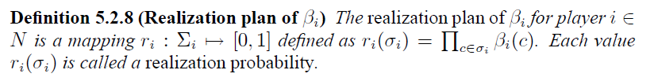
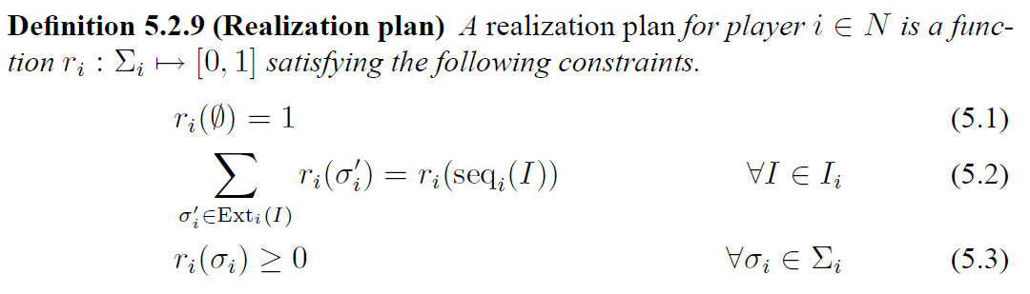
Overview | Sequence form | Computing equilibria | Summary
Realization plan
Another definition (Linear equation definition):

Slide 13
Overview | Sequence form | Computing equilibria | Summary
Realization plan
1
a
L=0.5
R=0.5
2
b
c
A=0.3
B=0.7
(1,1)
1
1
d
e
l=0.4
r=0.6
l=0.4
r=0.6
f
g
h
i
(0,0)
(2,4)
(2,4)
(0,0)

Slide 14
Overview | Sequence form | Computing equilibria | Summary
Advantage of realization plan
Key advantage: it can be characterized by linear equations

Slide 15
Outline
Overview
Sequence form
Computing equilibria
Summary

Slide 16
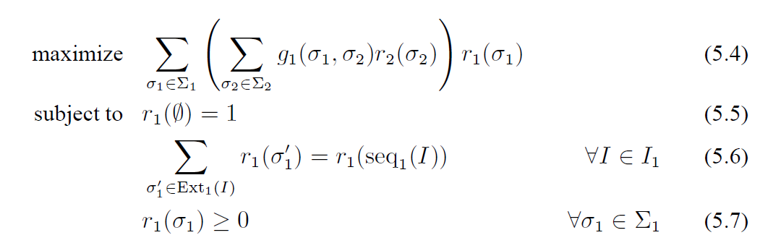
Overview | Sequence form | Computing equilibria | Summary
Best response in two-player games

Slide 17
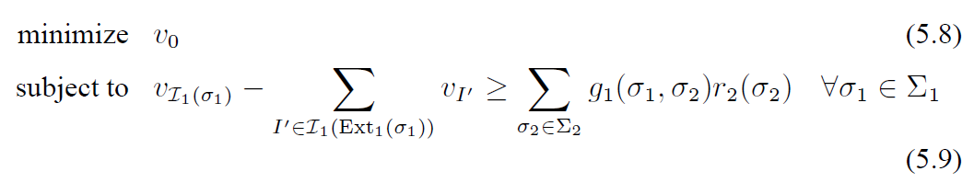
Overview | Sequence form | Computing equilibria | Summary
Best response in two-player games
Dual LP problem:
Why do we want to convert it to dual LP problem?

Slide 18

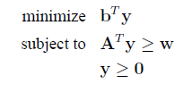
Overview | Sequence form | Computing equilibria | Summary
Dual problem

Slide 19
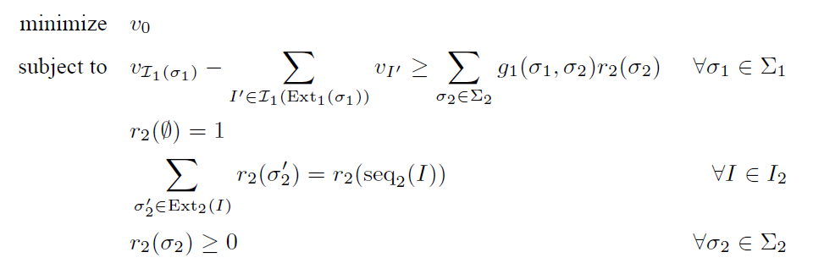
Overview | Sequence form | Computing equilibria | Summary
Equilibria in two-player zero-sum games
We can solve it in polynomial time!

Slide 20
Overview | Sequence form | Computing equilibria | Summary
Other applications
Compute equilibria in two-player general sum game
Compute equilibria in general two-player game

Slide 21
Overview | Sequence form | Computing equilibria | Summary
Summary
Sequence form is a new strategic description for an extensive game with perfect recall.
It has linear complexity.
It allows efficient computation of Nash equilibria in extensive-form game.

Slide 22
Reference
Shoham, Y., and Leyton-Brown, K. (2010). Multiagent Systems, Algorithmic, Game-Theoretic, and Logical Foundations.
von Stengel, B. (1996). Efficient computation of behavior strategies. GEB: Games and Economic Behavior, 14, 220–246.
von Stengel, B. (2002). Computing equilibria for two-person games. In R. Aumann, S. Hart (Eds.), Handbook of game theory, vol. III, chapter 45, 1723–1759. Amsterdam: Elsevier.
Nisan, N., Roughgarden, T., Tardos, E., and Vazirani, V. (2007). Algorithmic Game Theory.
Koller, D.,Megiddo, N., and von Stengel, B. (1996). Efficient computation of equilibria for extensive two-person games. GEB: Games and Economic Behavior, 14, 247–259.
Koller, D., and Megiddo, N. (1992). The complexity of two-person zero-sum games in extensive form. GEB: Games and Economic Behavior, 4, 528–552.

Slide 23
Thank you! Q&A

Slide 35


