Slide 1

PROTEIN ENGINEERING
Problem Statements

Slide 2
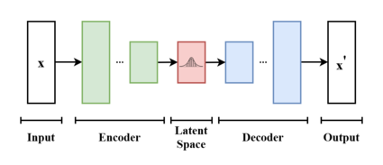
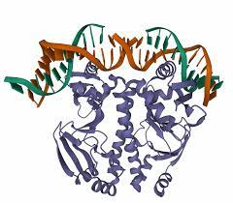
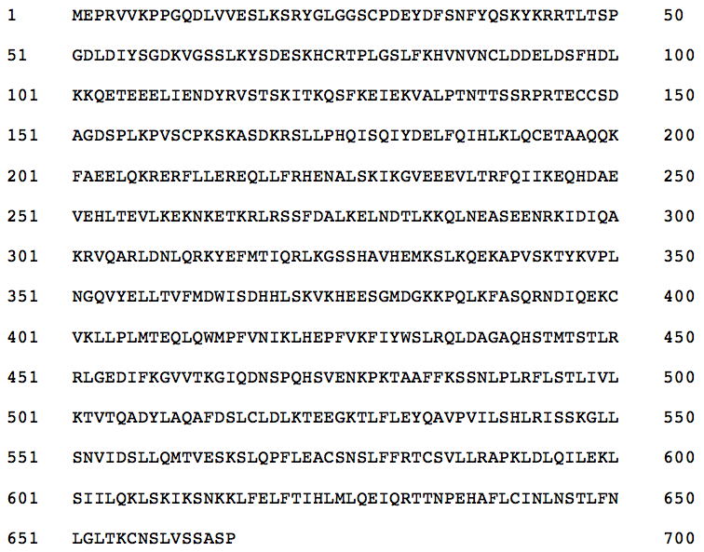
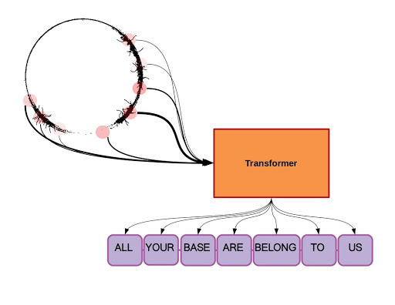
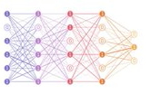
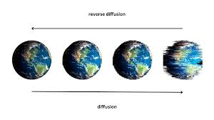
Protein Sequence Generation
Embeddings from different protein language models
Proteins sequence
Data
Meaningful proteins that can show prediction using Alphafold2 with high confidence.
VAE’s
GAN’s
Diffusion models
Transformers

Slide 3
Identify features that significantly contribute to classification accuracy of blood brain barrier penetrating peptides
Task to be performed
Feature type 1
Heterogenous feature fusion set
Different feature selection methods
Benchmark dataset B3P2
Feature type 2
Feature type 3
Stacked ensemble classifier
Final prediction

Slide 4
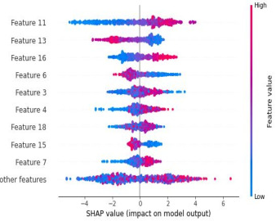
Classification model for antitubercular peptides and SHAP interpretation analysis of physiochemical properties
AA Index
Different feature selection methods
[Reduced vector size]
Length of sequence * 566 D feature vector
Find contribution of specific features/ properties of aminoacids on the model performance

Slide 5
Develop a model that can predict the immunogenicity of novel antigens for vaccine design.
Task to be performed
Feature type 1
Heterogenous feature fusion set
Different feature selection methods
Immunogenicity dataset
Positive/Negative dataset
Feature type 2
Feature type 3
Stacked ensemble classifier
Final prediction

Slide 6
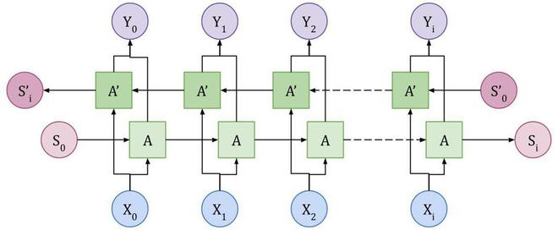
Model for predicting moon light proteins based on protein language models and deep learning
C
H
Y
W
M
A
P
P
N
Embeddings from different protein language models
K
H
E
D
comparison of different PLM embeddings
Moonlight Proteins sequence:
Perform more than one function

