Slide 1
API’s: How they connect the digital world
Kalugin Maksim
IRIT-RTF

Slide 2
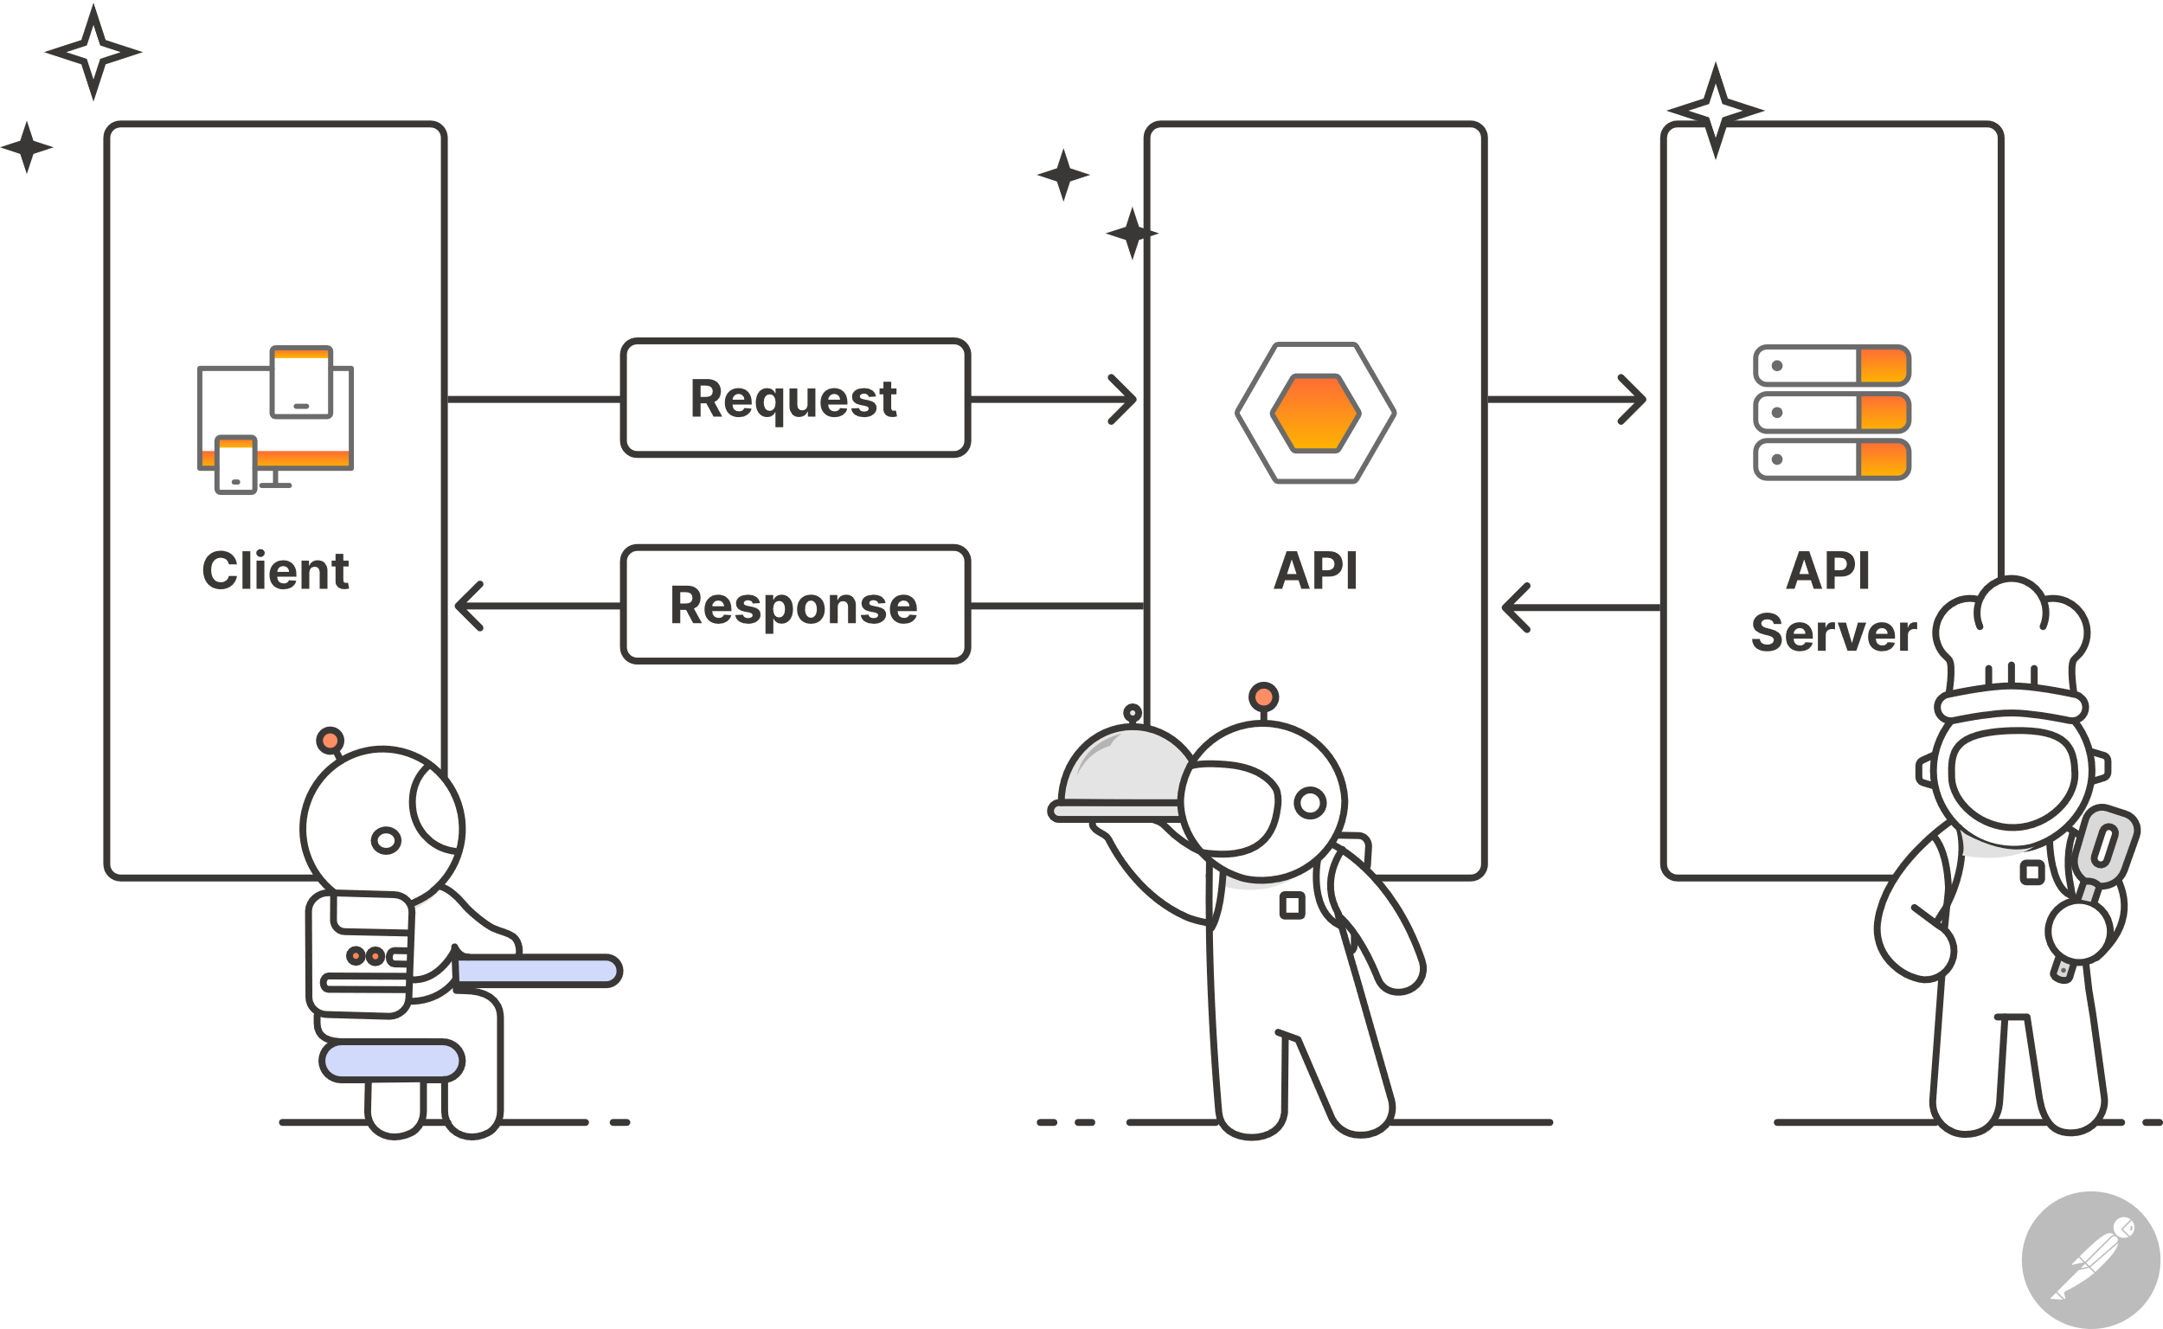
What is an API?

Slide 3
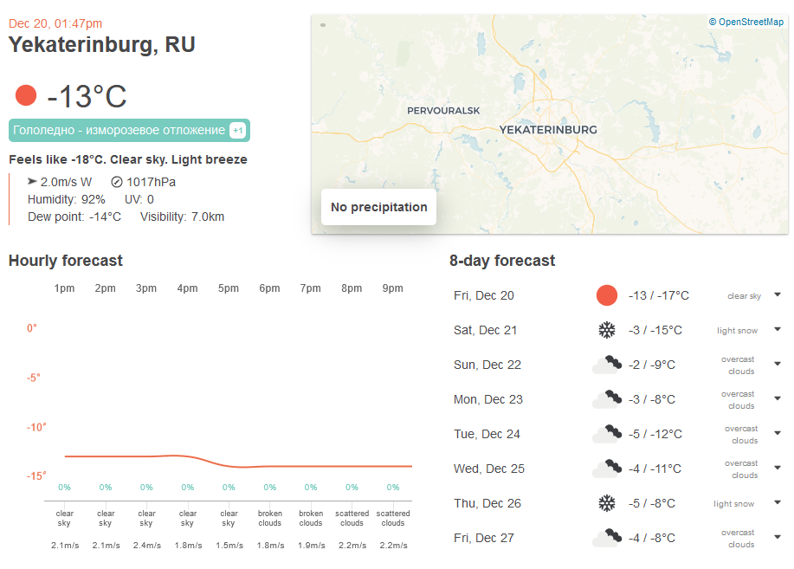

Example

Slide 4
Address
https://
api.openweathermap.org
/data/2.5
/weather
Hypertext Transfer Protocol with Encryption
API type and version
What data we need
Domain address

Slide 5
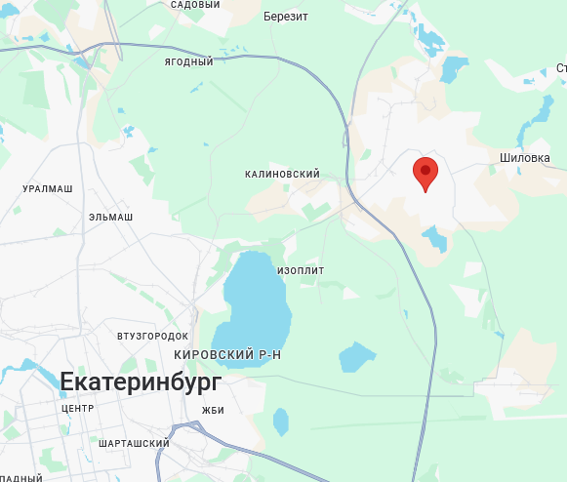
Location
?lat=56.9&lon=60.8

Slide 6
Mode view data
HTML (HyperText Markup Language): Website structure
JSON (JavaScript Object Notation): Simple data exchange
XML (Extensible Markup Language): Complex data structure
&mode=html
&mode=json
&mode=xml

Slide 7
API key and others
&appid=c0157c4a6d394e541f91ecb3df65a565
&units=imperial / metric / standard
&lang=ru (and others)

Slide 8
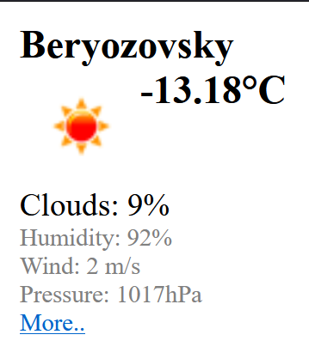
Result
https://api.openweathermap.org/data/2.5/weather?lat=56.9&lon=60.8&mode=html&appid=c0157c4a6d394e541f91ecb3df65a565
Request
https://api.openweathermap.org/data/2.5/weather
?lat=56.9&lon=60.8&mode=html
&appid=c0157c4a6d394e541f91ecb3df65a565
Response

Slide 9

Benefits
Development is faster and cheaper
Focus on new features
Possibility of creating large ecosystem

Slide 10







Conclusion

